Slide 1

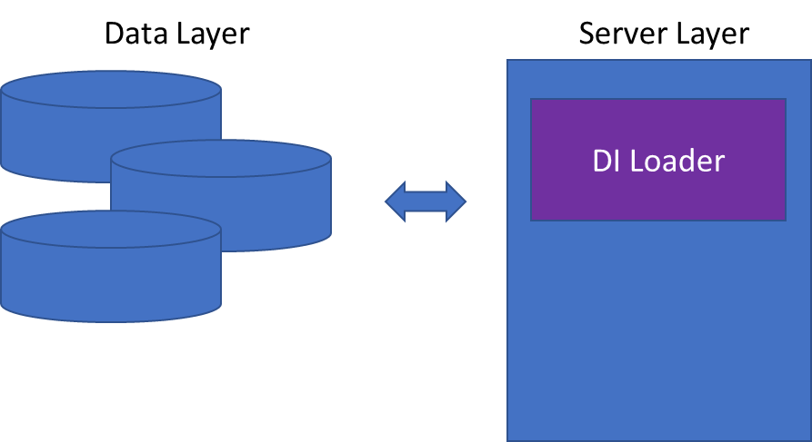
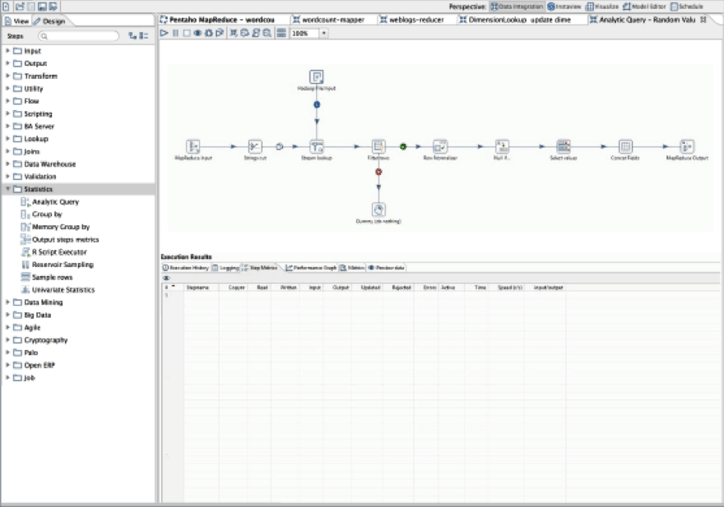
Pentaho introduction
Pentaho Data Integration (PDI)
ETL Tool (Extract -> Transform -> Load)
SQL server supported
JAVA supported
JS supported
Embedded H2 Database supported
VM

Slide 2
Move/DLQ
n_fh
StaticWip
ActlWip
StaticMove
ActlMove
MoveDLQ
StaticWip
ActlWip
StaticMove
ActlMove
MoveDLQ
Planned CT
fh
StaticWip
ActlWip
StaticMove
ActlMove
MoveDLQ
bank
StaticWip
ActlWip
StaticMove
ActlMove
MoveDLQ
Actl CT

