Slide 1
OPTICS Work in Progress
By: Robert James
December 18, 2025

Slide 2
About Me
T32 OPTICS Research Fellow
General Surgery Resident (Weill Cornell) on dedicated research block (Year 1 of 2)
Mentored by Dr. Neha Goel: Disparities & genomics in breast cancer outcomes
Collaboration with Dr. Katherine Panageas: Genomic predictors of brain metastasis (GENIE BPC)
Collaboration with Dr. Tracy-Ann Moo and Dr. Solange Bayard: LLM-based oncologic history summarization (today’s focus)
Research interest: Applying AI to breast cancer care—outcome prediction and LLM-supported clinical workflows
Notes:
I’m a first-year T32 OPTICS research fellow and a general surgery resident at Weill Cornell. I’m currently on a dedicated research block, which is the first year of a two-year research fellowship.
My primary mentor is Dr. Neha Goel, a breast surgeon, and my work with her focuses on understanding how disparities and tumor genomics influence breast cancer outcomes.
I’m also working with Dr. Kathy Panageas on a project using the GENIE BioPharma Collaborative dataset to evaluate genetic predictors of brain metastasis in breast cancer patients.
In addition, I’ve been collaborating with Dr. Tracy-Ann Moo and Dr. Solange Bayard in the breast surgery department on a project investigating the use of large language models to summarize oncologic histories for breast cancer patients, which will be the focus of today’s talk.
More broadly, my personal research interest is in identifying ways to responsibly integrate artificial intelligence into breast cancer care—both through machine learning approaches to predict outcomes and through deep learning methods, including large language models, to support clinical decision-making.

Slide 3
Goals & Structure of Today’s Talk
Overarching Goal
Responsibly integrate artificial intelligence into breast cancer care
Informed by my goal to pursue a career in breast surgical oncology
Today’s Focus
Brief overview of outcomes modeling work
Deeper dive into LLMs for clinical care (primary focus)
Notes:
Ways in which I have set out to achieve this overarching goal:
Predictive modeling of outcomes
Clinical workflow support using large language models

Slide 4
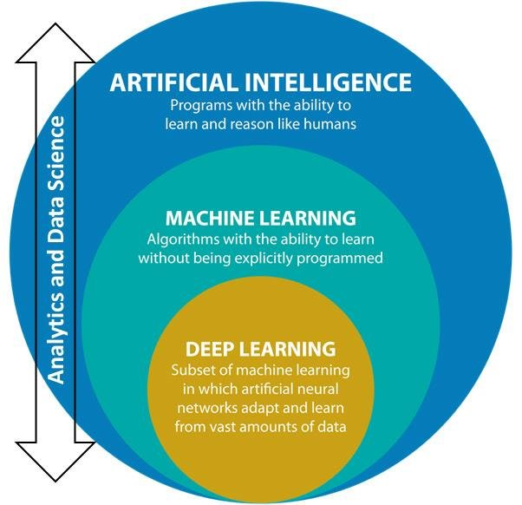
Subsets of AI in My Research
AI for Outcomes Prediction
Machine learning approaches to predict time to recurrence
Emphasis on ensemble methods
Brief context on relevant coursework and training
AI for Clinical Care
Use of large language models to support clinical workflows
Focus on summarizing oncologic histories in breast cancer
Primary focus of today’s presentation
Adapted from: AI as a Challenging Problem: Solvable without Data but Morally Intelligence-Driven Insights
Notes:
Bullets instead of two collumns

Slide 5
AI for Outcomes Prediction – Machine Learning
Training & Coursework
Summer Institute in Statistics for Big Data (University of Washington)
Data analytics workflow using R
Data Analyst Track (DataCamp)
Statistical analysis, data manipulation, and visualization in R
ML Foundations I & II Bootcamps (Alberta Machine Intelligence Institute)
Core machine learning concepts and modeling foundations
Applied AI & Data Science Program (MIT)
Machine learning, deep learning, and generative AI using Python
Master’s-level coursework in Biostatistics (MSKCC)
Notes:
To support my work in outcomes prediction, I’ve pursued formal training in machine learning and data science. My earlier training included bootcamps in machine learning with the Alberta Machine Intelligence Institute (AMII for short), as well as the Summer Institute in Statistics for Big Data with the University of Washington and the DataCamp data analyst track, which focused on statistical modeling and data workflows using R.
More recently, I’ve been completing an Applied AI and Data Science program through MIT, which is Python-based and covers supervised and unsupervised learning, ensemble methods, deep learning, and generative AI.
Using this training, I’m developing an ensemble-based model to predict time to recurrence in breast cancer, incorporating clinical, pathologic, and socioeconomic variables. I’ll touch on this briefly before transitioning to the main focus of today’s talk
Fix bulleting

Slide 6
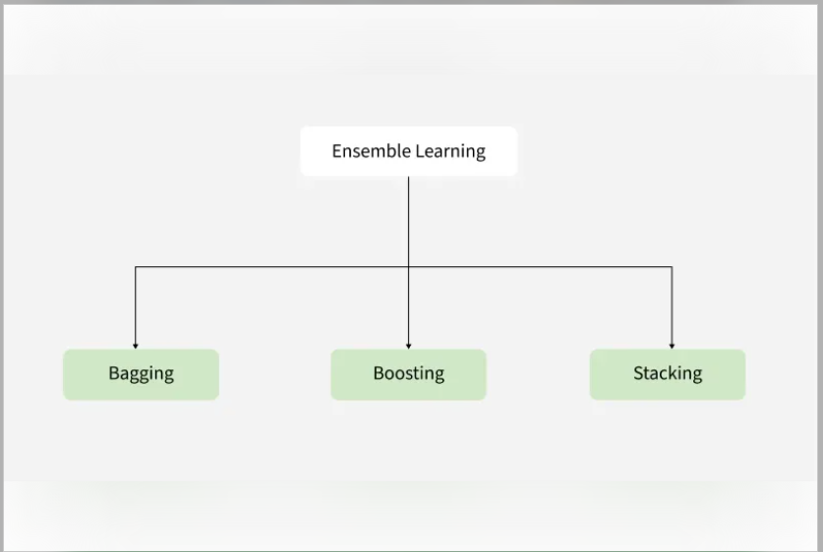
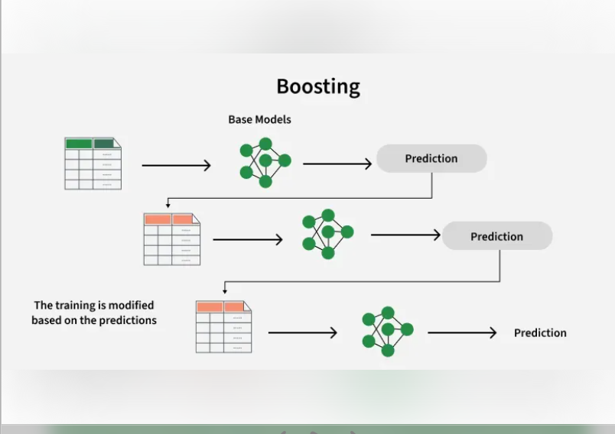
AI for Outcomes Prediction – Machine Learning
Predictive Modeling
Development of an ensemble-based model using XG Boost to predict time to recurrence
Incorporates clinical, pathologic, and socioeconomic variables
Ensemble learning combines multiple models to improve predictive performance
Intended application: predicting time to recurrence in breast cancer
Ongoing work with Dr. Katherine Panageas and Dr. Neha Goel
Figure adapted from “Types of Ensemble Learning,” GeeksforGeeks,
Notes:
For outcomes prediction, I’m approaching this through ensemble learning, which broadly refers to combining multiple models to improve performance and robustness. As shown on the left, ensemble methods generally fall into three categories: bagging, boosting, and stacking.
The approach I’m focusing on is boosting. The idea behind boosting is that models are built sequentially, where each new model is trained to focus on the observations that were hardest for the previous models to predict. Over time, the ensemble becomes increasingly accurate by learning from its own mistakes, which is what the schematic on the right is meant to illustrate.
XGBoost is a commonly used and well-validated boosting framework, particularly well suited for structured clinical, pathologic, and socioeconomic data. My intent is to use XGBoost as part of my work with Dr. Kathy Panageas and Dr. Neha Goel to develop predictive models for breast cancer outcomes, including time to recurrence.
I’ll keep this section brief and transition next to the main focus of today’s talk, which is the use of large language models in clinical care.
Decreased font size on xg boost
Divide the slides between ensemble work and boosting

Slide 7
AI for Clinical Care — Large Language Models
Goal - evaluate accuracy and documentation quality of large language models
Impact - reduce burden for nurses and physicians in clinical documentation and standardize the quality information generated
Notes:
Bullets
Spell out large language models
Make the goal shorter – evaluate accuracy and documentation quality of large language models
Impact: reduce burden for nurses and physicians in clinical documentation. Standardize information.

Slide 8
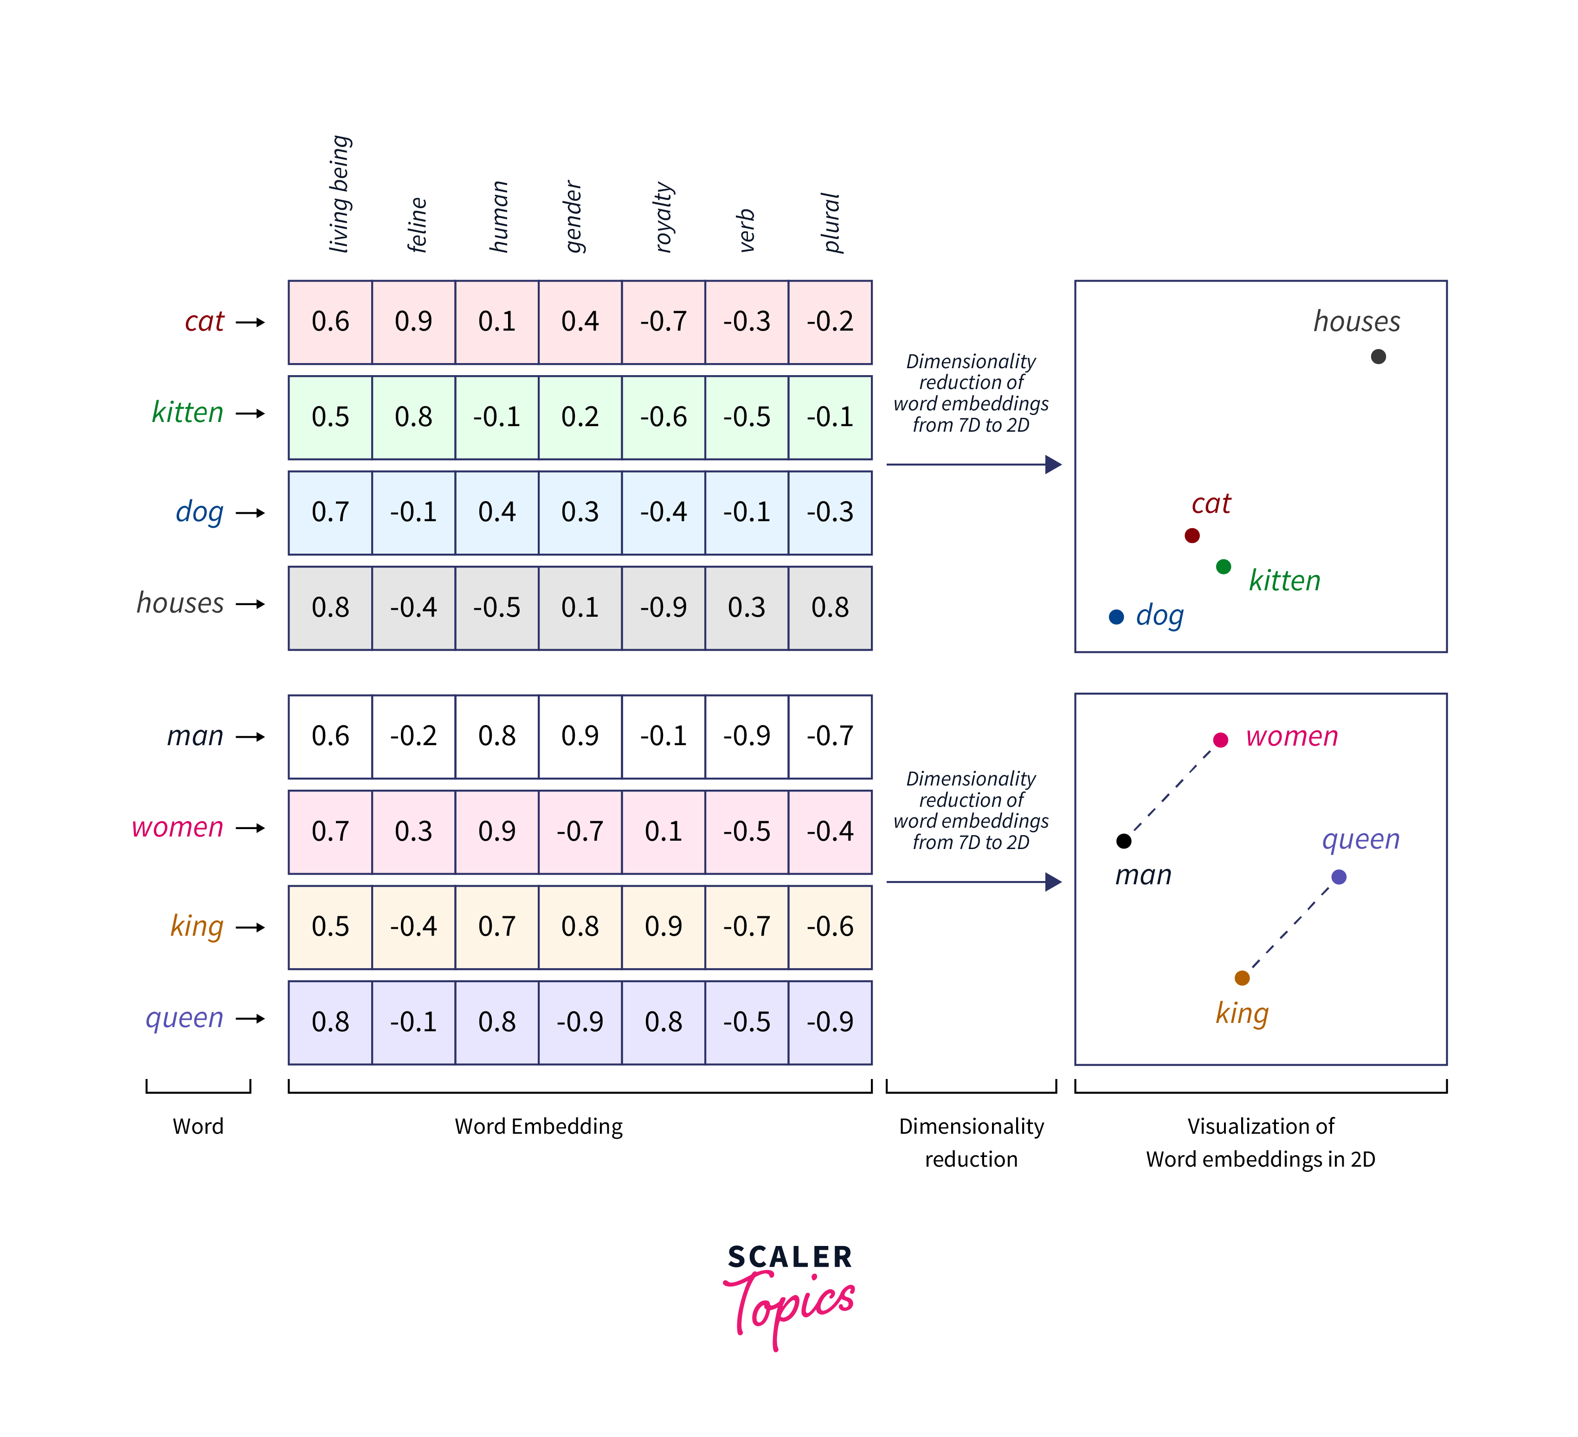
What is Natural Language Processing (NLP)?
Background
NLP is how computers read, interpret, and generate human language
Modern NLP represents words as numbers so models can learn meaning and relationships
Words with similar meaning end up close together in this numerical space
Source: TensorFlow Word Embeddings, Scaler Topics (https://www.scaler.com/topics/tensorflow/tensorflow-word-embeddings/)
Notes:
This image shows how a computer represents words. Instead of treating words as text, the model converts each word into a set of numbers, called a word embedding. Words that are used in similar ways—like cat and kitten—end up close together in this numerical space. When we visualize those numbers, we can see that relationships between words are preserved, like man to woman or king to queen. This is how modern NLP models capture meaning and context, rather than just matching keywords

Slide 9
From traditional NLP models → LLM
Background
Traditional NLP models (~1990s – early 2010s)
Rule based systems relying on keyword matching and dictionaries for information extraction
Neural NLP models (~2013 – 2016)
Recurrent neural networks (RNNs) - read text sequentially keeping a running memory of what came before, however lose information in long documents
Convolutional neural networks (CNNs) - detect local text patterns, however limited global context
Transformer architecture (2017)
Attention Is All You Need (Vaswani et al.)
Introduced self-attention, allowing all words to attend to each other
Model relationships across entire documents simultaneously
Serve as the foundation of the modern large language model
Vaswani A, et al. Attention Is All You Need. NeurIPS, 2017.
Notes:
Traditional NLP
- What it did well: Early NLP systems treated text like a set of patterns to be matched. They relied on hand-written rules and dictionaries to pull out specific pieces of information from notes.
- Key limitation: They worked for narrow, well-defined tasks but struggled with variability in language and couldn’t understand meaning or context.
Neural NLP
Recurrent Neural Networks
- What they’re good at: RNNs read text one word at a time, keeping a running memory of what came before. This makes them well-suited for modeling sequences, like sentences or short notes.
- Where they struggle: As text gets longer, earlier information fades from memory. In long clinical documents, important details at the beginning can be lost by the end.
Convolutional Neural Networks
- What they’re good at:CNNs look for local patterns in text—common phrases or word combinations—regardless of where they appear. They’re fast and effective at recognizing repeated structures.
- Where they struggle: They don’t naturally capture broader context or relationships across distant parts of a document, making it hard to understand long-range dependencies.
The major inflection point came with the Transformer architecture, introduced in 2017 by several researchers from Google in paper named ‘Attention Is All You Need.’ Introduced the Transformer architecture which use self-attention and allows every word in a document to directly relate to every other word.
What changed fundamentally: look at all parts of a document at once and explicitly model how different words and phrases relate to each other, regardless of distance.
Why this matters: made it possible to understand long clinical notes, preserve context, and generate coherent summaries rather than just extracting isolated facts.

Slide 10
Common clinical tasks for LLMs
Background
Clinical summarization
Turning long notes, imaging reports, and pathology results into concise, readable summaries
Information extraction
Identifying and structuring key facts (e.g., diagnoses, measurements, dates, biomarkers) from free text
Question answering over clinical documents
Responding to specific clinical questions using information contained in notes and reports
Clinical workflow support
Assisting with documentation, decision support, and reducing manual chart review

Slide 11
Breast cancer care: Use of NLP models to generate data from radiologic and pathologic reports
Prior Research
Prior work focuses on extracting structured fields from reports, not summarizing them
Most applications target BI-RADS and lesion characteristics across imaging modalities
LLMs are beginning to be explored, but summary quality and clinical accuracy remain under-evaluated
Diab KM, Deng J, Wu Y, Yesha Y, Collado-Mesa F, Nguyen P. Natural Language Processing for Breast Imaging: A Systematic Review. Diagnostics. 2023;13(8):1420. doi:10.3390/diagnostics13081420
Notes:
To put this in context, a 2023 systematic review by Diab and colleagues looked at how NLP has been used in breast imaging. They found that most prior work focused on extracting specific structured elements from radiology reports—such as BI-RADS categories, lesion descriptors, and imaging features—rather than generating narrative summaries. These models were mainly developed to support research and data abstraction, rather than clinical documentation. While more recent studies have begun exploring LLM-based approaches, the review highlights that there has been limited evaluation of summary-level clinical accuracy or direct comparison to staff-generated summaries. This gap is what our work aims to address

Slide 12
Shortcomings in current literature
The Gap
Often field extraction/classification, rather than comprehensive clinician summary
Limited work across different modalities—including radiologic and pathologic reports

Slide 13
Study Design & Data Sources
Methods
Data sources
Outside hospital radiology reports
Outside hospital pathology reports
Internal MSK radiology review
Internal MSK pathology review
Breast Surgery Bot (Claude)
Template based prompt
Designed to standardize summaries
Prompt guidance
Laterality
Abnormality
Size
Location
Interval change
Recommendation
Generated clinical summary
Structured
Complete
Comparable to staff-generated documentation
Notes:
This slide shows our workflow from left to right.
We start with multiple source documents, including outside and internal radiology and pathology reports, as well as the staff-generated surgical consultation summary. All of this information is provided to the model.
The key part is the middle — the Breast Surgery Bot uses a template-based prompt that explicitly tells the model what clinical details to look for. The arrow highlights an example of that prompt guidance, such as laterality, lesion characteristics, size, location, and recommendations.
By guiding the model in this way, we generate a structured, concise clinical summary that focuses on pertinent information and can be directly compared to staff-generated summaries.

Slide 14
Study Design
Methods
Cohort
200 breast surgery patients across all department attendings
Retrospective chart review
Validation
Staff-generated summary and LLM-generated summary compared to source documents
Evaluation of completeness, accuracy, and clinical concordance

Slide 15
Evaluation framework
Methods
Clinical accuracy
Element-level correctness of key clinical facts
Identification of omissions, contradictions, and fabrications
Text similarity metrics
BLEU and ROUGE compare generated summaries to reference summaries
Quantify surface-level overlap in wording and content
Clinical feasibility
Assessment of clinical acceptability for surgical workflow
Used to contextualize automated metrics
Gao S, Young MT, Qiu JX, et al. A systematic evaluation of large language models for clinical text summarization. npj Digital Medicine. 2024.
ROUGE & BLEU Scores,” Clement Bourgeois’ Machine Learning Theory Blog,

Slide 16
Clinical implications
Reduces manual workload associated with summarizing imaging and pathology reports
Standardizes oncologic history collection across staff and sites
Improves completeness of key breast cancer–specific clinical information
Mitigates variability driven by differences in staff training and experience

Slide 17
Potential study limitations
No universally accepted gold standard exists for evaluating clinical summarization beyond lexical overlap metrics
The human validation aspect of this study by reviewers introduces the potential for bias
Lack of direct EMR integration necessitates manual retrieval of radiologic and pathologic records, adding intermediate steps and potential delays to the workflow
Notes:
While automated metrics such as BLEU and ROUGE provide reproducible comparisons, they do not fully capture clinically meaningful correctness or completeness. This limitation reflects a broader challenge in clinical NLP, where gold standards for summarization quality remain an active area of research.

Slide 18
Safety and ethical considerations
All LLM-generated summaries require clinician review and verification before use in clinical decision-making
The tool is designed to augment—not replace—clinical judgment
Staff must retain competency in independently collecting oncologic histories in the setting of system downtime
Notes:
This tool is intended as a clinical support system. Even with validation, it does not replace provider review, and key oncologic details must always be verified. Importantly, we view preservation of staff competency and workflow resilience as ethical requirements, not optional safeguards

