Slide 1
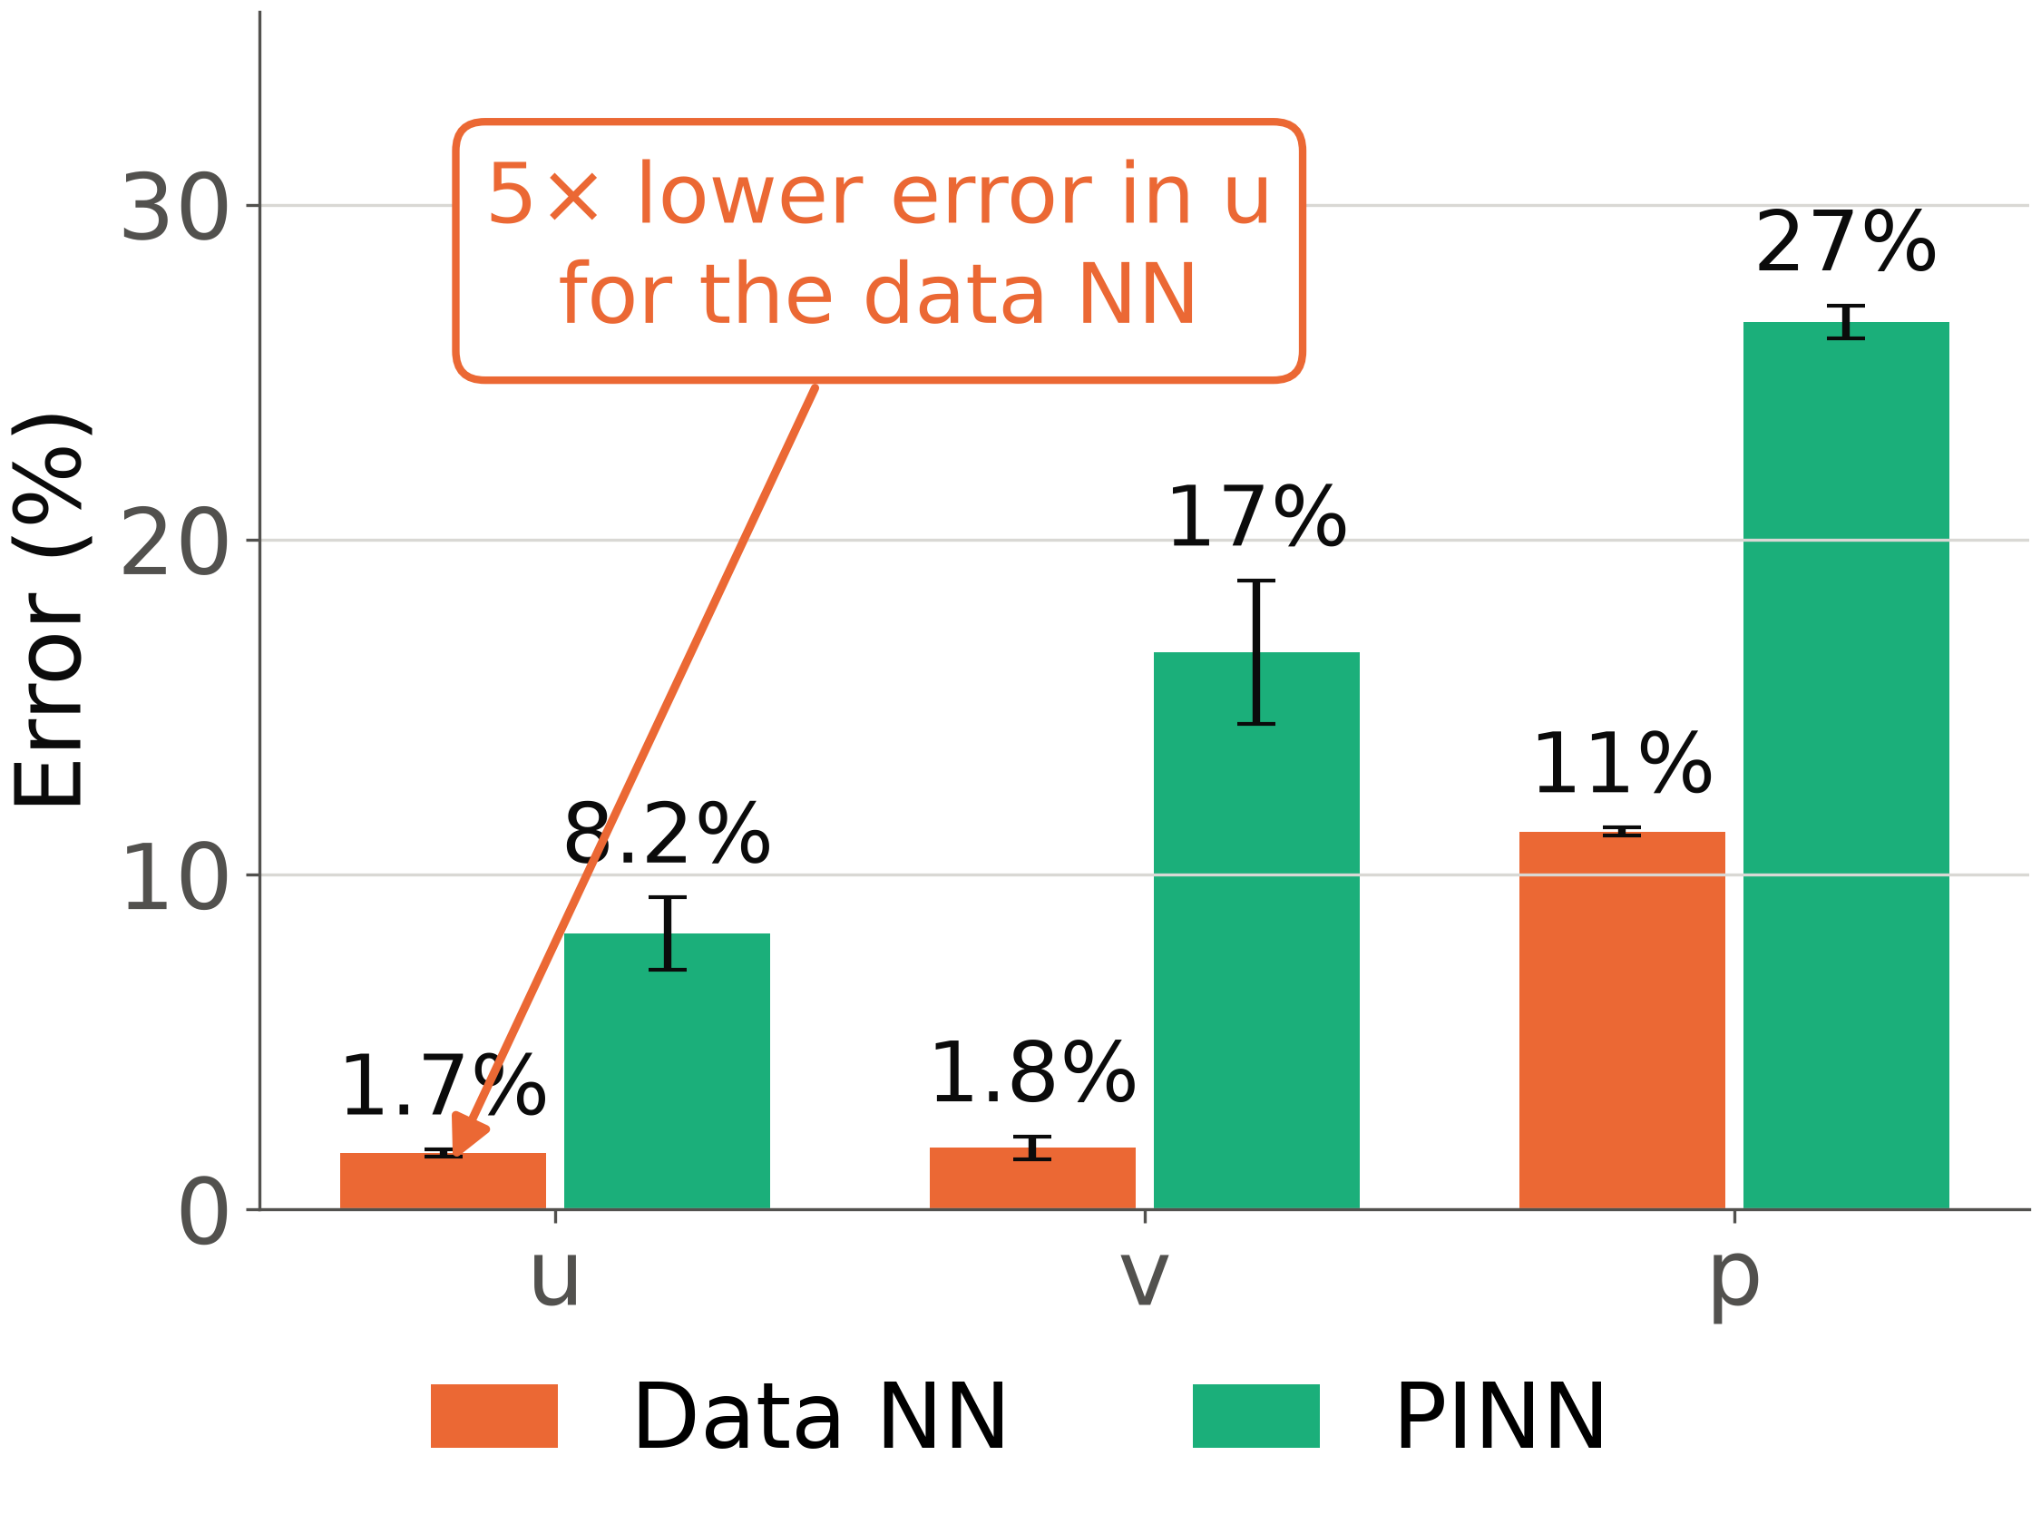
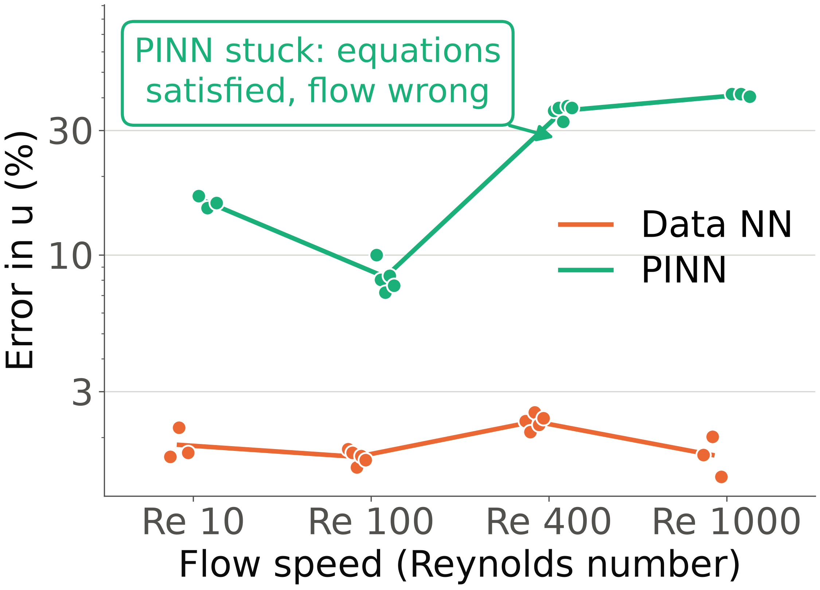
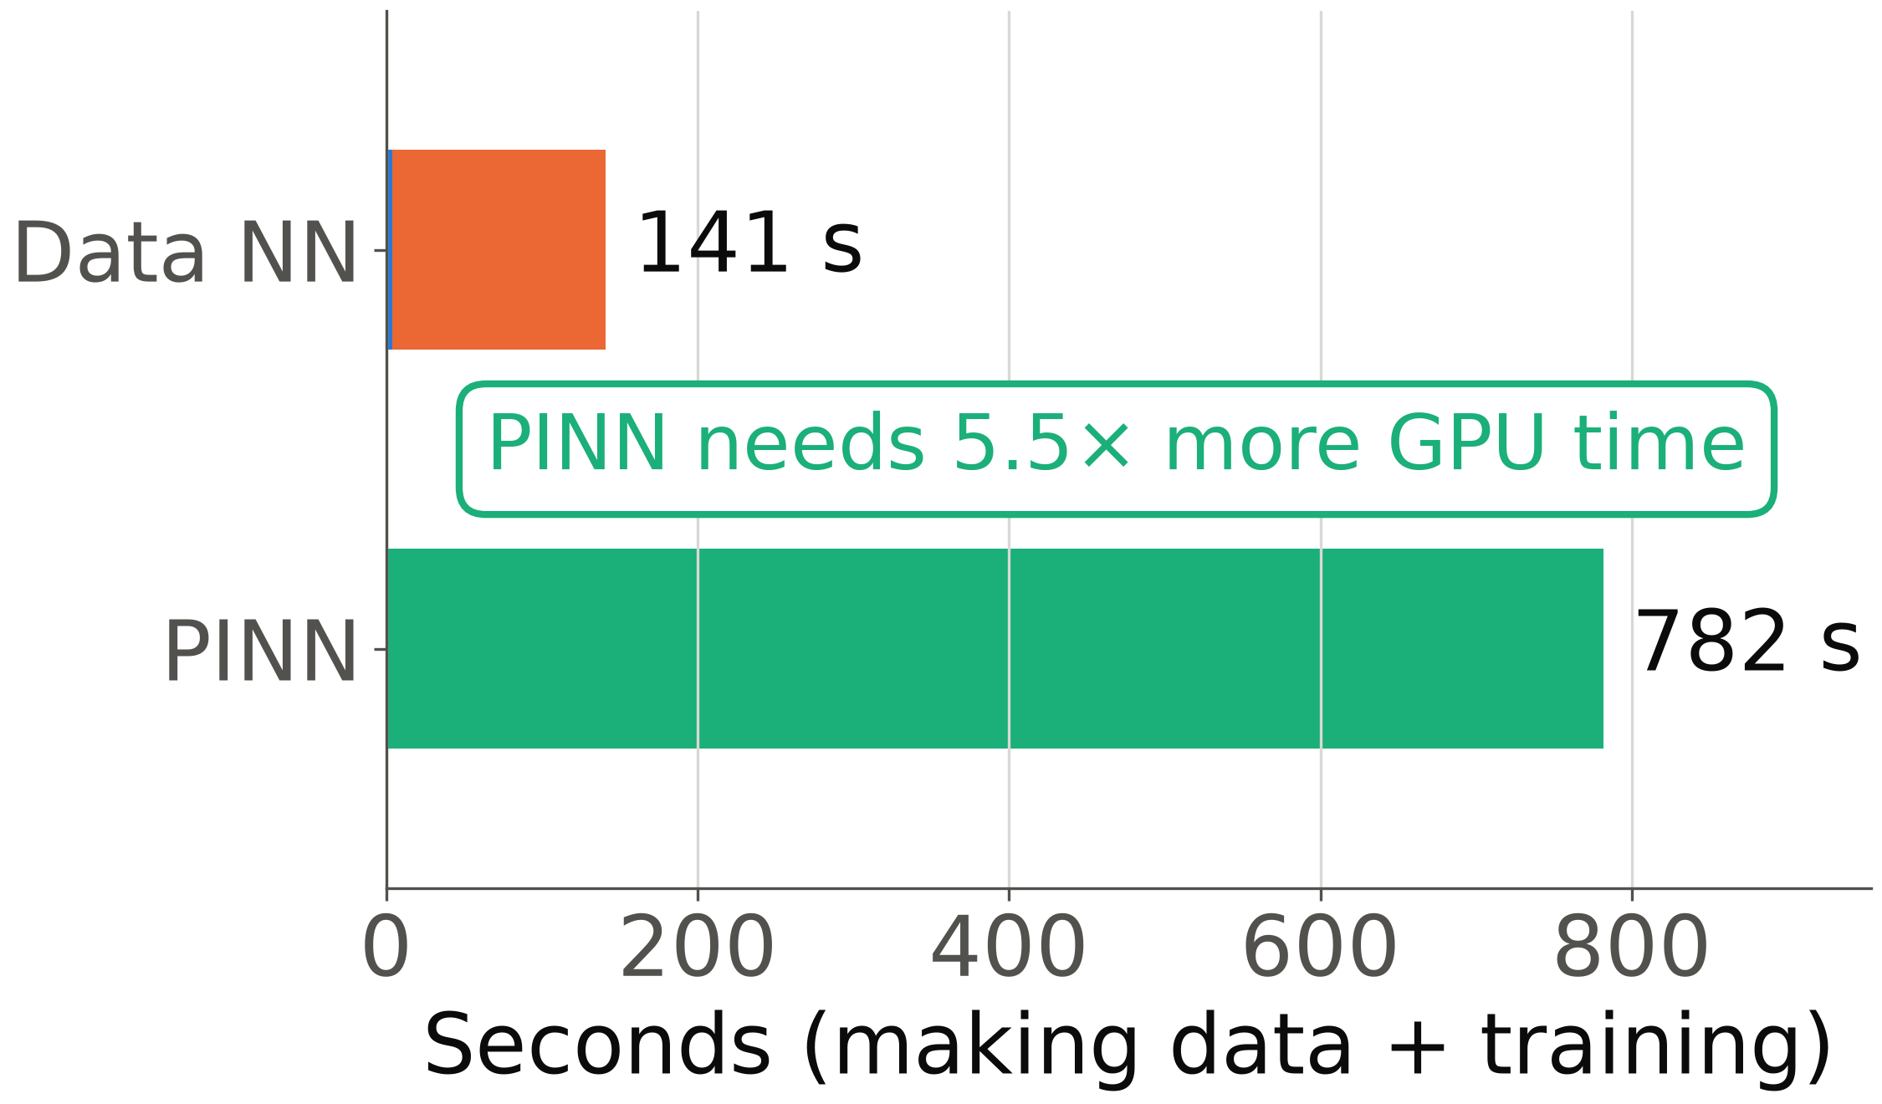
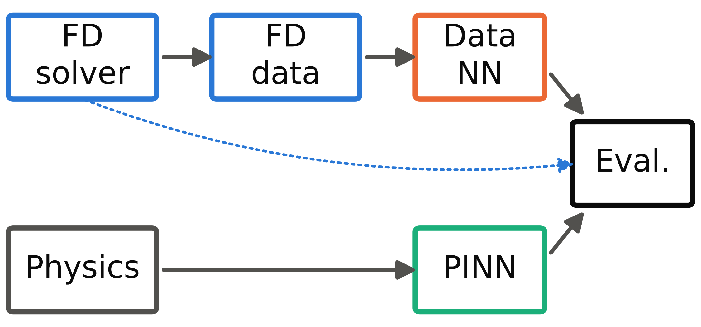
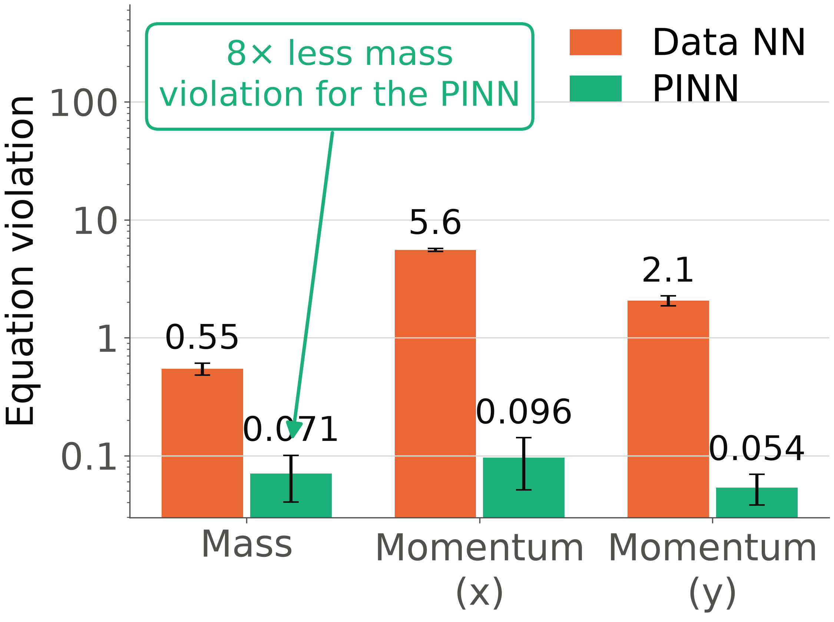
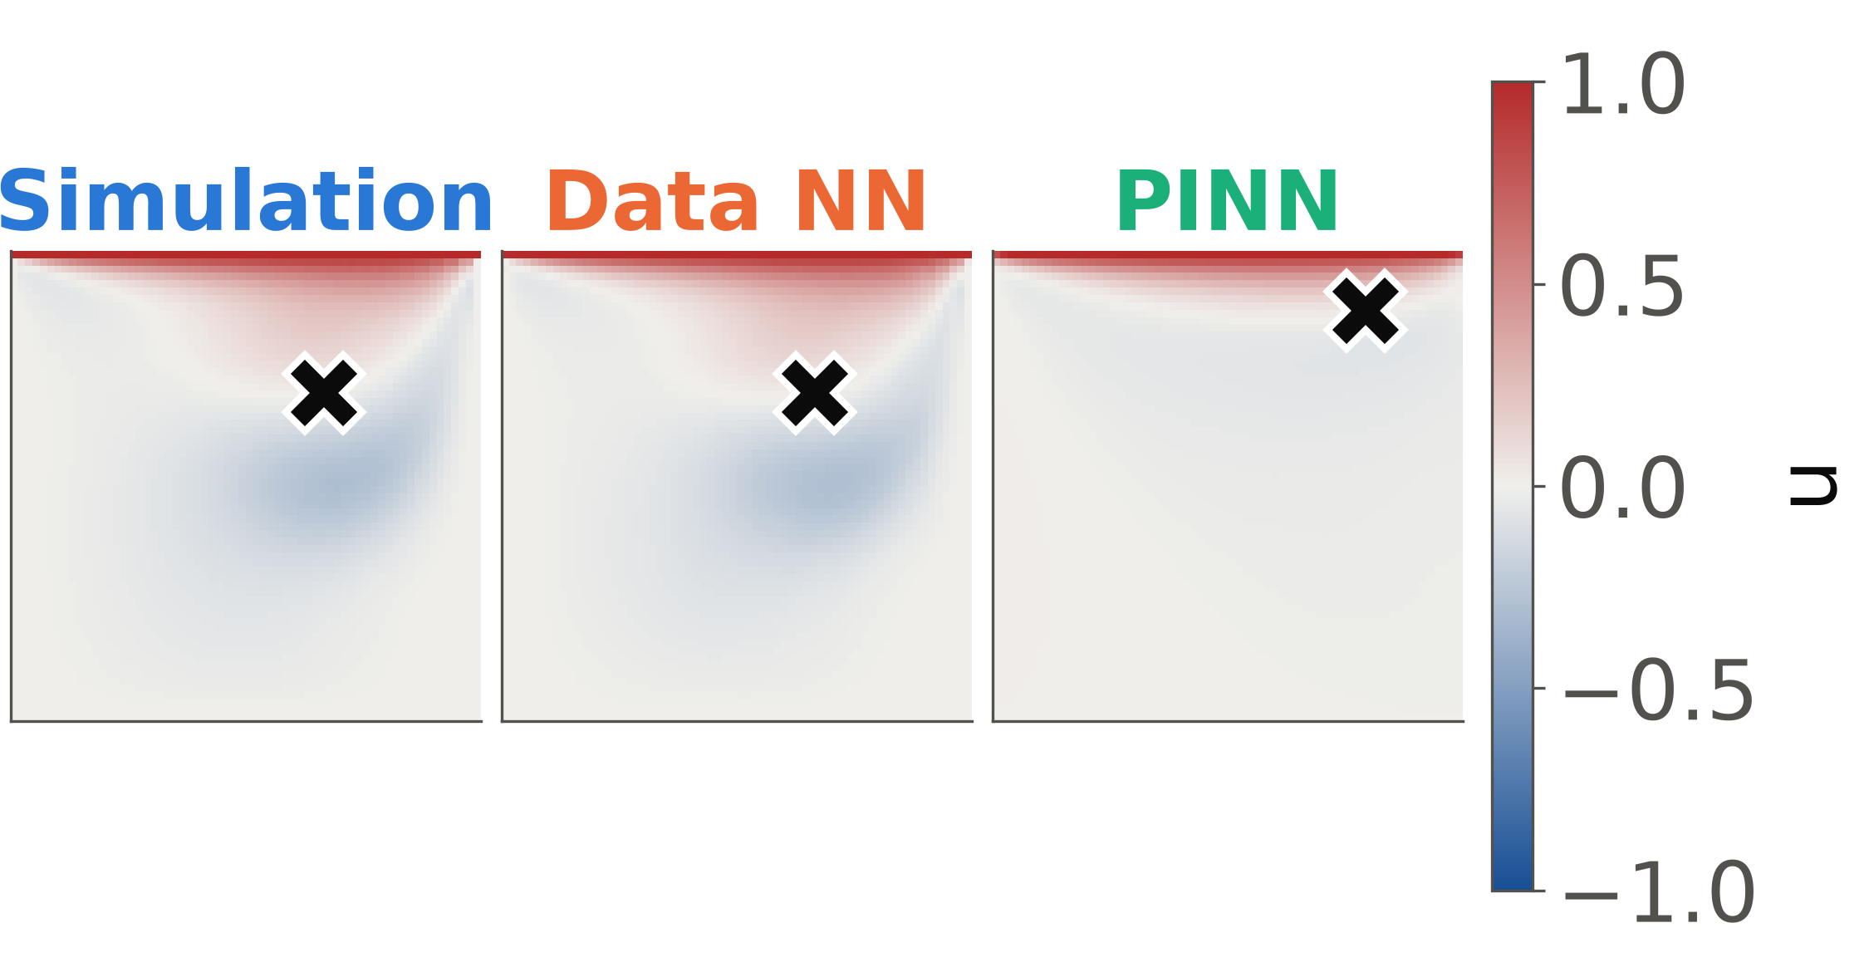
Evaluating Physics-Informed Learning for Fluid Dynamics
Roberto Pollicino (CS '26)
Adviser: Brian C. O'Neill, PhD (Computer Science)
Which is the better way to teach a network fluid flow: simulation data or physics?
RQ1: The data NN matches the simulation 5× more closely.
RQ3: Across flow speeds the data NN stays reliable; the PINN does not.
RQ4: The PINN needs no data, but 5.5× more training time.
A trained neural network predicts a flow in milliseconds instead of running a slow simulation. A data-driven network (data NN) learns from simulation results, so a simulation must run first. A physics-informed network (PINN) [3] learns only from the flow equations: no data, but more computing.
RQ1 Which is more accurate?
RQ2 Which obeys the physics better?
RQ3 Which is more reliable across seeds and flow speeds?
RQ4 What does each cost?
Here the simulation took only 3.9 s, so data was cheap. GPU memory: 708 MB (PINN) vs 122 MB (data NN).
Error in u: 1.7% vs 8.2% (Re = 100, mean of 5 seeds).
Every seed is a dot. Error in u at Re = 10, 100, 400, 1000: data NN 1.9%, 1.7%, 2.3%, 1.7%; PINN 16%, 8.2%, 36%, 41% (Re = 10, 100, 400, 1000).
Neither wins outright; their opposite strengths point to a hybrid.
Both networks were built and scored the same way; only what they learn from differs.
RQ2: The PINN obeys the flow equations 8× more closely.
RQ3: Satisfying the equations did not make the PINN's flow correct.
• Data NN: more accurate and cheaper, when simulation data already exists.
• PINN: needs no data and obeys the physics, but costs more and needs far more training as the flow speeds up.
• Next: a hybrid trained on a little data plus the physics loss could cut both the data and the computing needed (not tested here).
[1] Marchi, C. H., Suero, R., and Araki, L. K. 2009. The lid-driven square cavity flow: numerical solution with a 1024 x 1024 grid. J. Braz. Soc. Mech. Sci. Eng. 31, 3, 186–198.
[2] Hou, S., Zou, Q., Chen, S., Doolen, G., and Cogley, A. C. 1995. Simulation of cavity flow by the lattice Boltzmann method. J. Comput. Phys. 118, 2, 329–347.
[3] Raissi, M., Perdikaris, P., and Karniadakis, G. E. 2019. Physics-informed neural networks: a deep learning framework for solving forward and inverse problems involving nonlinear partial differential equations. J. Comput. Phys. 378, 686–707.
Test flow: fluid in a box driven by a sliding lid. Reference: a finite-difference (FD) simulation that matches published results [1, 2]. Both networks: 17,091 parameters, 20,000 training steps, 3-5 seeds, scored on points and times never seen in training.
Re = 400 at t = 5. The PINN conserves mass better than the data NN (0.03 vs 0.55), yet its vortex (✕) sits against the lid.
Trained 5× longer (100,000 steps), the same PINN's error in u falls from 36% to 15% (one seed): it was under-trained, not unable.
Violation of mass conservation: 0.071 for the PINN vs 0.55 for the data NN.
Contact: CONTACT EMAIL

