Slide 1
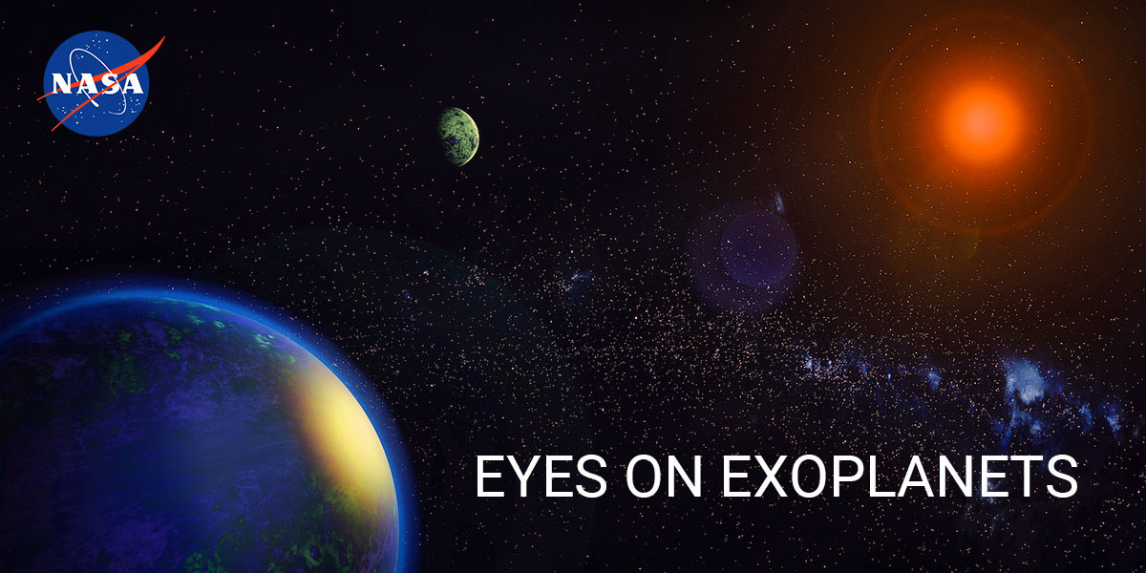
Universita degli Studi di Bari Aldo Moro
Machine Learning Exam - A.A. 2025/2026
Distance-Based Clustering and Leakage-Aware Classification of NASA Exoplanets
CLUSTERING | SUPERVISED CLASSIFICATION
Roberto Pio Selvaggi
Corso di Machine Learning
Dipartimento di Informatica
A.A. 2025/2026
Dataset:
NASA Exoplanet Archive Intelligence [Dataset].
Kaggle.
https://www.kaggle.com/datasets/kanchana1990/nasa-exoplanet-archive-intelligence

Slide 2
Introduction & Problem Statement
Motivation, research questions, and contributions
Dataset & Methodology
Feature audit, preprocessing, and experimental design
Outline
Unsupervised Clustering
K-Means, hierarchical methods, and cluster interpretation
CONTENTS
Supervised Classification
Leakage-aware ablation study of planet type classification
Discussion & Conclusions
Key findings, limitations, and methodological takeaways
2

Slide 3
01 Introduction > 1.0 What Are Exoplanets?
3
01 Intro
What Are Exoplanets?
Definition
02 Dataset
Exoplanets are planets outside our Solar System. They orbit stars other than the Sun and span a wide range of sizes, masses, orbital periods, and physical environments.
How They Are Detected
03 Clustering
Major detection methods include transit photometry, radial velocity, direct imaging, microlensing, and timing techniques. These methods generate heterogeneous catalogues with different levels of completeness and uncertainty.
04 Supervised
Why They Matter for Machine Learning
Exoplanet catalogues combine physical, orbital, stellar, and observational information. This makes them useful for exploratory analysis, but also risky because some categorical labels are derived from the same quantities used as model features.
05 Conclusions
In This Project
The goal is to study whether exoplanets form meaningful groups and how much supervised planet_type classification depends on near-definitional features such as mass and radius.

Slide 4
01
CHAPTER ONE
Introduction & Problem Statement
Motivation, research questions, and contributions
1.1 The derived-label problem in exoplanet catalogues
1.2 Research questions & contributions
4

Slide 5
01 Introduction > 1.1 Motivation
5
01 Intro
Motivation: The Derived-Label Problem
The Dataset: NASA Exoplanet Archive
02 Dataset
6,150 confirmed exoplanets with 31 columns spanning physical measurements (radius, mass, temperature), orbital properties (period, eccentricity, semi-major axis), stellar characteristics, and derived categorical labels (planet_type, star_type, habitable_zone_flag).
The Core Problem: Semantic Leakage
03 Clustering
Catalogues mix raw physical measurements with derived labels that conflate observation and classification. ML applied naively produces misleading results: classifiers reconstruct definitional rules rather than learning genuine predictive structure (Kapoor & Narayanan, 2023).
04 Supervised
Why Clustering as the Core?
Unsupervised clustering discovers natural groupings from physical properties alone, without reference to any pre-existing taxonomy. Derived labels are deliberately excluded from the fit and used only post-hoc for interpretation.
05 Conclusions
Pipeline Overview
A two-part pipeline: (1) Distance-based clustering with K-Means and hierarchical methods on planetary/orbital features; (2) Leakage-aware supervised extension measuring how much planet_type classification depends on near-definitional features (mass, radius).
Derived labels must be excluded from unsupervised fitting to avoid reasoning and inflated performance metrics.

Slide 6
01 Introduction > 1.2 Research Questions & Contributions
6
01 Intro
Research Questions & Contributions
RESEARCH QUESTION 1
RESEARCH QUESTION 2
02 Dataset
Do confirmed exoplanets form natural groupings based on physical and orbital properties alone, without reference to any pre-existing taxonomy?
How much predictive signal for planet_type survives the removal of near-definitional features, namely planetary mass and radius?
03 Clustering
Four Main Contributions
04 Supervised
Feature audit separating physical measurements, derived labels, and observational metadata with explicit exclusion criteria
05 Conclusions
Clustering comparison of K-Means with single and complete linkage across two feature spaces, with Silhouette and cluster-size diagnostics
Bootstrap stability analysis and post-hoc Adjusted Rand comparison for clustering, plus leakage-aware ablation study for supervised task
Bootstrap confidence intervals and corrected resampled t-tests providing dependence-aware statistical context for supervised comparison

Slide 7
02
CHAPTER TWO
Dataset & Methodology
Feature audit, preprocessing, and experimental design
2.1 Dataset overview & feature audit
2.2 Preprocessing pipeline
2.3 Feature sets & clustering design
8

Slide 8
02 Dataset > 2.1 Dataset Overview & Feature Audit
9
01 Intro
Dataset Overview & Feature Audit
6,150
31
6
3
02 Dataset
Confirmed Exoplanets
Columns
Planet Type Classes
Feature Categories
03 Clustering
Feature Categories and Exclusion Rationale
Category | Features | Status
Physical / Orbital | period, radius, mass, temp, eccentricity, semi-major axis | Used for clustering
Stellar | star temp, radius, mass, age, surface gravity, metallicity | Set B only
Derived Labels | planet_type, star_type, orbital_period_cat, habitable_zone_flag | Excluded - post-hoc only
Metadata | planet_name, host_star, discovery_method, ra, dec, disc_year | Excluded
04 Supervised
05 Conclusions

Slide 9
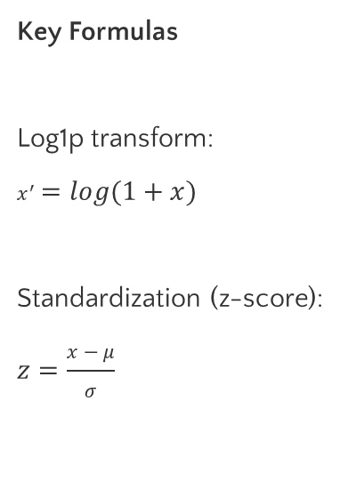
02 Dataset > 2.2 Preprocessing Pipeline
10
01 Intro
Preprocessing Pipeline
9
02 Dataset
Log1p Transform
Median Imputation
Standardization
Pipeline CV
03 Clustering
Log1p Transform
Five variables with heavy right skew:
orbital_period, planet_radius, planet_mass, semi_major_axis, dist_from_earth
Median Imputation for missing value
SimpleImputer(strategy="median")
StandardScaler
Required for distance-based methods
Cross Validation
GridSearchCV iteration with 5-fold StratifiedKFold, preventing test-set information from contaminating preprocessing statistics.
Key Formulas
Log1p transform:
$$x^{′}=log⁡(1+x)$$
Standardization (z-score):
$$z=\frac{x−μ}{σ}$$
04 Supervised
05 Conclusions

Slide 10
02 Dataset > 2.3 Feature Sets & Clustering Design
11
01 Intro
Feature Sets & Clustering Design
Set A: Planetary / Orbital (6 features)
Set B: Planetary + Stellar (12 features)
02 Dataset
equilibrium_temp_k
orbital_eccentricity
orbital_period_days_log
planet_radius_earth_log
planet_mass_earth_log
semi_major_axis_au_log
Set A features +
star_temp_k
star_radius_sun
star_mass_sun
star_age_gyr
star_surface_gravity
star_metallicity
03 Clustering
04 Supervised
Clustering Methods & Validation
05 Conclusions
K-Means (n_init=20, random_state=42) - centroid-based partitioning
Agglomerative - single linkage
Agglomerative - complete linkage
k = 2 to 8 evaluated; Silhouette + cluster-size diagnostics
Bootstrap (20 resamples, 80% with replacement and random_state =42 to avoid ) + post-hoc Adjusted Rand Index with external labels. Labels excluded from model fitting and selection.

Slide 11
03
CHAPTER THREE
Unsupervised Clustering
K-Means, hierarchical methods, and cluster interpretation
3.1 Clustering methods overview
3.2 Silhouette comparison & cluster selection
3.3 Cluster profiles & external validation
12

Slide 12
03 Clustering > 3.1 Clustering Methods Overview
13
01 Intro
Clustering Methods: K-Means & Hierarchical Linkage
K-Means
Single Linkage
Complete Linkage
02 Dataset
Minimizes sum of squared distances to centroids:
$$arg⁡{min⁡}_{S}∑_{i=1}^{k}∑_{x∈S_{i}}∥x−μ_{i}∥^{2}$$
Used with n_init=20 to reduce initialization sensitivity. Produces easily interpretable clusters via centroid profiles.
Distance between clusters = minimum distance between any pair of points:
$$d(A,B)={min⁡}_{a∈A,b∈B}d(a,b)$$
Vulnerable to chaining effect. Tends to isolate outlier chains.
Distance between clusters = maximum distance between any pair:
$$d(A,B)={max⁡}_{a∈A,b∈B}d(a,b)$$
Tends to produce compact, spherical clusters. Also isolates outliers in this dataset.
03 Clustering
04 Supervised
Silhouette Score
05 Conclusions
For each point i: $s(i)=\frac{b(i)−a(i)}{max⁡(a(i),b(i))}$
where $a(i)$ = mean intra-cluster distance, $b(i)$ = mean nearest-cluster distance
Range [-1, 1]: +1 = well-separated, 0 = boundary, negative = possible misassignment
Silhouette is chosen because it is internal, requires no labels, and enables comparison across k values.

Slide 13
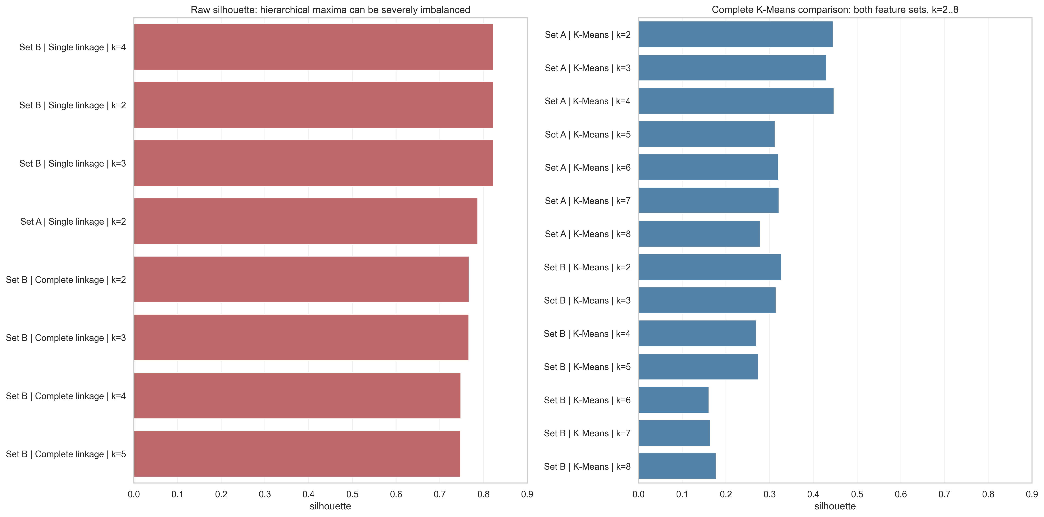
03 Clustering > 3.2 Silhouette Scores & Cluster Balance
14
01 Intro
Silhouette Scores & Cluster Balance Diagnostics
Feature Set | Method | N_Cluster | Silhouette | Cluster Sizes | Status
B - Planetary/Stellar | Single | 4 | 0.8228 | 6145 / 2 / 2 / 1 | Severely imbalanced
B - Planetary/Stellar | Complete | 2 | 0.7667 | 6136 / 14 | Severely imbalanced
A - Planetary/Orbital | K-Means | 4 | 0.4471 | 4054 / 1174 / 850 / 72 | Selected
A - Planetary/Orbital | K-Means | 2 | 0.4460 | 4196 / 1954 | Binary comparison
02 Dataset
03 Clustering
04 Supervised
05 Conclusions
Figure 1: Silhouette scores for all method, feature set, and k combinations. Single and complete linkage produce severely imbalanced partitions despite high raw scores.

Slide 14
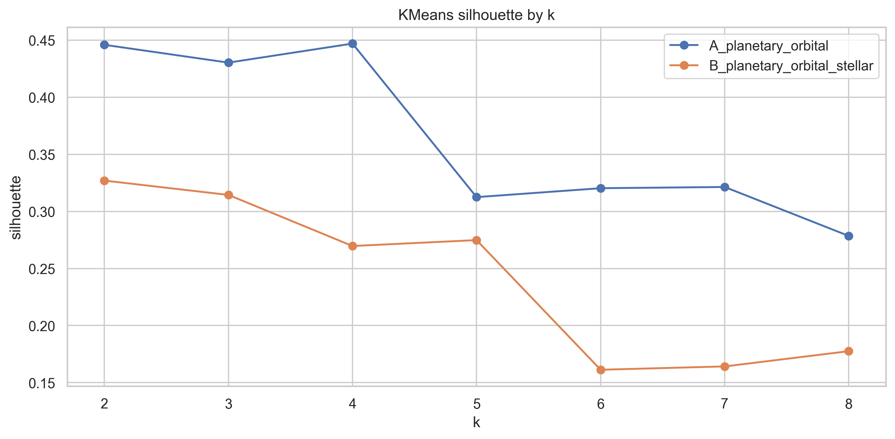
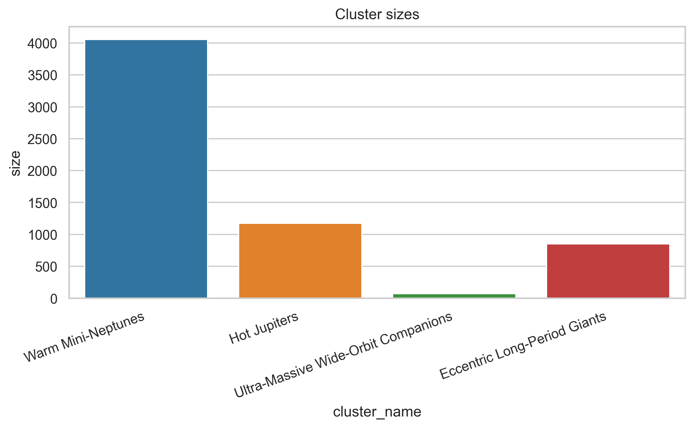
03 Clustering > 3.2 K-Means Silhouette by k
15
01 Intro
K-Means Silhouette by k & Cluster Sizes
02 Dataset
03 Clustering
04 Supervised
05 Conclusions
Key Observations
K-Means k=2 (Silhouette 0.446) and k=4 (0.447) differ by only 0.0011 - essentially equivalent. k=4 retained for interpretability (reveals Hot Jupiters vs Eccentric Giants). Set A outperforms Set B in non-degenerate configurations. Bootstrap stability: mean 0.412 +/- 0.065 over 20 resamples.

Slide 15
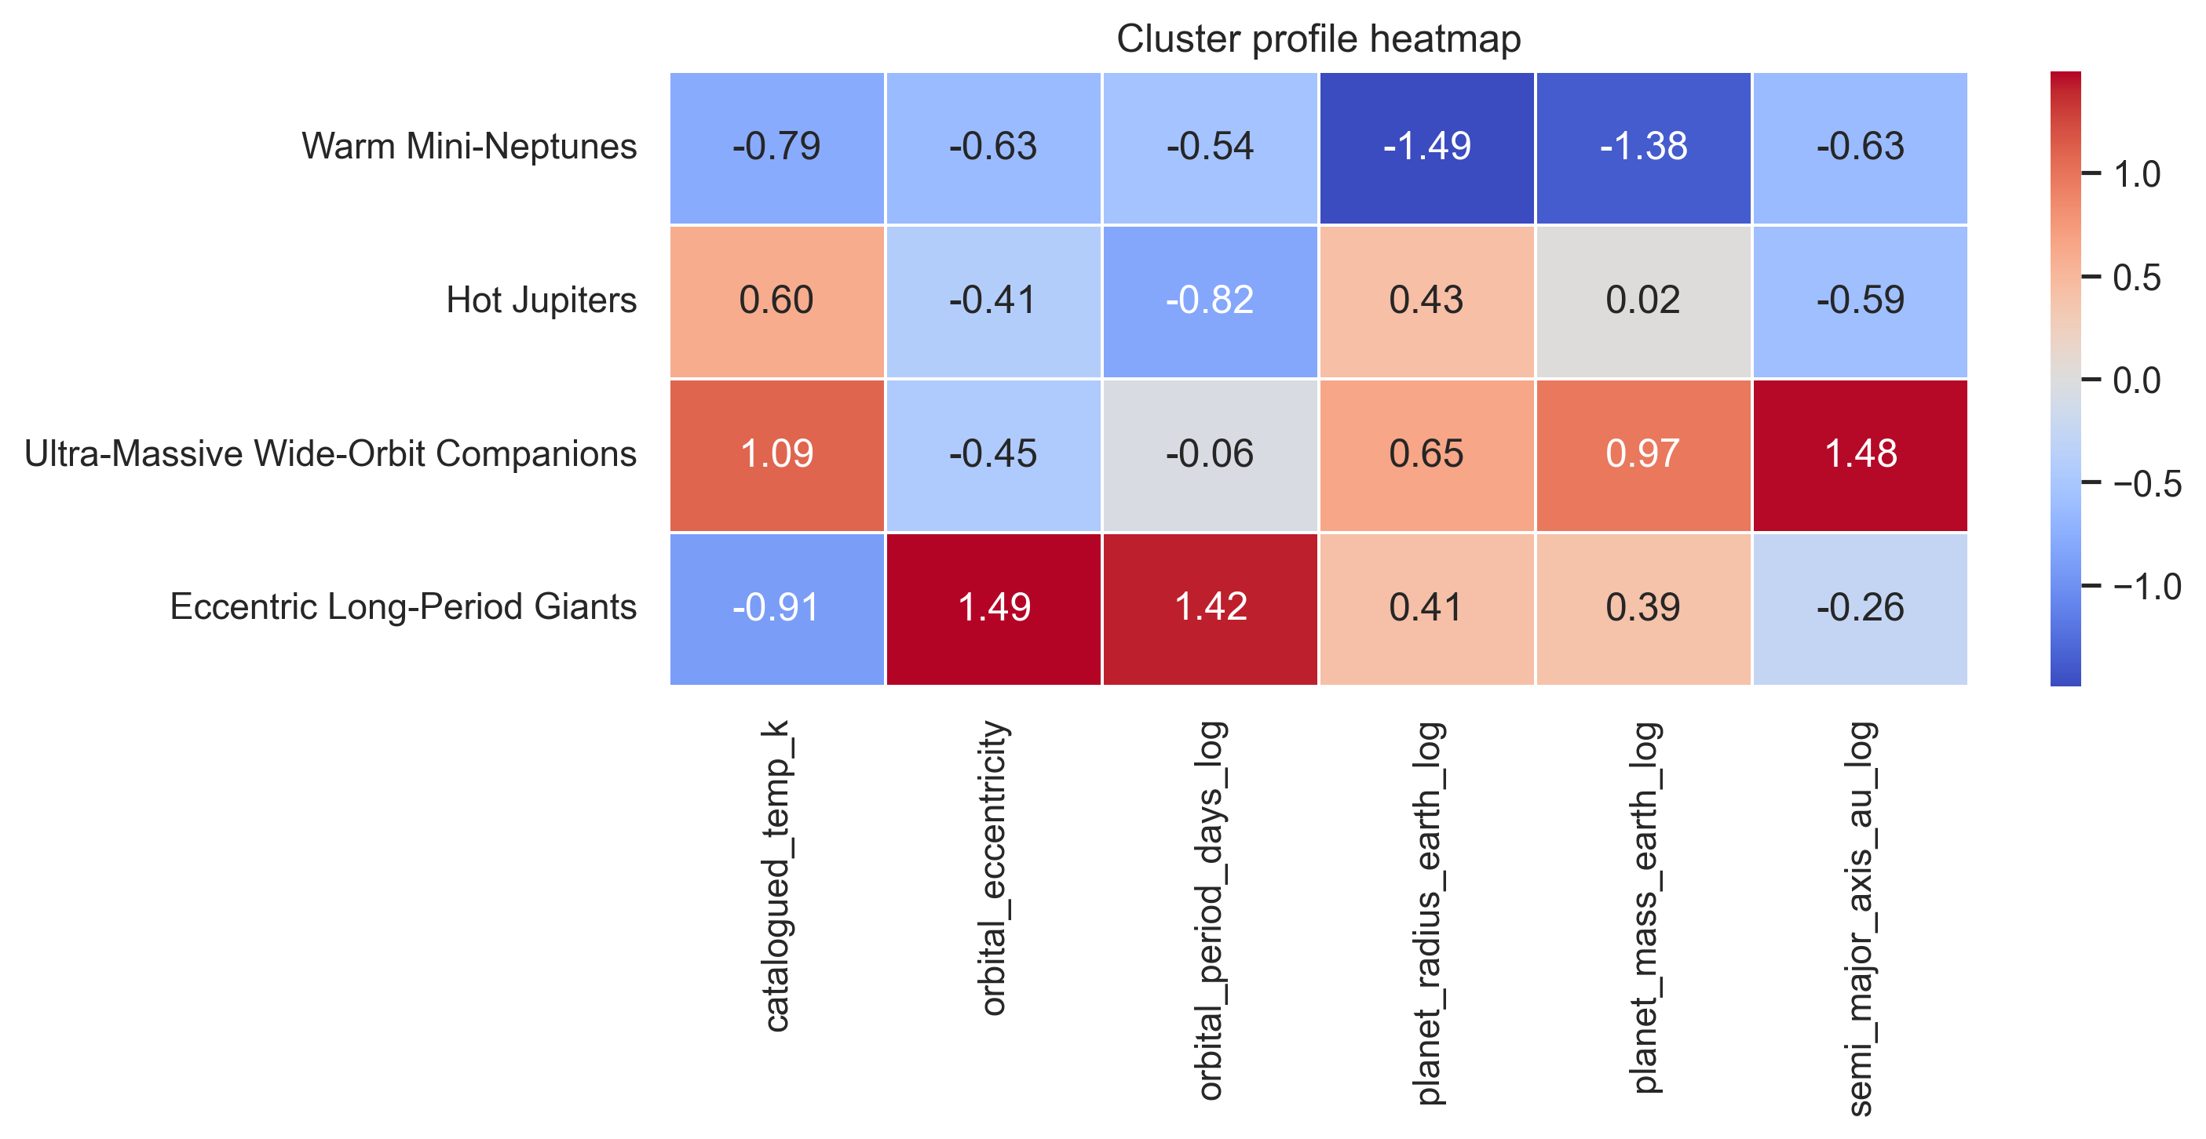
03 Clustering > 3.3 Cluster Profiles
16
01 Intro
Cluster Profiles: Four Interpretable Groups
Cluster | Name | n | % | Temp (K) | Ecc. | Mass | SMA
0 | Warm Mini-Neptunes | 4054 | 65.9 | 807 | 0.026 | 1.91 | 0.136
1 | Hot Jupiters | 1174 | 19.1 | 1227 | 0.053 | 5.64 | 0.257
2 | Wide-Orbit Companions | 72 | 1.2 | 1378 | 0.048 | 8.14 | 5.773
3 | Eccentric Long-Period Giants | 850 | 13.8 | 771 | 0.286 | 6.59 | 1.139
02 Dataset
03 Clustering
04 Supervised
05 Conclusions
Figure 2: Z-score heatmap of mean feature profiles for the four clusters
z = (valore del cluster - media generale) / deviazione standard.

Slide 16
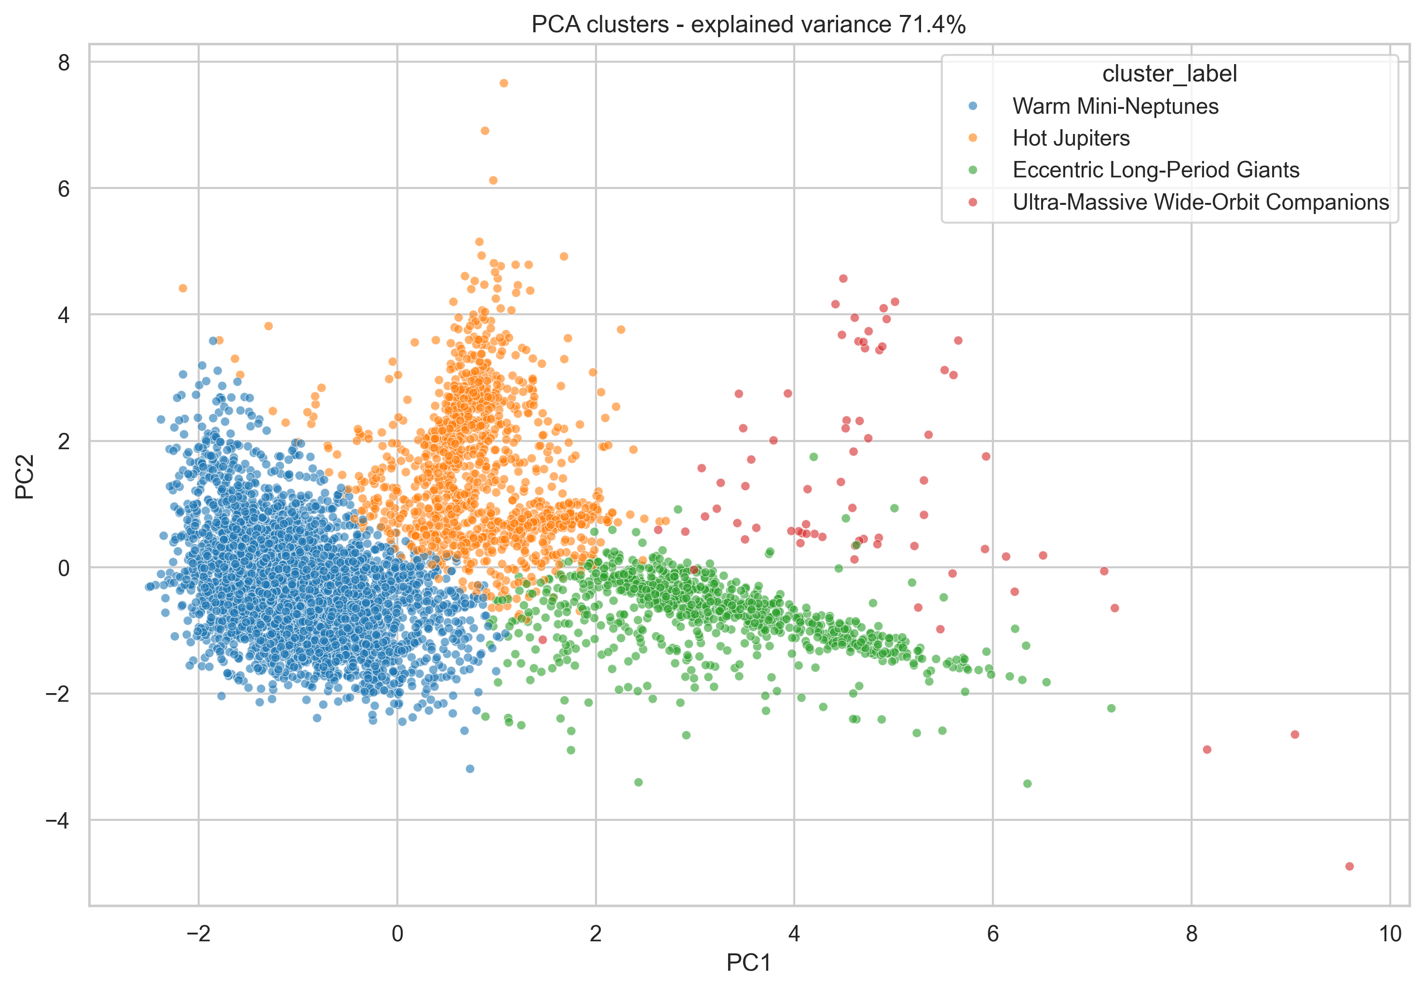
03 Clustering > 3.3 PCA Visualization
17
01 Intro
PCA Visualization of Clusters
02 Dataset
03 Clustering
04 Supervised
05 Conclusions
Interpretation
The 2D projection shows four partially overlapping groups, consistent with Silhouette ~0.447 indicating a continuous physical domain rather than sharply separated classes.

Slide 17
03 Clustering > 3.3 External Validation (ARI)
18
01 Intro
Post-Hoc External Validation: Adjusted Rand Index
ARI corrects pairwise partition agreement for chance: $ARI=\frac{∑_{ij}(\frac{n_{ij}}{2})−[∑_{i}(\frac{a_{i}}{2})∑_{j}(\frac{b_{j}}{2})]/(\frac{n}{2})}{\frac{1}{2}[∑_{i}(\frac{a_{i}}{2})+∑_{j}(\frac{b_{j}}{2})]−[∑_{i}(\frac{a_{i}}{2})∑_{j}(\frac{b_{j}}{2})]/(\frac{n}{2})}$
02 Dataset
External Label | Samples | ARI | Interpretation
planet_type (no Unknown) | 6100 | 0.307 | Partial agreement with dataset taxonomy
orbital_period_cat | 6150 | 0.224 | Partial agreement with orbital categories
star_type | 6150 | 0.043 | Near-random agreement
habitable_zone_flag | 6150 | -0.044 | Below-chance agreement
03 Clustering
04 Supervised
05 Conclusions
Key Takeaway
The partition partially recovers planet type and orbital period taxonomy (expected, as these are derived from features in the clustering space), but does NOT reproduce stellar taxonomy or habitability. This confirms the clusters are discovering genuine structure, not copying labels.
Note: Since planet_type and orbital_period_cat are partly derived from variables in the clustering feature space, ARI is interpreted descriptively rather than as independent ground truth. External labels were never used in model fitting or selection.

Slide 18
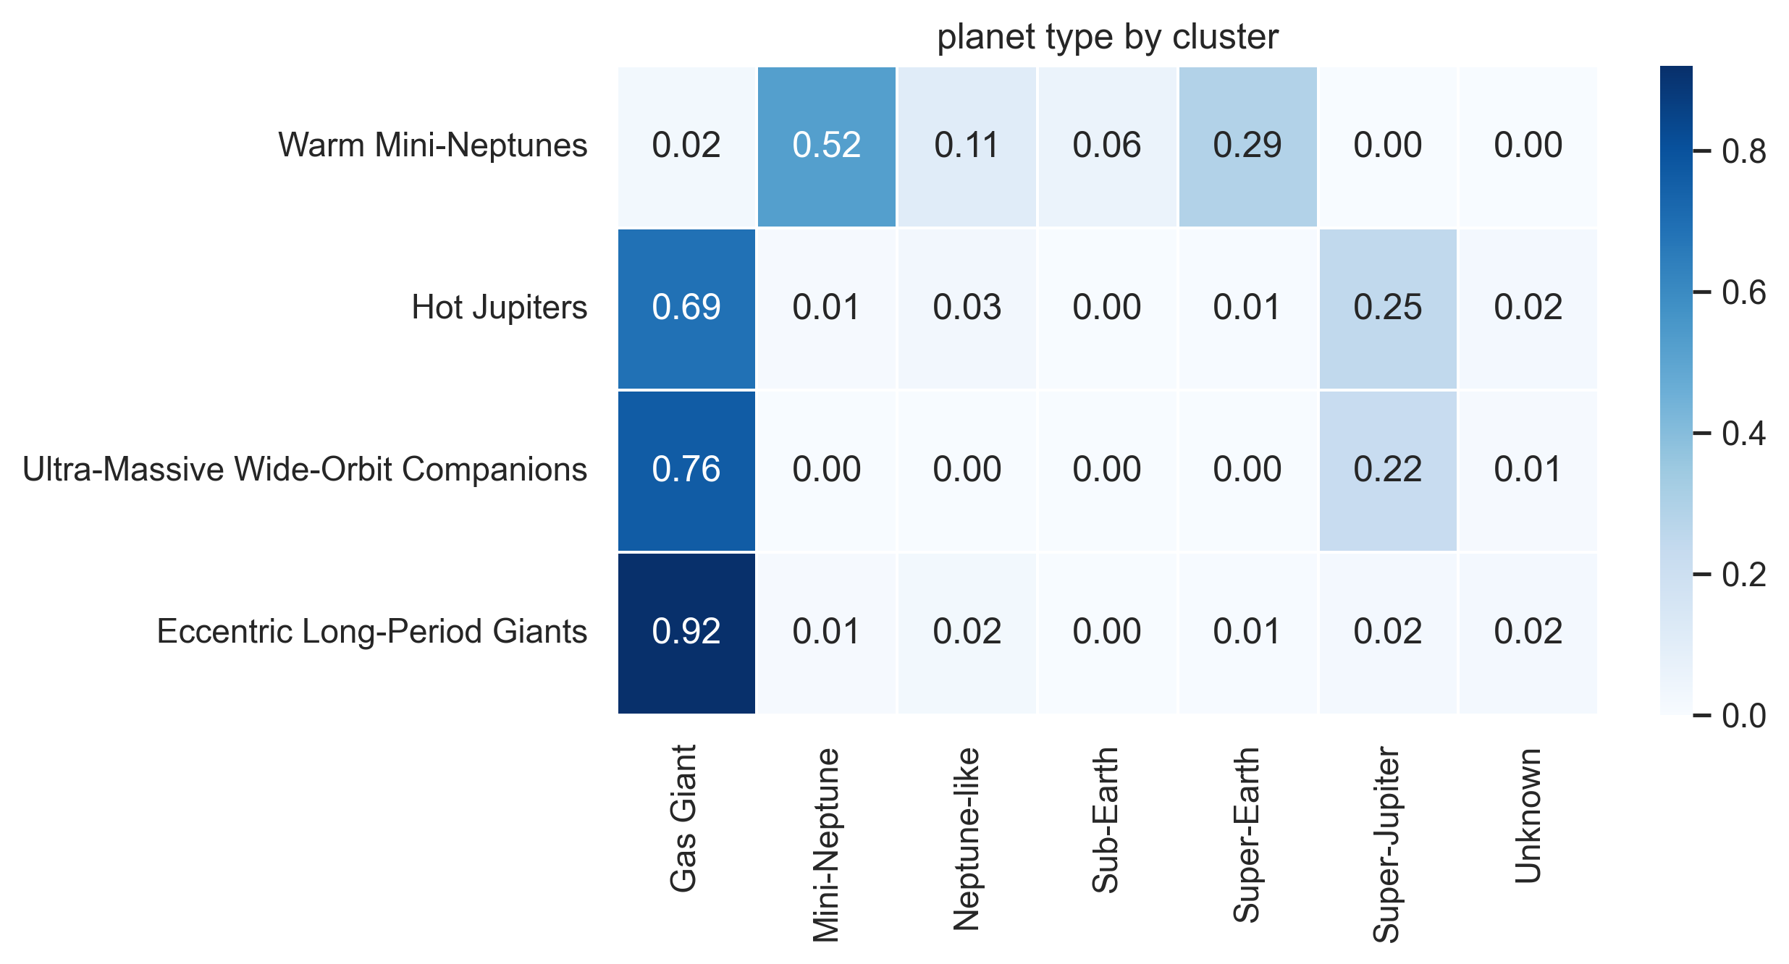
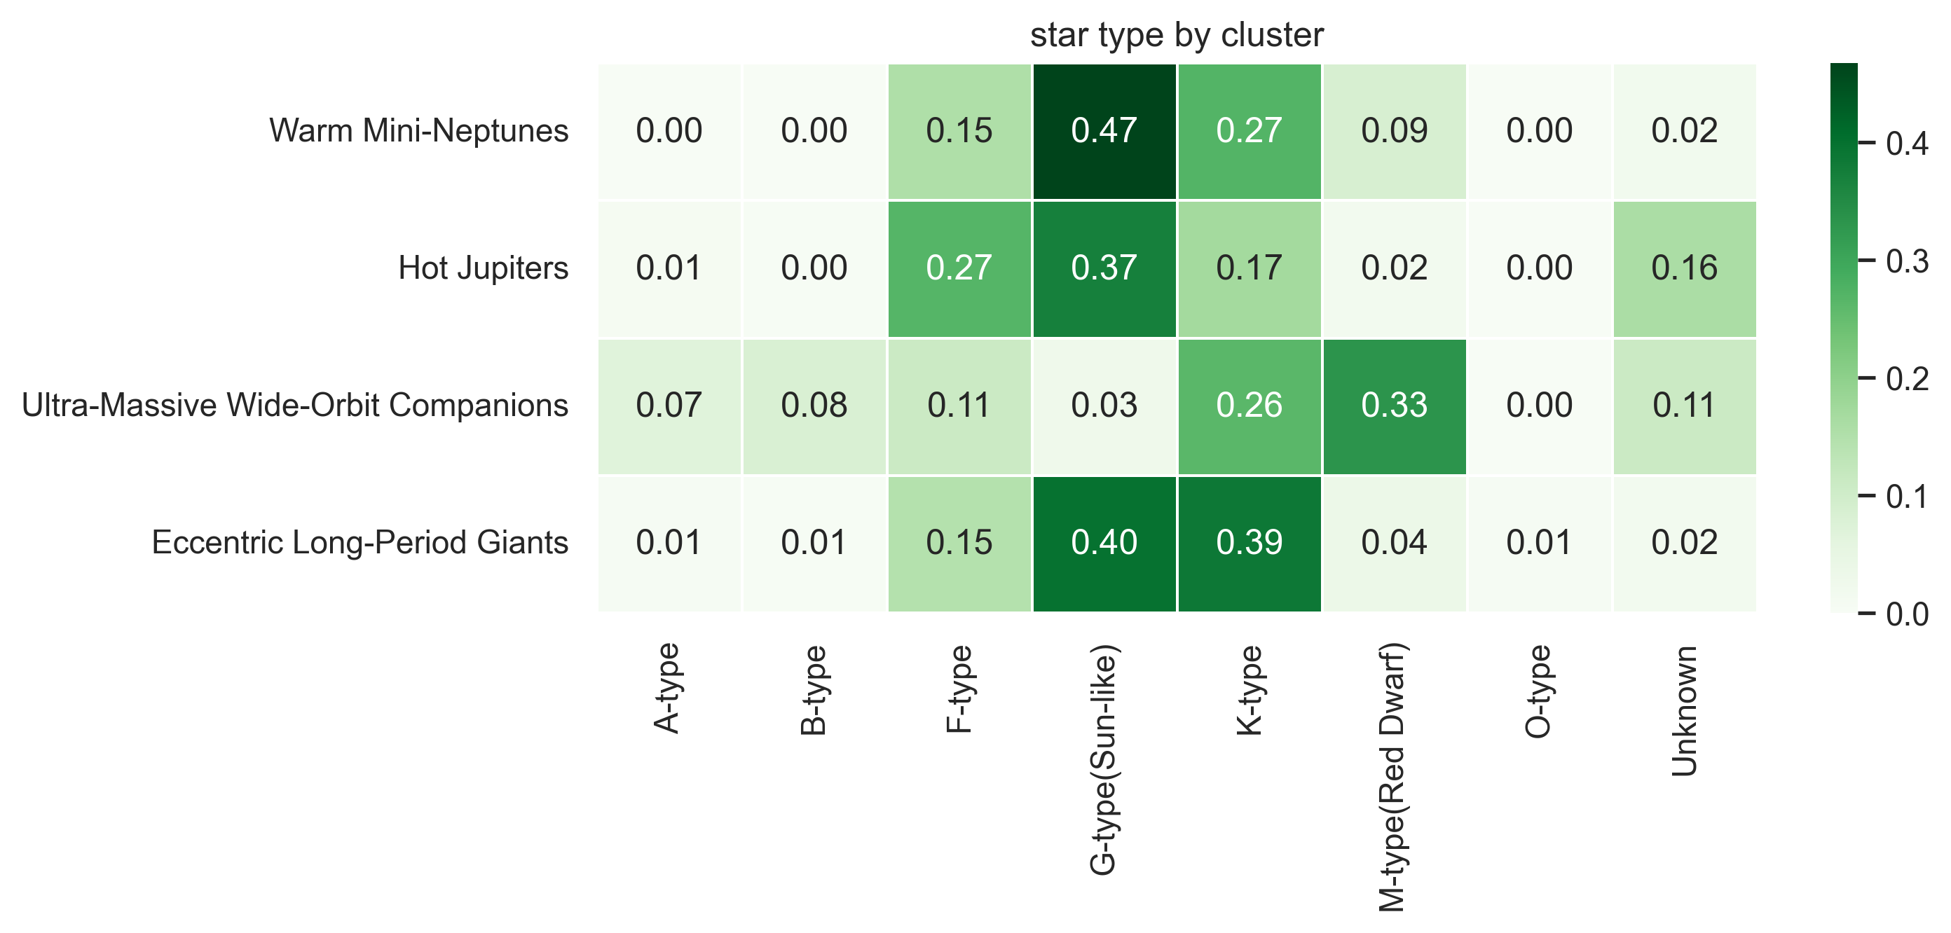
03 Clustering > 3.3 Planet Type & Star Type by Cluster
19
01 Intro
Planet Type & Star Type Distribution by Cluster
02 Dataset
03 Clustering
04 Supervised
05 Conclusions
Observations
Cluster 0 = Mini-Neptunes, Cluster 1 = Gas Giants, Cluster 3 = Eccentric Giants. Star type shows near-random alignment (ARI=0.043), confirming clusters are driven by planetary properties.
Figure 3: Cross-tabulations of planet_type (left) and star_type (right) against cluster assignments. Used post-hoc only.

Slide 19
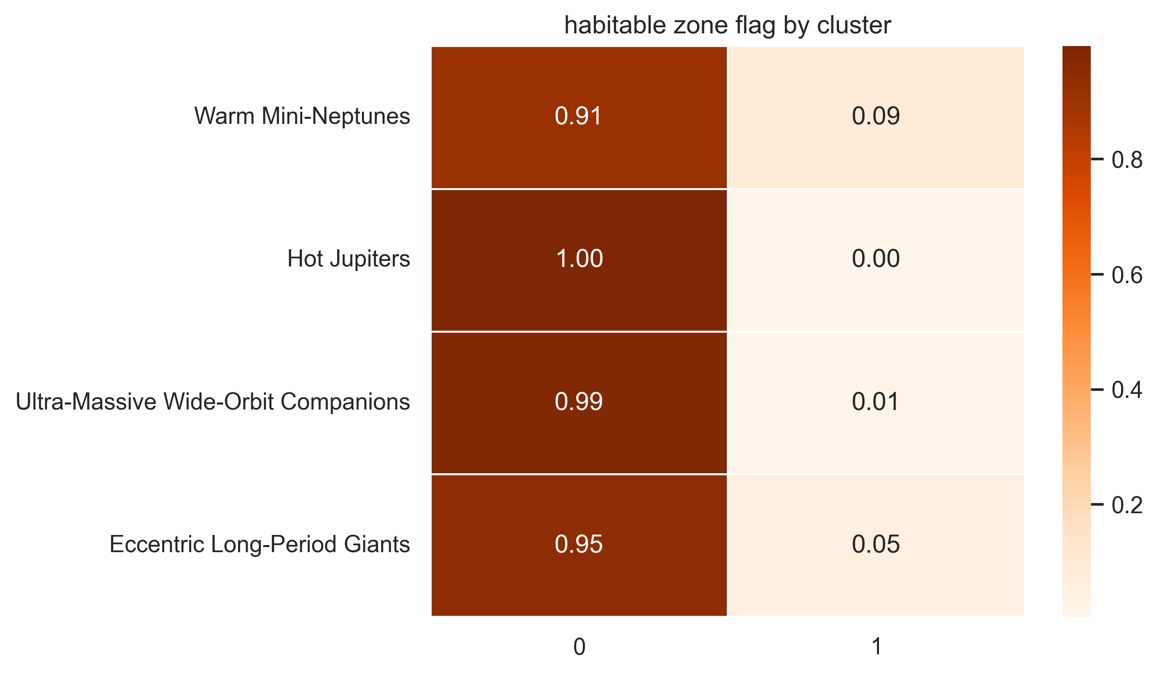
03 Clustering > 3.3 Habitability & Orbital Period
20
01 Intro
Habitability & Orbital Period by Cluster
02 Dataset
03 Clustering
04 Supervised
05 Conclusions
Cluster 2 Sensitivity Analysis
All 72 Wide-Orbit Companions remain in the matched extreme group when period and temperature are jointly removed (matched group size = 81, Jaccard = 0.889; whole-partition ARI = 0.834). This confirms the group is not created solely by these two features. 69/72 members discovered by direct imaging; median SMA ~325 AU (range 22-19,000 AU); mean log-mass 8.14 corresponds to ~11 Jupiter masses, near the 13 M_{Jup} brown-dwarf boundary.

Slide 20
04
CHAPTER FOUR
Supervised Classification
Leakage-aware ablation study of planet type classification
4.1 Setup A vs Setup B (ablation design)
4.2 Supervised results & confusion analysis
4.3 Confidence intervals & statistical tests
21

Slide 21
04 Supervised > 4.1 Setup A vs Setup B
22
01 Intro
Supervised Extension: Setup A vs Setup B
Setup A - Full Features (16 features)
Setup B - Ablation (14 features)
02 Dataset
All 16 features including:
planet_radius_earth_log
planet_mass_earth_log
+ 6 planetary/orbital features
+ 6 stellar features
+ 4 contextual features
Expected: near-perfect performance
(mass and radius are definitional)
Features:
- planet_radius_earth_log
- planet_mass_earth_log
+ 6 planetary/orbital
+ 6 stellar features
+ 4 contextual features
Expected: significant drop
(genuinely difficult classification)
03 Clustering
04 Supervised
05 Conclusions
Models & Validation
Target: planet_type (6 classes: Gas Giant, Mini-Neptune, Neptune-like, Sub-Earth, Super-Earth, Super-Jupiter; 6,100 samples after excluding Unknown)
Models: Logistic Regression | Decision Tree | Random Forest | SVM (RBF) | KNN
Validation: 80/20 stratified split, GridSearchCV with 5-fold StratifiedKFold, optimize Macro-F1. Preprocessing inside pipeline to prevent leakage.
The ablation study asks: without the most definitional features, does any real predictive signal remain for planet_type?

Slide 22
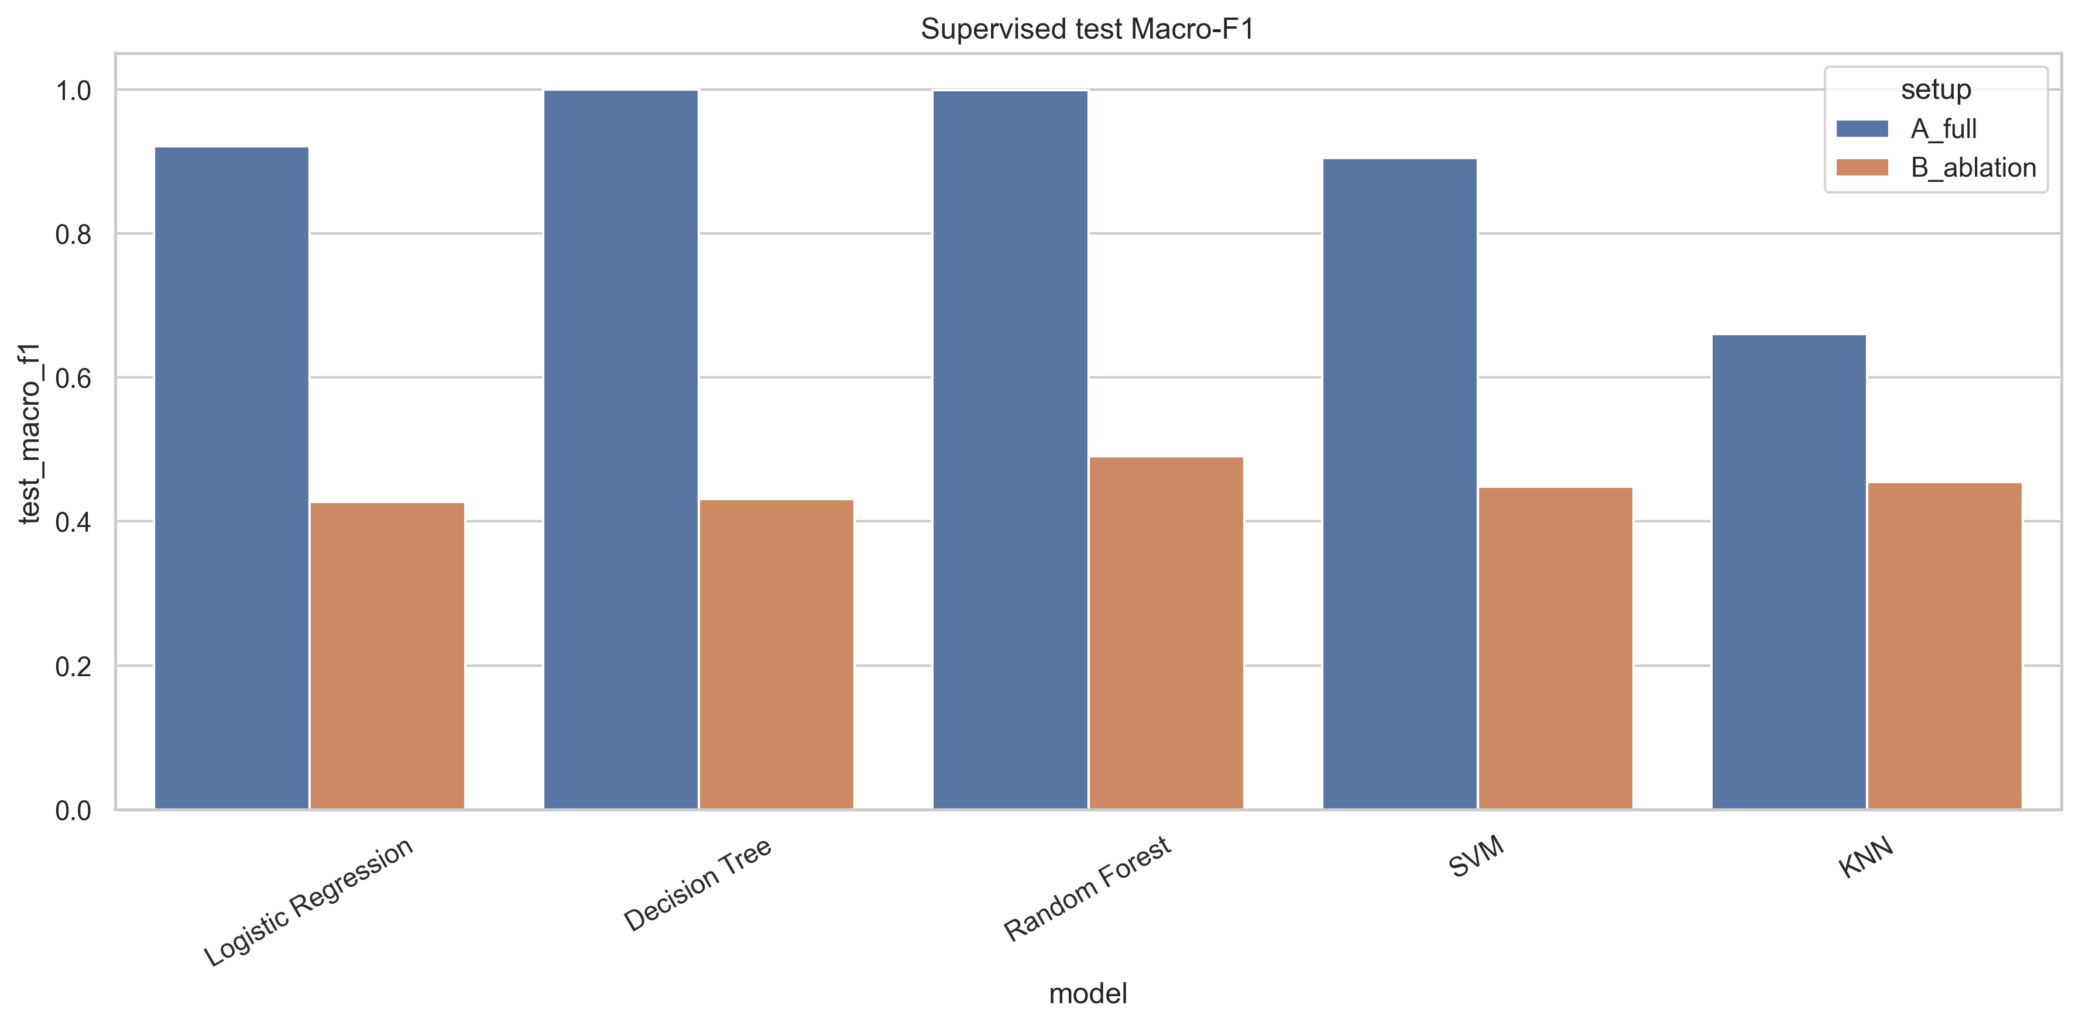
04 Supervised > 4.2 Supervised Results
23
01 Intro
Supervised Results: The Leakage Effect
Setup | Model | Accuracy | Macro-F1 | Drop Random Forest A_full → Random Forest B_ablation
A - Full | Decision Tree | 1.0000 | 1.0000 | -
A - Full | Random Forest | 0.9992 | 0.9989 | -
A - Full | Logistic Regression | 0.9459 | 0.9208 | -
A - Full | SVM | 0.9344 | 0.9046 | -
A - Full | KNN | 0.7746 | 0.6604 | -
B - Ablated | Random Forest | 0.5959 | 0.4904 | -0.5085
02 Dataset
03 Clustering
04 Supervised
05 Conclusions
Figure 4: Macro-F1 comparison across all models for Setup A (Full) and Setup B (Ablation). Near-perfect Setup A scores confirm semantic leakage.

Slide 23
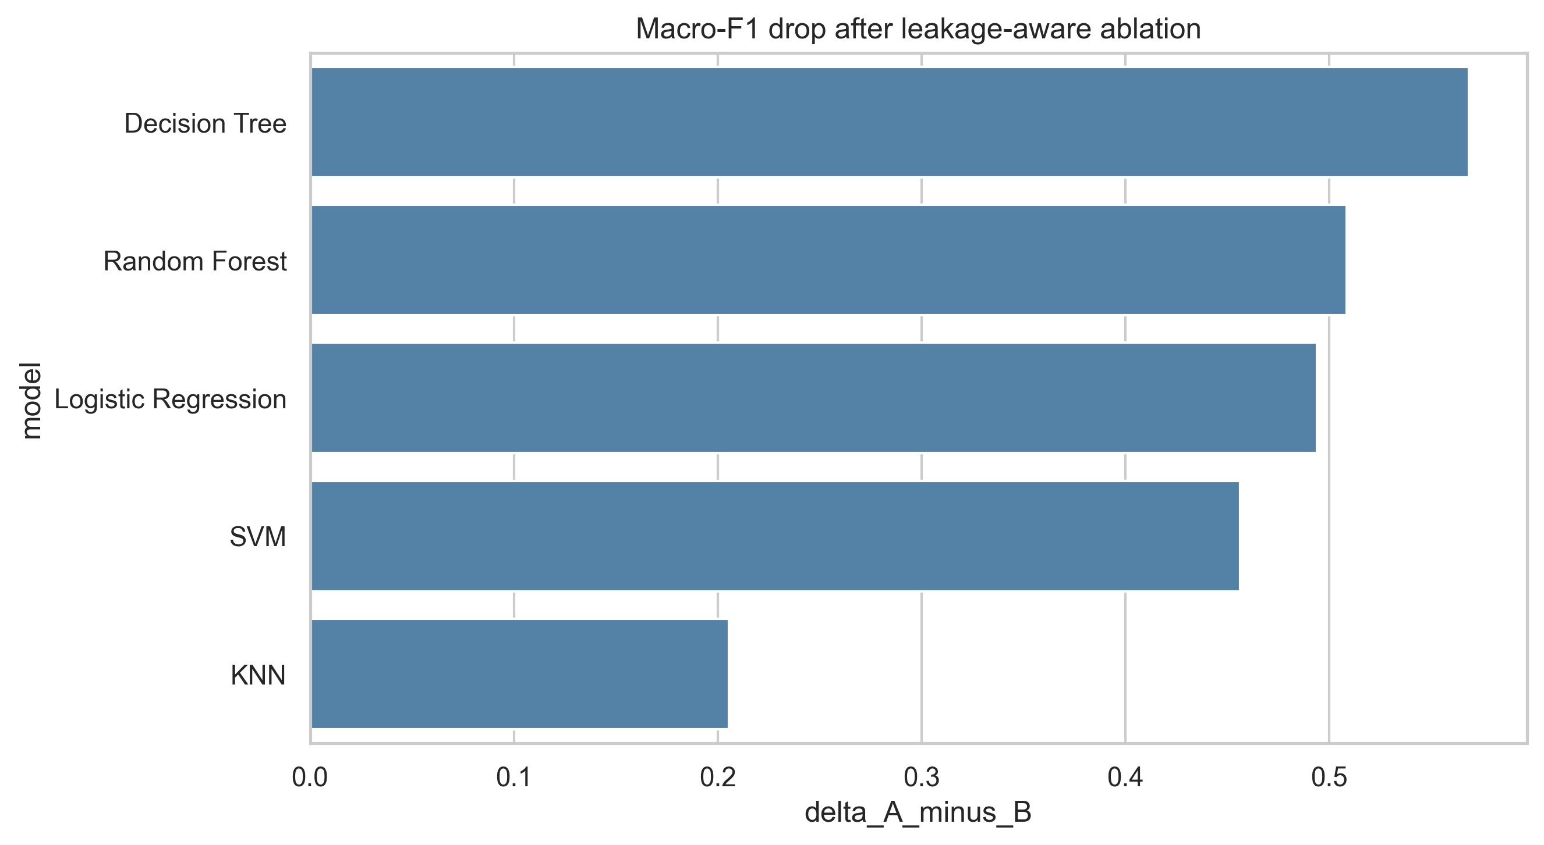
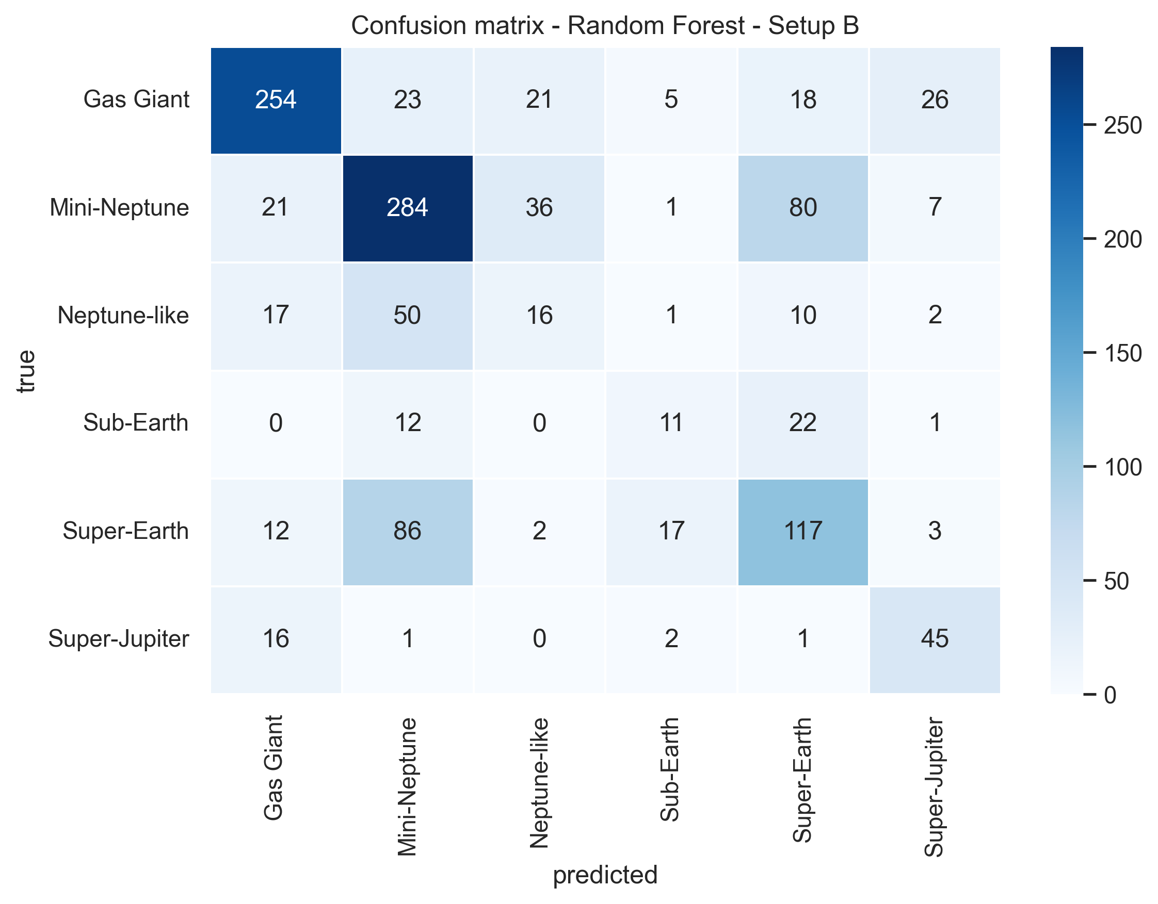
04 Supervised > 4.2 Ablation & Confusion Analysis
24
01 Intro
Ablation Comparison & Confusion Analysis
02 Dataset
03 Clustering
04 Supervised
05 Conclusions
Confusion Pattern in Setup B
Best Setup B model: Random Forest (Macro-F1 = 0.490). Largest confusion: Super-Earth vs Mini-Neptune (86+80 errors in opposite directions), Neptune-like predicted as Mini-Neptune (50 cases). This is coherent with removing mass and radius - the features that separate neighbouring planet classes. The confusion pattern itself is evidence that the model is now learning from genuinely overlapping classes rather than reconstructing definitional thresholds.
Figure 5: Macro-F1 drop from Setup A to B (left) and confusion matrix of best Setup B model, Random Forest (right).

Slide 24
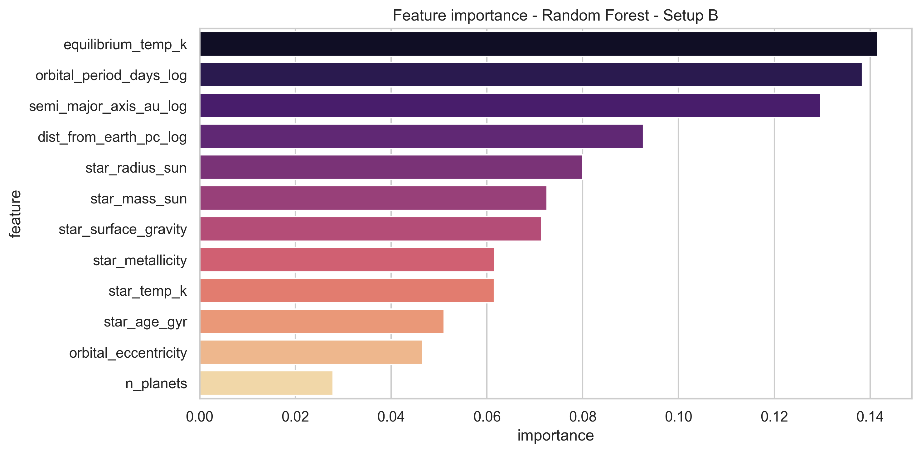
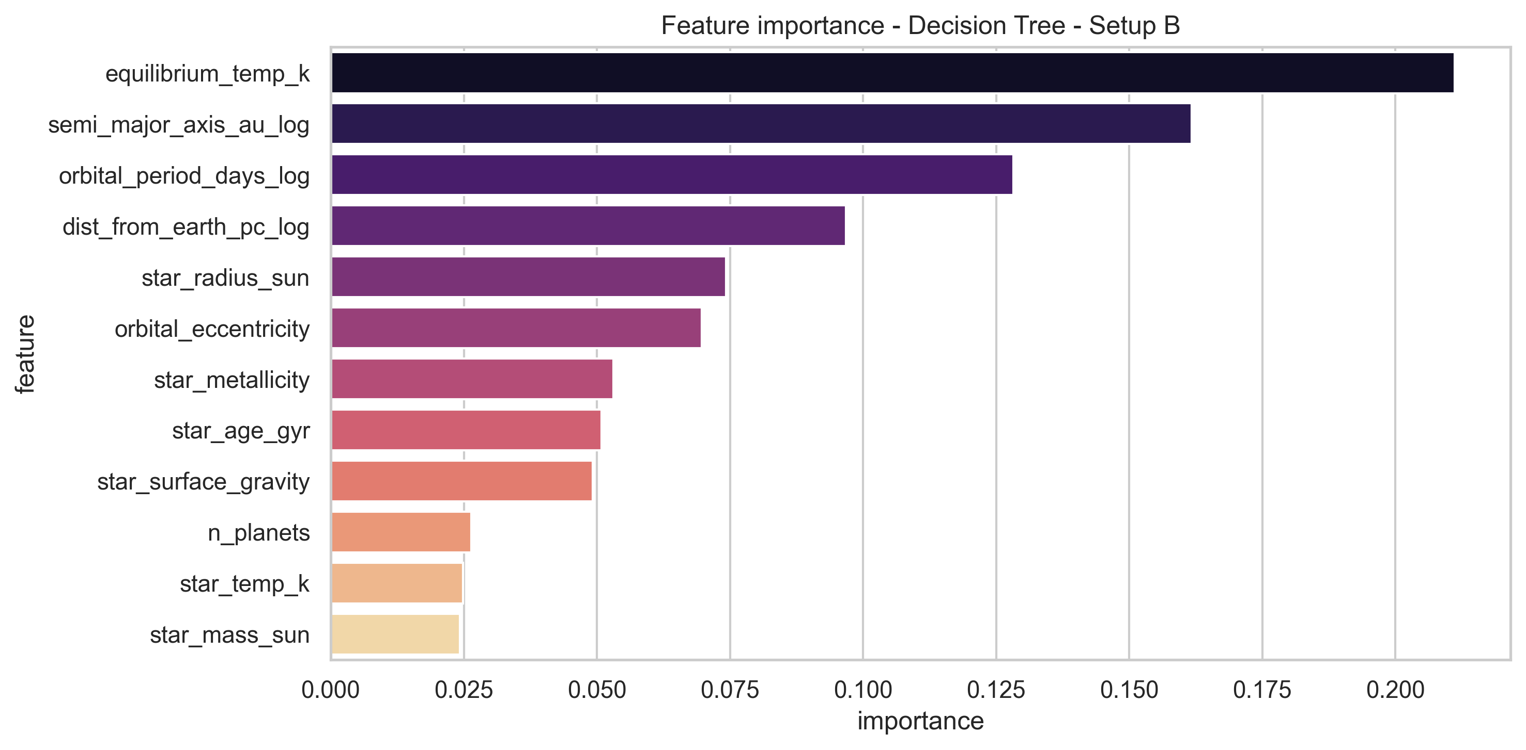
04 Supervised > 4.2 Feature Importance in Setup B
25
01 Intro
Feature Importance in Setup B
02 Dataset
03 Clustering
04 Supervised
05 Conclusions
What Drives Prediction Without Mass/Radius?
Random Forest top features: catalogued temperature (0.142), orbital period (0.138), semi-major axis (0.130). These are predictive, not causal - temperature semantics are heterogeneous for direct-imaging companions. Different models weight features differently, revealing alternative decision boundaries in the reduced feature space.
Figure 6: Feature importance for Random Forest (left) and Decision Tree (right) in Setup B. Without mass and radius, remaining physical features carry the predictive signal.

Slide 25
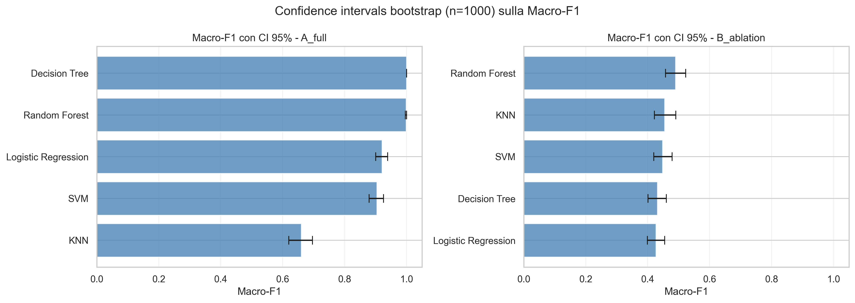
04 Supervised > 4.3 Confidence Intervals & Tests
26
01 Intro
Confidence Intervals & Statistical Significance
Model | Macro-F1 | 95% CI
Random Forest | 0.490 | [0.457, 0.523]
KNN | 0.455 | [0.422, 0.491]
SVM | 0.448 | [0.420, 0.479]
Decision Tree | 0.432 | [0.401, 0.460]
Logistic Regression | 0.427 | [0.399, 0.455]
Corrected Resampled t-test
02 Dataset
10 paired Macro-F1 values from repeated stratified 5-fold CV (2 repetitions). Correction accounts for dependence between overlapping training sets (Nadeau & Bengio, 2003).
Random Forest vs KNN:
diff = 0.037, t = 6.754, p = 0.000083
SVM vs KNN: p = 0.826
03 Clustering
04 Supervised
05 Conclusions
Figure 7: Bootstrap 95% confidence intervals on Macro-F1 for all models in both setups. Setup B intervals show genuine uncertainty after removing definitional features.

Slide 26
04 Supervised > 4.4 Validation Strategy
27
01 Intro
Validation Strategy: From Clustering Quality to Statistical Testing
Unsupervised clustering
Supervised classification
Silhouette for k = 2,...,8 across K-Means, single and complete linkage
Cluster-size diagnostics to detect degenerate partitions
Bootstrap stability: 20 resamples, 80% of data with replacement
Post-hoc ARI against external labels, used only descriptively
80/20 stratified train/test split with preprocessing inside the pipeline
GridSearchCV with 5-fold StratifiedKFold, optimized on Macro-F1
Leakage-aware ablation: full feature set vs mass/radius removed
Bootstrap 95% confidence intervals and corrected resampled t-test
02 Dataset
03 Clustering
1. Internal validation
Silhouette Index
2. Stability
Bootstrap resampling
over 20 resamples
3. External comparison
Post-hoc ARI only
planet_type ARI = 0.307
4. Statistical context
Confifence Interval + t-test
04 Supervised
05 Conclusions

Slide 27
05
CHAPTER FIVE
Discussion & Conclusions
Key findings, limitations, and methodological takeaways
5.1 Key findings & interpretation
5.2 Limitations & future work
5.3 Conclusions & contributions
29

Slide 28
05 Discussion > 5.1 Key Findings
30
01 Intro
Key Findings & Interpretation
Clustering Findings
Supervised Findings
02 Dataset
Moderate Silhouette (0.447) is consistent with a continuous physical domain where planetary families have no sharp boundaries - this is expected, not a failure.
Four interpretable groups discovered without using any derived labels: Warm Mini-Neptunes (66%), Hot Jupiters (19%), Eccentric Long-Period Giants (14%), Ultra-Massive Wide-Orbit Companions (1%).
Partial ARI with planet_type (0.307) indicates clusters recover some existing taxonomy but are not redundant - they add genuine exploratory value.
Near-perfect Setup A (Macro-F1 = 1.000 for Decision Tree) is NOT predictive success - it demonstrates that planet_type is reconstructible from mass and radius alone.
Setup B drop to ~0.49 shows that without definitional features, the task is genuinely difficult. The remaining signal comes from temperature, orbital period, and semi-major axis.
Confusion pattern in B (Super-Earth vs Mini-Neptune) confirms the model now learns from genuinely overlapping classes rather than reconstructing thresholds.
03 Clustering
04 Supervised
05 Conclusions
The clustering Silhouette of 0.447 indicates moderate structure in a continuous domain. The supervised Macro-F1 drop of 0.509 provides concrete, quantified evidence of semantic leakage. Together, these tell a coherent methodological story.

Slide 29
05 Discussion > 5.2 Limitations
31
01 Intro
Limitations & Future Work
Dataset
Kaggle dataset is derived from NASA Exoplanet Archive. Substantial missingness and heterogeneous temperature semantics limit physical interpretation.
02 Dataset
Supervised Validation
03 Clustering
One stratified holdout with internal GridSearchCV. Future work: nested cross-validation for less optimistic model selection.
Statistical Tests
04 Supervised
T-tests use 10 overlapping splits with fixed hyperparameter configs.
Target Definition
05 Conclusions
planet_type is likely derived from physical thresholds. Future work: validate against an external taxonomy or expert-labelled source.

Slide 30
05 Discussion > 5.3 Conclusions & Contributions
32
01 Intro
Conclusions & Methodological Contributions
A Reproducible Two-Part Pipeline
02 Dataset
Unsupervised exploration (clustering) combined with leakage-aware supervised analysis (ablation), implemented in 6 sequential Jupyter notebooks with pinned dependencies.
Cluster-Size Diagnostics Prevent Imbalanced Partitions
03 Clustering
Joint inspection of Silhouette and cluster sizes prevents severely imbalanced hierarchical partitions (e.g., 6145/2/2/1) from being mistaken for useful structure.
Interpretable Four-Cluster Solution
04 Supervised
K-Means k=4 yields four readable planetary families; k=2 remains a parsimonious alternative. Post-hoc ARI (0.307 with planet_type) shows partial, not redundant, agreement with taxonomies.
Ablation Study Quantifies Semantic Leakage
05 Conclusions
Macro-F1 drops from 0.999 to 0.490 after removing mass and radius - concrete, quantified evidence that near-perfect classification was driven by feature-label dependence, not predictive discovery.
Dependence-Aware Statistical Context
Bootstrap confidence intervals and corrected resampled t-tests provide statistical rigor that accounts for the dependence structure in cross-validation splits.
All code is available as 6 sequential Jupyter notebooks (01_Audit to 06_Report), executable on standard CPU with no specialized hardware.

Slide 31
Thank You
GRAZIE PER L'ATTENZIONE
Roberto Pio Selvaggi | Universita degli Studi di Bari Aldo Moro
Machine Learning Exam - A.A. 2025/2026
Dipartimento di Informatica
2025/2026
Questions & Discussion | Q & A

