Slide 1
Short-Time Spectral Attenuator and process inversion for Musical Effect
Alessandri Roberto
Cicognani Roberto Leone

Slide 2


Content
Introduction
Methodology
Objectives
Results and Discussion
Conclusion
Further Recommendations

Slide 3
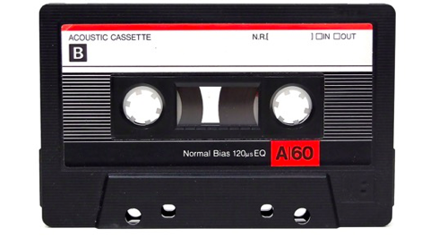
Introduction: Context
High Quality Audio Today
Nostalgia and Necessity
Random Background Noise
Perceived as “hiss”
Electrical and Environmental Origin
Noise at all frequencies

Slide 4
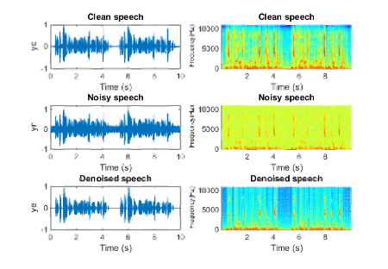
Introduction: Problem Formulation
Why STSA?
Not stationary signals and little knowledge needed
Non-distruptive analysis in freq domain
Speech Enhancement and Recording Restoration
Music Effect by Inversion
Song Resynthesis

Slide 5

Methodology: Model of Noise
Additive, uncorrelated, stationary
s[n]: signal without noise
v[n]: noise
x[n]: our signal !
y[n]: output
Sx: power spectrum of clean
Sn: power spectrum of noise
v[n]
s[n]
x[n]
Restoration
y[n]

Slide 6
Methodology: STSA
Suppression Rules:
Power Spectral Matching
Wiener Filter
Spectral Matching
Noise Power Level Estimate
Noise Suppression Rule
Short-Time Analysis
Short-Time Synthesis
x[n]
Spectral Gain
y[n]

Slide 7

Methodology: the Music Effect
What if instead of attenuating the noise we enhance it?
Add special noise to clean sound as a musical effect
Using the inverse of the suppression rules

Slide 8
Methodology: STSE
Noise Power Level Estimate
Noise Suppression Rule
Function Inversion
Short-Time Sinusoidal Re-Synthesis
Short-Time Analysis
x[n]
Spectral Gain
y[n]

Slide 9
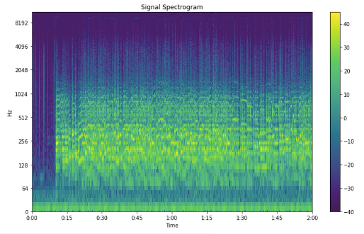
Methodology: Short-Time Processing Parameters
Choice of the length of the window
Longer: Level of signal components cancelled increases with the bandwidth (40 ms)
Shorter: Pure tone and noise correlation issues (20-30 ms)
Choice of hopsize: avoid aliasing(50-75%)
N = 1024 or 2048

Slide 10
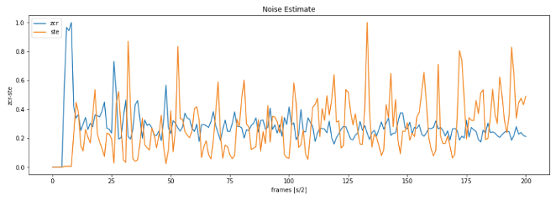
Methodology: Noise Estimation
ZCR and STE Calculation
Locate Noisiest frame
Power Spectrum Density Extimation
Short-time Analysis

Slide 11
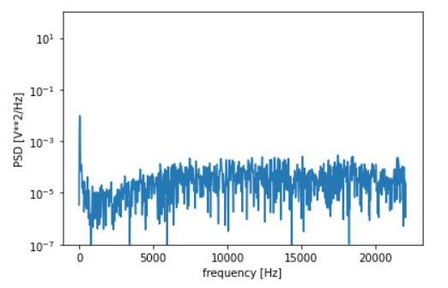
Methodology: Noise Power Spectrum Estimate

Slide 12
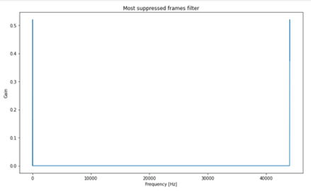
Methodology: Suppression Rule Application
Signal Segmentation and FFT
Gain Estimation
Signal Filtering and IFFT
Reconstruct the Signal

Slide 13
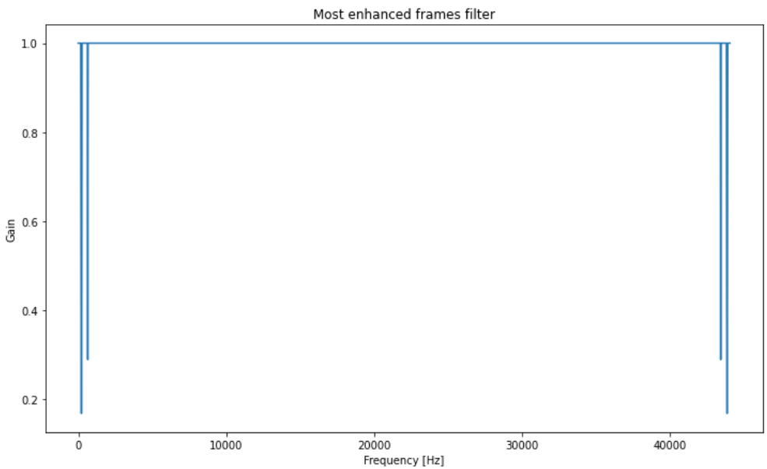
Methodology: Enhancement Rule Application
Signal Segmentation and FFT
Gain Estimation
Gain Inversion
Signal Filtering and IFFT
Reconstruct the Signal

Slide 14
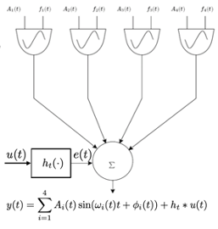
Methodology: Sinusoidal Oscillator
Sinusoidal Oscillator
Spectrum Resynthesizer
Frame-by-Frame Spectrum Resynthesis

Slide 15

Objectives of the project
STSA Implementation “by the book”
Suppression rules comparison
Process Inversion
Check quality of Sinusoidal Resynthesis
Notes:
.

Slide 16

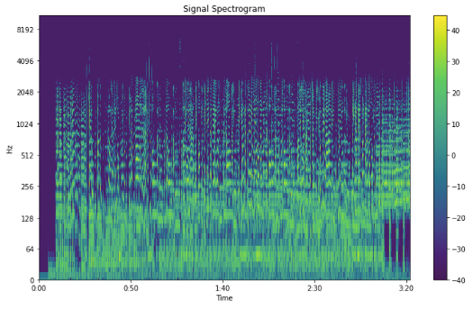

Results
Noisy Record
Clean Record

Slide 17
Results: Limitations
Difficult to analyze the results of STSA generally
STSA doesn’t reduce the noise present in sub-bands with signal components
Easier with a pure tone than a a wideband signal

Slide 18
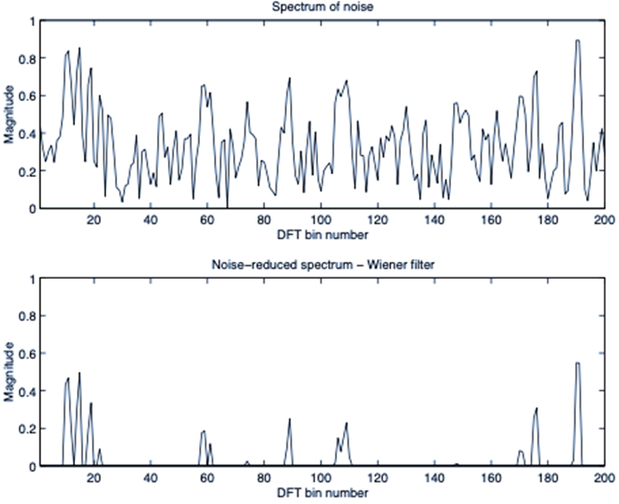
Results: Musical Noise
Remaining noise’s quality
Short-lived tones with randomly distributed frequencies
“Birdsong”

Slide 19
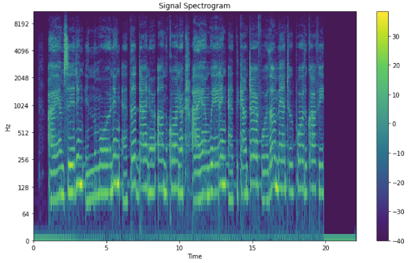
Results
Noisy Record
Clean Record

Slide 20

Results
Signals after the process have a clearly audible noise
Signals results to be also quite distorted
Frame-by-Frame Spectrum Resynthesis is Computationally Demanding

Slide 21
Conclusions and Further Recommendations
Better localize the frame that seems to have “uncorrelated Gaussian noise”
Make the algorithm Suppression-rule Adaptive (SNR?)
Try different Enhancement Rules instead of inverting Suppression ones
Try different types of synthesis

Slide 22
THANK YOU FOR YOUR ATTENTION!

