Slide 1
Introduction to Next-Generation Sequencing Technologies
Kris Holton
HMS Research Computing
Genetics 303qc

Slide 2

HMS Research Computing
Manage O2 High Performance Compute Cluster
Research Computing Consultants
Planning experiments
Analysis
Scaling/scripting
User Training
O2 for New/Orchestra users
R/Python/Perl/Matlab
Parallel Computing/Git and Github
NGS
Biostatistics
rchelp@hms.harvard.edu

Slide 3
Topics for today
Sequencers + Technology
HiSeq/MiSeq/NextSeq/IonTorrent/PacBio/NanoPore/Fluidigm
NGS Branches
DNA/ChIP/ATAC/Exome/RNA/miRNA/SingleCell/Drop/inDrop/10x/CLiP/Ribo/16s
Library Prep
Analysis
Options
Software
Experimental Design
Data Deposition

Slide 4

Sequencing Core
Two Illumina cBot stations
One Illumina HiSeq 2500 sequencer
Three Illumina MiSeq sequencers
Four Illumina NextSeq 500 sequencer
Single-cell: Fluidigm C1
Library prep service: IntegenX Apollo
Shearing: Covaris S2
QC: Agilent TapeStation, BioAnalyzer

Slide 5

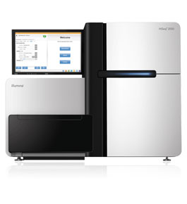
Illumina HiSeq 2500
Up to 2 x 250 reads (paired end)
Rapid Run or High Output
Single or Dual Flow Cell
Flow Cell: 8 lanes
Up to 1TB/run

Slide 6
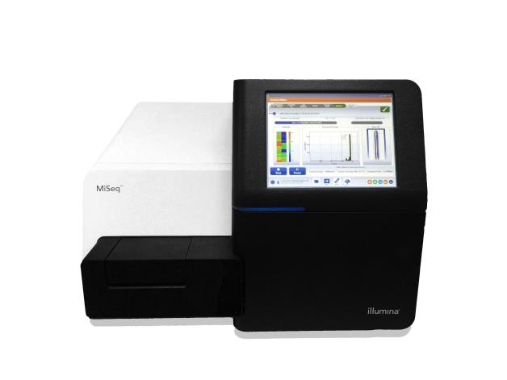
Illumina MiSeq
Targeted, small genome
2 x 300 reads (paired-end)
15GB output/run
Single flow cell
Single lane
Multiplex: up to 384 samples/run

Slide 7
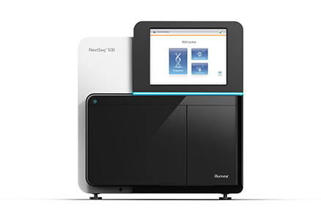
Illumina NextSeq 500
2 x 150 reads (paired end)
High Output/Mid Output
Up to 120GB/run
Single flow cell
4 lanes/flow cell

Slide 8
SBS: Sequencing By Synthesis
Video!

Slide 9

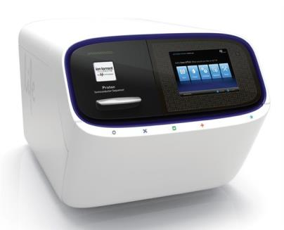
Ion Torrent
Semiconductor chip
Adding dNTP: release pyrophosphate + H⁺
Add single nucleotide, measure proton release
400 base read length
Homopolymers

Slide 10


PacBio
SMRT technology: Single Molecule, Real-Time
Long read lengths (circularized)
Zero-mode waveguides (illuminate well)
Labelled flurophores
“Movie” of sequence-by-synthesis

Slide 11

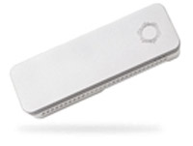
Oxford NanoPore
Biological or synthetic pores
Measure change in current through pore
Long read lengths (200KB)
Real Time
Portable (USB)
Application: any type of molecule

Slide 12
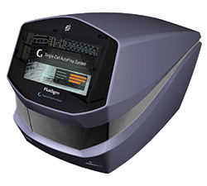
Fluidigm C1
Single cell isolation
Integrated fluidic circuit
Stain captured cells/visualize for viability, cell surface markers, reporter genes
Lyse for ‘seq

Slide 13
NGS Technology Variations

Slide 14
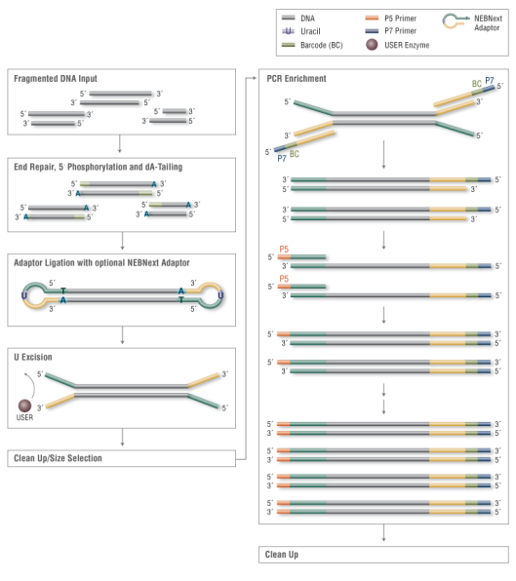
DNA-seq
New England Biolabs

Slide 15
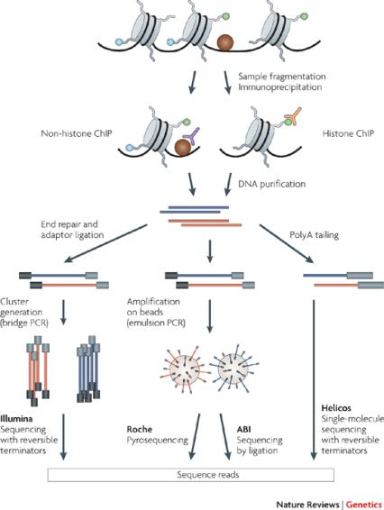
ChIP-seq
Peter J. Park, Nature 2009

Slide 16
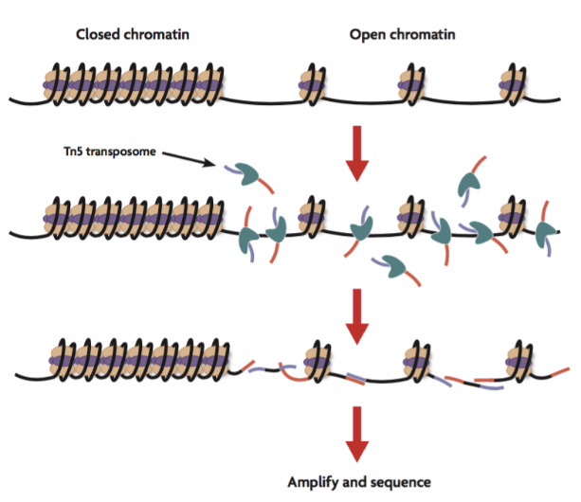
ATAC-seq
www.activemotif.com

Slide 17
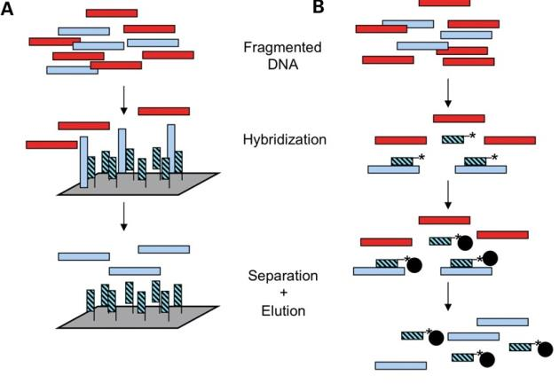
Exome Sequencing - Capture
Teer & Mullikin, Human Molecular Genetics 2010

Slide 18
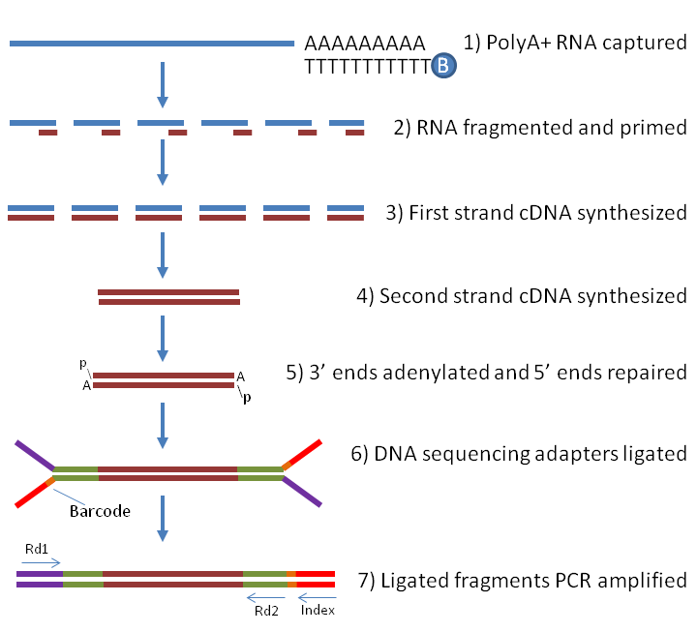
RNA-seq
Labome

Slide 19
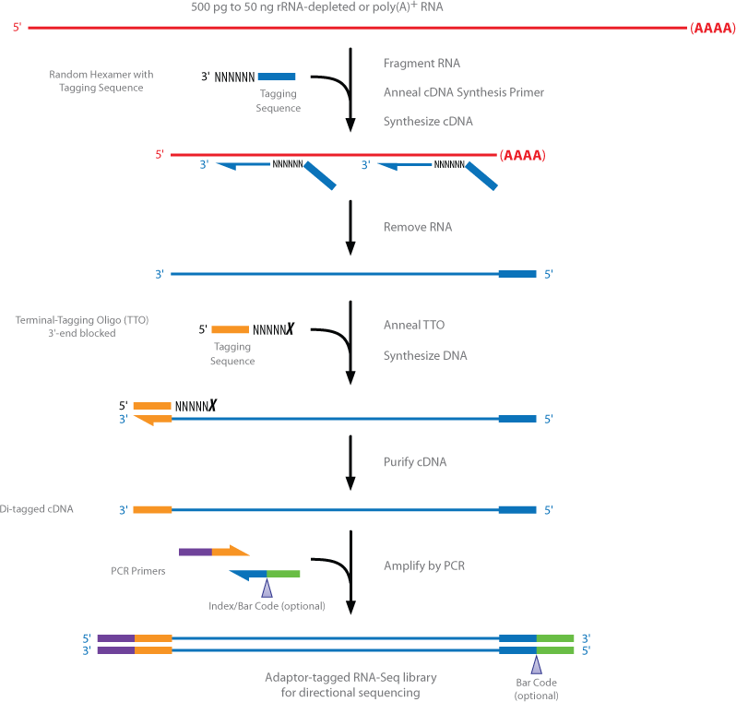
RNA-seq: strand-specific
Illumina

Slide 20
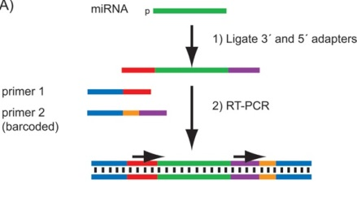
miRNA-seq
Head et al Biotechniques 2014

Slide 21
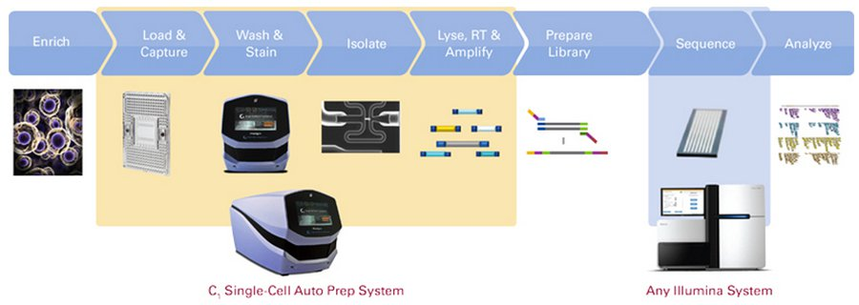
Single Cell RNA-seq

Slide 22
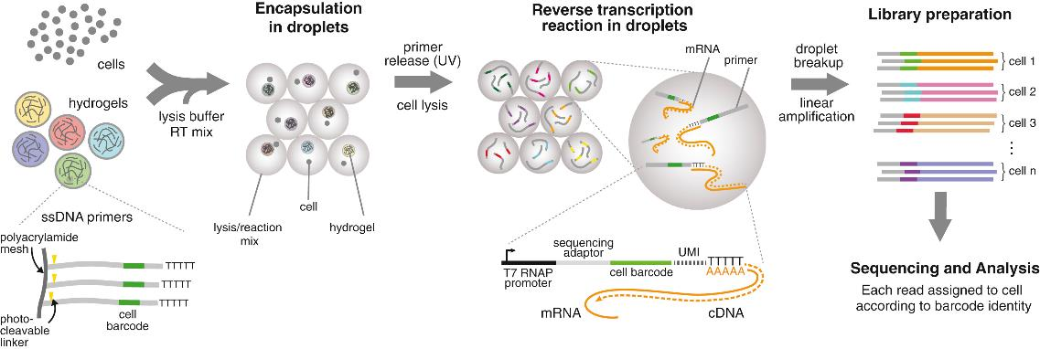
inDrop
Klein et al Cell 2015

Slide 23
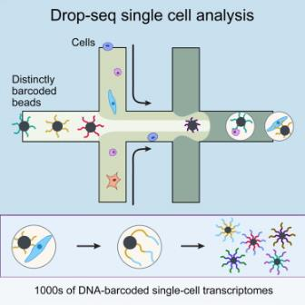
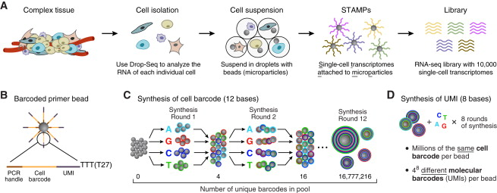
Drop-seq
Macosko et al., Cell, 2015

Slide 24
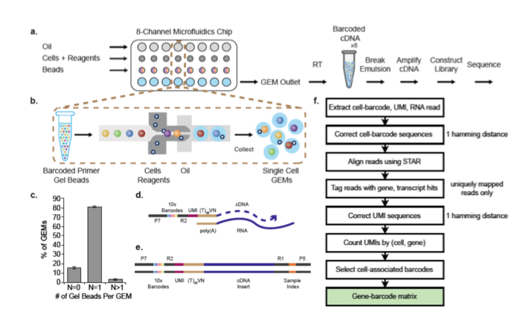
10x Genomics Single Cell
10x Genomics

Slide 25
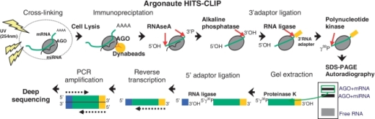
HITS-CLIP
Thomson et al Nucleic Acids Research 2011

Slide 26
CLIP-seq Approaches
HITS-CLIP: UV crosslinking + IP
PAR-CLIP: photoreactive ribonucleoside + UV crosslink + IP
iCLIP: 3’ exonuclease to crosslink

Slide 27
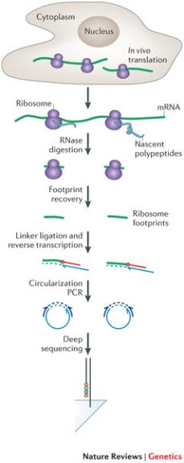
Ribo-seq
Ingolia, Nature 2014

Slide 28
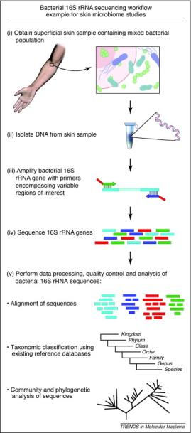
16s Amplicon Sequencing
Microbiome: study phylogeny and taxonomy
Based on rRNA
Ideal for MiSeq
Kong Science 2011

Slide 29
Library Prep
Service vs DIY Approach

Slide 30
Library Prep: Biopolymers
Bring DNA or RNA
Apollo Wafergen 324 Robot
Covaris S2
Hamilton Star Plus Robot
MJ Research Tetrad DNA Engine Thermal Cycler
Qiagen Qiagility Robot

Slide 31
Library Prep: Isolation
Mechanical
Organic
Solid-phase
QC check: TapeStation, BioAnalyzer, Qubit

Slide 32
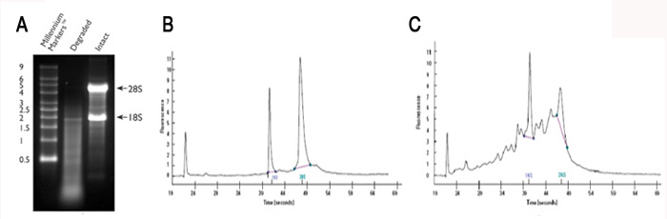
Library Prep: RNA QC
RNA-seqlopedia

Slide 33
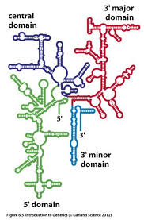
RNA Target Enrichment
Get rid of rRNA!
oligo-DT beads (pull down poly-A tail RNA only
rRNA depletion by hybridization
Ribominus, Ribo-Zero, GeneRead kits
www.mun.ca

Slide 34
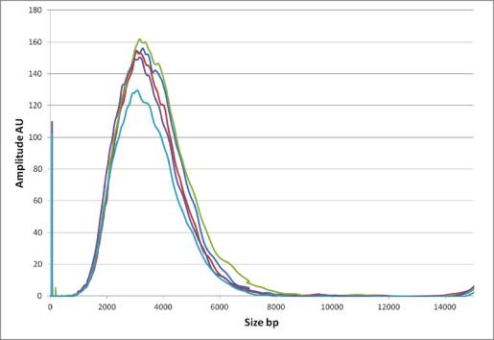
Fragmentation: DIY
Covaris hydroshearing (available at BioPolymers): uniform distribution
Heat
Ribonuclease
Sonication
Covaris

Slide 35
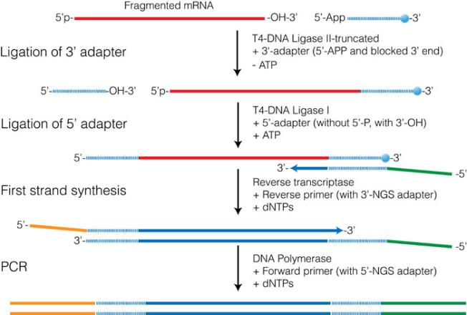
RNA-seq library prep
RNA-seqlopedia

Slide 36
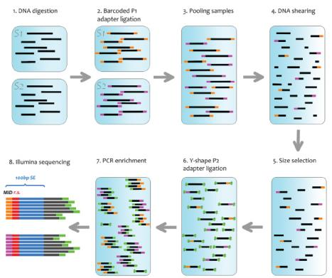
Multiplexing
Run more than 1 sample per lane in a flowcell
Attach barcodes with unique sequence IDs
Separate .fastq files created for each barcode
Purchase sets from Biopolymers
IDT DNA

Slide 37
Analysis

Slide 38

Analysis Options
HMS RC/O2 HPC environment
User Training courses
Consulting on individual experiments, from design to analysis
DIY
Pipelines
Free!
HCBC:
User Training courses (fee)
Consult (fee), comprehensive analysis

Slide 39

Galaxy
Graphical, web-based tool to analyze NGS
Front-end for popular tools like “Tuxedo” family
Create own cloud instance or use public servers
Limited in how much data can be uploaded
Not scalable

Slide 40
High Performance Computing for NGS
Spread computation over multiple cores with a large amount of allocated memory
Long runtimes
Large storage allocations
Some algorithms are linux-specific builds
Allows maximum customization of options
Automation of workflows
“Set it & forget it”

Slide 41
Analysis: Getting Started
Quality Control, Trimming

Slide 42
Quality Report: FastQC
Check the quality of sequence, identify issues
Quality score of bases along read length
Presence of barcode, adapter, repetitive sequence, kmers
GC content

Slide 43
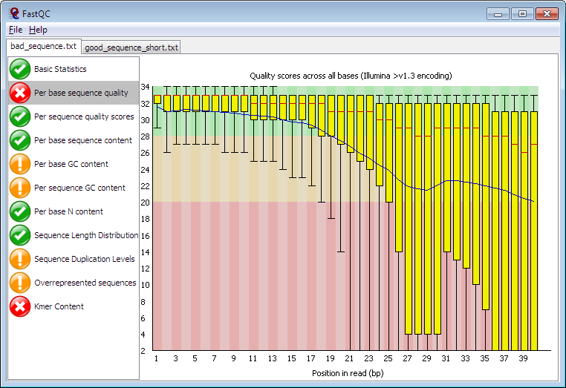
FastQC: Poor Sequence

Slide 44
Trimming: Adapter/Barcode Removal
Sequences won’t align well with too much of these!
Dynamic (based on sequence/quality) or blunt (remove X from 5’, Y from 3’)
O2 Options:
Cutadapt
Trimmomatic
PCR Duplicates
Picard MarkDuplicates
Samtools rmdup

Slide 45
Alignment

Slide 46
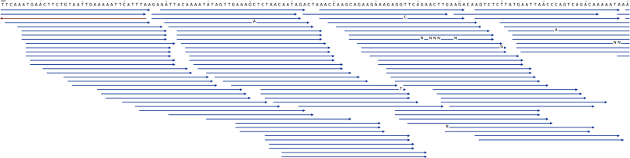
Aligners
Create BAM/SAM alignment file
bwa mem
blat
Bowtie1/2
Tophat2->HiSat2
Novoalign
STAR
Kallisto
seqan.readthedocs.org

Slide 47
What is an alignment index file?
Algorithm-specific way to parse a genome
Created from a .fasta file of the genome or transcriptome
O2: /n/groups/shared_databases
BWA
Blat
Bowtie1, 2
Hisat2
Novoalign
STAR
RSEM
kallisto

Slide 48
Alignment Considerations
Number of substitutions/deletions/additions
Gap length
Quality
Unique mapping of reads
Maximum number of mappings
Splicing/isoforms

Slide 49
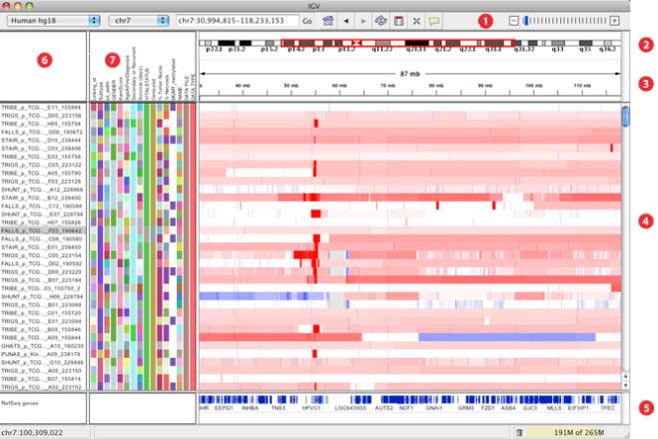
Genome Visualization: IGV
Broad – IGV

Slide 50
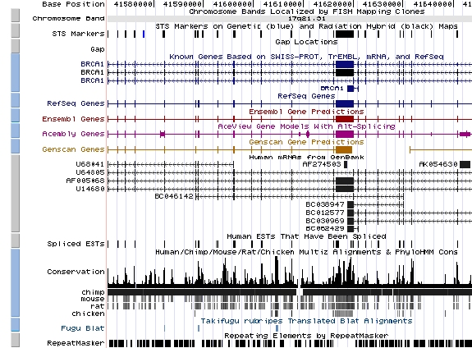
Genome Visualization: UCSC
UCSC

Slide 51
Analysis: After Alignment

Slide 52
DNA/Exome: Variant Callers/CNV
Genome Analysis Tool Kit (GATK)
VarScan2
MuTect
Breakdancer
CONTRA
CNVnator
Annotate: ANNOVAR

Slide 53

Peak Callers : ChIP, ATAC
SPP (R)
GEM
PeakSeq
MACS2
Differential: DiffBind (R)

Slide 54
Peak Callers: CLIP-seq
PARalyzer
dCLIP
CIMS

Slide 55
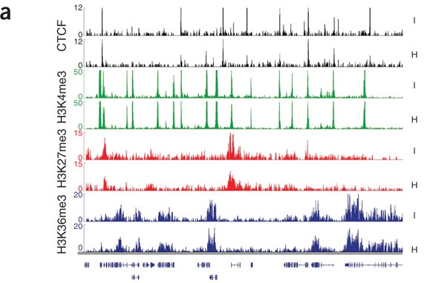
Peak Visualization
Goren et al Nature Methods 2010

Slide 56



Motif Analysis
HOMER
MEME/MAST
de Novo & Known Motifs

Slide 57
Differential Expression Analysis
DESeq2 (R - counts)
edgeR (R - counts)
baySeq (R - counts)
EBSeq (R - counts)
CuffDiff (Tuxedo suite –RC Pipeline)
RSEM (RC Pipeline)

Slide 58
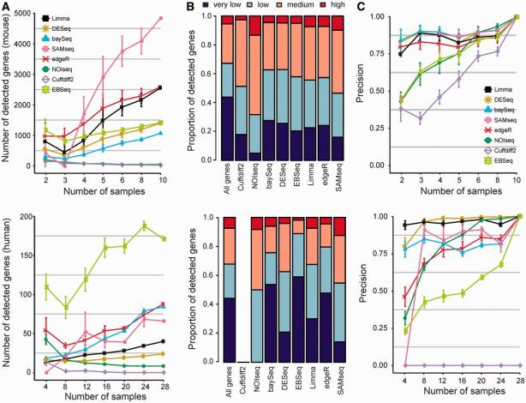
Comparing DE algorithms
Seyednasrollah et al Briefings in Bioinformatics 2013

Slide 59
Single Cell
scde (R)
Seurat (R)
Pagoda (R)
MAST (R)
Monocle (R)

Slide 60
Functional Enrichment Analysis
GOSeq (R)
Control for Gene Length
Query GO and KEGG
Metacore (Countway)
Pathway, Drug-rich vocabulary
Ingenuity (Countway)

Slide 61
Considerations

Slide 62
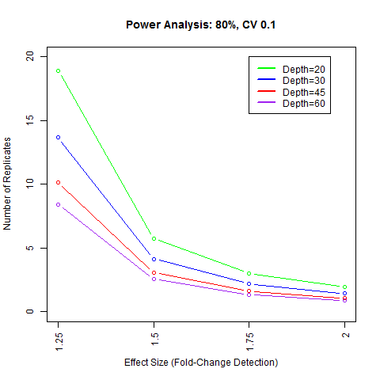
Power Calculation
Number of replicates needed
Sequencing depth
Statistical power determines ability to draw conclusions (refute the Null Hypothesis of “no difference”)

Slide 63
Experimental Design
Control variables
Biological Replicates
Cell prep: treatments & days matter
Mice: age, sex, isolate location, date of isolation, date of library prep
Talk to RC/HCBC: one conversation can save $$$ & headache!

Slide 64


Data Deposition
GEO (Gene Expression Omnibus)
Upload as SRA
Funding source may require data deposit
Don’t be a jailer!
Bild et al PLOS Biology 2014

Slide 65
For further questions
http://rc.hms.harvard.edu
rchelp@hms.harvard.edu
Office Hours: Wed 1-3p Gordon Hall 500

