Slide 1

Intro to R/Bioconductor HMS Research Computing
Fall 2018
Kris Holton

Slide 2
What can you do with R?
R is a statistical language
R is free!
Bioconductor - thousands of packages for your workflow
biomaRt - annotate samples
Heavy duty statistics!
Make plots!

Slide 3
Course Objectives
Learn to run R on O2
Gain familiarity with R language
Learn to import/export data
Simple Statistics/Plotting
Use case: heatmap

Slide 4
Notation
mfk8@compute-a:~$
O2 bash (your console/terminal)
>
In R (either personal computer or in O2 running R)
Blue content: try it out!

Slide 5

R on

Slide 6
R on O2
Open a high-memory R session – better than a desktop!
Log in to O2 with X11 enabled (important for graphics)
Mac: Xquartz installed, in console
ssh -XY user123@o2.hms.harvard.edu
Linux
ssh -XY user123@o2.hms.harvard.edu
Windows: MobaXterm has X11 client built-in
ssh -XY user123@o2.hms.harvard.edu

Slide 7
SLURM and O2
SLURM is how we interact with the cluster
Simple interactive session:
mfk8@login01:~$ srun --pty –p interactive –t 0-12:00 --mem 8G --x11 bash
(where 8G is memory requested)
Graphics: SSH Keys!
srun: add --x11
sbatch: add --x11=batch
Parallel/doParallel, BiocParallel, doMC libraries: run over multiple cores (-c up to 20 cores)
Rmpi, SNOW, doMPI: run R scripts over multiple nodes (>20 cores)

Slide 8
R Versions
mfk8@login01:~$ module spider R
Why does it matter what version of R you run?
Downstream packages may only work with certain versions of R.
How to load a version of R (“extra” recommended)
mfk8@login01:~$ module load gcc/6.2.0 R/version
Unloading R
module unload R/version
Starting R from an interactive (not login!)
mfk8@compute-a:~$ R

Slide 9
Managing your R packages on O2
It is best to manage your own R packages to work with the version of R you select. In doing so, there are no disruptions to your workflow.
Setting up your O2 R library (1 time, not in .bashrc)
mfk8@login01:~$ mkdir -p ~/R-version
mfk8@login01:~$ export R_LIBS_USER=“~/R-version”
mfk8@login01:~$ echo 'R_LIBS_USER="~/R-version”’> $HOME/.Renviron
If you must manually download a package (not through Bioconductor/CRAN etc), put the package in the set up location (/home/mfk8/R-version)
Accessing packages manually uploaded to your O2 R library (first time)
> install.packages("name-of-your-package“)

Slide 10
Installing Packages

Slide 11

Bioconductor
“Bioconductor provides tools for the analysis and comprehension of high-throughput genomic data.”
Fast, easy way to access packages.
Source Bioconductor: tells R to look at Bioconductor repository for packages
Top of script:
> source("http://bioconductor.org/biocLite.R") > biocLite()

Slide 12
Installing packages through Bioconductor
Available packages:
http://www.bioconductor.org/packages/release/BiocViews.html#___Software
Easy install of new packages:
> biocLite(“nameofpackage”) At the top of every R session using the package, it must be called via:
> library(“nameofpackage”)
Example:
> biocLite(“biomaRt”)
> library(“biomaRt”)

Slide 13
Installing packages through CRAN
CRAN is the Comprehensive R Archive Network
First time install of a package:
> install.packages(“name-of-package”)
(asks you to select a mirror: pick something from or near the country you’re in)
At the top of every R session using the package, the package must be called via: > library(“nameofpackage”)

Slide 14
Installing packages through Github
First, install devtools
> install.packages(‘devtools’)
> library(devtools)
Then, install_github repo/packages
> install_github(“repo/package”)

Slide 15
R documentation
General R help on a function
> ?name_of_function
> help(name_of_function)
Learn how to use your package (vignettes open in your web browser) > browseVignettes(package = "name_of_package")
> ?t.test

Slide 16
Setting your R “working directory”
Simplifies paths
What is your current WD?
> getwd()
Setting your WD:
> setwd(“path”)
An O2 example:
> setwd(“/home/mfk8/MyDataDirectory”)
A Mac example:
> setwd(“/Users/mfk8/MyDataDirectory”)
A Windows example (note forward slashes):
> setwd(“C:/Users/mfk8/My Documents/MyDataDirectory”)

Slide 17
R Basics:
To “print” in R Just type a variable or object’s name, R will display as much as it can
“Commenting” in R
# means what appears afterwards is not passed as an argument
Keep a file of your commands – anything from Sublime to Notepad++ to Google Drive notepad: have syntax highlighting
You can copy-paste multiple times, this overwrites.
Watch quotation marks (often introduced by Microsoft Word/Powerpoint): R gets fussy with certain smart quotes/fonts

Slide 18
Data Objects

Slide 19
How R Thinks: Variables
Assign variables with a <- (traditional) or = (new way)
A variable can be overwritten so be careful with naming
Names can be UPPER/lowercase/./_ mixes, but can’t start with a number
> myX <- 5
> myX
[1] 5

Slide 20
Data Type: Vectors
Basic way to store data
c stands for “concatenate”: put these together as a vector
> myvector <- c(3,5,7)
> myvector
[1] 3 5 7

Slide 21
Vectors Types
atomic: all the same data type
numeric:
> mynumeric <- c(3,5,7)
character:
> mycharacter <- c(“bob”, “nancy”, “jose”)
#note quotation marks “ “ (single or double fine, try to be consistent)
logical:
> mylogical <- c(TRUE, FALSE, TRUE)

Slide 22
Changing Your Vector Type
General workflow:
> variable <- as.type(variable)
> myvector <- as.character(myvector)
> myvector
[1] “3”, “5”, “7” #see how these are now in “ “ like a character vector
Applicable to changing between other types
Where this comes in handy: when R says you are trying to do an operation on your variable that is one type of vector, when it has to be another type. Use wisely.

Slide 23
Data Type: Lists
Like vectors with mixed data types (numeric, character, logical)
mylist <- c(3, “TP53”, FALSE)
“unlist”-ing a list tries to coerce the data to an atomic vector of all the same type (lowest common denominator, usually a character)

Slide 24
Data Type: Factors
Makes a vector nominal (able to be ordered by integers)
Create a variable “gender” with 2 "male" entries and 4 "female" entries
> gender <- c(rep("male", 2), rep("female", 4))
> gender <- factor(gender) # stores gender as 2 2’s and 4 1’s and associates
> gender
[1] male male female female female female
Levels: female male
Now 1=female, 2=male internally (alphabetically)
R now treats gender as a nominal variable

Slide 25
Data Type: Matrices
Data must be all the same type (numeric, character, logical)
Columns must have the same length
Creation:
> mymatrix <- matrix(c(1:6), nrow=3, ncol=2)
Indexed by [row,column]
> mymatrix[1,1] #returns item in row 1, column 1
> mymatrix[1,] #returns all of row 1
> mymatrix[,1] #returns all of column 1

Slide 26
Data Type : Data Frames
Subset of matrices allowing mixed types (numeric, character, logical): lists!
> mydataframe<-as.data.frame(mymatrix)
You can give columns names so you can index by them
> names(mydataframe) <- c(“column1name”, “column2name”)
You can use unique identifiers as rownames (no repeats!)
> row.names(mydataframe)<-mydataframe[,1]

Slide 27
Dataframes: Indexing/Converting
Can use matrix or $ notation
> mydataframe$column1name #works on column1
> mydataframe[,1] #works on column1
> mydataframe[“rowname1”,] #works on rowname1
> mydataframe[1,] #works on row 1
> mydataframe[-1,] #excludes row 1
To make a data frame into a matrix for certain operations:
> mymatrix <- as.matrix(mydataframe) #turns data into all the same type (lowest common denominator is usually character)

Slide 28
Dataframes: indexing shortcut
“attach” makes names of lists/dataframes accessible without $
> attach(mydataframe)
“detach” when finished
> detach(mydataframe)

Slide 29
Adding and joining rows/columns
“rbind” to add a row or another df/matrix to a pre-existing dataframe/maxtrix
> mymatrix <- rbind(mymatrix, newrow)
> mymatrix <- rbind(mymatrix, matrixtwo)
“cbind” to add a column or another df/matrix to a pre-existing dataframe/matrix
> mymatrix <- cbind(mymatrix, newcol)
> mymatrix <- cbind(mymatrix, matrixtwo)

Slide 30
Useful functions:
> class(object) #gives object class
> mode(object) #gives object type
> length(vector) #gives length
> dim(object) #gives matrix/dataframe dimensions
> nrow(object) #gives number of rows
> ncol(object) #gives number of columns
> str(object) #gives object structure
> head(object) #gives first 6 rows
> tail(object) #gives last 6 rows
> summary() #quick statistics

Slide 31
Missing Values
Placeholders
NA: Not Available
NaN: Not a Number
is.na(x) is a logical test for NA/NaN
is.nan(x) is a logical test for only NaN
x[!is.na(x)] subsets and excludes NAs

Slide 32
Doing Math

Slide 33
Simple Arithmetic
> 18 + 22 #addition
> 18 – 12 #subtraction
> 18 * 2 #multiplication
> 18 / 2 #division
> 18 %/% 4 #integer part of quotient
> 18 %% 4 #modulo (remainder)
> 18 ^ 2 #exponent

Slide 34
Built-in math functions
> log(10) #natural log (base e)
> exp(2.302585) #antilog (e raised to power)
> log10(100) #log base 10
> sqrt(88) #square root
> factorial(8) #factorial
> choose(12, 8) #combinations (binomial coefficients)
> round(log(10), digits=3) #round to specified digits
> runif(5) #number of random numbers between 0-1
> rnorm(5) #random numbers from uniform normal distribution
> abs(18 / -12) #absolute value

Slide 35
Built-in math functions 2
> max(object) # max
> min(object) #min
> sum(object) #sum
> mean(object) #mean
> median(object) #median
> range(object) #range
> var(object) #variance
> sd(object) #standard deviation
> length(object) #number of values

Slide 36
Series Shortcuts
Series: colon or “seq”
> 10:1
> seq(from, to, by)
> seq(1, 10, 2) # gives odd numbers
Repeat
> rep(what, times)
> rep(10, 10)

Slide 37
Logical Operations: < > =
Test of condition: returns logical TRUE/FALSE
> test1<- c(1,2,3)
> test1 > 2
[1] FALSE FALSE TRUE
> test1 >= 2
[1] FALSE TRUE TRUE
> which(test1 >= 2)
[1] 2 3
> test1[test1 >=2] #subsetting data based on equality condition
> any(test1 >=5) #FALSE
> all(test1 >=5) #FALSE

Slide 38
Control Structures

Slide 39
“for” loops
Way to iterate over data
R sometimes breaks with complicated “for” “if” “else” loops
> myvector <- c(1,3,5)
> j <- NULL #initialize it, good practice
> newvector <- NULL #initialize it, good practice
> for (i in myvector) {
j <- i + 20
newvector <- c(newvector, j)
}
> newvector

Slide 40
Functions
Way to pack up commands into a repeatable format
> five = 5
> three = 3
> myfunction <- function(x,y) {
z = x + y
return(z) #what output is seen outside of function
}
> myfunction(five,three)
[1] 8
> myanswer <- myfunction(five, three); myanswer
[1] 8

Slide 41
Lambda-like functions
“Anonymous” in-place functions
Call function on some variable, and use that variable in the calculations
> (function (x) x^2)
> plot(function (x) x^2)

Slide 42
Apply
Returns an object based on applying a function to a dataframe or matrix or list
Format: apply (to_what, how, function)
“1” is to apply over rows, “2” is to apply over columns
> mymatrix <- apply(mymatrix, 1, function)
> mymatrix <- apply(mymatrix, 2, function)
> apply(mymatrix, 1, sum) #row sums
> apply(mymatrix, 2, sum) #column sums

Slide 43
Variations on apply
sapply: (to_what, function) returns a vector
> sapply(1:3, function(x) x^2)
[1] 1 4 9
lapply: (to_what, function): returns a list
> lapply(1:3, function(x) x^2)
[[1]]
[1] 1
[[2]]
[1] 4
[[3]]
[1] 9

Slide 44
More applies
mapply (multivariate): pass more arguments
> mapply(function, arguments, MoreArgs=X)
by: factors
> by(data, factor, function)
replicate: repeat
> replicate(repetitions, function(data))
Also tapply, eapply, rapply, vapply
Useful packages: plyr, dplyr

Slide 45
Importing Data

Slide 46
Importing Data: text file
You can specify how your data is separated (comma separated: “,” tab: “\t” space: ” “), and if the first row is a “header” row containing the column names)
mydata <- read.table(file=”PathToFile/filename.csv”, header=TRUE, sep=”,”)
add “row.names=1 to make column 1 the rownames (only if these are unique identifiers!)
stringAsFactors=FALSE converts all strings to characters

Slide 47
Importing Data from MS Excel
Read in the first worksheet from the workbook myexcel.xlsx
First row contains variable (column) names
> library(xlsx) #install the first time from CRAN
> mydata <- read.xlsx("c:/myexcel.xlsx", 1)
Read in the worksheet named mysheet
> mydata <- read.xlsx("c:/myexcel.xlsx", sheetName = "mysheet")

Slide 48
Importing Data from SPSS
In SPSS: save SPSS dataset in transport format
get file='c:\mydata.sav'.
export outfile='c:\mydata.por'.
in R
> library(Hmisc) #install the first time from CRAN
> mydata <- spss.get("c:/mydata.por", use.value.labels=TRUE)
# last option converts value labels to R factors

Slide 49
Importing Data from SAS
In SAS: save SAS dataset in transport format
libname out xport 'c:/mydata.xpt';
data out.mydata;
set sasuser.mydata;
run;
In R
> library(Hmisc) #install the first time from CRAN
> mydata <- sasxport.get("c:/mydata.xpt")
# character variables are converted to R factors

Slide 50
Importing Data from STATA
In R: input Systat file
> library(foreign) #install the first time from CRAN
> mydata <- read.systat("c:/mydata.dta")

Slide 51
Exporting Data
Easy way to export a variable (vector, dataframe, matrix, etc):
> write.table(nameofvariable, file=“path/nameoffile.tsv”, sep=“\t”) #sep=“,” or “ “ etc
Add
row.names=FALSE #turn off row names
col.names=FALSE #turn off column names
col.names=NA #Excel-like readability
quote=FALSE #turn off character string quoting

Slide 52
Saving your workspace
Save and pick up where you leave off – saves variables
> save.image()
> save(object list, file=”mysaves.RData”)
Loading workspaces
> load(“mysaves.RData”)

Slide 53
Class Example

Slide 54
Class Example
Download class data and R script to a folder from
http://hmsrc.me/rclassfiles
Set your working directory to the folder where your data is
> setwd(“pathtofolder/note/forward/slashes”)
A Mac example:
> setwd(“/Users/mfk8/Downloads”)
A Windows example (note forward slashes):
> setwd(“C:/Users/mfk8/Downloads”)

Slide 55
Class Sample – Import Data
Import Rcoursetestdata1.csv as data frame, with headers and row names > mydf <- read.table(“Rcoursetestdata1.csv", header=TRUE, row.names=1, sep=",")
> head(mydf)
TNBC1 TNBC2 TNBC3 Normal1 Normal2 Normal3
ENSG00000008988 15258 15077 144720 12095 43544 46883
ENSG00000009307 14660 20767 8678 13774 23030 18917
ENSG00000019582 50866 55775 15089 6696 13754 86319
ENSG00000026025 21174 47966 26682 6068 21126 12728
ENSG00000034510 25645 31574 56403 29590 25216 37199
ENSG00000044574 23910 27200 13757 13364 10852 12378

Slide 56
Class Sample - Continued
Get basic statistics on mydf
> summary(mydf)
TNBC1 TNBC2 TNBC3 Normal1
Min. : 0 Min. : 65 Min. : 31 Min. : 22
1st Qu.: 7888 1st Qu.: 9538 1st Qu.: 9324 1st Qu.: 5074
Median : 13034 Median : 16568 Median : 19108 Median :10869
Mean : 18596 Mean : 26036 Mean : 25646 Mean :14746
3rd Qu.: 23850 3rd Qu.: 28194 3rd Qu.: 30389 3rd Qu.:18866
Max. :103007 Max. :351603 Max. :272582 Max. :89837
Normal2 Normal3
Min. : 208 Min. : 15
1st Qu.: 7124 1st Qu.: 8944
Median : 14005 Median : 17710
Mean : 19425 Mean : 25481
3rd Qu.: 21576 3rd Qu.: 32191
Max. :212582 Max. :244692

Slide 57
Class Sample – Transposing Data
Need your data to read the other way? Turn it into a matrix, and transpose!
> mymatrix <- as.matrix(mydf)
> myTmatrix<- t(mymatrix) #t = transpose
> myTdf <- as.data.frame(myTmatrix) #makes a data frame again
> myTdf
ENSG00000008988 ENSG00000009307 ENSG00000019582 ENSG00000026025
TNBC1 15258 14660 50866 21174
TNBC2 15077 20767 55775 47966
TNBC3 144720 8678 15089 26682
Normal1 12095 13774 6696 6068
Normal2 43544 23030 13754 21126
Normal3 46883 18917 86319 12728

Slide 58
Class Example – Data Ops Cont’d
Get basic statistics on transposed data frame
> summary(myTdf)
ENSG00000008988 ENSG00000009307 ENSG00000019582 ENSG00000026025
Min. : 12095 Min. : 8678 Min. : 6696 Min. : 6068
1st Qu.: 15122 1st Qu.:13996 1st Qu.:14088 1st Qu.:14828
Median : 29401 Median :16789 Median :32978 Median :21150
Mean : 46263 Mean :16638 Mean :38083 Mean :22624
3rd Qu.: 46048 3rd Qu.:20305 3rd Qu.:54548 3rd Qu.:25305
Max. :144720 Max. :23030 Max. :86319 Max. :47966

Slide 59
Class Example: Simple t-test
Do a t-test on TNBC and Normal from mydf
> t.test(mydf[,1:3], mydf[,4:6])
Welch Two Sample t-test
data: mydf[, 1:3] and mydf[, 4:6]
t = 2.3053, df = 1168.9, p-value = 0.02132
alternative hypothesis: true difference in means is not equal to 0
95 percent confidence interval:
527.5122 6556.6411
sample estimates:
mean of x mean of y
23426.08 19884.01

Slide 60
Class Example: Simple Wilcoxon
wilcox.test(mymatrix[,1:3], mymatrix[,4:6])
Wilcoxon rank sum test with continuity correction
data: mymatrix[, 1:3] and mymatrix[, 4:6]
W = 199820, p-value = 0.0009604
alternative hypothesis: true location shift is not equal to 0

Slide 61
Class Example: Linear Modelling
model<-lm(y ~ x1 + x2 …, data=data)
> mymodel <- lm(TNBC1 ~ Normal1, data=mydf)
> anova(mymodel)
Analysis of Variance Table
Response: TNBC1
Df Sum Sq Mean Sq F value Pr(>F)
Normal1 1 5.4597e+09 5459744483 20.215 1.177e-05 ***
Residuals 198 5.3477e+10 270084874
---
Signif. codes: 0 ‘***’ 0.001 ‘**’ 0.01 ‘*’ 0.05 ‘.’ 0.1 ‘ ’ 1

Slide 62
Class Sample: Practical Plotting

Slide 63
Saving plots
Use “File->”save as” or,
Open up a plot file (png, pdf, jpeg, tiff, bmp)
> png(file=“nameyourfile.png”)
Make your plot
> plot()
Turn plot off
> dev.off()

Slide 64
Plotting Options
main = “Title” #title
xlab= “x label” #x-axis label
ylab=“y label” #y-axis label
xlim(N,N) #x-axis start, stop
ylim(N,N) #y-axis start, stop
col =c(“color1”, “color2”) #vector with colors
lty = c(N, N) #line type
lwd= c(N, N) #line width
cex = N #size of text and symbols
pch = N #plot point symbol type
par(mfrow(x,y)) #multiple figures in one plot

Slide 65
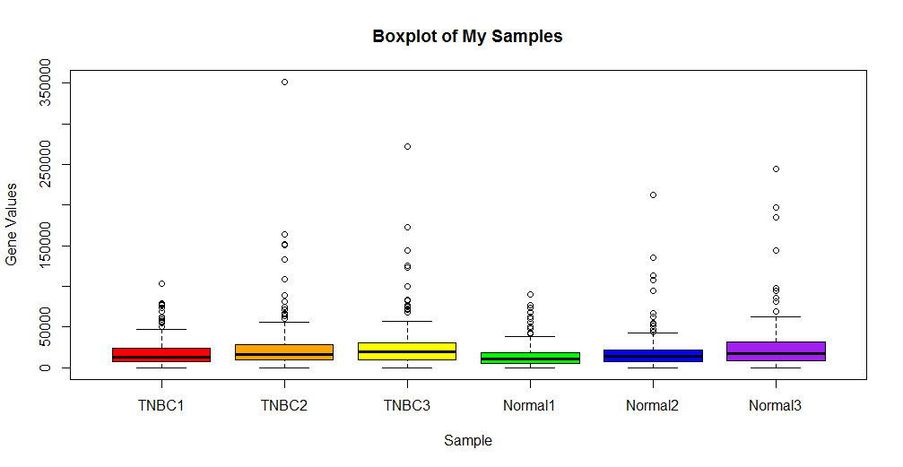
Class Example – Boxplot of Samples
Boxplot of Samples
> boxplot(mydf, main=”Boxplot of My Samples”, xlab=”Sample”, ylab=”Gene Values”)

Slide 66
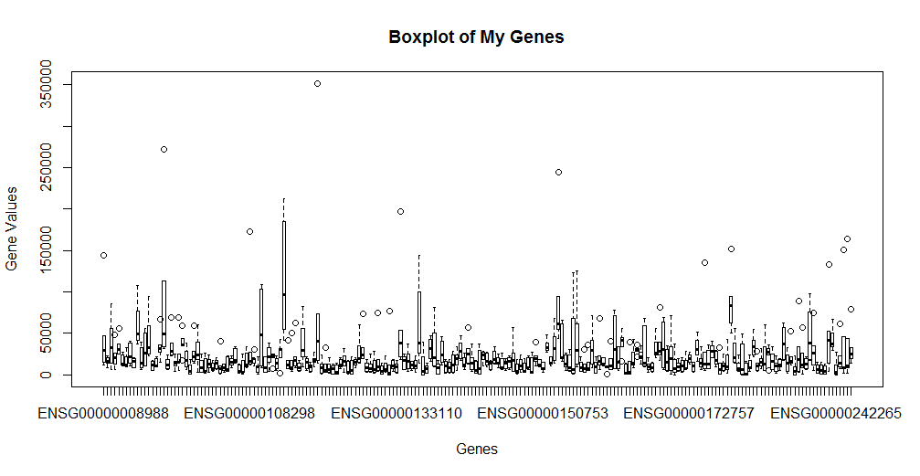
Class Example – Boxplot of Genes
Boxplot of Genes
> boxplot(myTdf, main=”Boxplot of My Genes”, xlab=”Gene”, ylab=”Gene Values”)

Slide 67
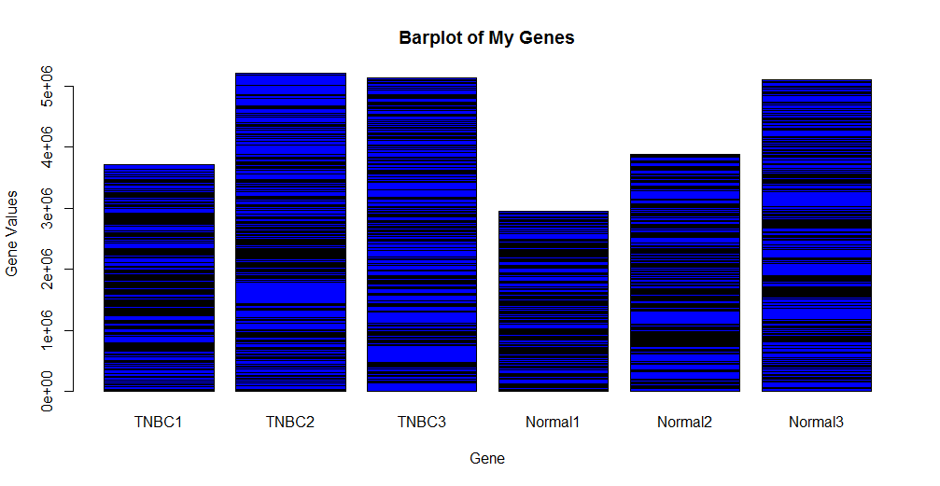
Class Example – Barplot of Genes
Barplot of Genes #barplot needs a matrix
> barplot(myTmatrix, main=”Barplot of My Genes”, xlab=”Gene”, ylab=”Sample Values”)

Slide 68
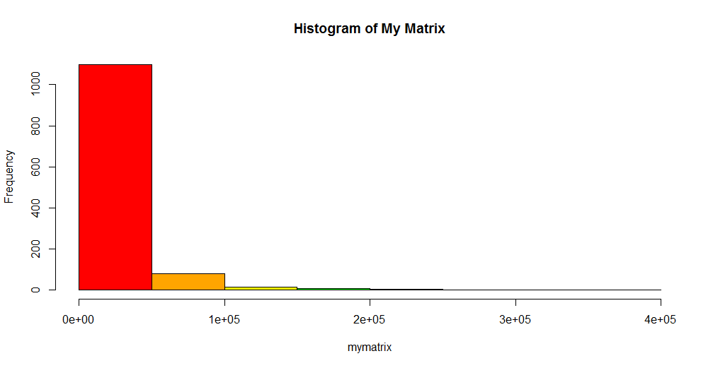
Class Example – Histogram of Values
Plot a histogram of the frequency of values in mymatrix
>hist(mymatrix)

Slide 69
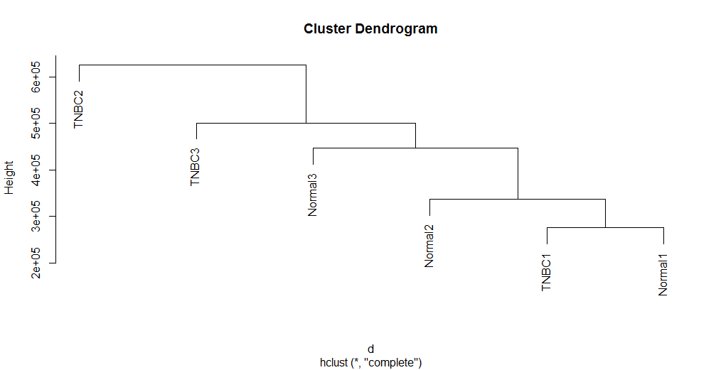
Class Example - HCL
Do hierarchical clustering of samples
> d <- dist(myTmatrix) #takes matrix as input, calculates distance
> hc <- hclust(d) #performs HCL on distance matrix
> plot(hc)

Slide 70
Class Sample – Line Graphs
#start a line plot with ENSG00000008988 "b" means both points and lines
> plot(myTdf$ENSG00000008988, type="b", col="green", ylim=c(10000,150000), main="Gene Values Over Samples", xlab="Sample", ylab="Gene Values")
#add a new line for ENSG00000009307 "lines" adds a line to the current plot
> lines(myTdf$ENSG00000009307, type="b", col = "blue")
#add a new line for ENSG00000019582
> lines(myTdf$ENSG00000019582, type="b", col="red")

Slide 71
Class Sample – Line Graphs Legend
> legend(5, 140000, #positions x, y
c("TPS20", "CSDE1", "CD74"), #line names
lty=c(1,1), #specifies lines
lwd=c(2.5,2.5), #specifies line width
col=c("green", "blue", "red") #add colors
) #ends legend

Slide 72
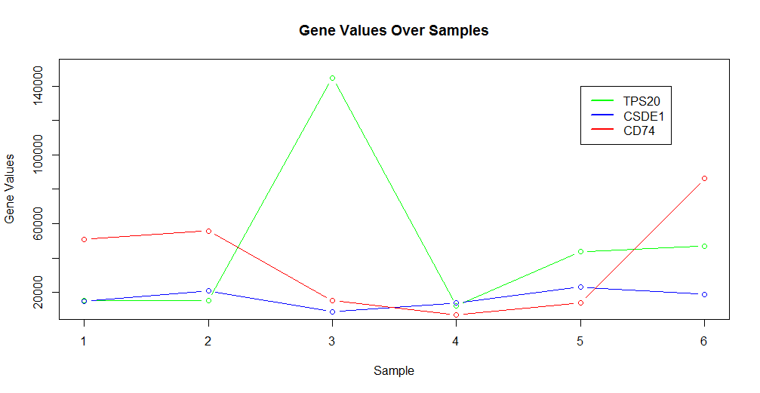
Class Sample – Line Graphs

Slide 73
Class Example – Count Data
Import count data
> mytable<-read.table(“Rcoursetestdata2.csv", header=T, row.names=1, sep=",")
> mytable
neversmoke smoke pastsmoke gender
1 0 1 0 male
2 0 1 0 female
3 0 0 0 male
4 1 0 0 female
5 0 0 1 male
6 0 1 0 female
7 0 0 1 male
8 0 0 1 female
9 1 0 0 male
10 0 0 1 female

Slide 74
Class Example – Count Data Cont’d
Get summary statistic on mytable
> summary(mytable)
> summary(mytable)
neversmoke smoke pastsmoke gender
Min. :0.0 Min. :0.00 Min. :0.0 female:5
1st Qu.:0.0 1st Qu.:0.00 1st Qu.:0.0 male :5
Median :0.0 Median :0.00 Median :0.0
Mean :0.2 Mean :0.30 Mean :0.4
3rd Qu.:0.0 3rd Qu.:0.75 3rd Qu.:1.0
Max. :1.0 Max. :1.00 Max. :1.0
>

Slide 75
Class Example – Tables Cont’d
Take a subset of a table to do statistics on
> genderVsmoke <- table(mytable$gender, mytable$smoke)
> genderVsmoke
0 1
female 3 2
male 4 1

Slide 76
Class Example – Tables Cont’d
summary(genderVsmoke) does a Chi Square Test of Independence
> summary(genderVsmoke)
Number of cases in table: 10
Number of factors: 2
Test for independence of all factors:
Chisq = 0.4762, df = 1, p-value = 0.4902
Chi-squared approximation may be incorrect

Slide 77
Class Example – Tables Cont’d
Get the frequencies of a table via prop.table
> propgenderVsmoke <- prop.table(genderVsmoke)
> propgenderVsmoke
0 1
female 0.3 0.2
male 0.4 0.1

Slide 78
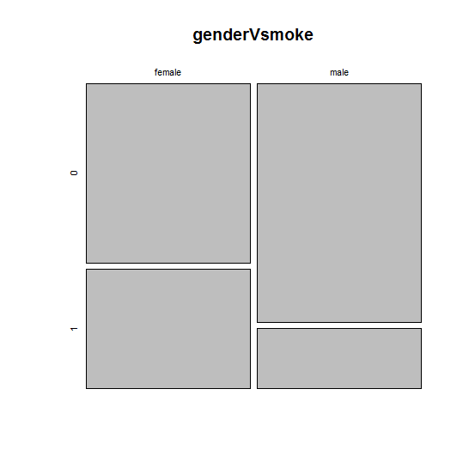
Class Example – Plotting Tables
Do a mosaicplot of table genderVsmoke
> mosaicplot(genderVsmoke)

Slide 79
Bonus Plot: Heatmap
Try installing packages “gplots” and “RColorBrewer”
> install.packages(“gplots”, “RColorBrewer”)
Call the libraries
> library(“gplots”)
> library(“RColorBrewer”)
Check out the code!

Slide 80
Useful R packages
“RColorBrewer” and “Viridis” – define colors and pallets
“gplots” and “ggplots2” – great for plotting
“genefilter” – useful to apply filters over matrices
“plyr” and “dplyr” – advanced matrix/df operations
“edgeR” and “DESeq2” – RNAseq differential analysis alternatives using count data as input
“biomaRt” – cross-annotate samples

Slide 81

RStudio
Feature-rich GUI for R, works on top of version of R installed
RMarkdown, Rshinyapps
Not optimized for multithreading
Good for proofing code, but not a scalable solution for HPC
Not currently available as an O2, but under consideration as a standalone service accessing O2 filesystems

Slide 82
Contact Information
HMS Research Computing
rchelp@hms.harvard.edu
Office Hours Wed 1-3p 500 Gordon Hall
http://rc.hms.harvard.edu/

