Slide 1
Magista is not a suitable partner for Eniac
Low tech product portfolio
Low value products
Long delivery time

Slide 2
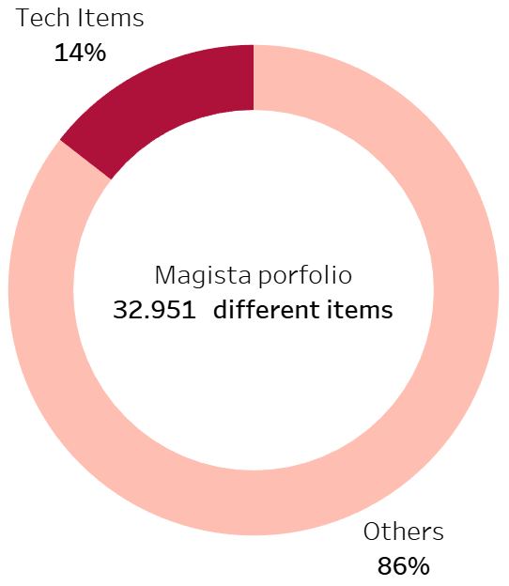
Magista does not focus on tech products
Items grouped as Tech
Computers
Computers accessories
Electronics
Fixed telephony
Tablets printing image
Telephony
Watches gifts

Slide 3
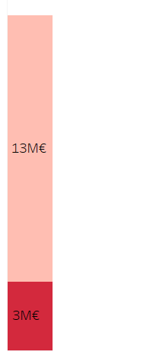
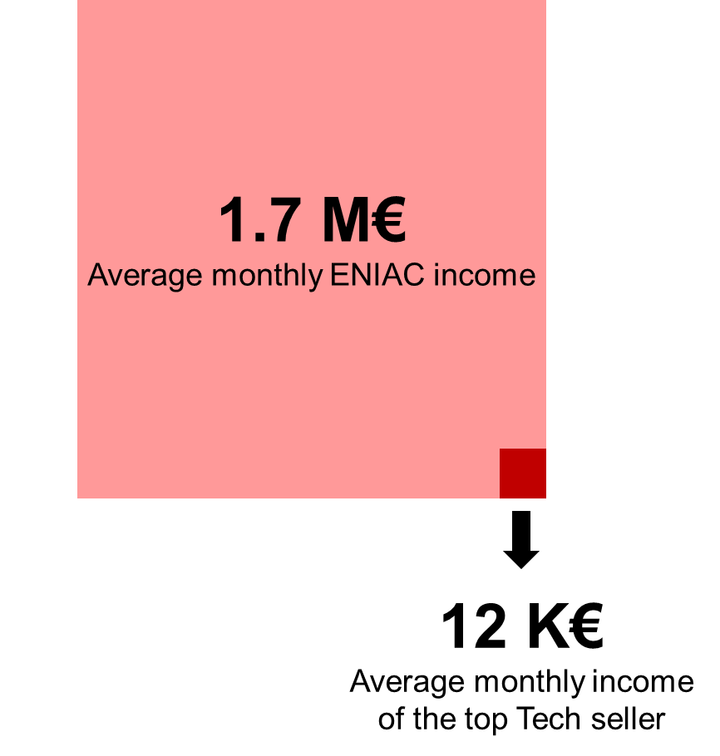
The revenue of tech products represents a low percentage of Magistas sales
Tech Items 18%
Total revenue

Slide 4
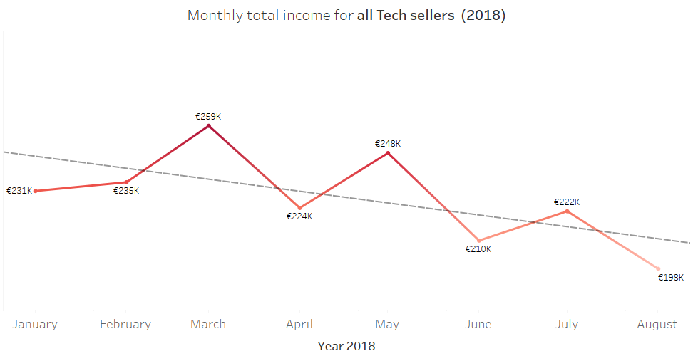
The total monthly revenue of all Tech sellers represents a 15% of ENIAC revenue
Revenue of Tech products

Slide 5
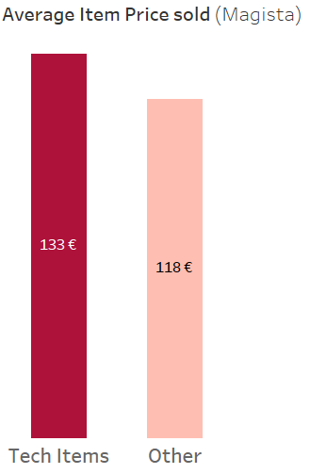
Magista works with Low-value products
514 €
Avg. Item price Eniac

Slide 6
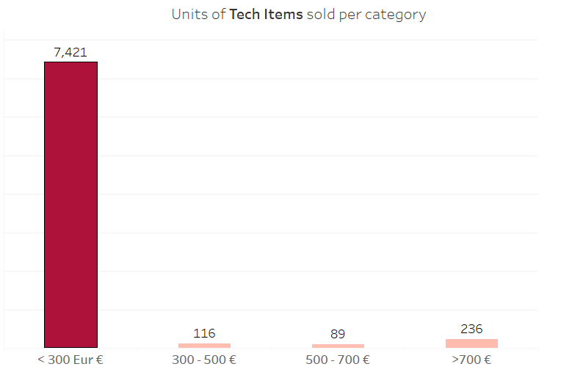
Magista works with Low-value products
95%
Of Tech related sold units are Low value products
Operative issues
High discard rates expected
Lower standards

Slide 7
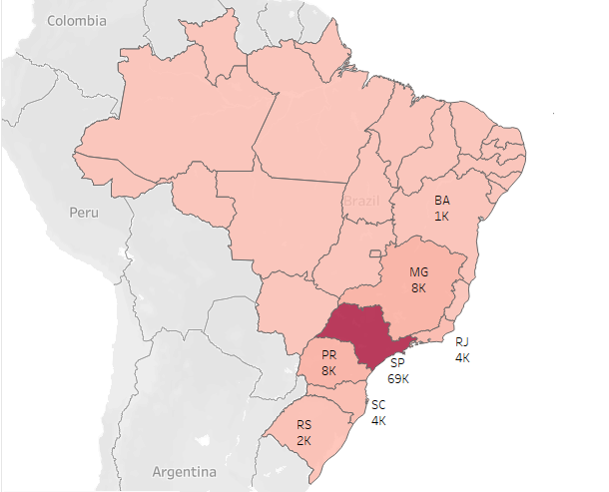
Magista does not reach the whole Brazil on time
99K Orders
Total Orders sold (2016-2018)
70% in São Paulo
98% in SE-Region

Slide 8
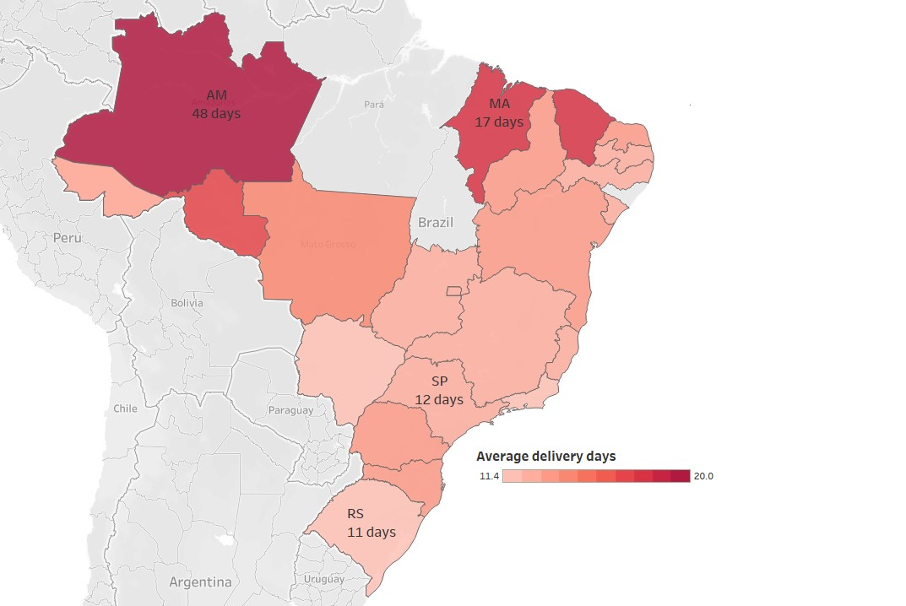
Magista does not reach the whole Brazil on time
Average delivery time of Magista:12 days
(Up to 50 days in some regions)
AVG delivery time from Apple/br
- 1-2 days in São Paulo
- 5-7 days in Amazonas
- 8-10 days in Maranhão
12 days
Average delivery times for Magista
10 days
MAX. delivery time for Apple(BR)

