Slide 1
ENERGY REPORT
Automatic exploration of energy consumption timeseries Roberto Chiosa

Slide 2
OVERVIEW

Slide 3
Introduction
Why do we need data exploration?
Data exploration is necessary to understand something

Slide 4
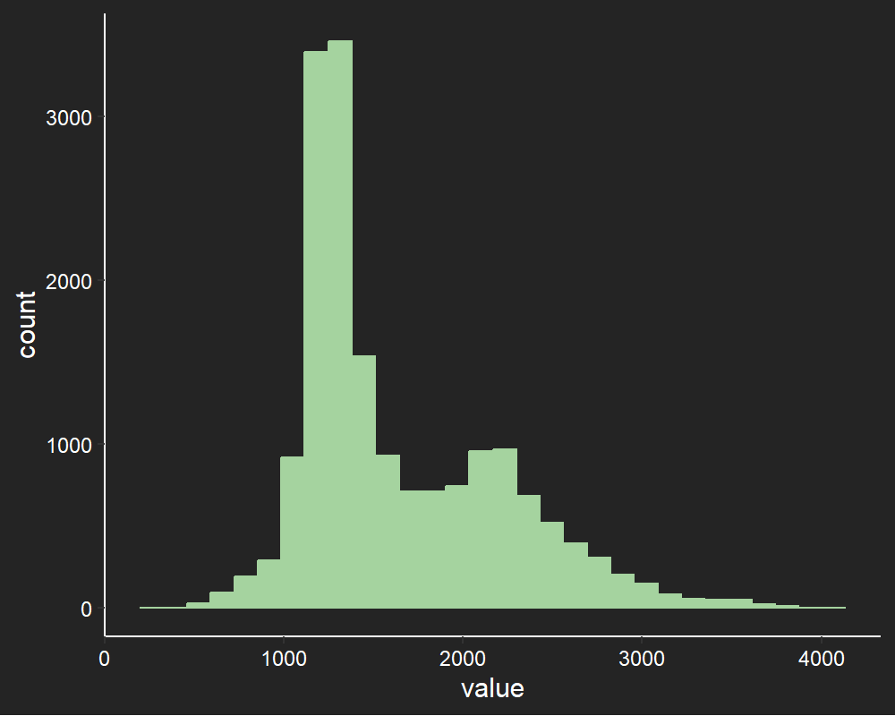
value Histogram
This slide is describing in details the column value.
Minimum value 211 kW
Maximum value 4019 kW

Slide 5
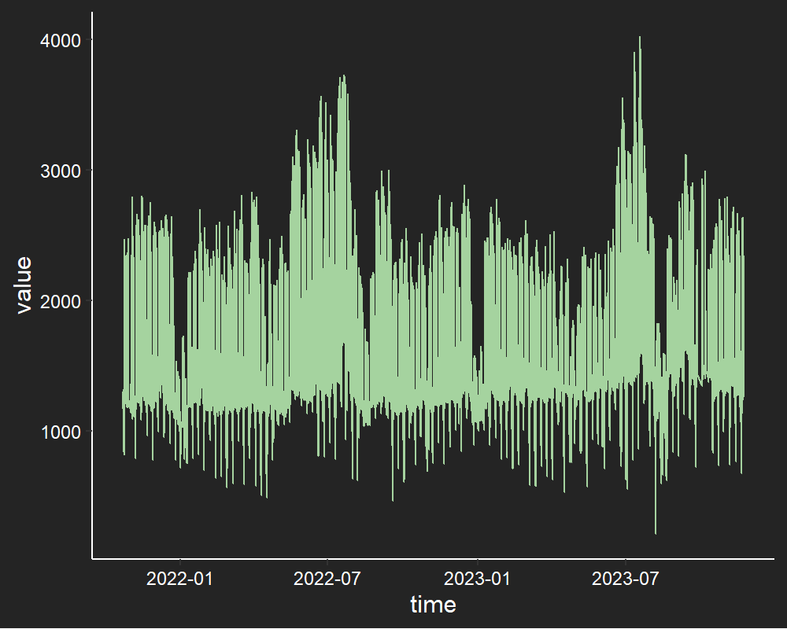
value Line Plot
This slide is describing in details the column value.
Minimum value 211 kW
Maximum value 4019 kW

