Slide 1
CRYPTO REPORT
Overview of the principal cryptocurrency on the market, automatically generated by RMarkdown Roberto Chiosa

Slide 2
OVERVIEW

Slide 3
Bitcoin
One column master slide
ciao

Slide 4
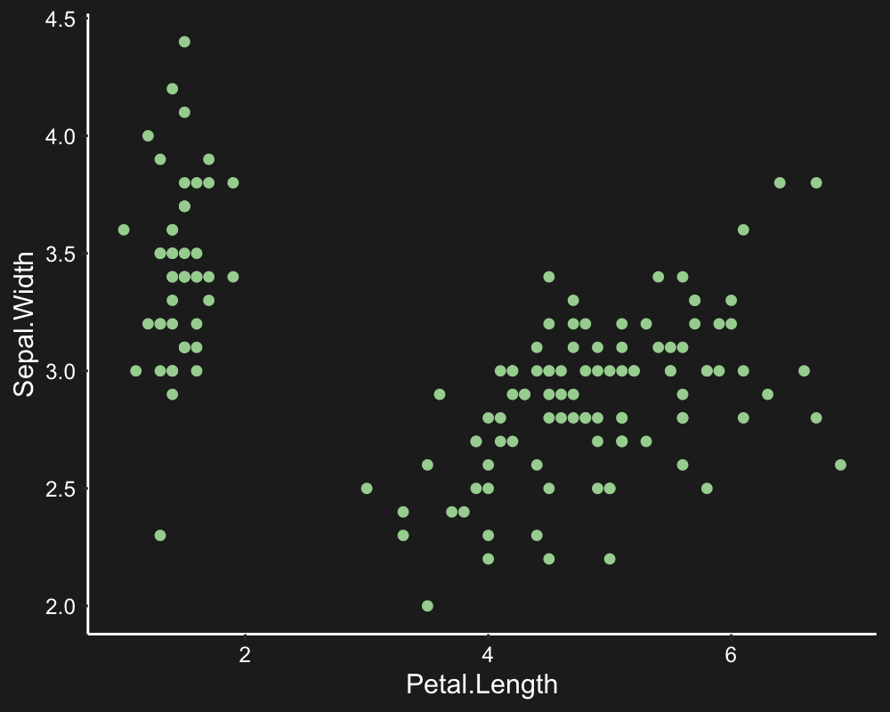
Etherium
hello

