Slide 1
Using cluster analysis for Identifying outliers and possibilities offered when calculating Unit Value Indices
OECD NOVEMBER 2011
Evangelos Pongas

Slide 2
Objectives of the presentation
Present outlier detection methods used by Eurostat unit G5 in the field of international trade of goods detailed statistics (ITGS)
Present current investigations in cluster analysis methods and possibilities offered to improve unit value indices

Slide 3
Three main outlier detection methods used
Outliers at main characteristics of the distribution of detailed data
Hidiroglou and Berthelot method
K-means clustering

Slide 4
Distribution characteristics of monthly detailed data – step 1
For each month and for a period of 12 to 24 months calculate from detailed data:
  Mean
  Standard deviation
  Maximum and Minimum
  Skewness and Kurtosis
  Count of records
Construct 7 seven time series of 12-24 elements
Standardise the time series by deducting average and dividing by standard deviation.

Slide 5
Distribution characteristics of monthly detailed data – step 2
Apply classical (mean, standard deviation) and robust (median, quartiles of robust deviation) methods to detect outliers
Calculate z-scores = how many times each element of the time series is far in terms of standard deviation from the centre of the distribution (mean). For the N(0,1) distribution, 99.7 of z=scores are less than 3 (or more than -3). Such elements are considered as outlies.

Slide 6
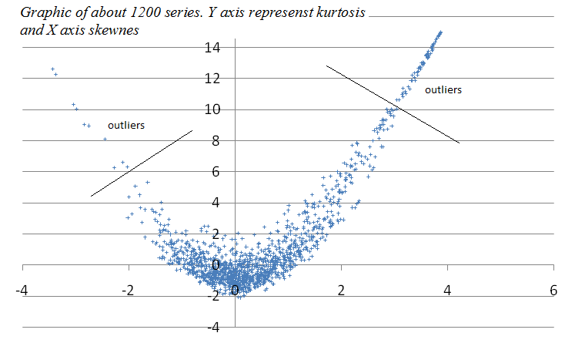
Distribution characteristics of monthly detailed data – step 3

Slide 7
Distribution characteristics of monthly detailed data – conclusions
Fast execution: About 2 hours for all EU Member States
Decision support: Publish or not publish
Detection of procedural errors: Missing records, generalised errors, empty records

Slide 8
Distribution characteristics of monthly detailed data – conclusions
Fast execution: About 2 hours for all EU Member States
Decision support: Publish or not publish
Detection of procedural errors: Missing records, generalised errors, empty records

Slide 9
Distribution characteristics of monthly detailed data – conclusions
Fast execution: About 2 hours for all EU Member States
Decision support: Publish or not publish
Detection of procedural errors: Missing records, generalised errors, empty records

Slide 10
Distribution characteristics of monthly detailed data – conclusions
Fast execution: About 2 hours for all EU Member States
Decision support: Publish or not publish
Detection of procedural errors: Missing records, generalised errors, empty records

Slide 11
Hidiroglou and Berthelot method
Selection of data blocks for at least one year monthly data
  By product, partner, flow
  Eventually by mode of transport
Linear transformation of data
Application of robust based outlier method based on median and first/third quartiles
Weight the importance of the specific data

Slide 12
Hidiroglou and Berthelot method: conclusions
Univariate method easy to apply
Error order according importance
Problems when variance
Weight the importance of the outlying specific data
Often erroneous detection of outliers when variance is high
Cannot detect records that violate the correlation structure of the data

Slide 13
Detection of outliers with the k-means clustering method: step 1
Selection of data blocks for at least one year monthly data
  By product, partner, flow
  Eventually by mode of transport
Normalization of data
Application to raw data and to ratios

Slide 14
Detection of outliers with the k-means clustering method: step 2
Application of k-means clustering for 2-5 number of clusters
Selection of best number of clusters based on R-square: > 50% and step to higher cluster when more than 10% improvement
Detect outlying clusters with small number of data
Apply distance function for confirmation of outliers
Same approach for inliers. Need to find similar to outliers distance function

Slide 15
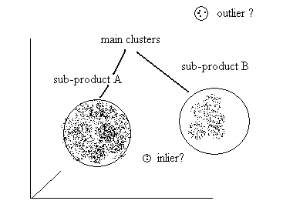
Detection of outliers with the k-means clustering method: in theory

Slide 16
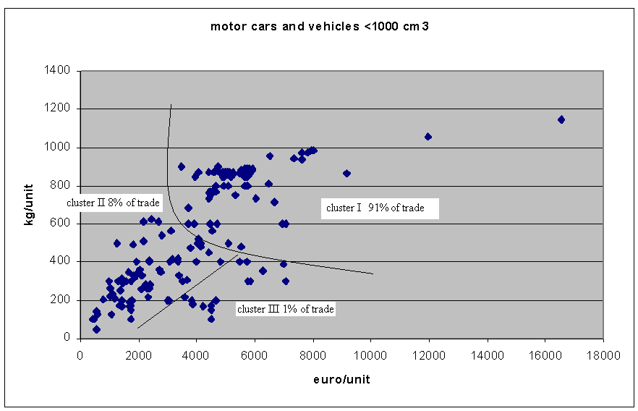
Detection of outliers with the k-means clustering method: in practice (no outliers)

Slide 17
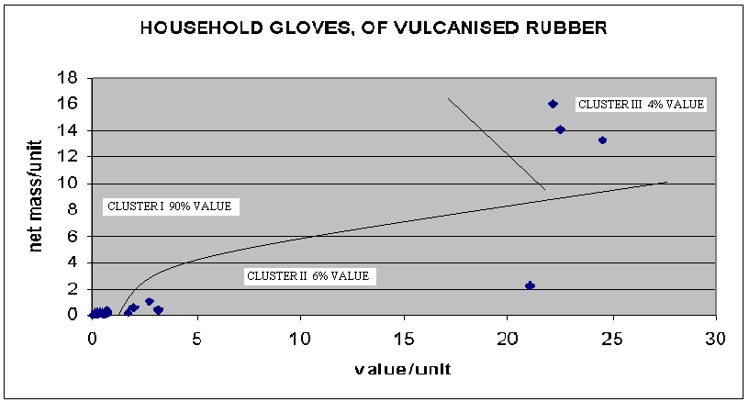
Detection of outliers with the k-means clustering method: in practice (with outliers)

Slide 18
Other possible uses of k-means clustering method
Detection of sub-products for classification and indices purposes
Cleaning data for indices purposes
  No need to define parameters as in other robust methods
  Data grouping according needs
  Possibility to define indices at very detailed level
Clusters are stable over time (but not geographically)

Slide 19
Thank you for your attention!

