Slide 1
eMall
Cialini – Colangelo – La Ferla

Slide 2
Requirement Analysis
and Specification Document
(RASD)

Slide 3
Goals & use-cases of the system
Stations
Location, price
and offers
Reservations
Energy settings
Charging Process
Monitor
Stop
Pay
Customization
Vehicles
Payments
Recommendations

Slide 4
Requirements
Requirements
Station View: the Driver must be able to visualise (map and list) the nearby stations and to book the desired station
Charging Process: the Driver is notified when the recharge ends and can stop the charging process
Profile: the User can select an active vehicle and an active payment method
Recommendations: Driver can accept a reservation suggestion by the system
The CPO Administrator must be able to know the status of his stations and to manage their settings

Slide 5
Assumptions
Sockets
Universal type
Retrieve real time info
Speed constraint
External Services
GPS and schedule information
Vehicle information and license plate verification
DSO and station information
Notes:
Key decision not letting user to manually write the plate to have only consistent data

Slide 6
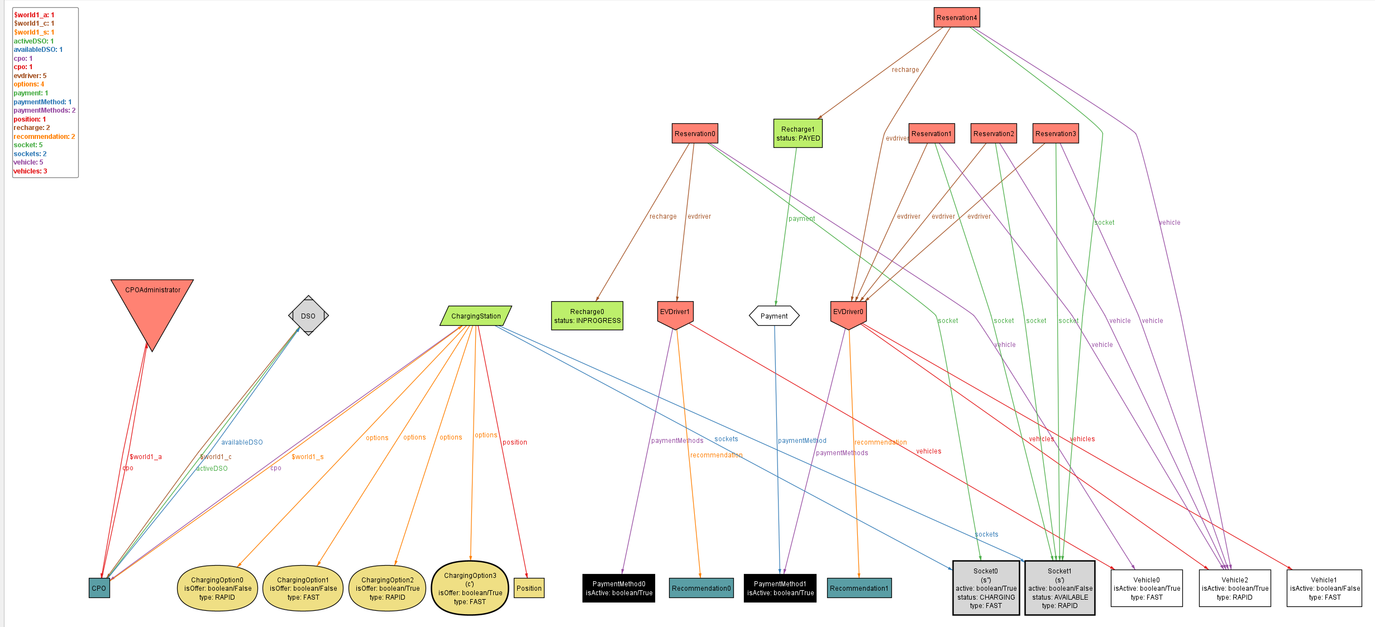
Alloy worlds

Slide 7
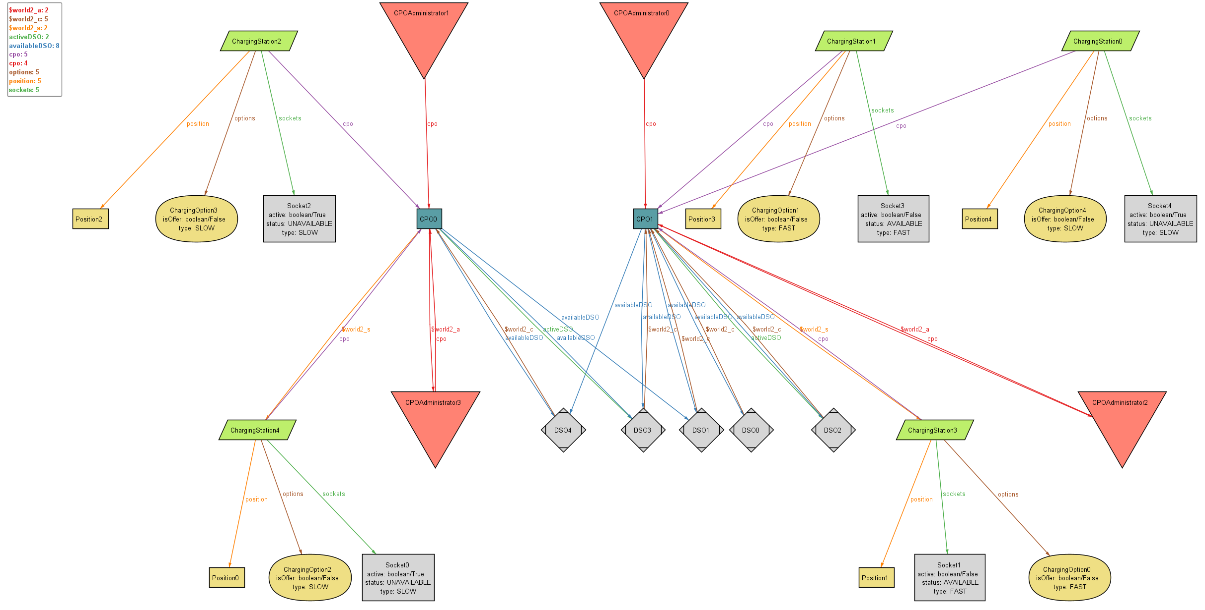
Alloy worlds

Slide 8
Design Document
(DD)

Slide 9
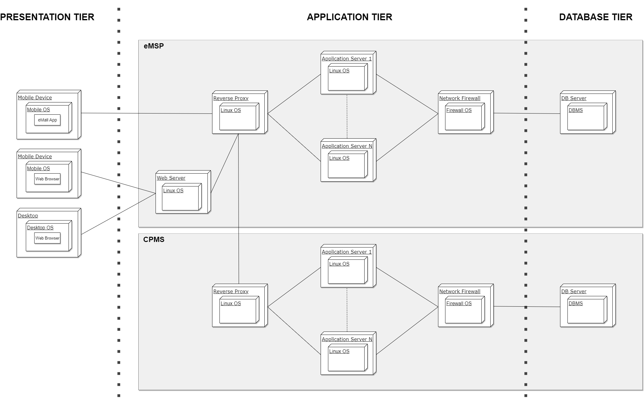
Deployment architecture
Deployment
Notes:
3 tier architecture
Mobile app for both platforms mainly just for presentation
Our App server for main logic
External database to increase and scalability

Slide 10
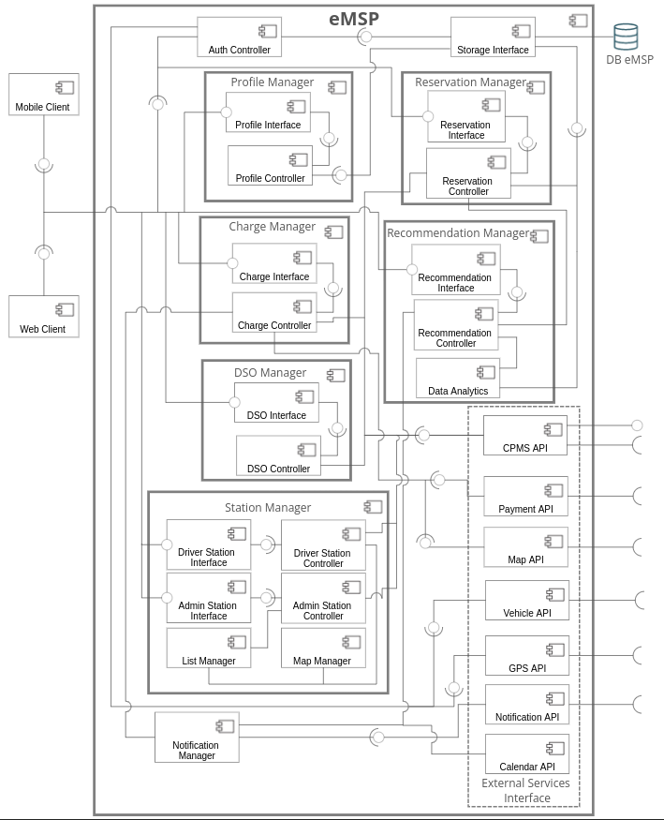
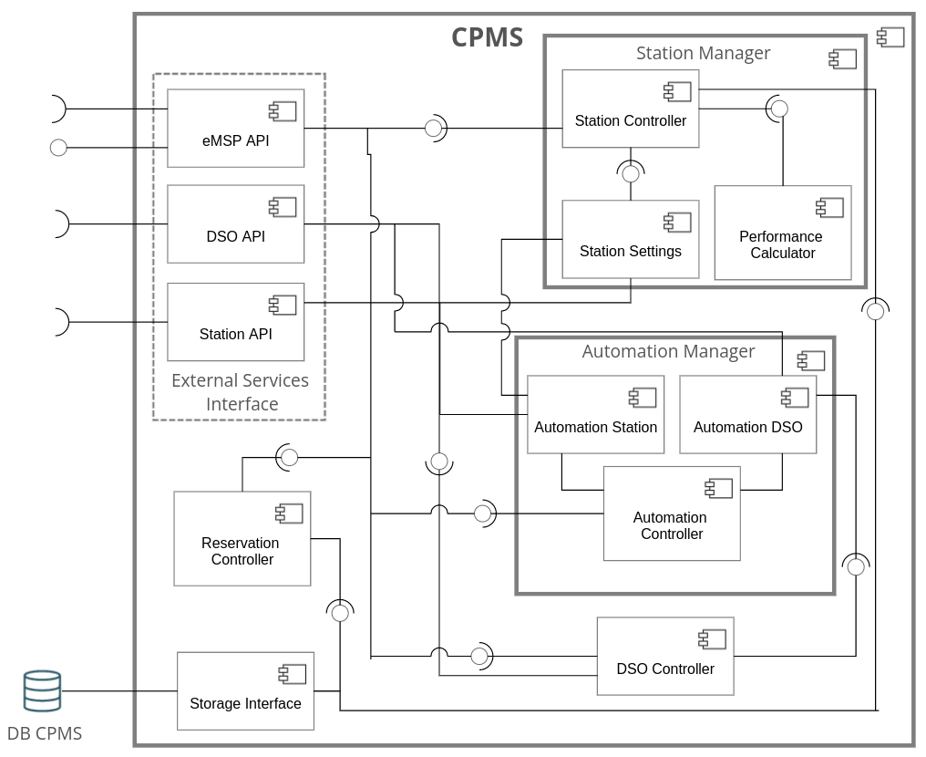
eMSP and CPMS components architecture
Notes:
The core are use cases: clean architecture means having one component for each use case. Two interfaces . In and out

Slide 11
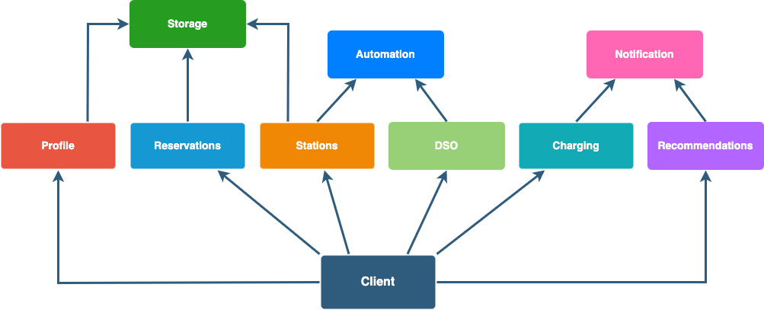
Implementation and testing
Implementation & Testing
Bottom-up strategy
Unit test in each subsystem
Backend subsystems integration
System integration

Slide 12
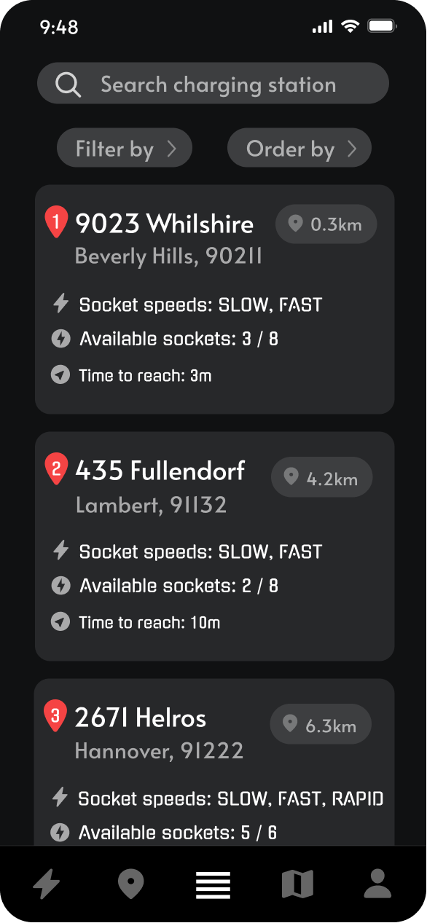
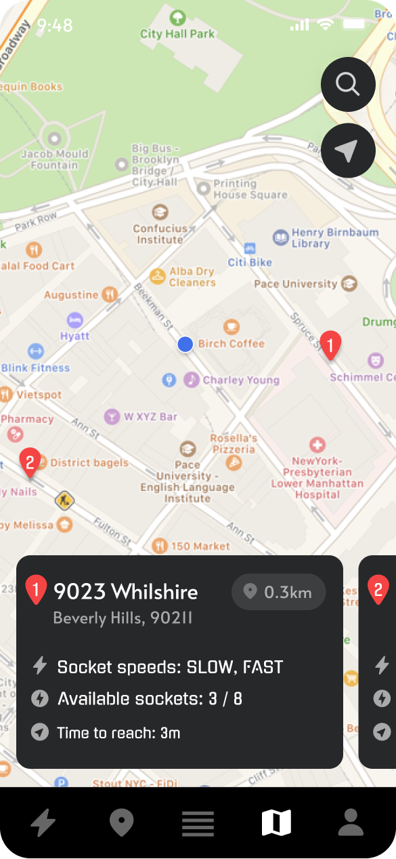
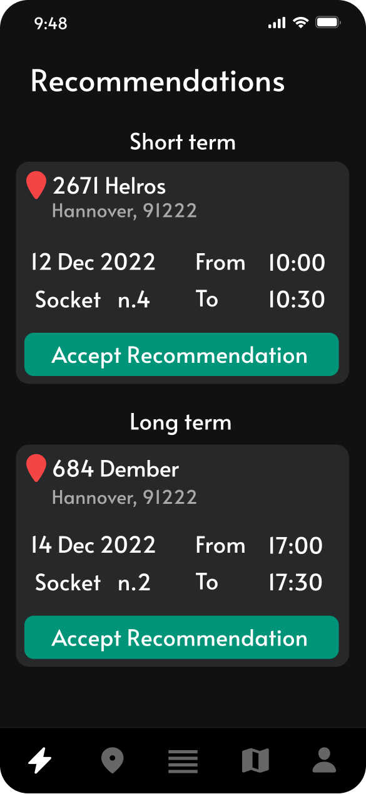
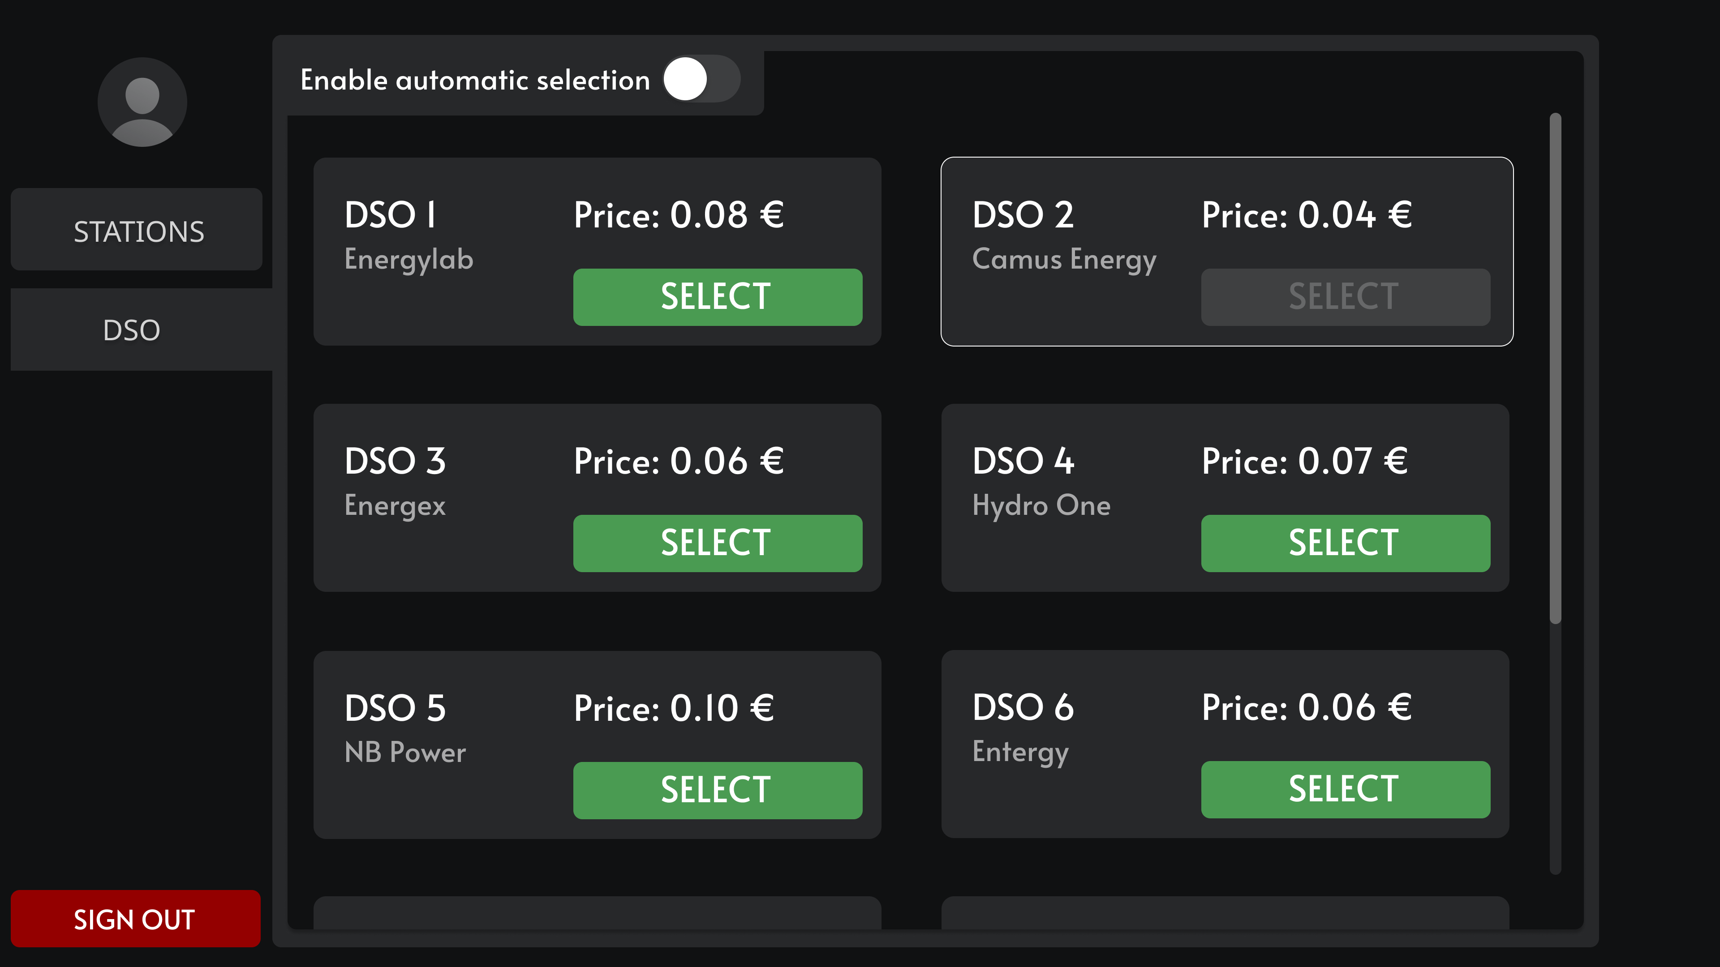
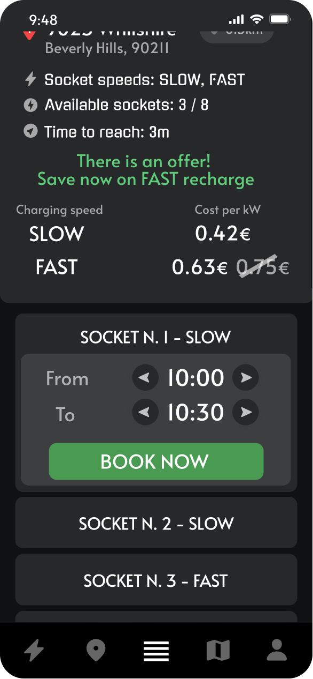
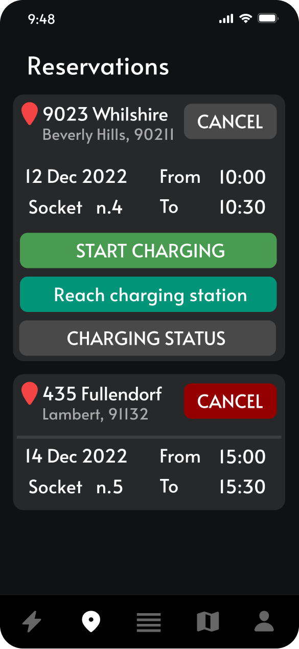
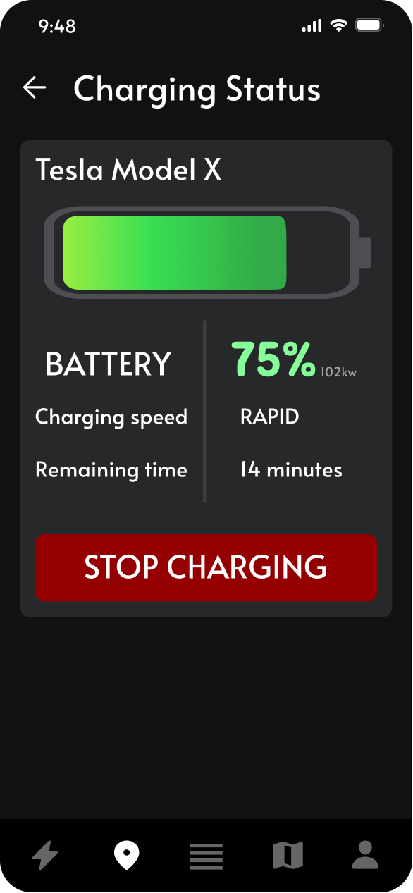
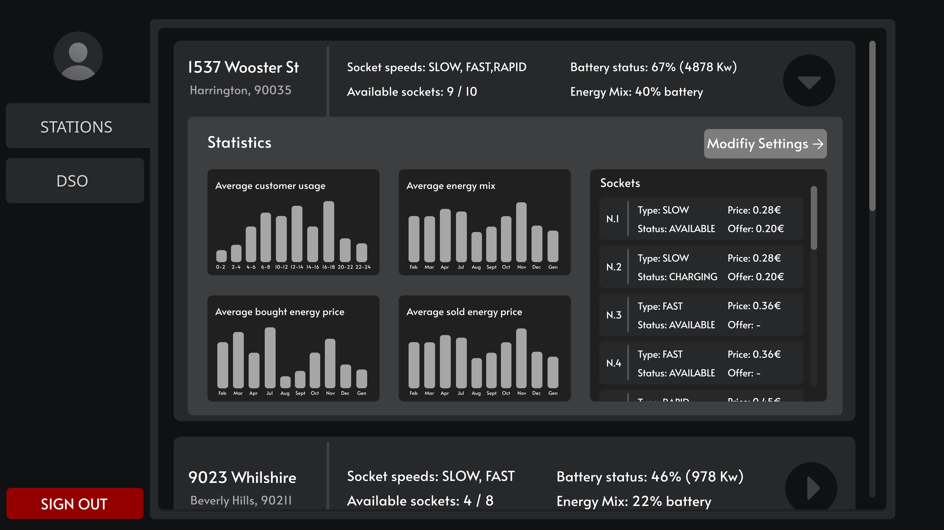
Mockups

