Slide 1
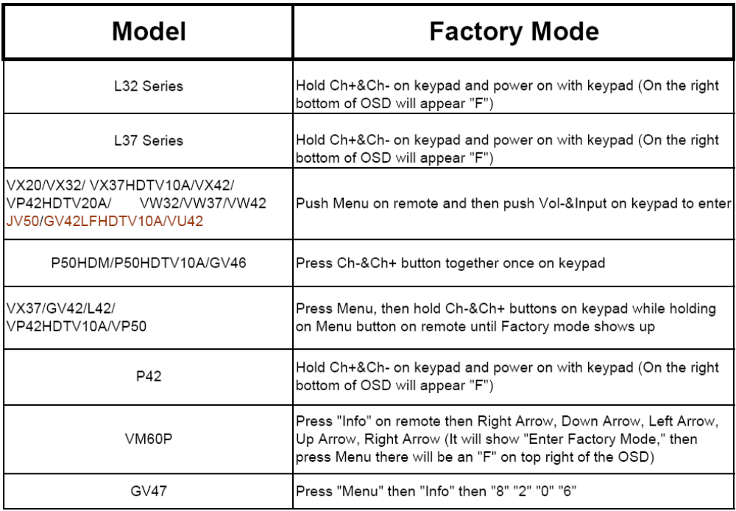
Firmware version check procedure --- Step 1

Slide 2
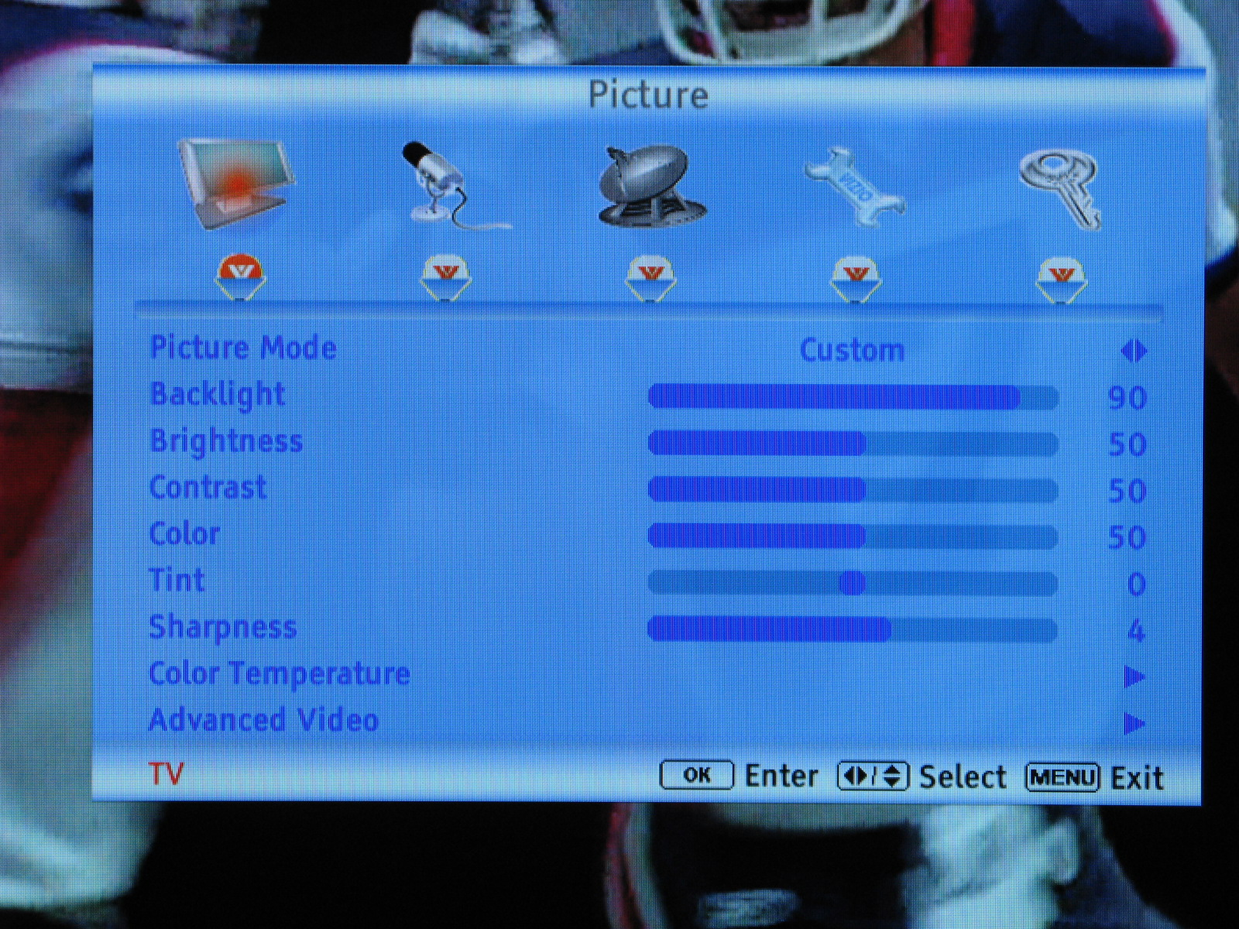
Firmware version check procedure --- Step 2
For some models, needing to turn on the user manual.

Slide 3
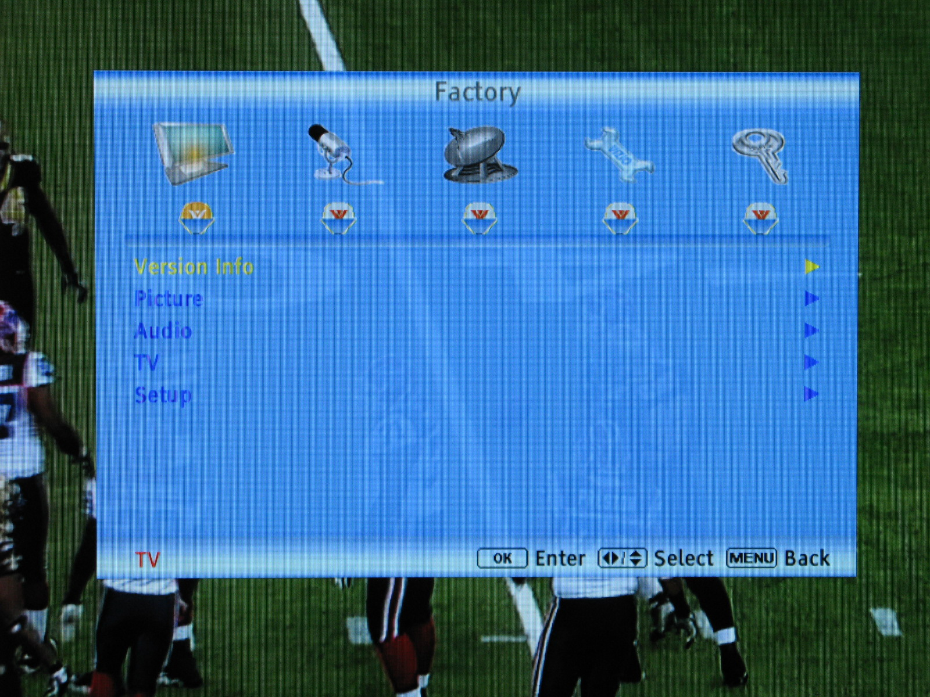
Firmware version check procedure --- Step 3
After holding the hotkeys, the factory will be jumped out, and selecting the Version Info.

Slide 4
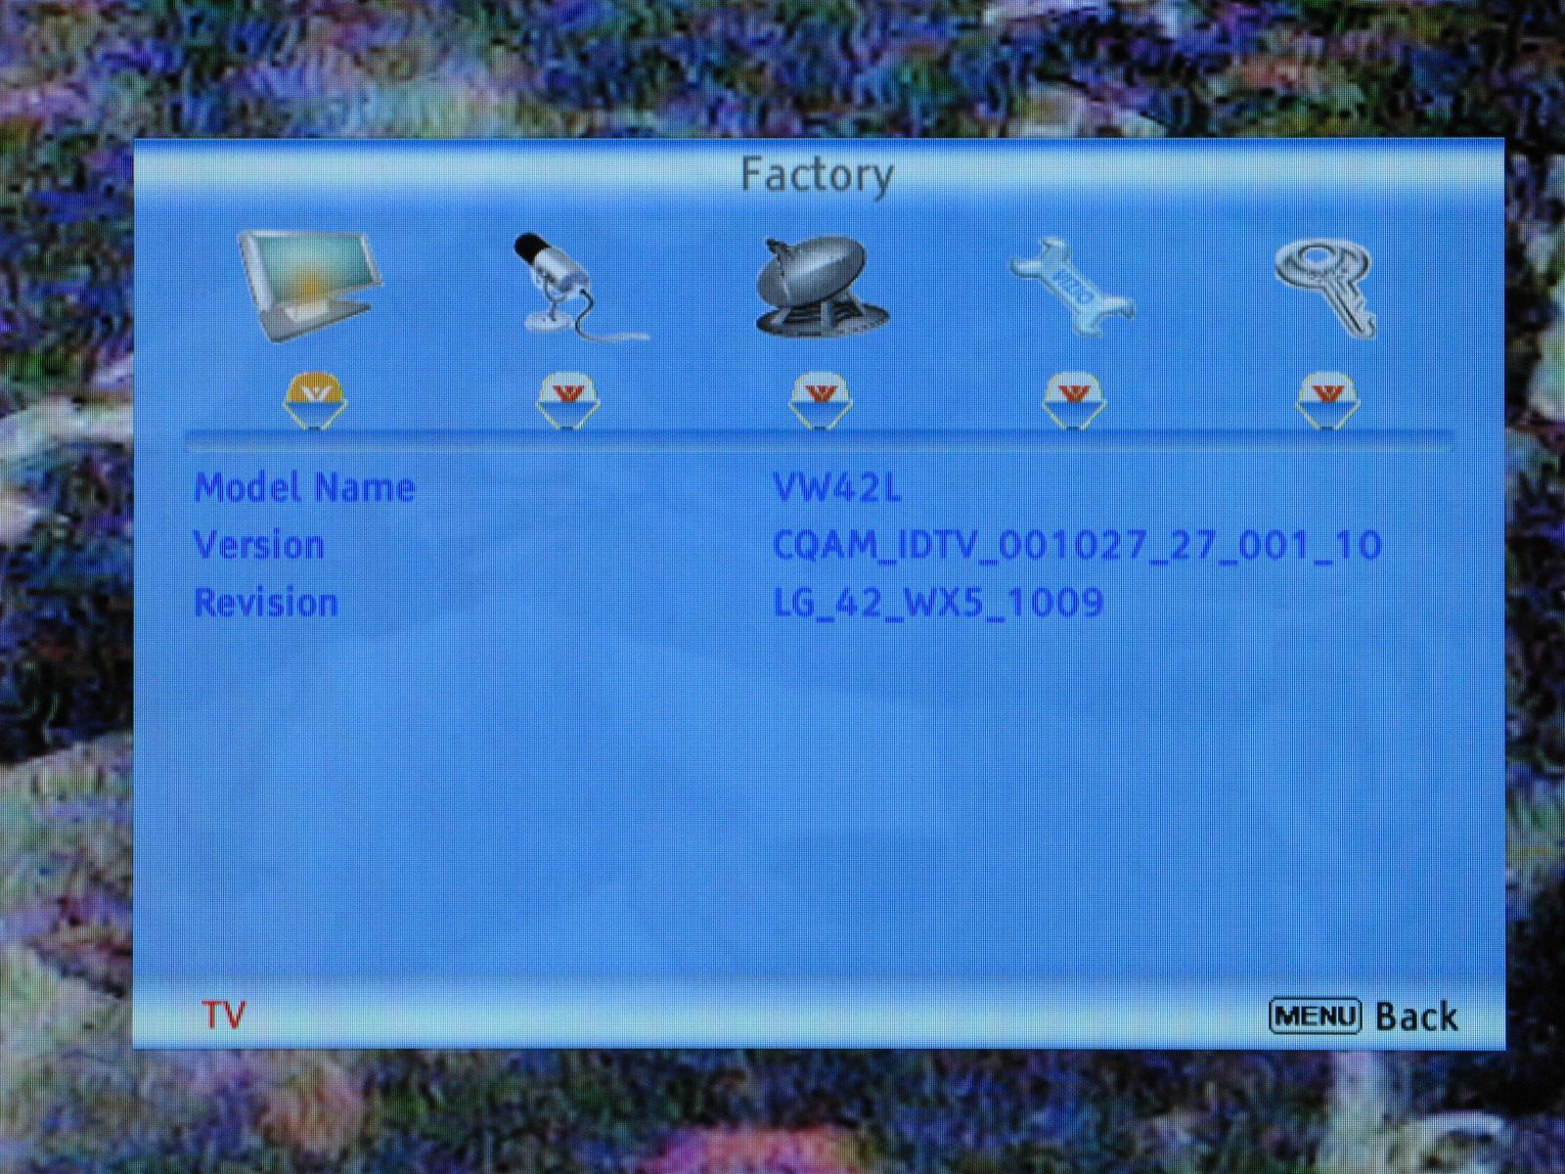
Firmware version check procedure --- Step 4
Please check the model and firmware version to make sure it is the latest version.

