Slide 1
Power management in Smart Homes
Roberto Leyva

Slide 2
Agenda
Background
Objective
Data Management
Description of data
Plan to address known issues
Descriptive statistics
High-level recommendations
Closing

Slide 3
Background
A large regional residential developer is designing a large 'Smart Home' apartment housing development and is looking for evidence or positive reasons for adopting the use of electrical sub-metering devices used for power management in Smart Homes.
We gathered 2,049,280 measurements from a house located in Sceaux at 7km from Paris, France.

Slide 4
Objective
Find enough evidence to help support the developer's marketing claims of sub-meters providing owners with 'useful' power usage analytics.

Slide 5
Data Management
Perform an 'analytical deep dive' of sub-metering generated data and producing high quality visualizations that show the power usage over time.

Slide 6
Description of data
Date: Date in format dd/mm/yyyy
Time: time in format hh:mm:ss
Global_active_power: household global minute-averaged active power (in kilowatt)
Global_reactive_power: household global minute-averaged reactive power (in kilowatt)
Voltage: minute-averaged voltage (in volt)
Global_intensity: household global minute-averaged current intensity (in ampere)
Sub_metering_1: energy sub-metering No. 1 (in watt-hour of active energy).
It corresponds to the kitchen, containing mainly a dishwasher, an oven and a microwave (hot plates are not electric but gas powered).
Sub_metering_2: energy sub-metering No. 2 (in watt-hour of active energy).
It corresponds to the laundry room, containing a washing-machine, a tumble-drier, a refrigerator and a light.
Sub_metering_3: energy sub-metering No. 3 (in watt-hour of active energy).
It corresponds to an electric water-heater and an air-conditioner.

Slide 7
Plan to address known issues
Combine the Date and Time to extract the quarter, month, week, day, etc. Then perform the analysis of each sub-meter over time.
Measure the rest of the electrical equipment in the house not measured by the sub-meters.

Slide 8
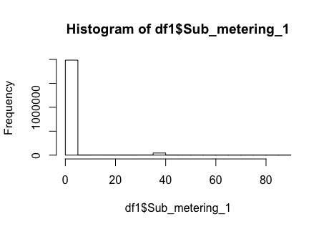
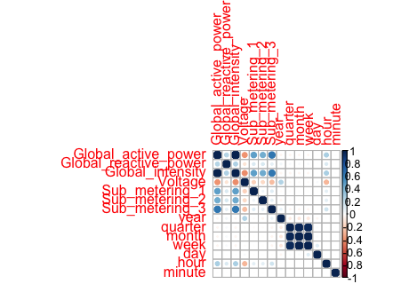
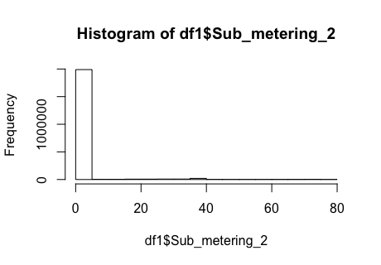
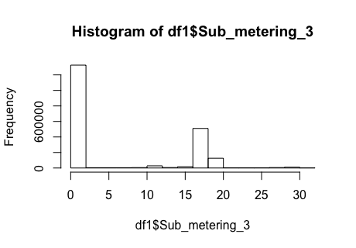
Descriptive statistics
Sub_metering_1 spends on average 1.122 in watt-hour, the least amount of power. However, it has the highest peak with 88 watt-hour of active energy.
Sub_metering_2 spends on average 1.299 in watt-hour of active energy and has a maximum of 80 watt-hour.
Sub_metering_3 spends on average 6.458 in watt-hour of active energy, the highest average of active energy of all. However, it has the lowest maximum of 31 in watt-hour of active energy.

Slide 9
High-level recommendations
Include the current measured in Amperes to know the flow of electricity to then deduce the power measured in Watts.
Include the cost per kilo-Watt-hour (kWh) or 1,000 Wh.
The refigerator should be in the sub-meter 1 with the kitchen related items.

Slide 10
Closing
The kitchen spends the leats amount of energy on average but has the highest peak.
The electric water-heater and the air conditioner spend the most amount of energy on average.
The quality of the data could be better by adding the recommendations.

