Slide 1
Data Mining
Roberto Leyva

Slide 2
Contents
How can data mining help?
Customer brand preferences
Results of customer preferences
Sales prediction
Results of sales prediction
Association discoveries
Results of association discoveries
Conclusion

Slide 3








How can data mining help?
Data mining
Raw data
Processed
Useful Insights
Some examples of what it can do:
Find unknown behavior patterns
Push correct advertisements
Prediction of trends

Slide 4
Customer brand preferences
Task
Predict which brand customers prefer in an incomplete survey. Which brand do customers prefer? Sony or Acer?
Method
Used three different machine learning (classification) models on a complete survey and chose one of them based on how accurate it can predict the brand. Then I used the most accurate model (92%) to predict the brand in the incomplete survey.

Slide 5
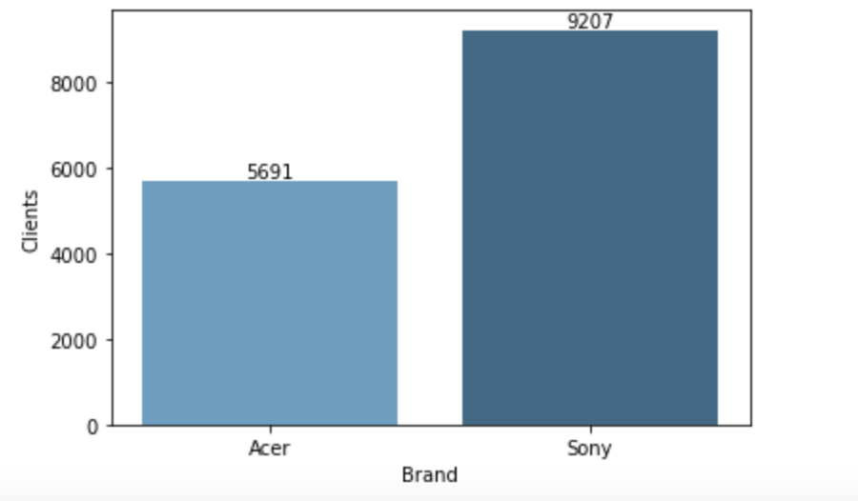
Results of customer preferences
The results were that customers’ preferences were highly dependent on their salary and age, and that 62% of them prefer Sony.

Slide 6
Sales prediction
Task
Predict the volume sales of PC, Laptop, Netbook, and Smartphones.
Method
Used three different machine learning (regression) algorithms on a complete data set and chose one of them based on how much it could explain the variance in volume (R squared). Then I used the model that explained the most variance (77%) to predict the volume sales of the products asked.

Slide 7
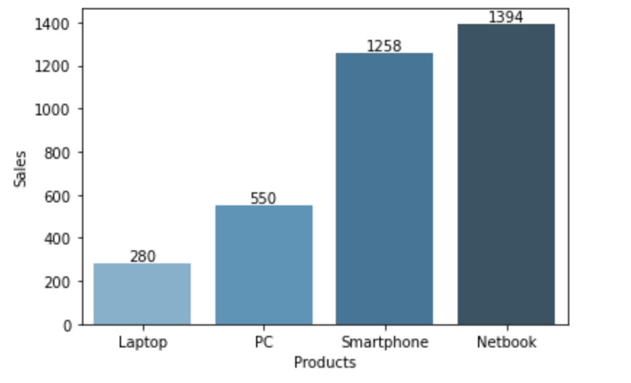
Results of sales prediction
The total of volume sales was 3,482 in which the Netbook has the biggest part with 40%, followed closely by Smartphone with 36%, then PC with 16%, and finally Laptop with an 8%.

Slide 8
Association discoveries
Task
Find patterns or relationships between the 43,104 items in the 9,835 transactions of Electronidex’s customers.
Method
Used a machine learning algorithm (apriori) to identify the frequencies of the items and to identify strong relationships between them with at least 80% confidence.

Slide 9
Results of association discoveries
Customers buy on average 4 items per transaction. Furthermore, 62% of transactions have 4 or less items.
The strongest association patterns have 4 items and 90% of them have the same item (ViewSonic Monitor) purchased given that other items were purchased.
The two strongest associations are:
83% of customers who buy Apple MacBook Pro, HP Black & Tri-color Ink, HP Laptop, and iMac also buy Acer Aspire.
100% of customers who buy Dell Desktop, iMac, Lenovo Desktop Computer, and Mackie CR Speakers also buy ViewSonic Monitor.

Slide 10
Conclusion
As shown in the examples, data mining is useful to discover insights and patterns in big amounts of data to make more informed decisions. Therefore, the expansion in funding that Blackwell is considering in Data mining will benefit their decision making.

