Slide 1
Identificando Clusters Textuais
Aprendizado Não Supervisionado
Roberto Martins

Slide 2
Sumário
Dataset
Redução de Dimensionalidade
Técnicas de Clusterização
Kmeans
DBSCAN
HDBSCAN
Análise dos Resultados

Slide 3
Dataset
Banana
1. Bananas are one of the most popular fruits worldwide.
2. They are botanically classified as berries.
Machine Learning
1. Machine learning is a subset of artificial intelligence.
2. Supervised learning relies on labeled data for training.
Outliers
1. The sky is blue and filled with fluffy clouds.
2. Elephants have long trunks and big ears.
Embedded data example:
[-0.0012083054, -0.007446289, -0.009544373, … ]
Dimensão de cada dado: 1024!
DATASET FINAL = (120, 1024)
Gerado artificalmente
2/3 Clusters
Dados Textuais
50 frases sobre Bananas
50 frases sobre Machine Learning
20 frases sobre assunstos aleatórios (~Outliers)
Uso de Modelo de Embedding ('embed-english-v3.0’ by Cohere)

Slide 4
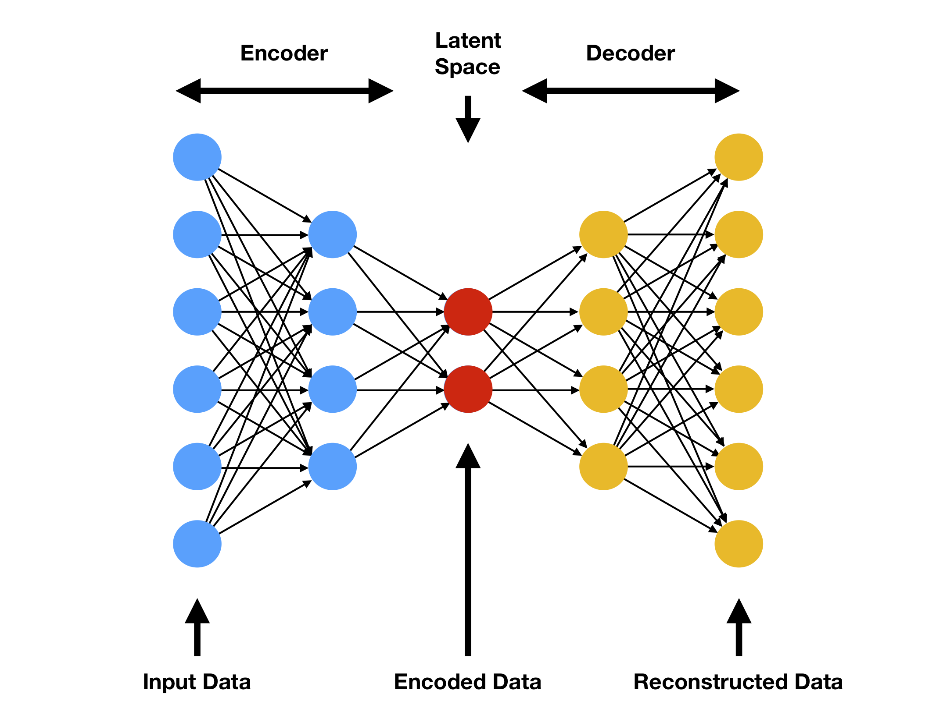
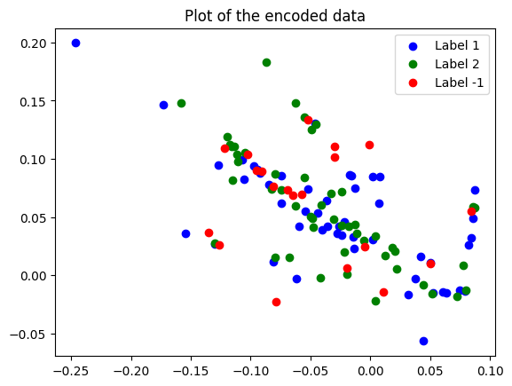
Redução de Dimensionalidade
Aplicação de um AutoEncoder
Redução da dimensionalidade de 1024 para 2 (eixo x, y)
Treinamos o autoencoder nos dados e plotamos os valores do espaco latent
OBJETIVO: Conseguimos separar dados textuais?
AutoEncoder
Dados Plotados

Slide 5
Técnicas de Clusterização
KMeans
Fundamental unsupervised learning for clustering.
Objective: Partition dataset into K clusters based on nearest mean.
Algorithm Steps:
Initialization: Randomly select K centroids.
Assignment: Assign each point to nearest centroid.
Update: Recalculate centroids based on cluster means.
Convergence Check: Repeat until centroids stabilize.
Key Concepts:
Centroids: Representative cluster points.
Assignment: Data point assignment based on centroid proximity.
Cohesion: Tightness within clusters.
Separation: Dissimilarity between clusters.
Challenges and Considerations:
Sensitivity to Initialization.
Determining optimal K.
Handling outliers.

Slide 6
Técnicas de Clusterização
DBSCAN
DBSCAN Algorithm:
Density-based clustering for arbitrary shapes, noise, and outliers.
Does not require pre-defined number of clusters.
Algorithm Steps:
Parameter Definition: ε (neighborhood distance) and Tau (minimum points).
Core Point Identification: Sufficient neighbors within ε.
Cluster Expansion: Recursively add reachable points.
Border Point Assignment: Near core points but lack MinPts neighbors.
Noise Identification: Points not in clusters.
Key Concepts:
Core Points: Sufficient neighbors within ε.
Border Points: Near cores but lack neighbors.
Noise Points (Outliers): Not in any cluster.
Density Reachability: Core points' chain within ε.
Challenges and Considerations:
Parameter Selection: Impact on clustering results.
High-Dimensional Data: Curse of dimensionality.

Slide 7
Técnicas de Clusterização
HDBSCAN Vs. DBSCAN
Hierarchical Clustering:
DBSCAN: Original lacks hierarchical structure.
HDBSCAN: Builds hierarchy for nuanced understanding.
Robustness to Parameter Selection:
DBSCAN: Manual ε and Tau selection.
HDBSCAN: Single parameter, less sensitive.
Handling Variable Density and Outliers:
DBSCAN: Struggles with varying density.
HDBSCAN: Adaptive density threshold.
Cluster Stability:
DBSCAN: Fixed clusters, sensitive to changes.
HDBSCAN: Stable clusters across granularity levels.
Applications:
DBSCAN: Known or estimable cluster count.
HDBSCAN: Varying densities, complex structures.

Slide 8
Técnicas de Clusterização
HDBSCAN
Hierarchical Clustering:
HDBSCAN builds a hierarchy of clusters using a technique called condensed trees or minimum spanning trees. This hierarchical structure allows for the identification of clusters at different levels of granularity, providing a more nuanced understanding of the data.
Robustness to Parameter Selection:
Automates the process of parameter selection by introducing a single parameter called min_cluster_size, which represents the minimum number of points required to form a cluster.
Handling Variable Density and Outliers:
Leverages the hierarchical clustering structure to adaptively determine the density threshold for cluster formation.
Cluster Stability:
The hierarchical structure allows for the identification of stable clusters that persist across different levels of granularity, reducing the sensitivity to minor fluctuations in the data or parameter values.
Applications:
HDBSCAN is well-suited for datasets with varying densities and complex structures.

Slide 9
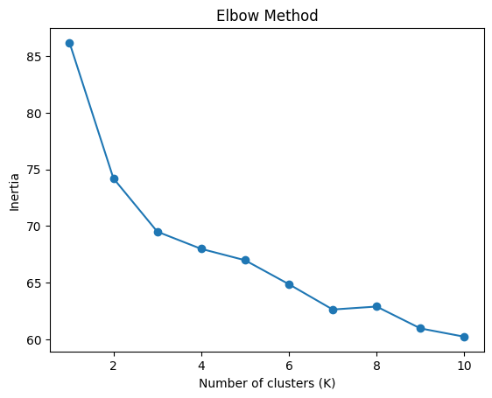
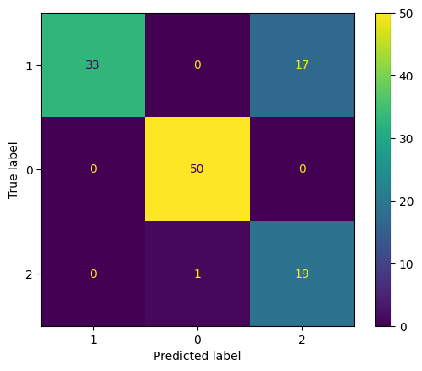
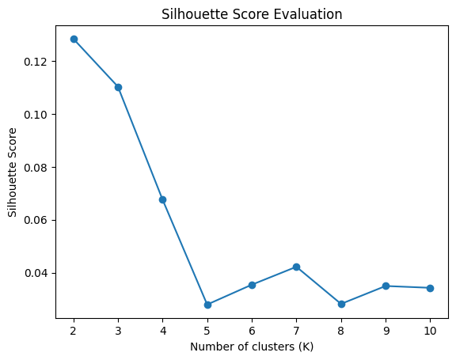
Análise dos Resultados
KMEANS
K ideal = 3
K ideal = 2
Accuracy per class:
Class ML: 100.00%
Class Banana: 66.00%
Class Outlier: 95.00%

Slide 10
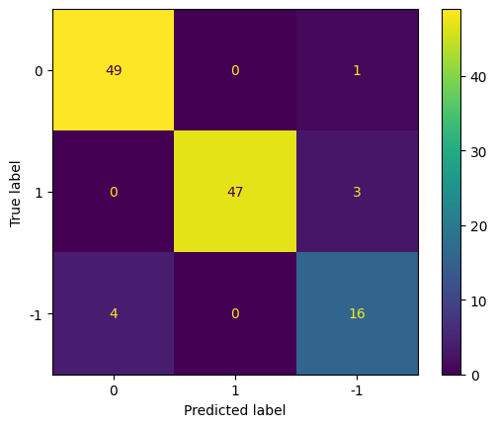
Análise dos Resultados
DBSCAN
Extensive hyperparameter Search:
160 + 152 = 304 Buscas!
eps: 1.05 min_samples: 2 counter: {-1: 11, 0: 54, 1: 49, 2: 3, 3: 3}
eps: 1.05 min_samples: 4 counter: {-1: 18, 0: 53, 1: 49}
eps: 1.05 min_samples: 6 counter: {-1: 18, 0: 53, 1: 49}
eps: 1.05 min_samples: 8 counter: {-1: 18, 0: 53, 1: 49}
eps: 1.05 min_samples: 10 counter: {-1: 18, 0: 53, 1: 49}
eps: 1.05 min_samples: 12 counter: {-1: 19, 0: 53, 1: 48}
eps: 1.05 min_samples: 14 counter: {-1: 20, 0: 53, 1: 47}
eps: 1.05 min_samples: 16 counter: {-1: 22, 0: 53, 1: 45}
eps: 1.05 min_samples: 18 counter: {-1: 22, 0: 53, 1: 45}
eps: 1.05 min_samples: 20 counter: {-1: 22, 0: 53, 1: 45}
eps: 1.05 min_samples: 22 counter: {-1: 25, 0: 53, 1: 42}
eps: 1.05 min_samples: 24 counter: {-1: 27, 0: 53, 1: 40}
eps: 1.05 min_samples: 26 counter: {-1: 27, 0: 53, 1: 40}
eps: 1.05 min_samples: 28 counter: {-1: 27, 0: 53, 1: 40}
eps: 1.05 min_samples: 30 counter: {-1: 28, 0: 53, 1: 39}
eps: 1.05 min_samples: 32 counter: {-1: 29, 0: 52, 1: 39}
eps: 1.05 min_samples: 34 counter: {-1: 31, 0: 51, 1: 38}
eps: 1.05 min_samples: 36 counter: {-1: 32, 0: 50, 1: 38}
eps: 1.05 min_samples: 38 counter: {-1: 34, 0: 48, 1: 38}
eps: 1.06 min_samples: 2 counter: {-1: 8, 0: 55, 1: 49, 2: 8}
SELECTED PARAMETERS
eps=1.05, min_samples=14
Accuracy per class:
Class Banana: 98.00%
Class ML: 94.00%
Class Outliers: 80.00%

Slide 11

Análise dos Resultados
DBSCAN
Análise dos Resultados
HDBSCAN
Zero Hyperparameter Search
X
Accuracy per class:
Class Banana: 98.00%
Class ML: 94.00%
Class Outliers: 80.00%
Accuracy per class:
Class Banana: 98.00%
Class ML: 96.00%
Class Outliers: 75.00%

Slide 12
Análise dos Resultados
Modelos apresentam performance surpreendente (1024 dimensões)
Possível mérito do modelo de Embedding
Kmeans – Quem diria…
DBSCAN - Busca de parâmetros Excessiva (304 operações de busca) – Labels são necessárias nesse caso, elimina o processo de não supervisão
HDBSCAN - Sem alteração de parâmetros chega em resultados similares ao do método não hierárquico

