Slide 1

Sustainability Study on Video Transcodings
x
Team 7 - Leonardo Lago, Andrea Malnati, Roberto Negro

Slide 2
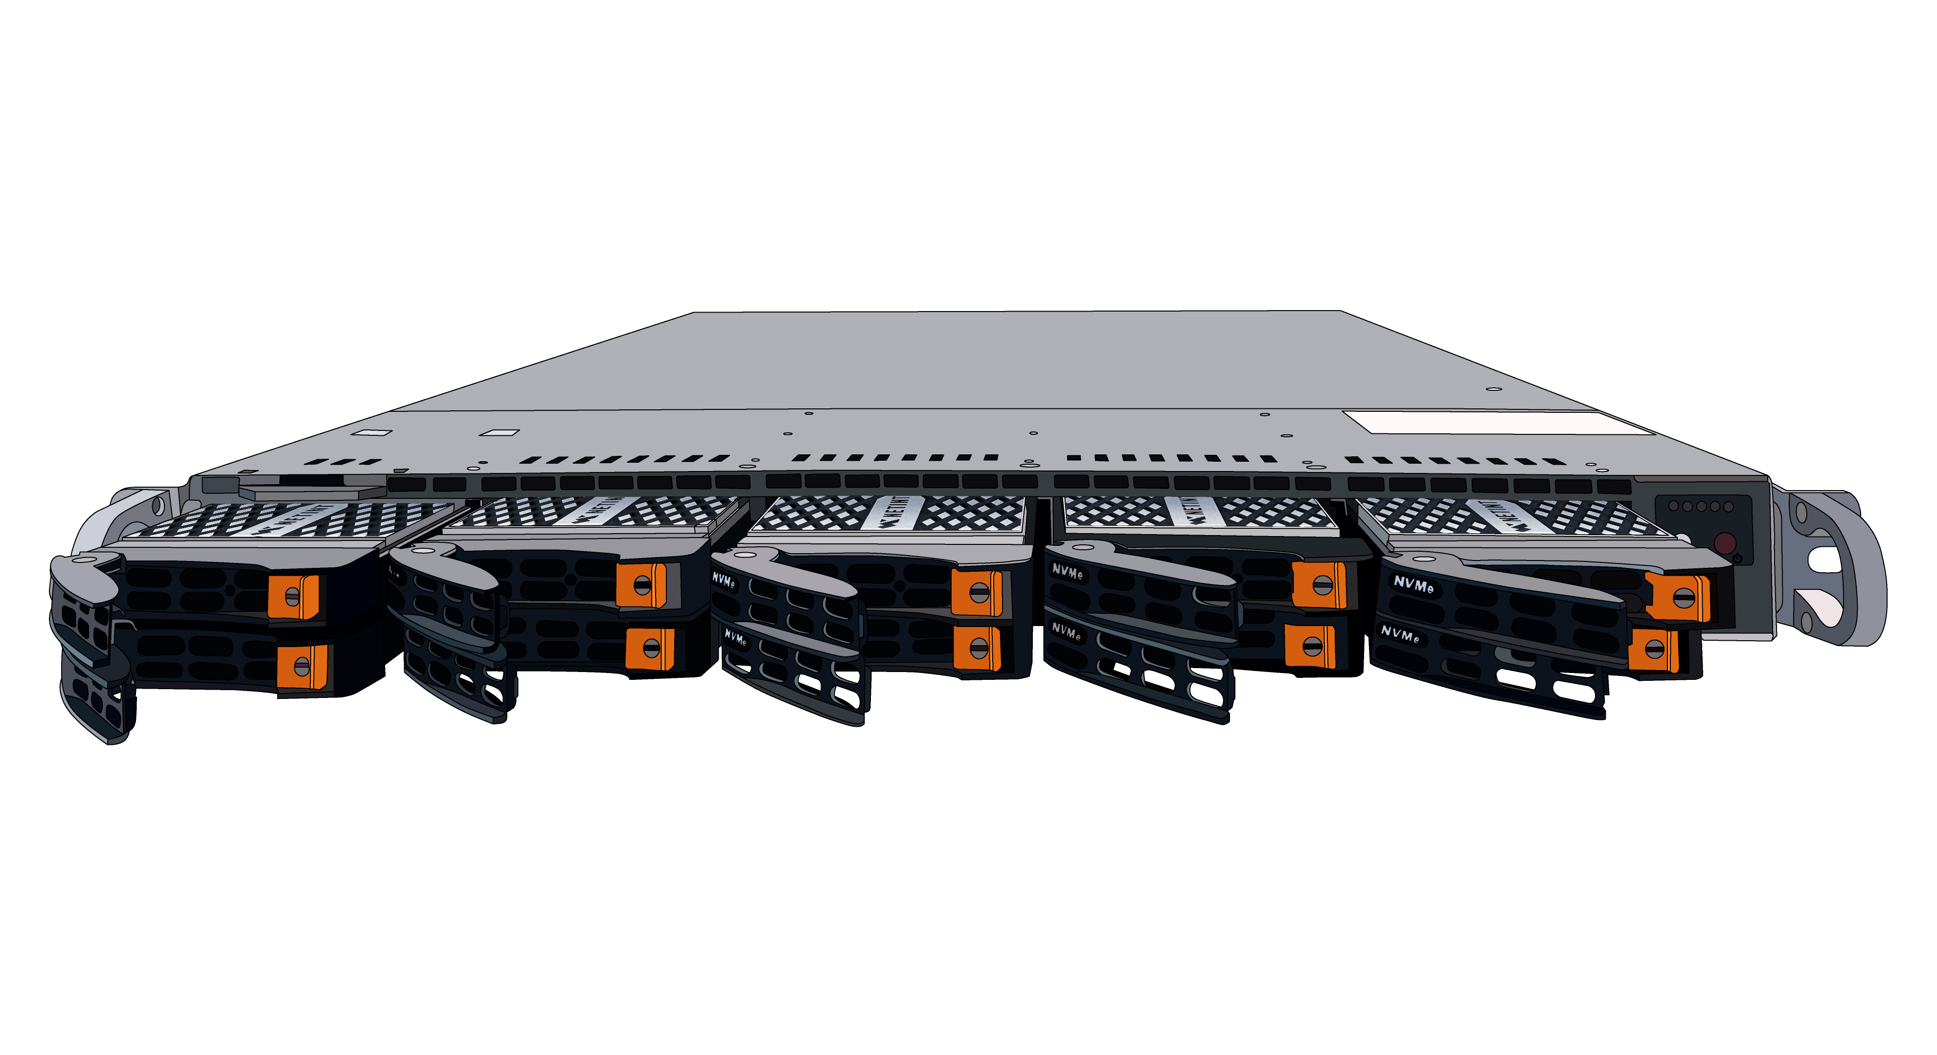
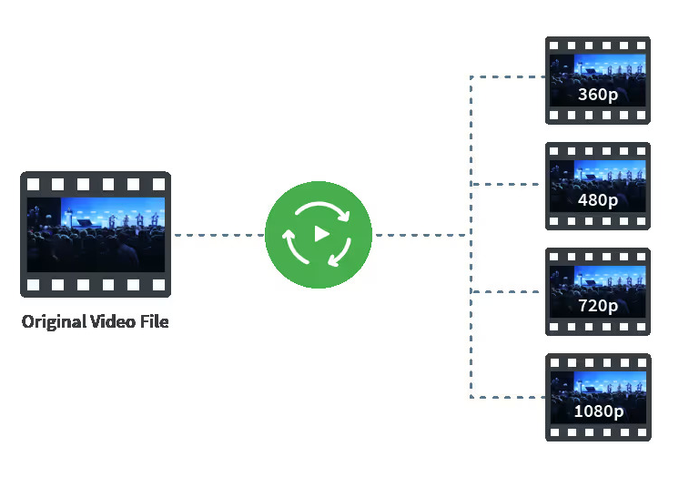
Project Objective
Estimate carbon emissions of a video processing server located in the Netherlands
Focus on the transcoding tasks
Process of decoding and re-encoding a video in many resolutions to enables adaptive streaming
One of the most energy-intensive tasks in the video processing pipeline
NETINT Quadra Video Server
Transcoding

Slide 3
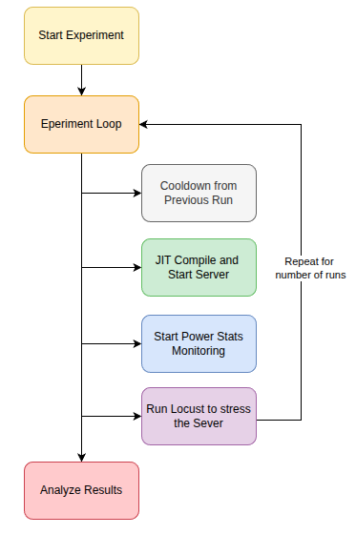
Experiment Design
Tracking both CPU and GPU
Evaluated 7 JIT profiles:
30 repetitions
Input 3 minutes at 1080p30
Output 1080p, 720p, 480p, 360p
3 minutes runs with 90s cooldown
3 request to ensure real-time transcoding

Slide 4
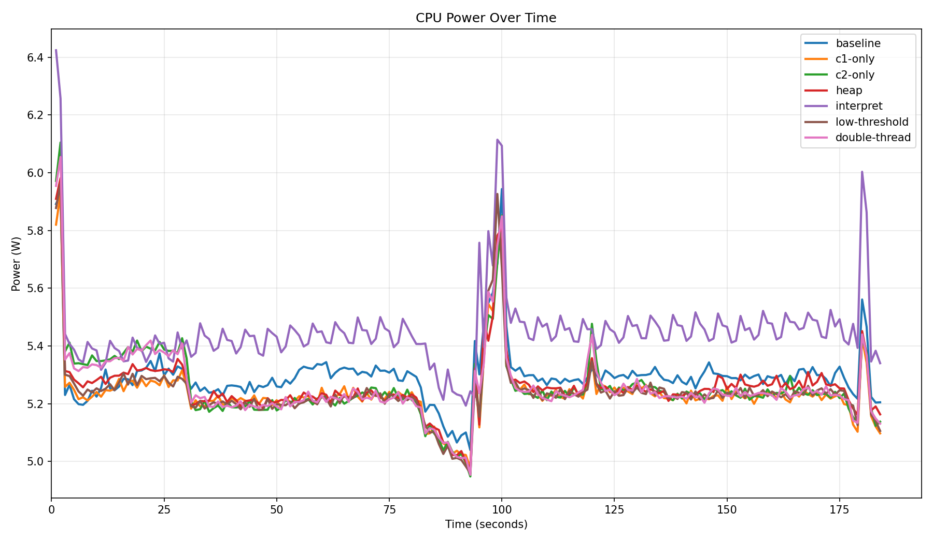
JIT Analysis

Slide 5
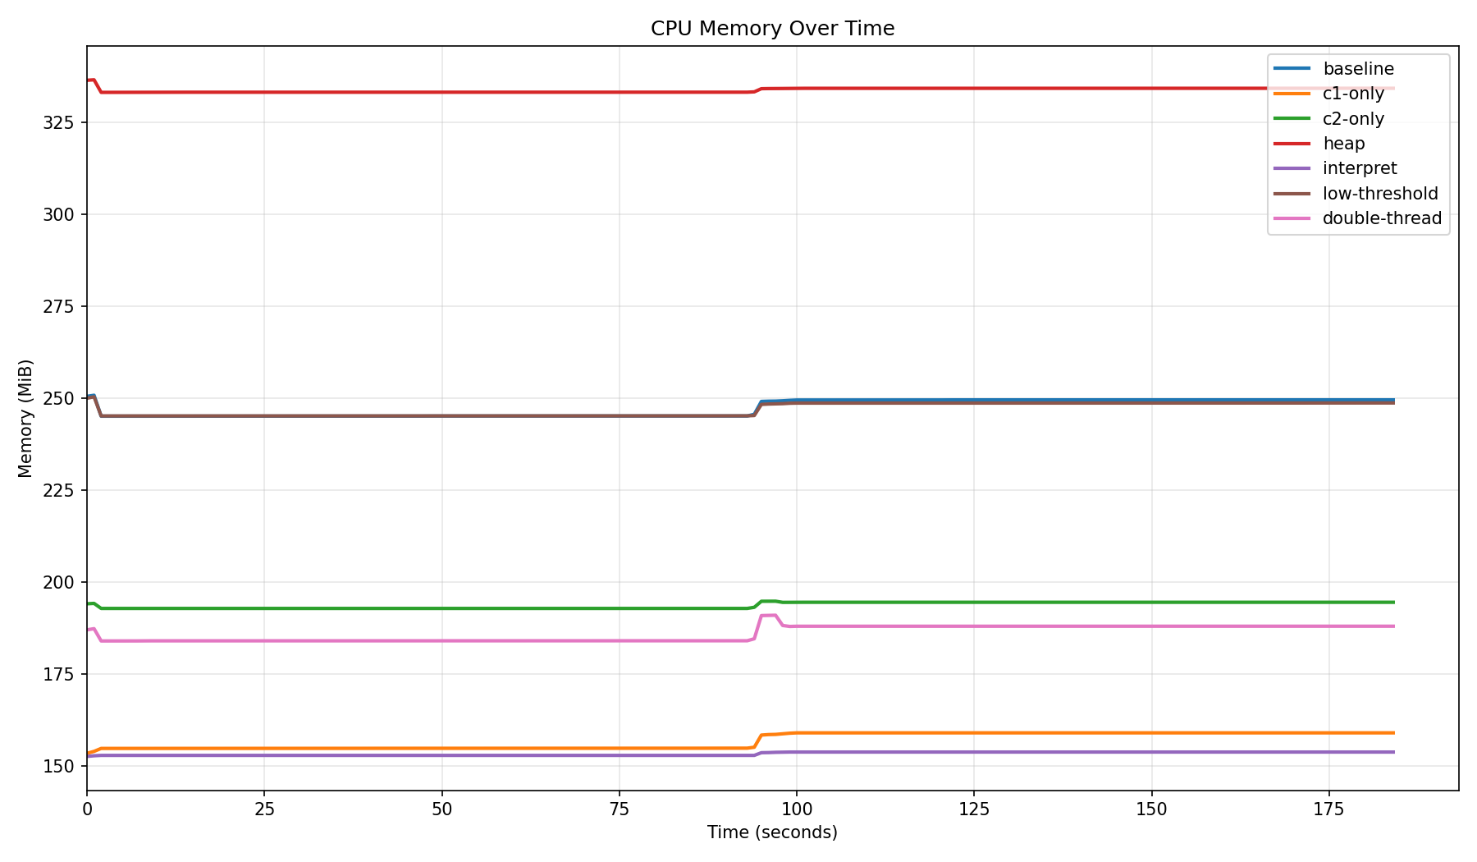
JIT Analysis

Slide 6



Carbon footprint estimation
Product | Performance (W/Stream) | Power proportion
NETINT T1U | 0.625 | 25%
NVIDIA T4 | 6.73 | 270%
NVIDIA 4060 Mobile | 2.491 | 100%

Slide 7
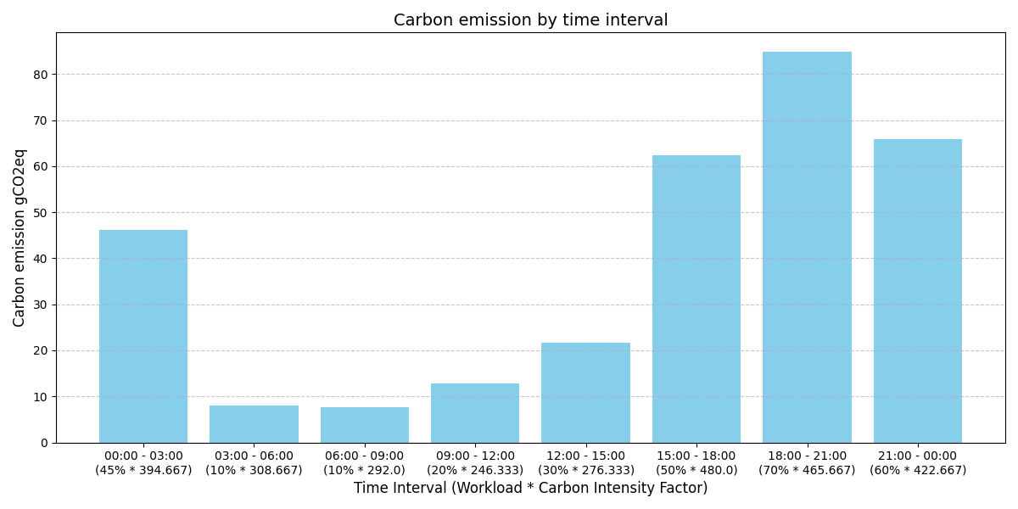
Results and Considerations
Time | Workload
00:00 - 03:00 | 45%
03:00 - 06:00 | 10%
06:00 - 09:00 | 10%
09:00 - 12:00 | 20%
12:00 - 15:00 | 30%
15:00 - 18:00 | 50%
18:00 - 21:00 | 70%
21:00 - 00:00 | 60%

Slide 8
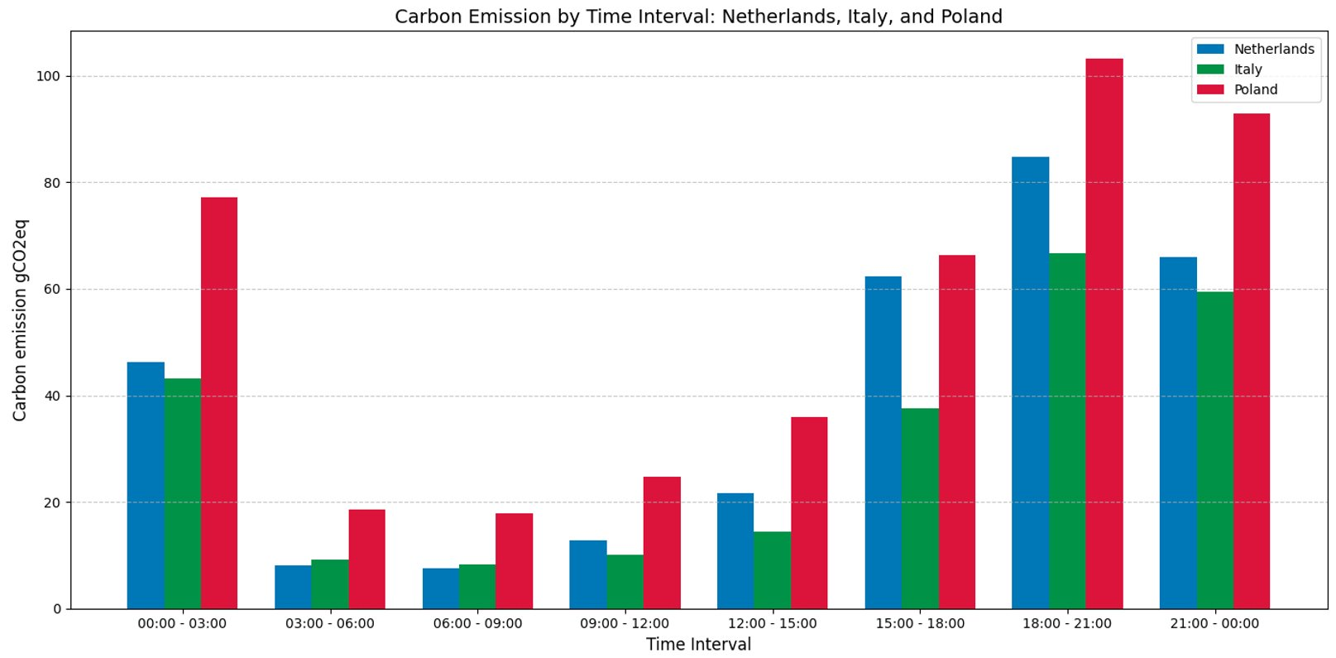
Results and Considerations

Slide 9

Reflections and Conclusions
Transcoding process already highly optimized
Carbon footprint changes every hour with clean energy availability.
Our proposal: allow users to choose a sustainable upload, shifting transcoding to cleaner energy windows.

Slide 10
Thank you for your attention

