Slide 1

Clustering Analysis of Sample Data
Roberto Pagliarini

Slide 2
Practical information
Course materials:
https://github.com/RobertoPagliarini/Introduction-to-Bioinformatics/tree/main
My email: roberto.pagliarini@uniud.it
Theorical lessons + R exercises
Slides + scripts

Slide 3
What is Bioinformatics?
Bioinformatics is an interdisciplinary field that uses computational tools and techniques to analyze and interpret large and complex biological data, such as DNA, RNA, and protein sequences.
It combines biology with computer science, mathematics, and statistics to manage, store, analyze, and disseminate biological information, helping researchers understand biological systems at a molecular level.
Key applications include genome sequencing analysis, predicting protein structures, identifying disease-associated genes, and designing new drugs, making it crucial for modern biology and medicine.

Slide 4
What is Clustering?
Unsupervised learning: no labels provided
Goal: group objects that are similar to each other
Widely used in:
- Genomics (gene expression, allele-specific expression)
- Market segmentation
- Image recognition

Slide 5
Clustering: a very simple example
Find “natural” groupings in unlabeled data

Slide 6
Why is Clustering Important?
Reduces complexity of large datasets
Reveals hidden structures
Helps generate hypotheses
Provides insight for downstream analyses (classification, prediction)

Slide 7
Similarity - distance
Distance d(x,y)
Measures the “dissimilarity between objects”
Similarity s(x,y)
S(x,y) ≈1/d(x,y)
Properties

Slide 8
Example in Bioinformatics
Clustering gene expression across samples
Identifying co-regulated genes
Grouping patients based on molecular profiles
Supports precision medicine

Slide 9
Key Challenges
Choosing the right number of clusters
What variables matter most?
Scalability: large datasets (e.g. RNA-seq)
Interpretability: biological meaning of clusters

Slide 10
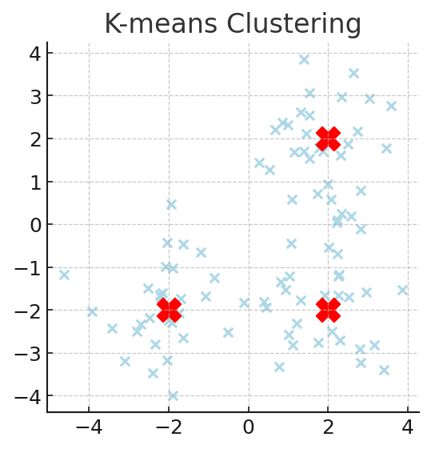
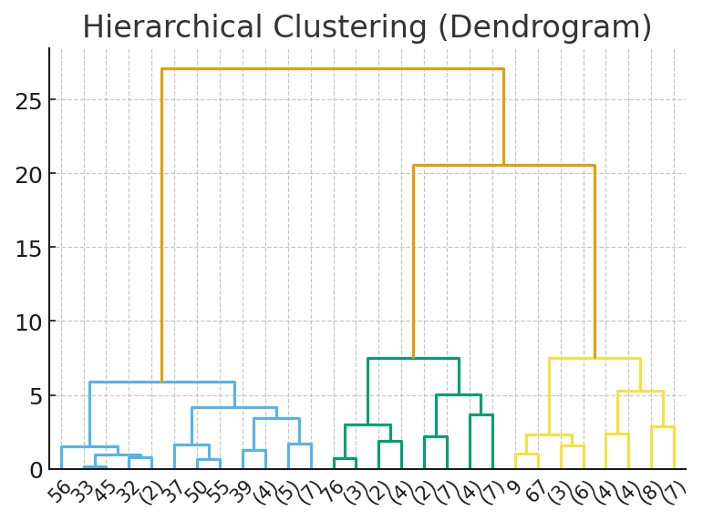
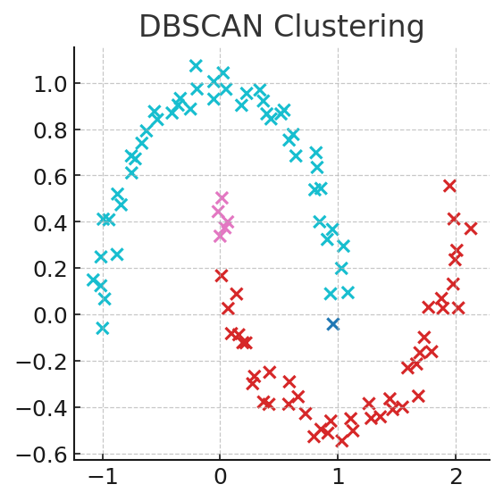
Common Methods
K-means: partitions data into k groups
Hierarchical clustering: tree-like structure
Density-based (DBSCAN): detects clusters of arbitrary shape
Model-based: assumes statistical distributions

Slide 11
Evaluation Metrics
Internal metrics: Silhouette score, Dunn index
External metrics: Adjusted Rand index (if labels exist)
Biological validation: overlap with known pathways/genes

Slide 12
Summary
Clustering = grouping data without labels
Essential tool for exploring high-dimensional data
Useful in biology to find gene groups or patient subtypes
Challenges: choosing methods, validating results

Slide 13
K-means Clustering Algorithm

Slide 14
What is K-Means Clustering
It is an unsupervised machine learning algorithm used for partitioning a dataset into a pre-defined number of clusters.
The goal is to group similar data points together and discover underlying patterns or structures within the data.
The aim is to minimize the distance between the points within a cluster.
K-means is a centroid-based algorithm or a distance-based algorithm
In K-Means, each cluster is associated with a centroid.

Slide 15
K-means Algorithm
Algorithm K-Means(D, k)
m ← D.size // number of instance
FOR i ← 1 TO k DO
μ_{i} ← random // select a random point
WHILE (termination condition)
FOR j ← 1 TO m DO // computing cluster membership
h ← argmin_{1≤i ≤k}dist(x_{j}, μ _{i})
C[h] ←x_{j}
FOR i ← 1 TO k DO
μ _{i} ←
RETURN Make-Predictor (w, P)

Slide 16
How K-Means Clustering Works?
Initialization: start by randomly selecting K points from the dataset. These points will act as the initial cluster centroids.
Assignment: for each data point in the dataset, calculate the distance between that point and each of the K centroids. Assign the data point to the cluster whose centroid is closest to it. This step effectively forms K clusters.
Update centroids: once all data points have been assigned to clusters, recalculate the centroids of the clusters by taking the mean of all data points assigned to each cluster.
Repeat: repeat steps 2 and 3 until convergence. Convergence occurs when the centroids no longer change significantly or when a specified number of iterations is reached.
Final Result: once convergence is achieved, the algorithm outputs the final cluster centroids and the assignment of each data point to a cluster.

Slide 17
K-means example [1]
k₁
Y
Selecting
3 random
centroids
k₂
k₃
X

Slide 18
K-means example [2]
k₁
Y
k₂
We assign
each point
to the closest
cluster
k₃
X

Slide 19
K-means example [3]
k₁
k₁
Y
Computing the
new centroids
k₂
k₃
k₂
k₃
X

Slide 20
K-means example [4]
Reassign
the points to the clusters
k₁
Y
k₃
k₂
X

Slide 21
K-means example [5]
k₁
Y
Reassigned points
k₃
k₂
X

Slide 22
K-means example [6]
k₁
Y
Computing
new centroids
k₃
k₂
X

Slide 23
K-means example [7]
k₁
Y
New centroids
k₂
k₃
X

Slide 24
Questions
﻿Will different initialization lead to different results?
Yes
No
Sometimes
﻿Will the algorithm always stop after some iterations?
Yes
No (We have to set a maximum number of iterations)
Sometime

Slide 25
K-means clustering in R
We will use the pasilla data from Bioconductor.

Slide 26
The Pasilla Dataset
This dataset is available from the Pasilla Bioconductor library and is derived from the work from Brooks et al. (Conservation of an RNA regulatory map between Drosophila and mammals. Genome Research, 2010).
Alternative splicing is generally controlled by proteins that bind directly to regulatory sequence elements and either activate or repress splicing of adjacent splice sites in a target pre-mRNA. Here, the authors have combined RNAi and mRNA-seq to identify exons that are regulated by Pasilla (PS), the Drosophila melanogaster ortholog of the mammalian RNA-binding proteins NOVA1 and NOVA2.

