Slide 1

DigitalTechne MVP May 21, 2024

Slide 2
Basic Roles
Laboratory:
Create DNA Cartridge
Insert the DNA analysis (both xls and pdf) in BlockChain
Artwork Owner:
create the opera folder in BC
Purchase cartridges
Place DNA ink on the artwork
Insert Dna data in blockchain (cartridge identifier and ink position on the artwork)
Artwork Stakeholder:
DNA verify (analysis of the swab and ink position are checked against the Blockchain record)

Slide 3
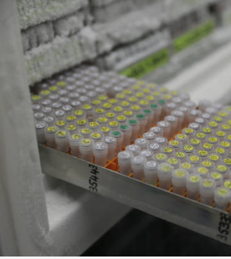
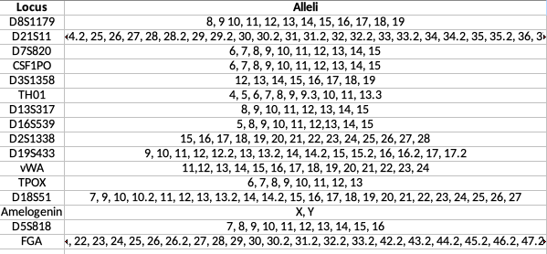
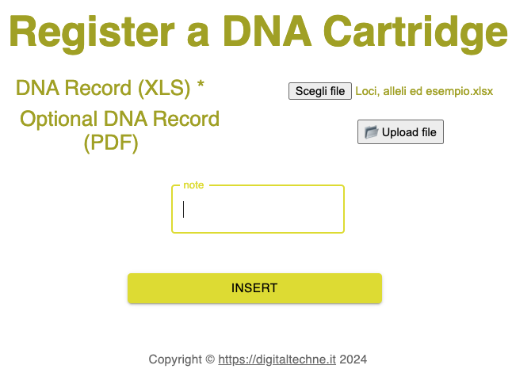
Laboratory: Create Cartridge, Analyze, Load in BC

Slide 4
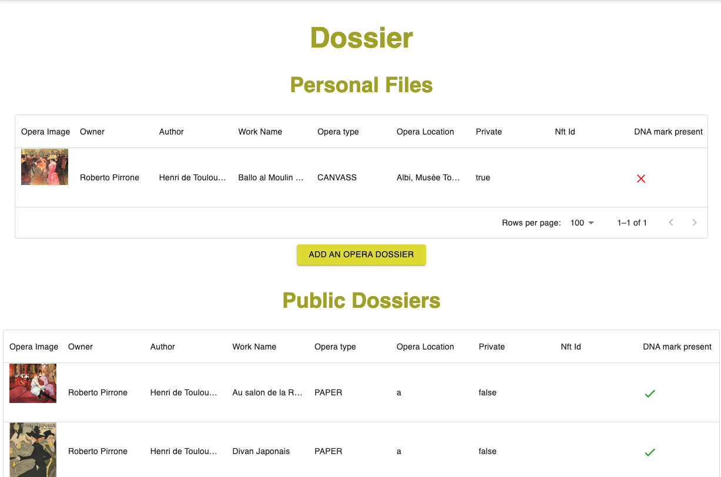
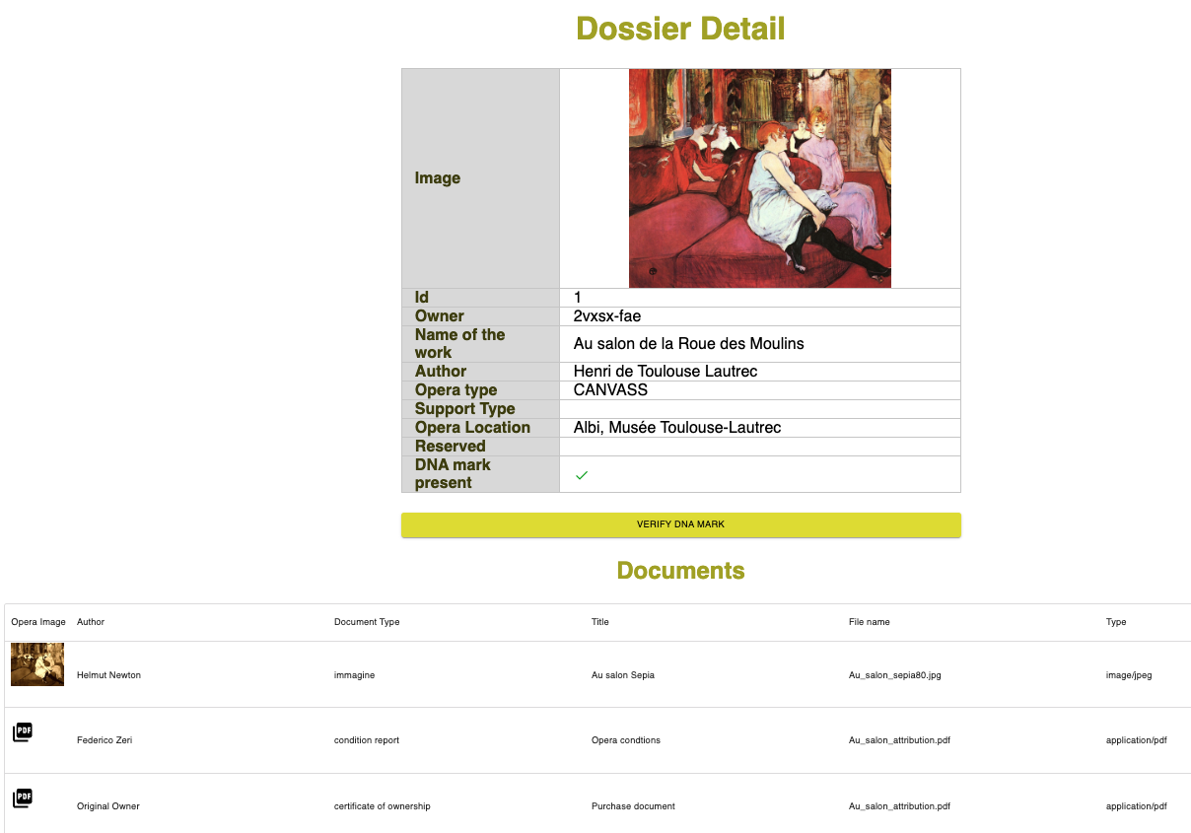
Owner: Create Archive, documents and images

Slide 5
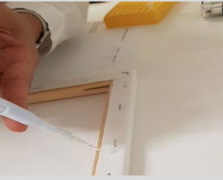
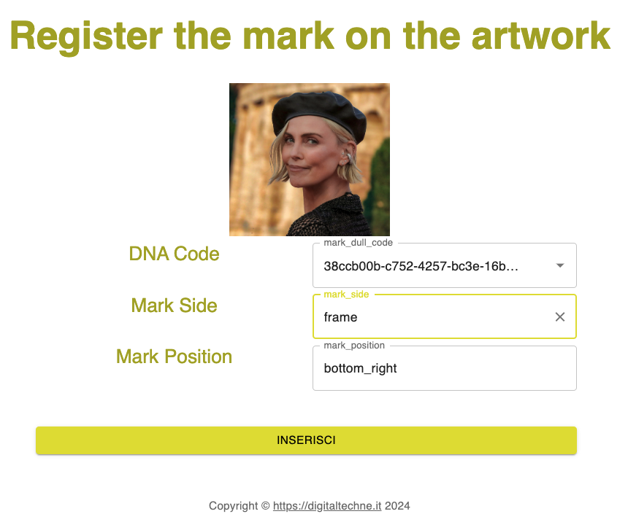
Owner, using the Signature Kit: put the genetic ink on the opera and in BC

Slide 6
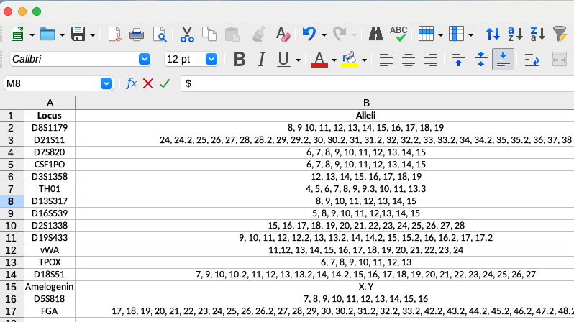
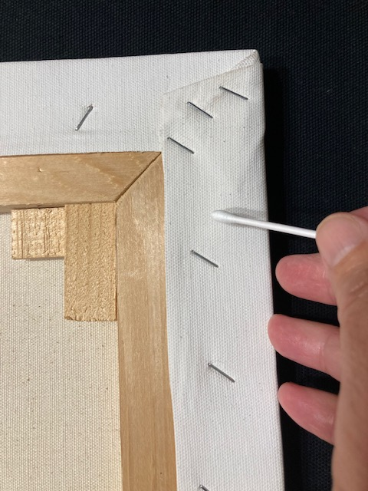
Verify Authenticity: Pick the DNA with a swab and analyze it

Slide 7
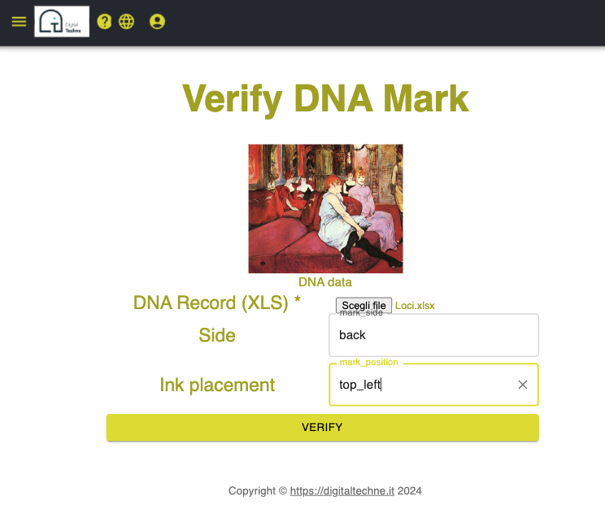
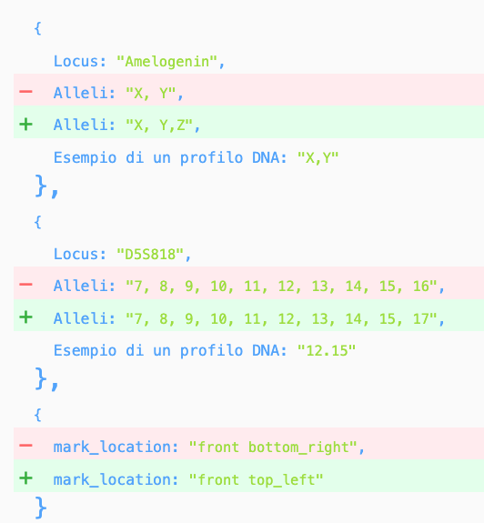
Verify: Compare analysis with DNA in BC

Slide 8
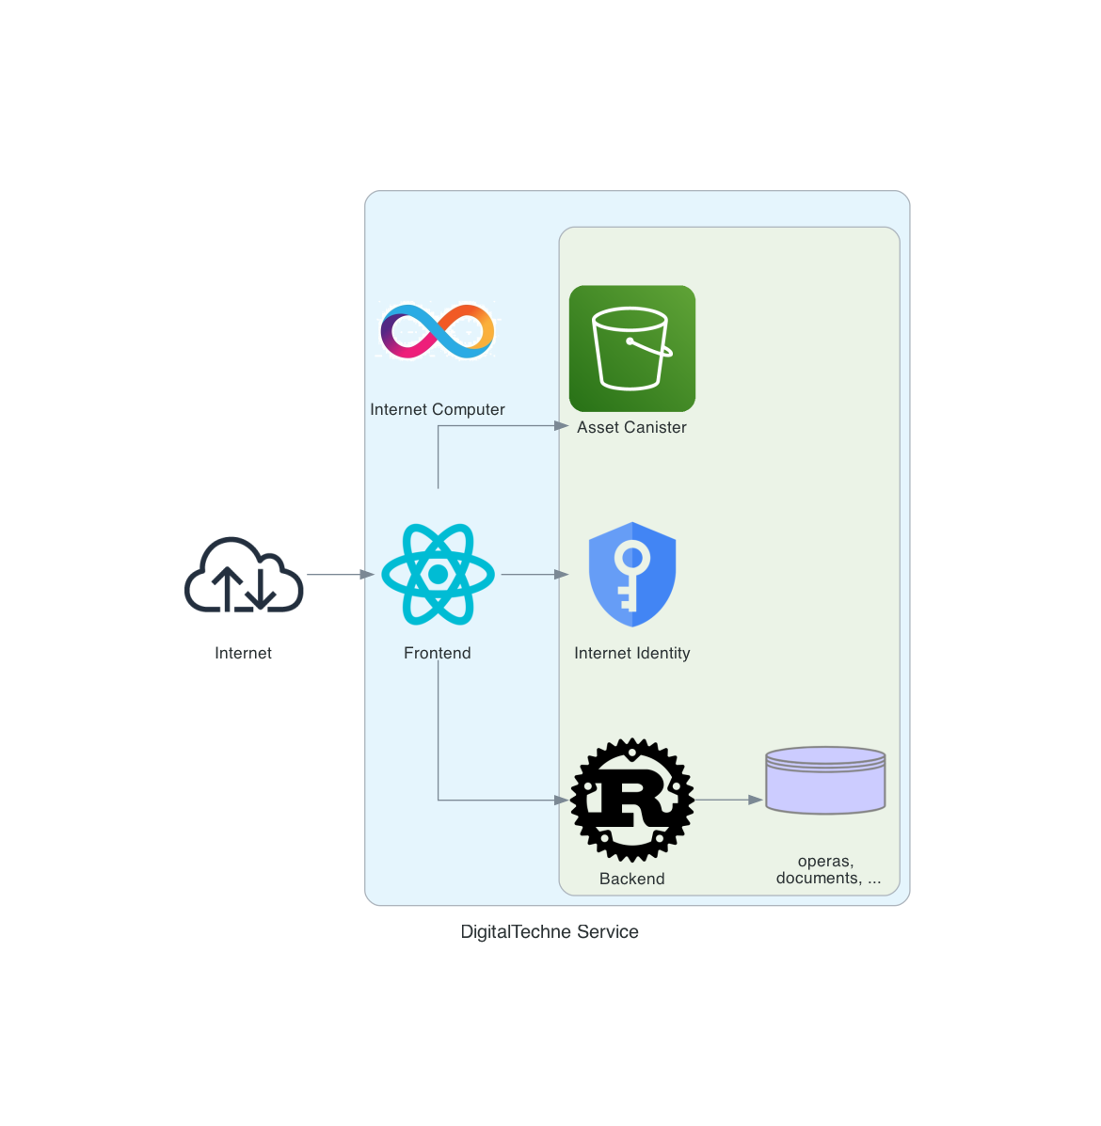
MVP Architecure
MVP in mainnet:
https://way7l-iqaaa-aaaan-qmfoa-cai.icp0.io/

