Slide 1

DigitalTechne TECHNICAL ASSESSMENT
November 21, 2024

Slide 2
Achievements so far
Moving from MVP to Production Ready
New Features Introduction

Slide 3
MVP → Production Ready
Same code base for multiple apps, refactoring of React components and Rust routines
Easy handling of new languages (automatic translation for Help on Line, manuals, prompts, Pull Down Menus)
Documentation (Rust doc and JSDoc)
Coding standards (Biome for React, rust fmt for backend code)
Automated Back End Test Suite

Slide 4
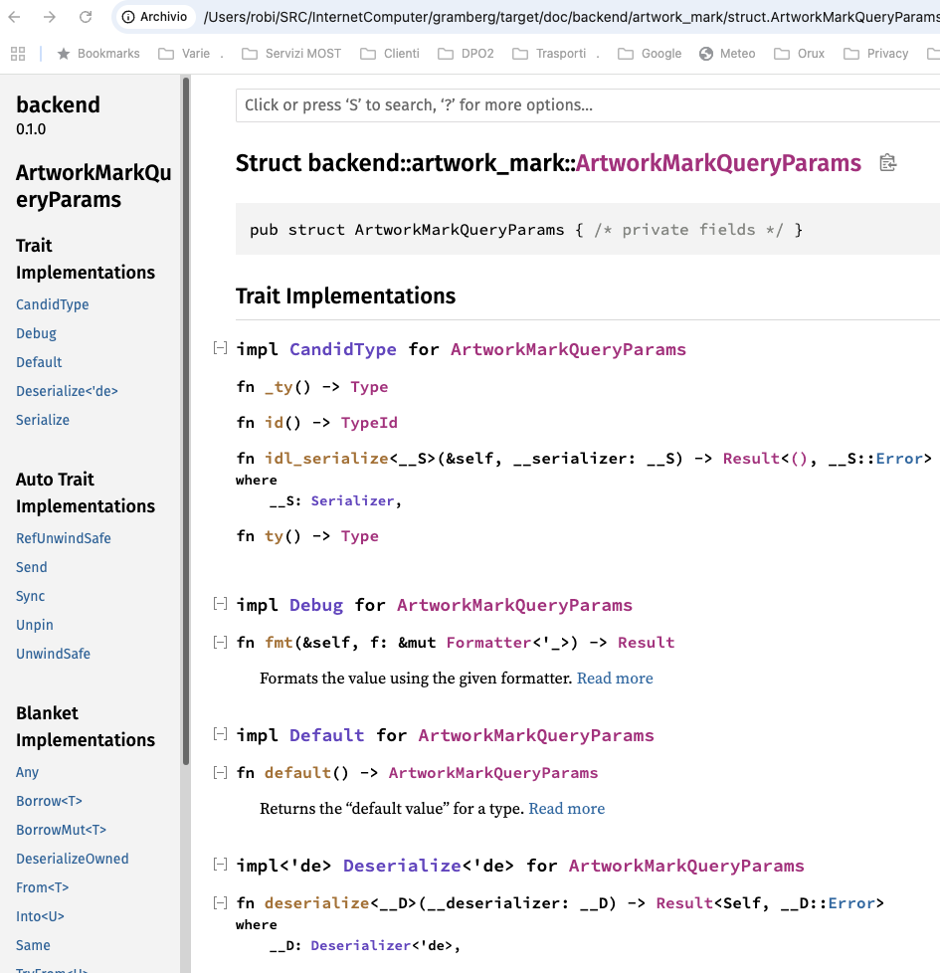
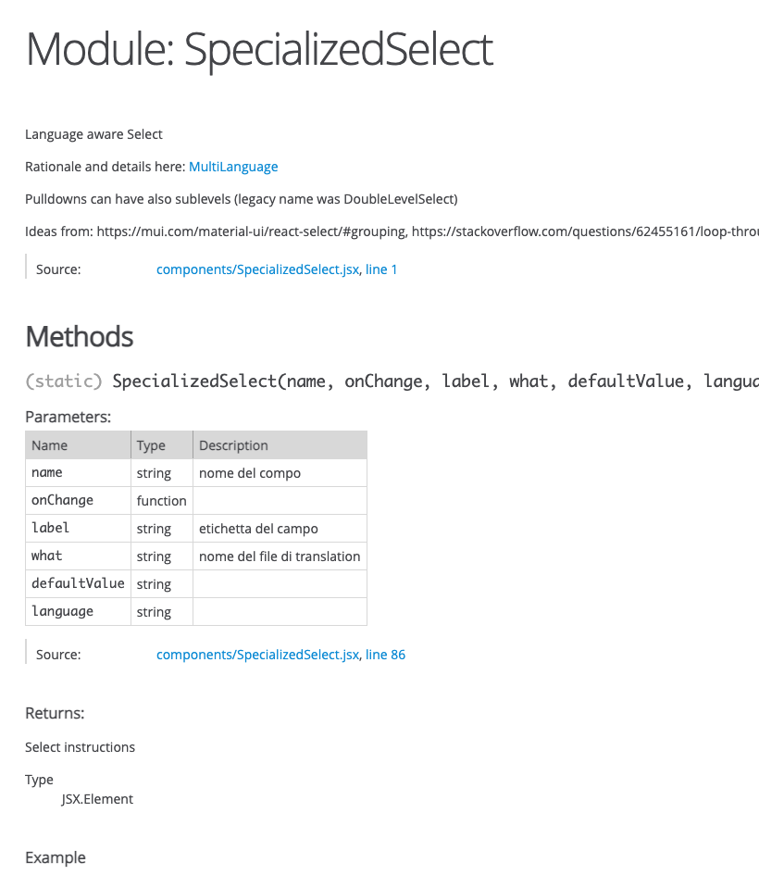
BE and FE Documentation

Slide 5
New Features
Activity Tracking (every change is recorded in a user readable format)
Multiple Marks on a single opera (when using artificial DNA, mark is not unique)
Role Based Access Control: Fine grain capabilities for each principal
Batch Inserts for metadata (XLSX files and document directories)

Slide 6
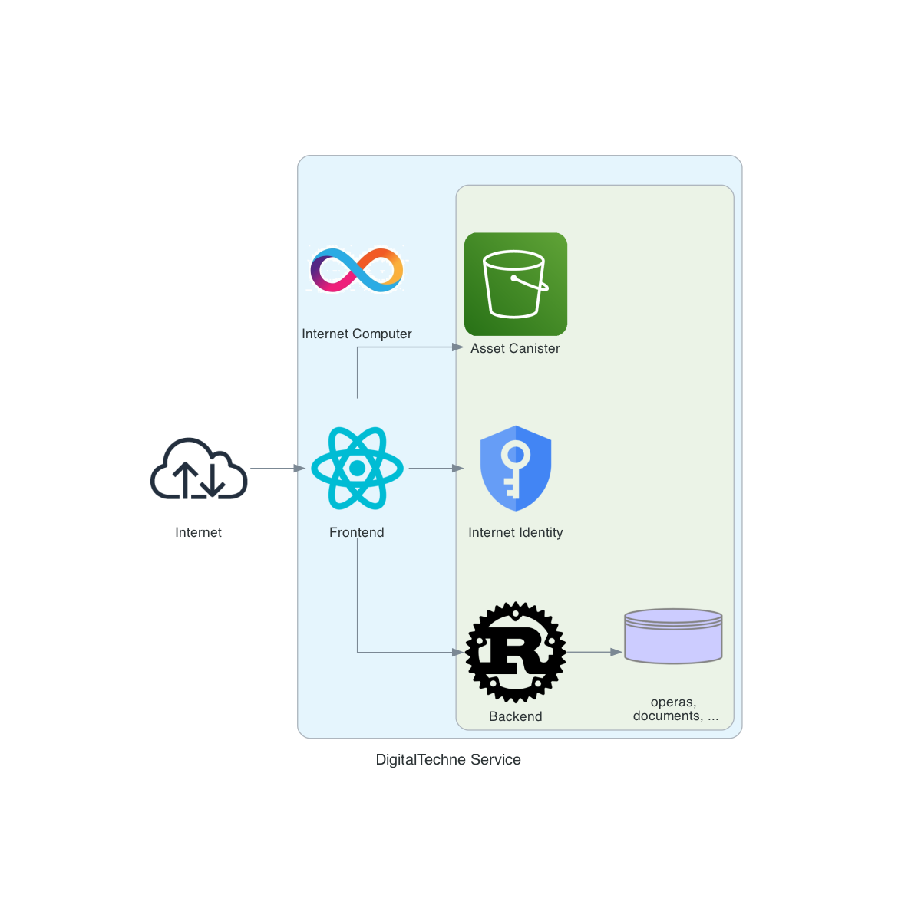
MVP Architecure
MVP in mainnet:
https://way7l-iqaaa-aaaan-qmfoa-cai.icp0.io/

