Slide 1

DigitalTechne MVP May 21, 2024

Slide 2
Company Mission and MVP Goal
Artwork forgery is a big concern. Our aim is to create an unbreakable and unique bond between the physical artwork and its digital representation, that will help to fight fakes
The bond (our Signature Kit) is made up of two elements: the genetic ink on the artwork and its digital representation on the IC Blockchain
The MVP will focus on the application logic of this solution

Slide 3
Simplified Solution Flow
Laboratory:
Create DNA Cartridge
Insert the DNA analysis (both xls and pdf) in BlockChain
Artwork Owner:
create the opera folder in BC
Purchase cartridges
Place DNA ink on the artwork
Insert Dna data in blockchain (cartridge identifier and ink position on the artwork)
Artwork Stakeholder:
DNA verify (analysis of the swab and ink position are checked against the Blockchain record)

Slide 4
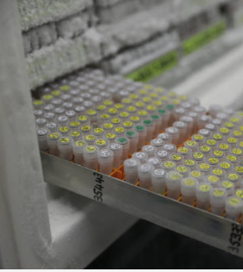
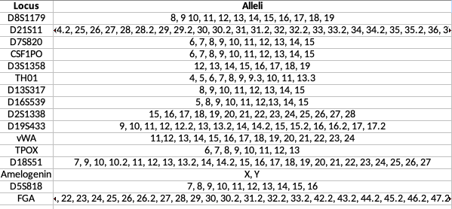
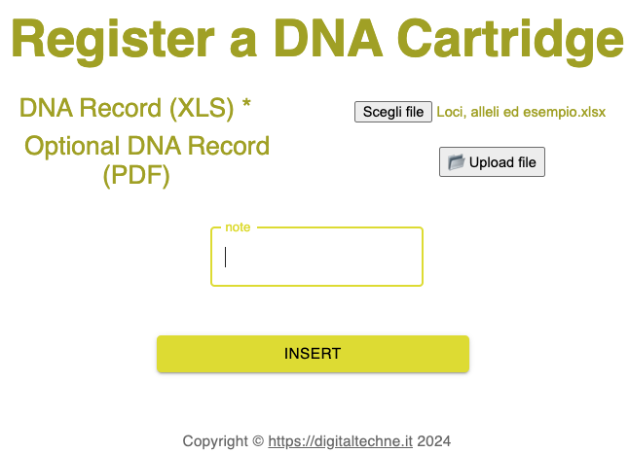
Laboratory: Create Cartridge, Analyze, Load in BC

Slide 5
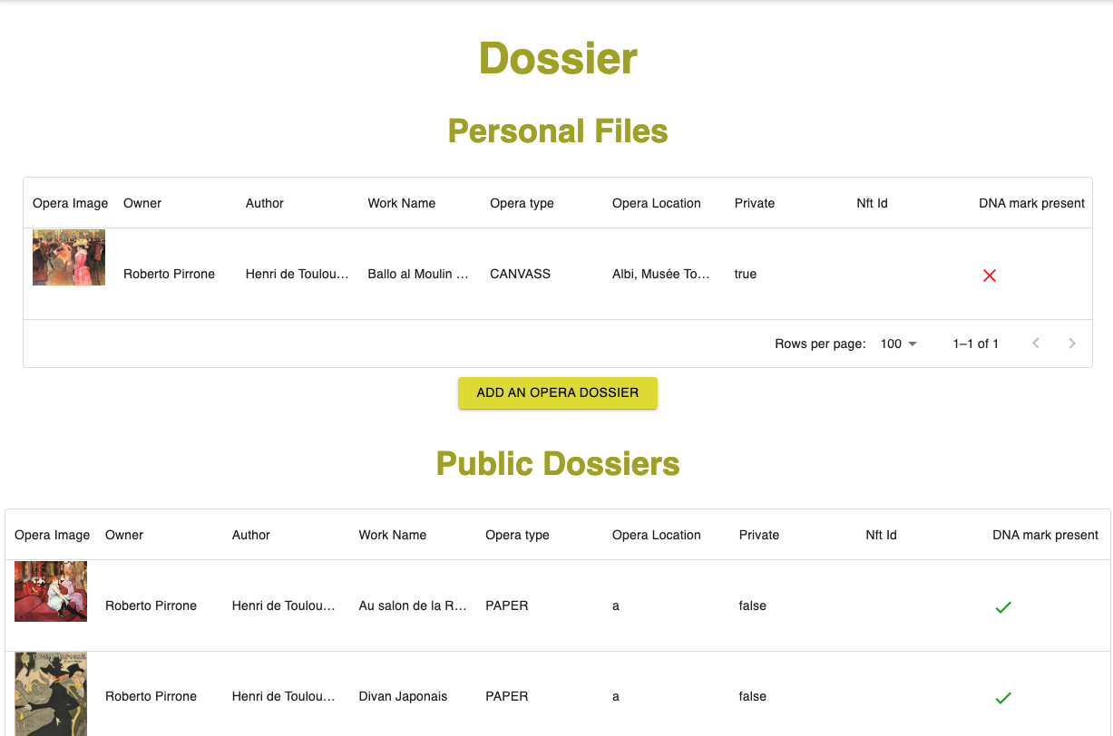
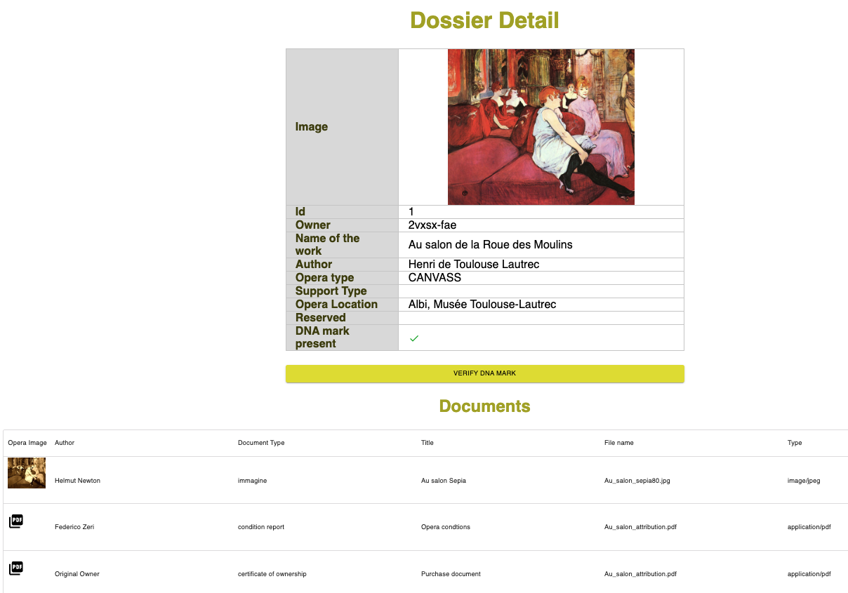
Owner: Create Archive, documents and images

Slide 6
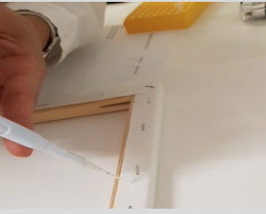
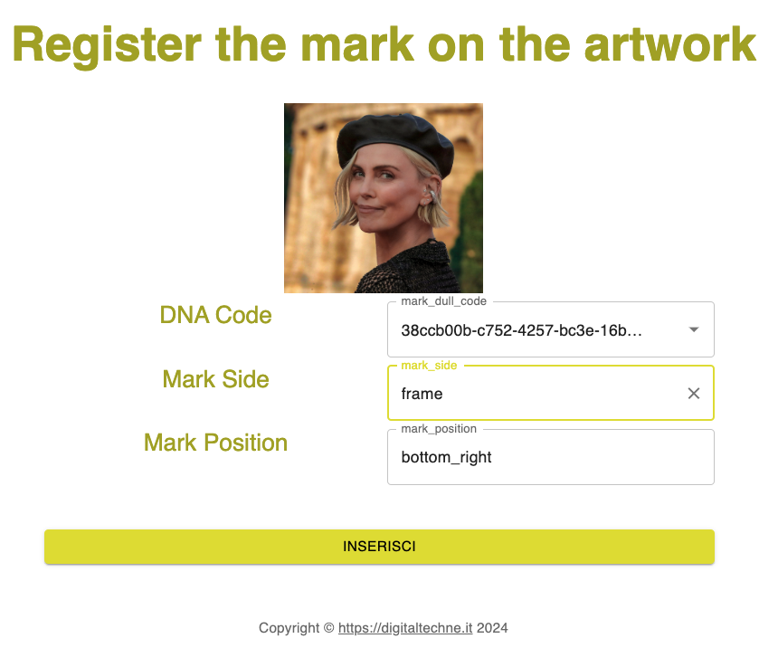
Owner, using the Signature Kit: put the genetic ink on the opera and in BC

Slide 7
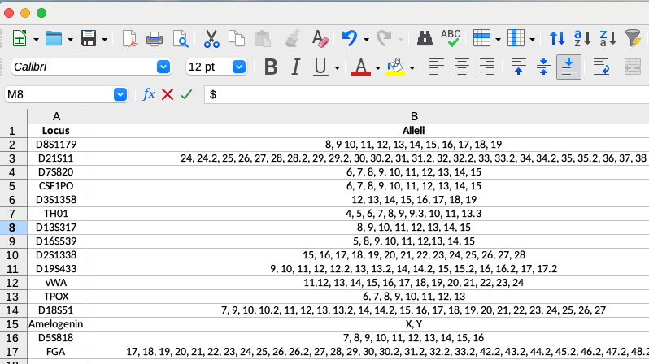
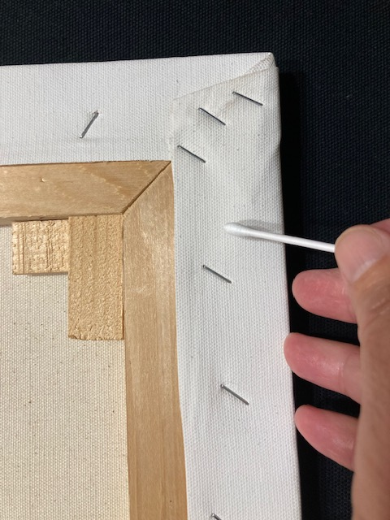
Verify Authenticity: Pick the DNA with a swab and analyze it

Slide 8
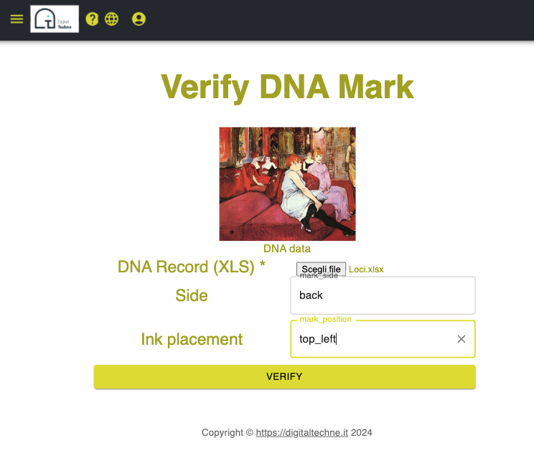
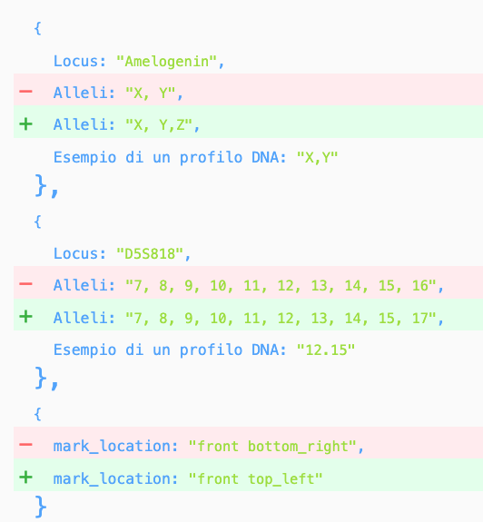
Verify: Compare analysis with DNA in BC

Slide 9
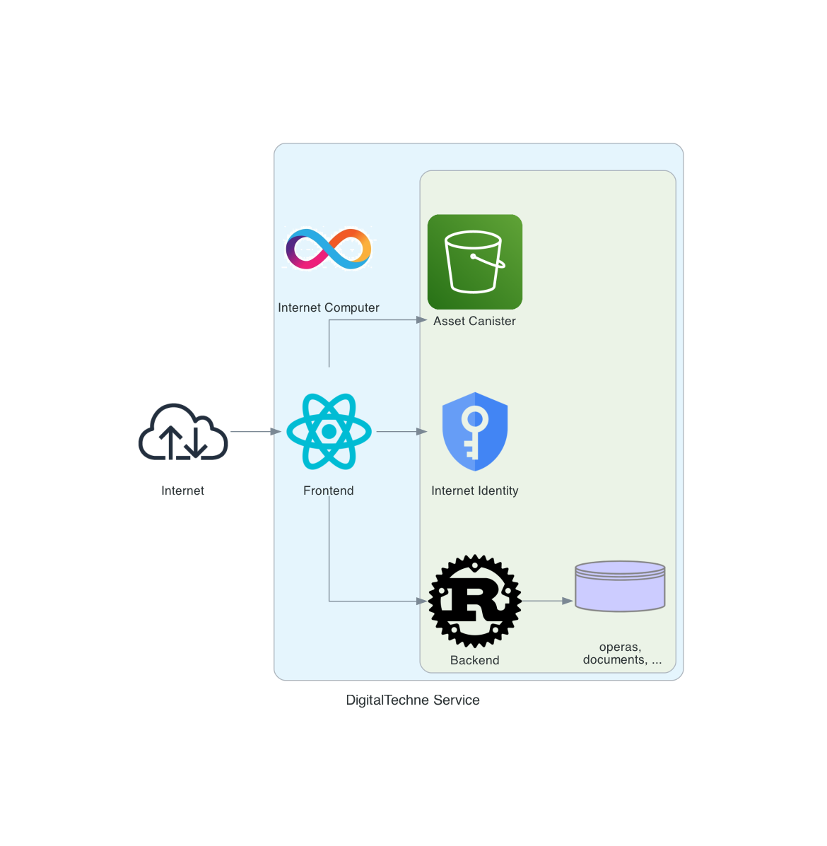
MVP Architecure
MVP in mainnet:
https://way7l-iqaaa-aaaan-qmfoa-cai.icp0.io/

Slide 10
Final Product needs
Reduce adoption friction:
NFID authentication?
Cartridge and Services Purchase: on ramp solutions (alchemy, banxa, ...), or even pure Fiat, off chain money
KYC for physical delivery of cardridges
Enforce Trust and Privacy:
IC Certified Assets
Encryption (Vet keys?) for data and documents
Enpower financial operations:
Mint NFT of each artwork (enrich image with custom EXIF/XMP tags for DNA strings)

