Slide 1

DigitalTechne MVP May 21, 2024

Slide 2
Company Mission and MVP Goal
Arwork forgery is a big concern. Our aim is to create an unbreakable and unique bond between the physical artwork and its digital representation, that will help to fight fakes
The MVP will focus on the application logic of this solution

Slide 3
Solution Flow
Create Cartridge of ink containing a unique DNA, and analyze it
Place a drop of ink on the physical artwork
Create on the Blockchain a digital folder of documents and images related to the artwork
Add the DNA analysis to the folder
Verify that the DNA on the artwork (collected with a swab) is the same registered on the blockchain

Slide 4
MVP Contents (Software only)
Laboratory: Insert the DNA analysis (both xls and pdf) in BlockChain
Artwork Owner: Purchase cartridges
Artwork Owner: Insert Mark in blockchain (cartridge identifier and ink position on the artwork)
Artwork Stakeholder: DNA verify (xls analysis of the swab and ink position are checked against the Blockchain record)

Slide 5
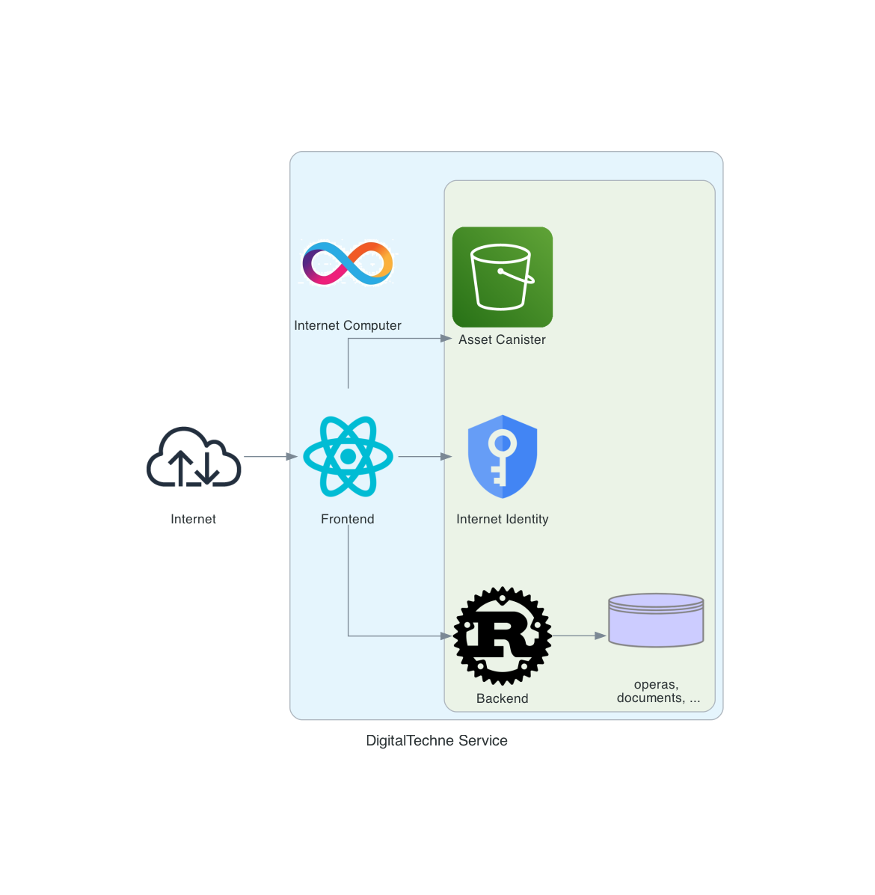
MVP Architecure

Slide 6
Final Product needs
Reduce adoption friction:
NFID authentication?
Cartridge and Services Purchase: on ramp solutions (alchemy, banxa, ...), or even pure Fiat, off chain money
KYC for physical delivery of cardridges
Enforce Trust and Privacy:
IC Certified Assets
Encryption (Vet keys?) for data and documents
Enpower financial operations:
Mint NFT of each artwork (enrich image with custom EXIF/XMP tags for DNA strings)

