Slide 1
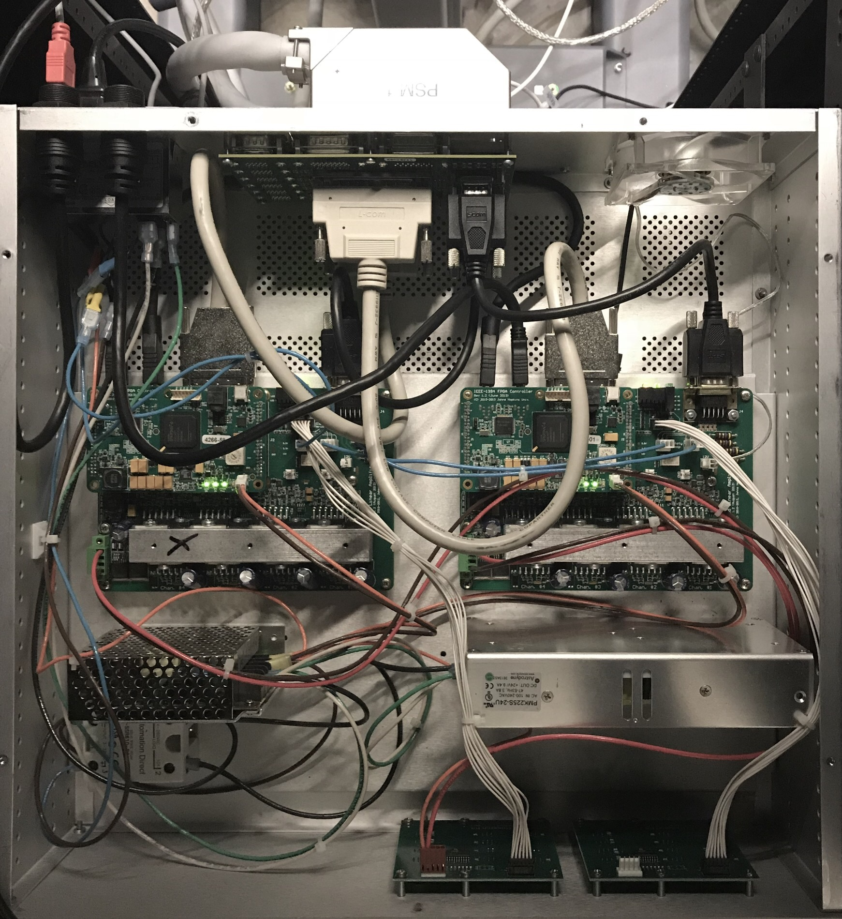
FireWire
Arm ITT Connector
dMIB
FireWire
SCSI 68
Low voltage
DB 9
Motor voltage
FPGA 1
FPGA 2
E-Stop
E-Stop
QLA 1
QLA 2
Logic Power Supply
Motor Power Supply
Safety Relay
Front LEDs

