Slide 1
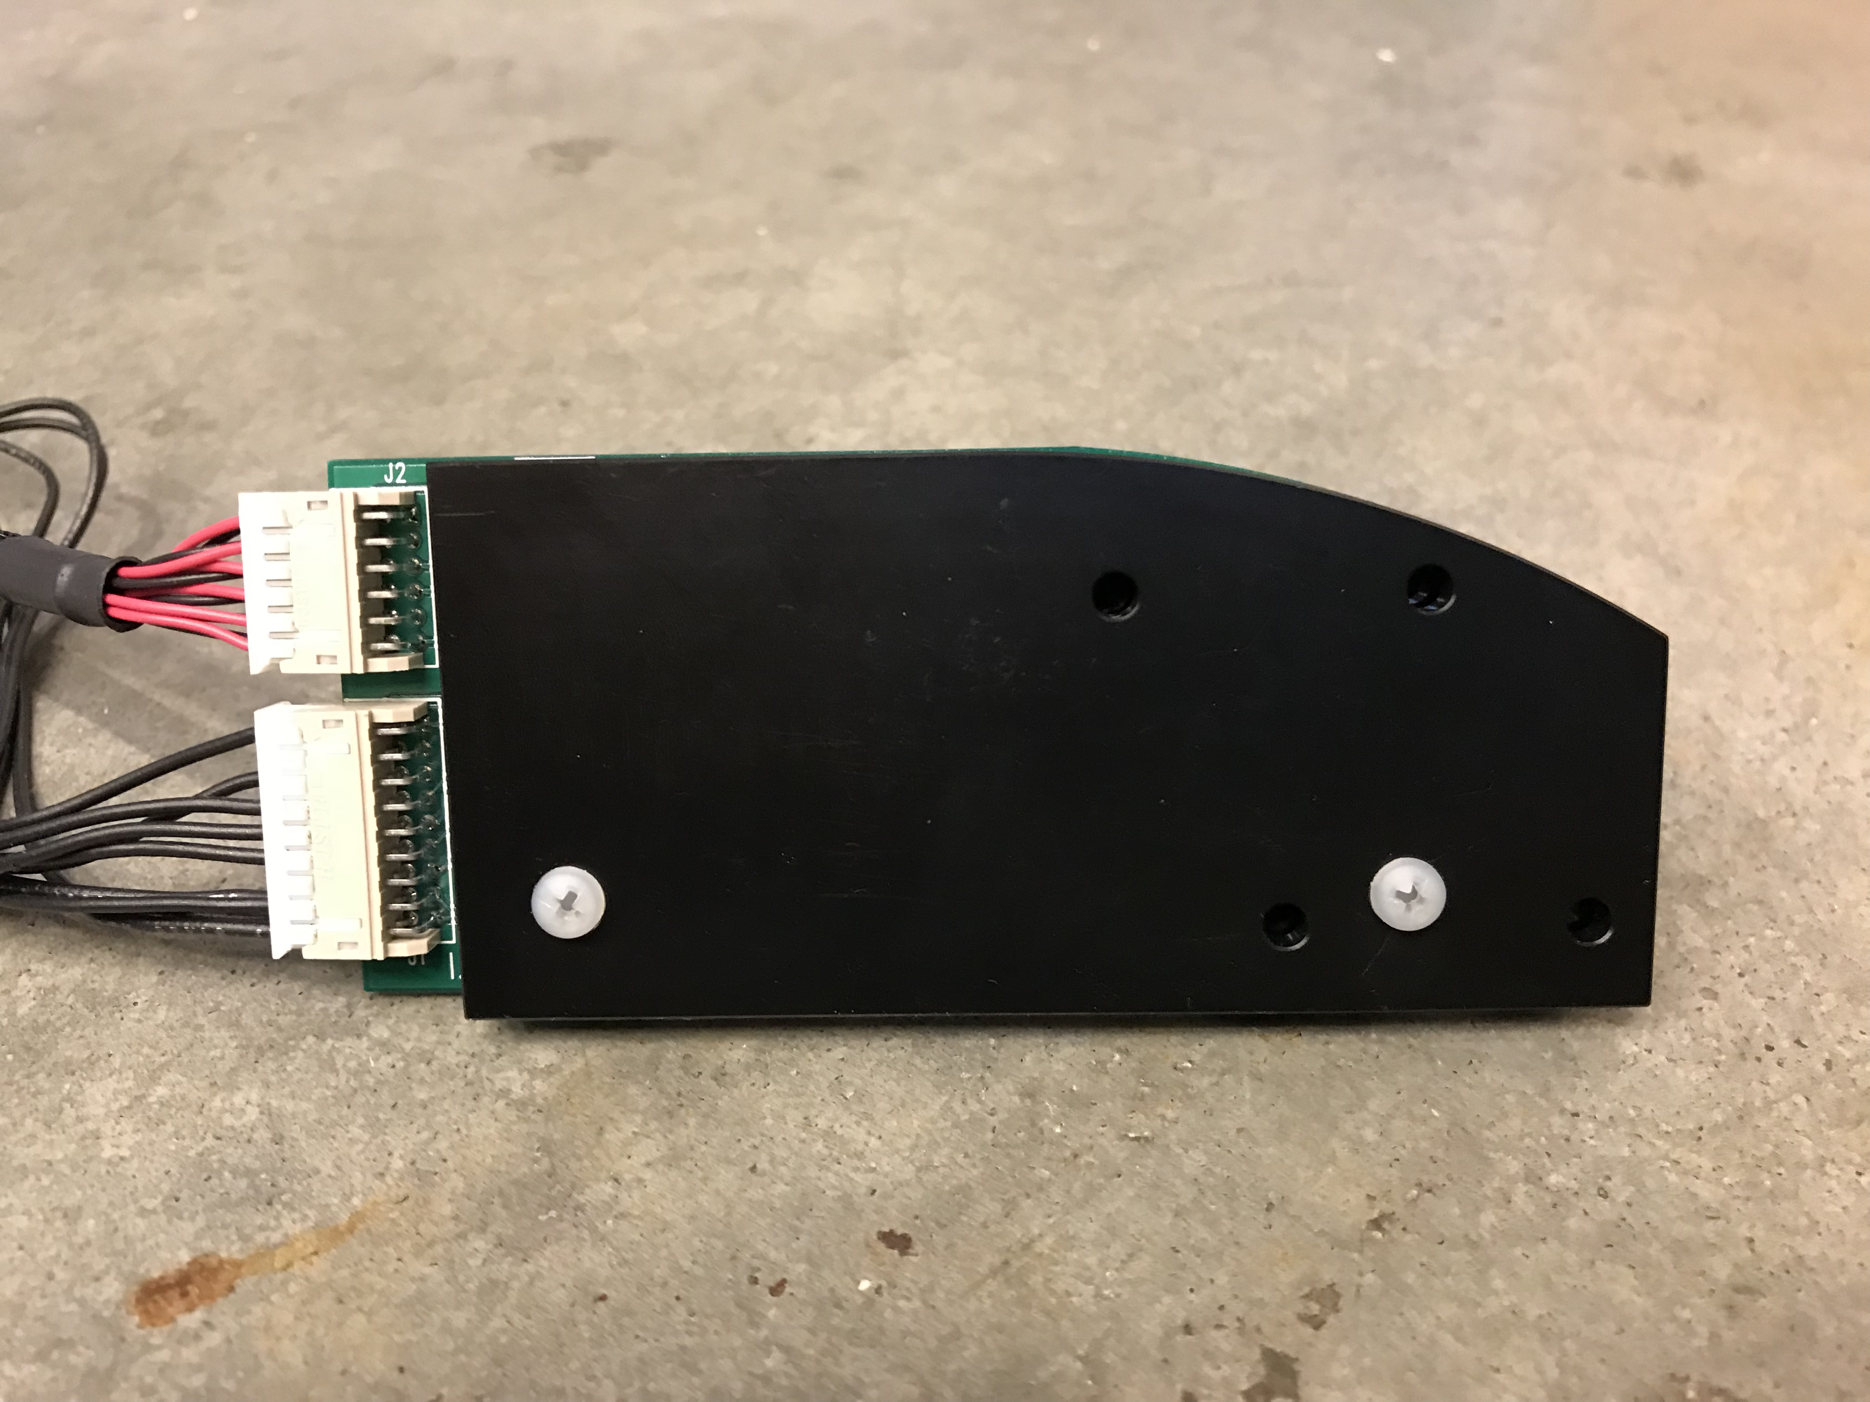
To LEDs
Sensor 3
Sensor 1
To controller
Sensor 4
Sensor 2

