Slide 1
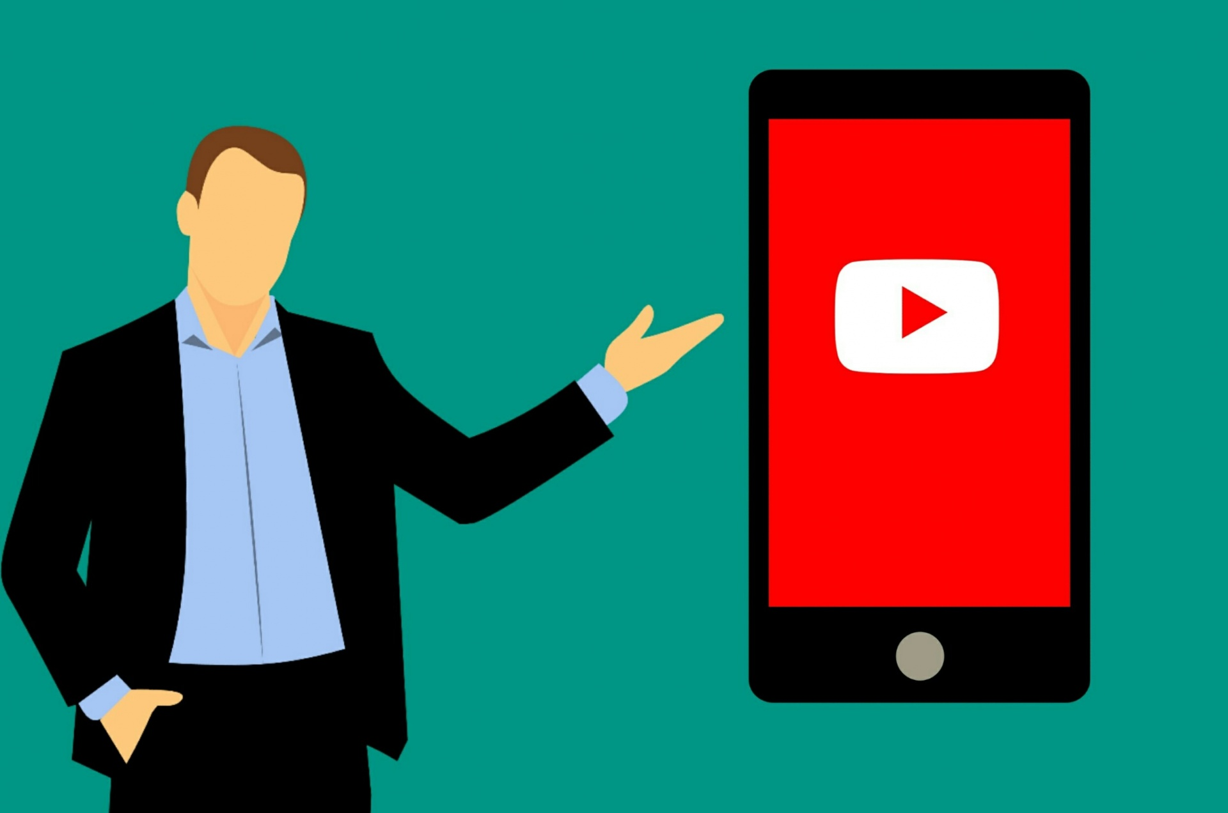
The idea behind the project is for the client to manage YouTube functions Remotely
YouTube Video Player
Introduzione

Slide 2

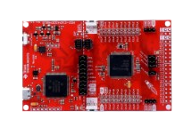
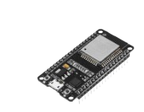
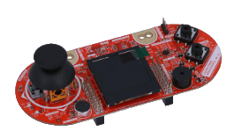
System
MSP432P401R LaunchPad
ESP32 (ESP32-WROOM-32)
MSP432P401R BoosterPack BOOSTXL-EDUMKII
development board for the MSP432P401R microcontroller.
microcontroller with Wi-Fi and Bluetooth for IoT applications.
range of sensors and user interface components.

Slide 3

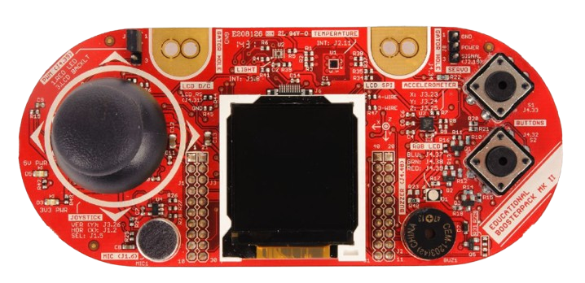
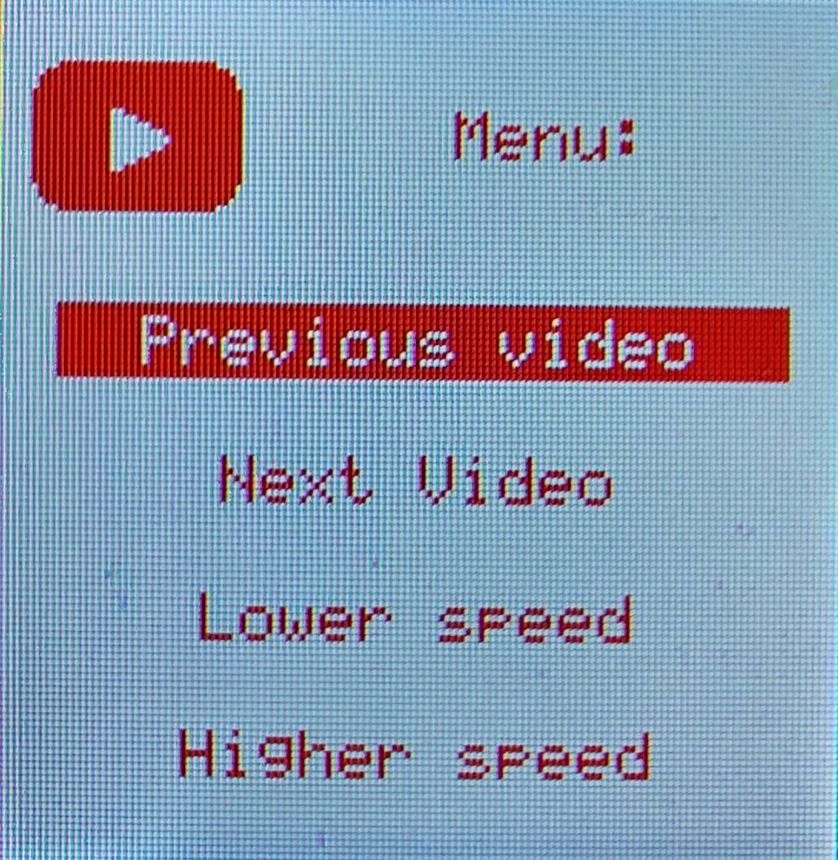
Commands
Volume up
Volume down
10 seconds backward
10 seconds forward
Mute/Unmute
Pause/play
Enter/exit the menu
Up
Down
Select
1
5
3
6
4
7
2

Slide 4



Working flow
action
interrupt
Specific message generated
CLIENT
UART
Transmitter
Receiver
Update display based on the data
HTTP request
Perform request
Data
Server handles requests
Send Data

Slide 5
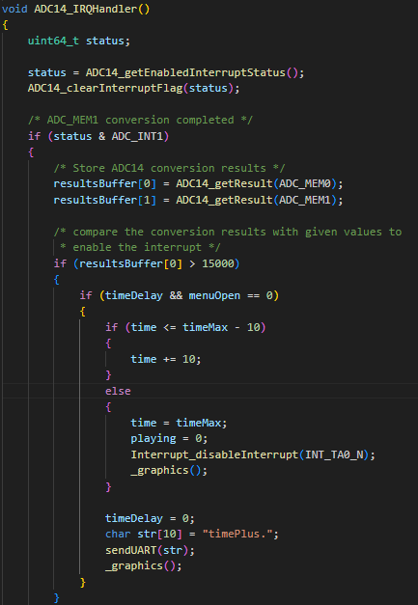
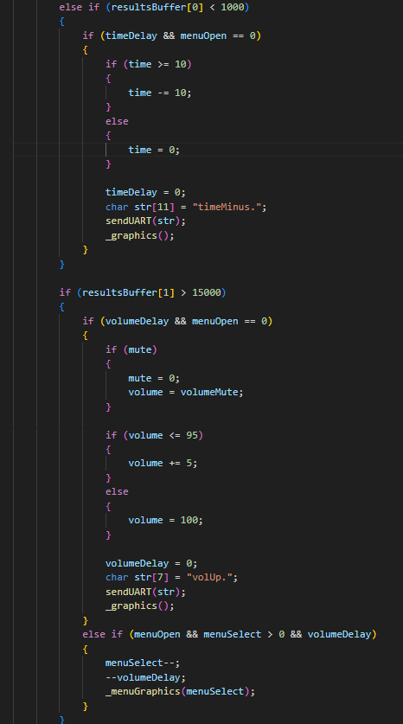
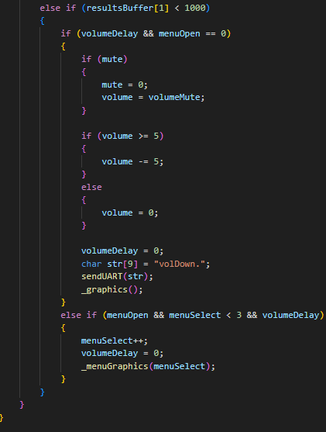

Control the movement of the Joystick

Slide 6
Problems encountered
Solutions to problems
No APIs
YouTube does not have APIs for its operations
Client server loaded by ESP32 was too heavy
Solution to no APIs
Communication with WebSockets:
2-way interactive communication session between the browser and the server.
Set up AWS server to handle the requests

Slide 7
Conclusions and future work
It was a great experience to learn how to interact with softwares and sensors.
We also learned how to use WebSocket APIs instead of relying on APIs offered by the server
We were able to set up a server to handle requests
We could improve the system by adding many different streaming platforms on a single page and control them all simultaneously and add different commands

