Slide 1
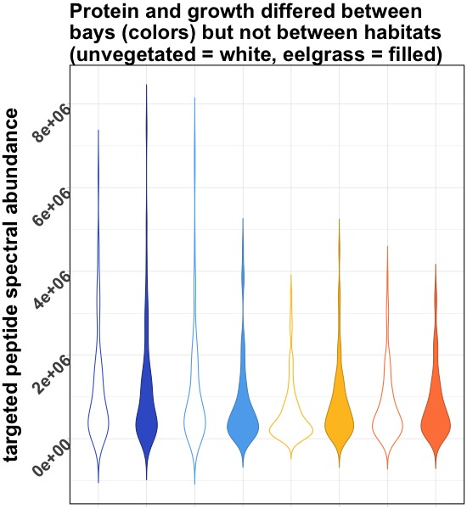
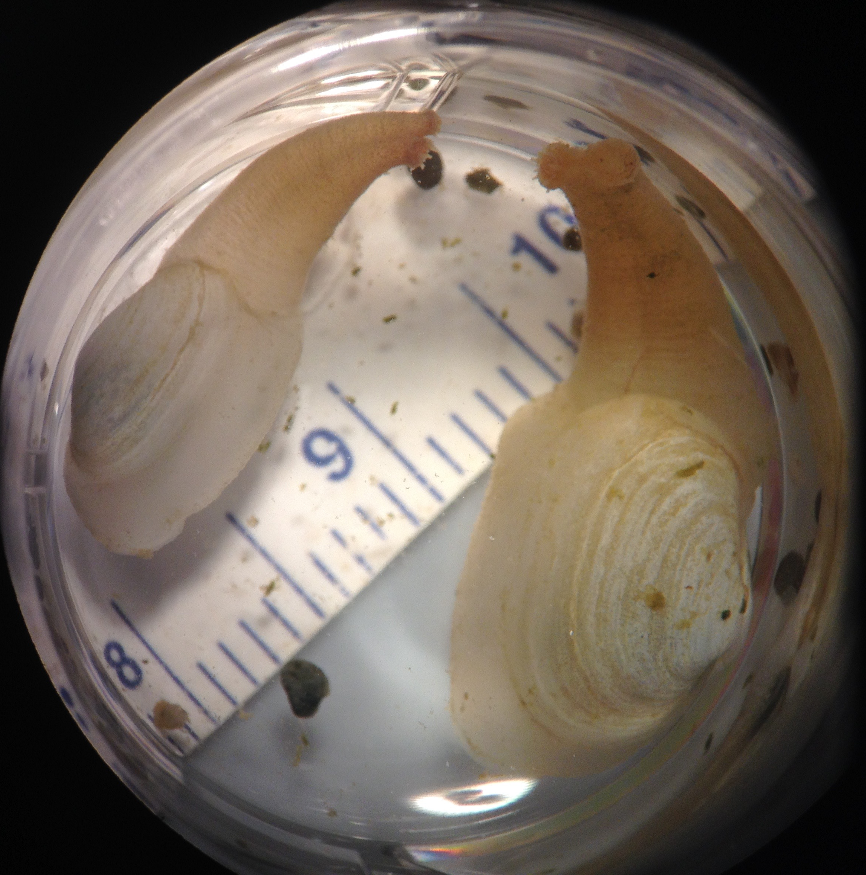
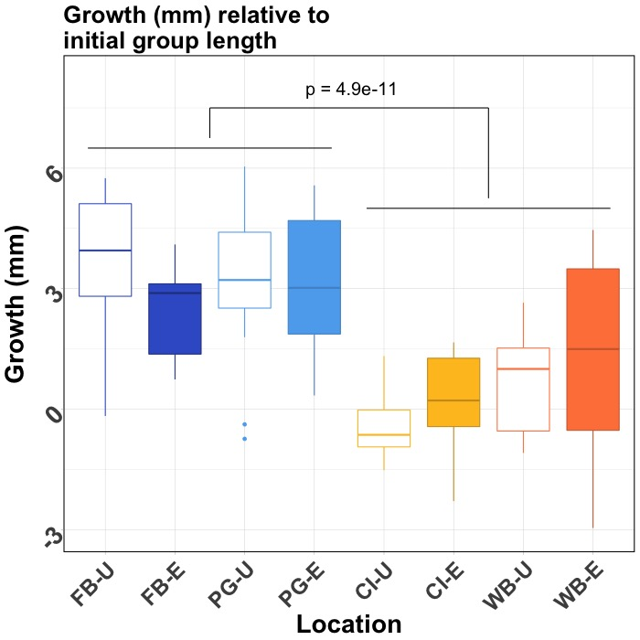
Washington State
p = 1.4e-3
Juvenile geoduck deployed for 30 days, gill protein abundance compared between habitats and bays using proteomics targeted at oxidative stress response
2-Stage Proteomics Approach
Peptide Discovery
Data Independent Acquisition
Targeted Quantification
Selected Reaction Monitoring

