Slide 1
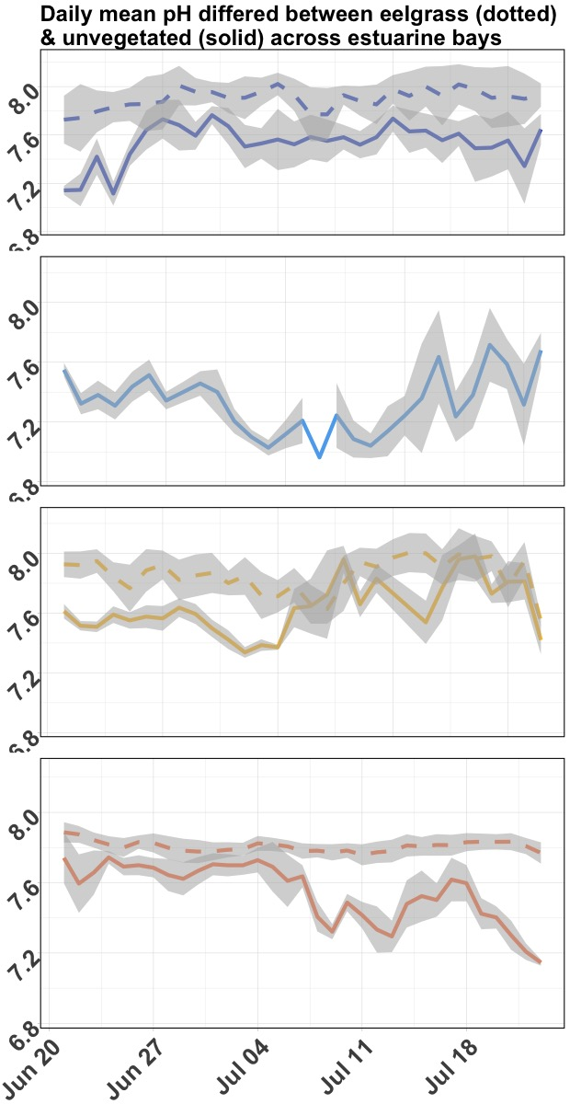
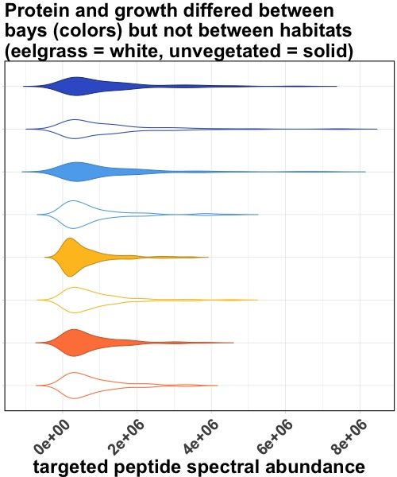
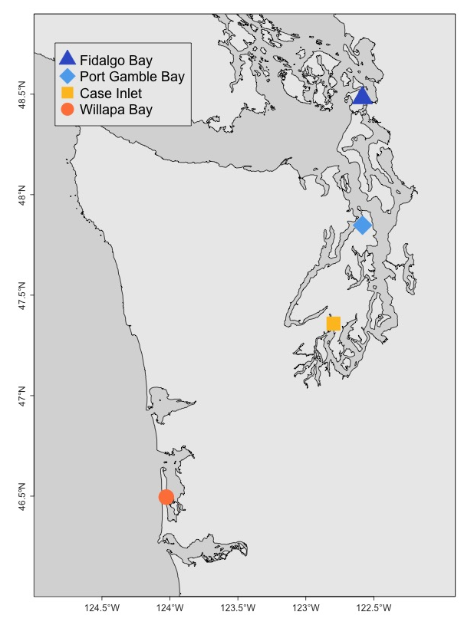
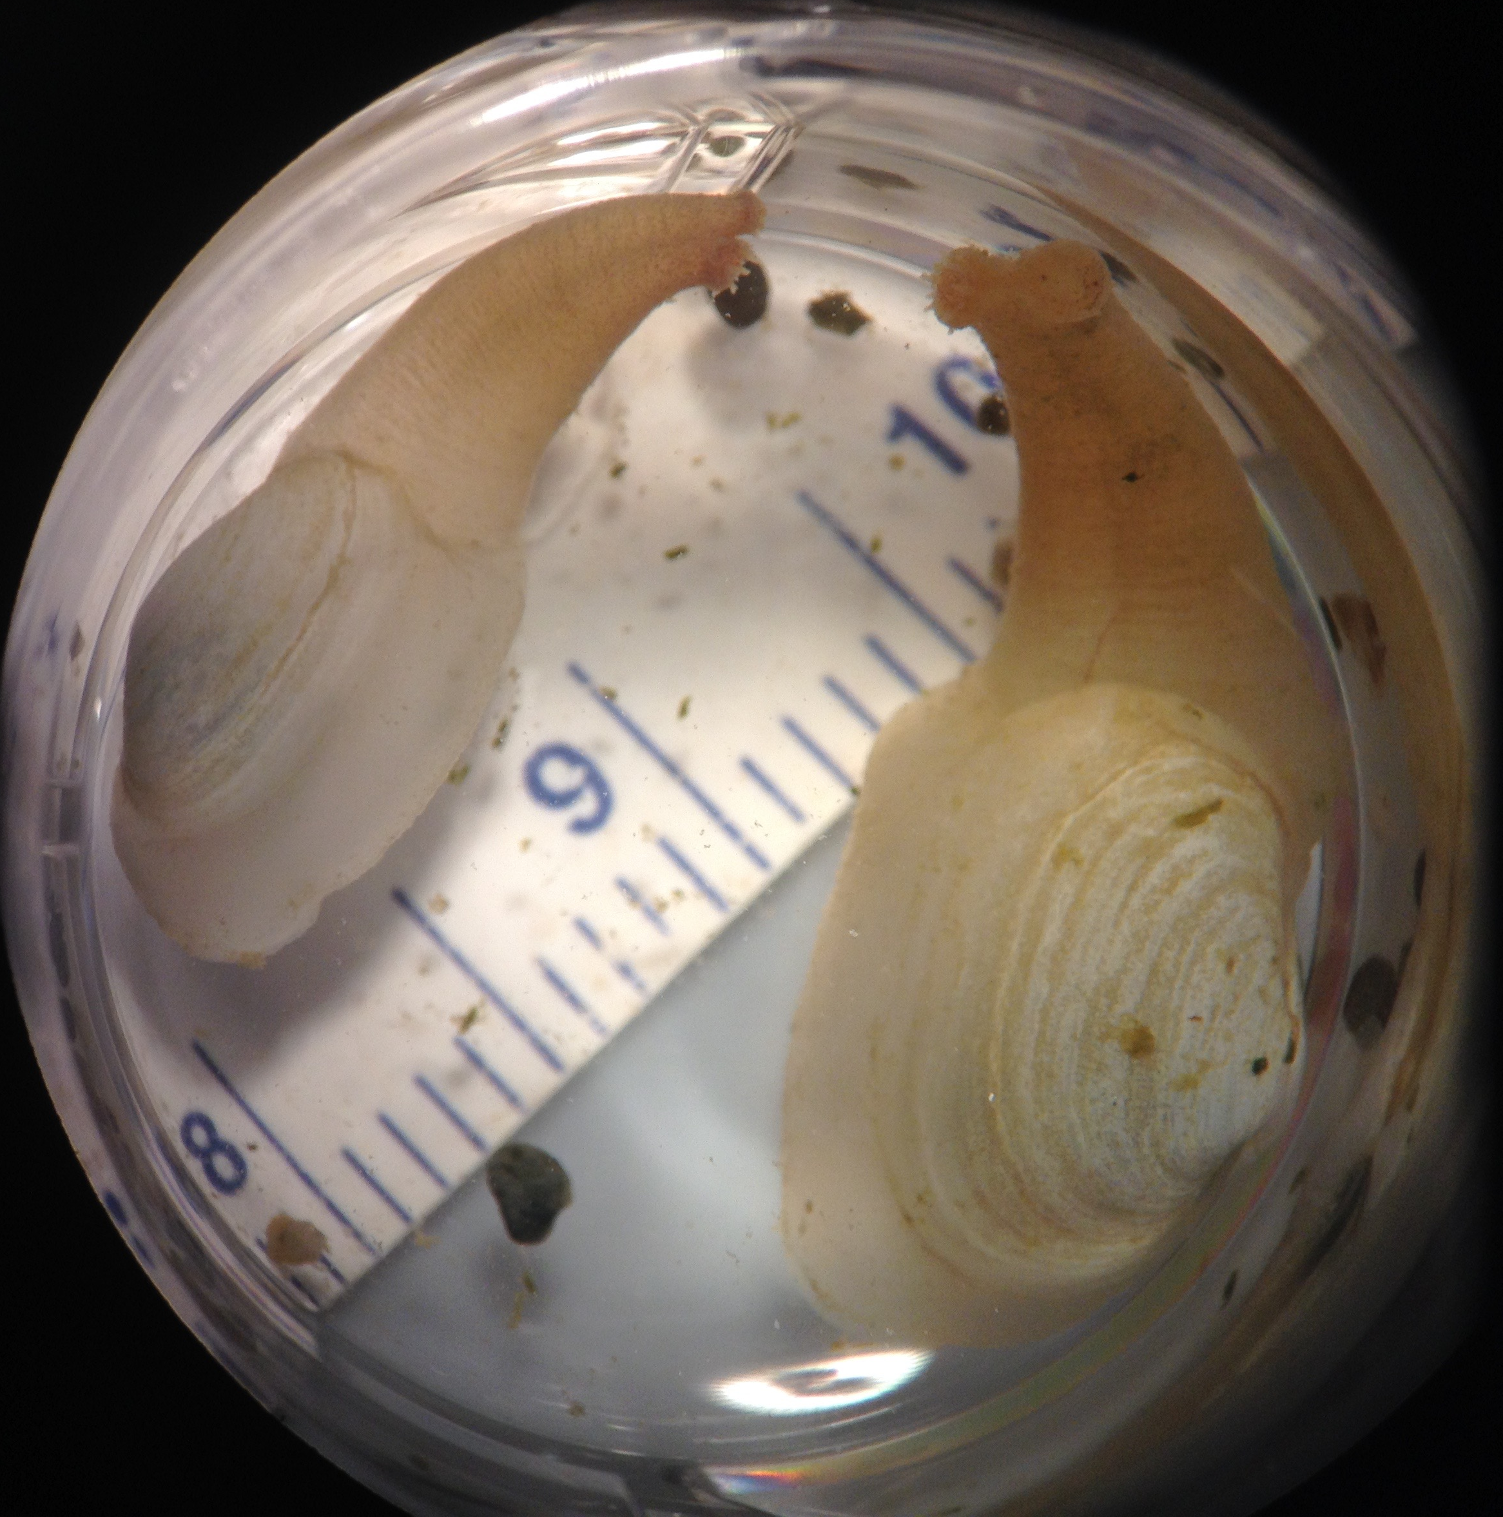
**
Juvenile geoduck deployed for 30 days, gill protein abundance compared between habitats and bays using proteomics targeted at oxidative stress response
Targeted Quantification
Selected Reaction Monitoring
Peptide Discovery
Data Independent Acquisition
2-Stage Proteomics Approach
Washington State

