Slide 1
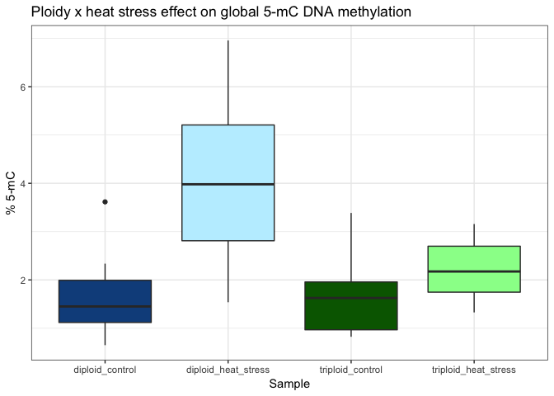
a
a
a
Heat stress effect on global DNA methylation in C. gigas diploids and triploids. Boxes indicate median (thick black line) and the first and third quartile of % 5-mC global DNA methylation. “Control” indicates oysters not exposed to heat stress. Means sharing a letter are not significantly different at P < 0.05 (Tukey-adjusted comparison).

