Slide 1
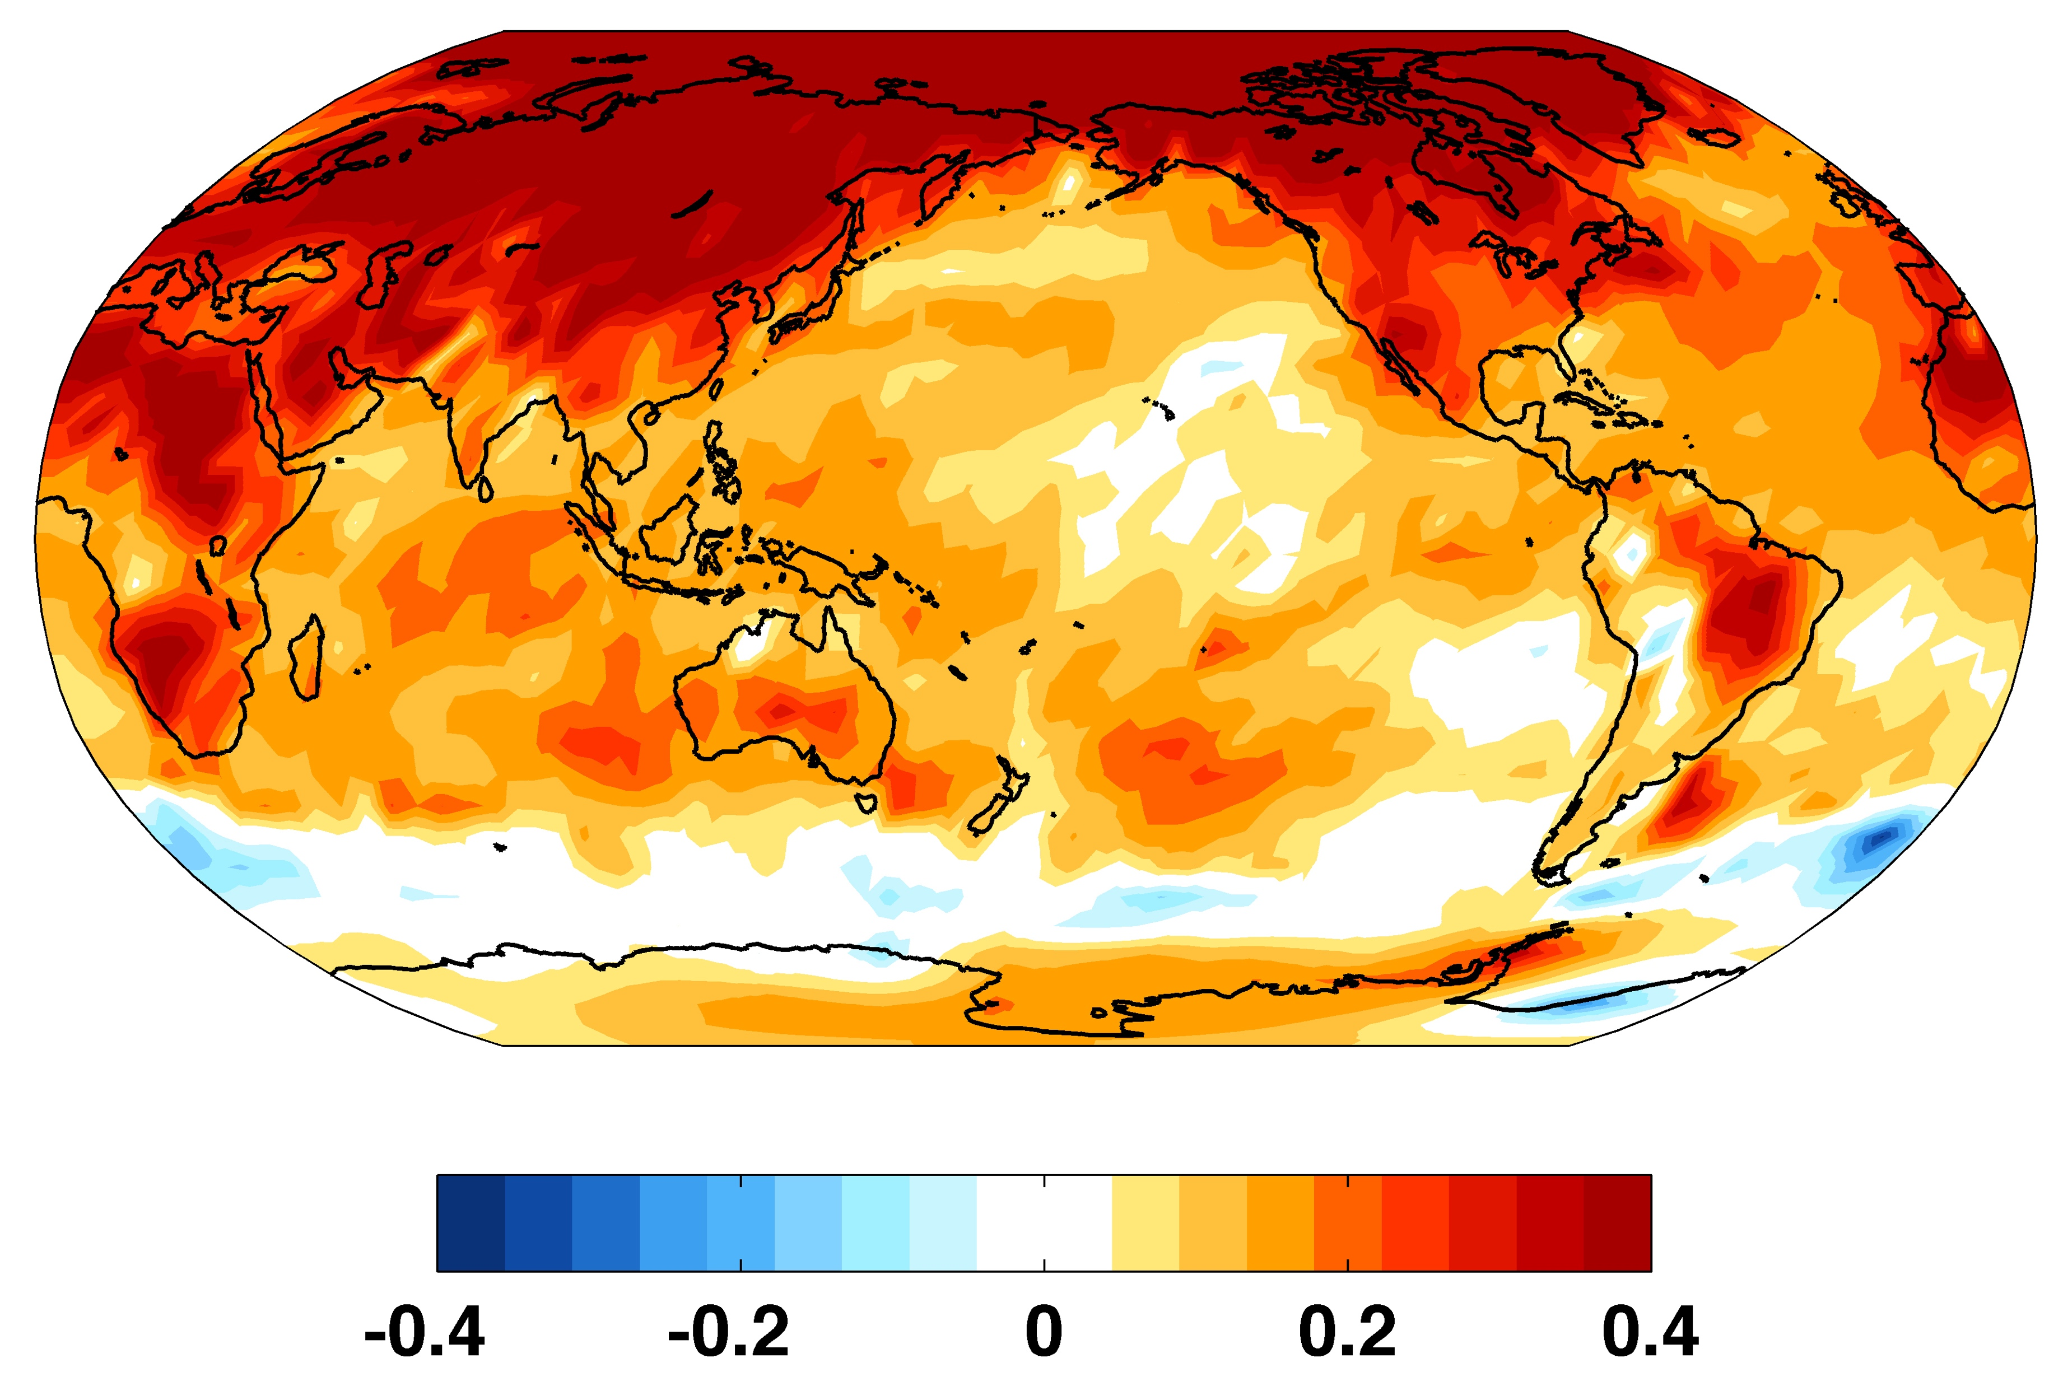
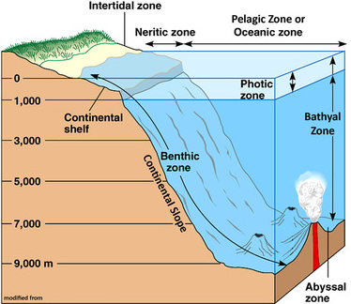
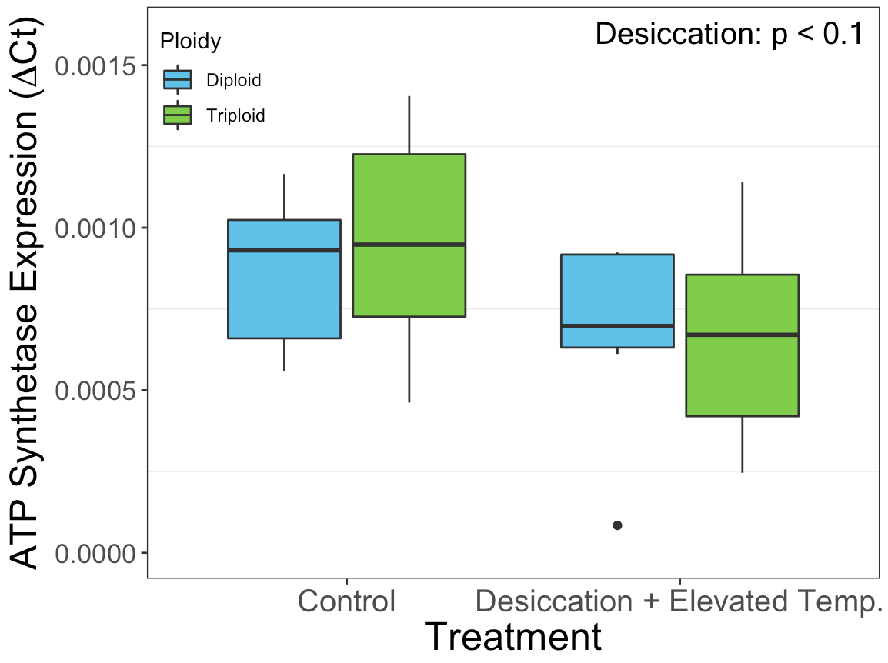
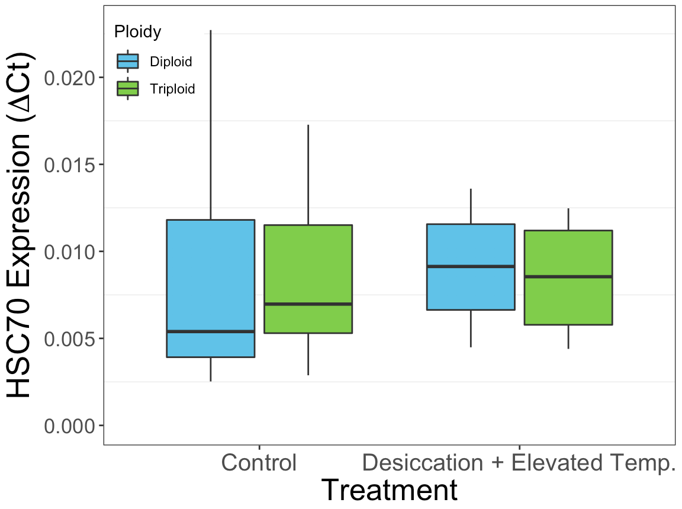
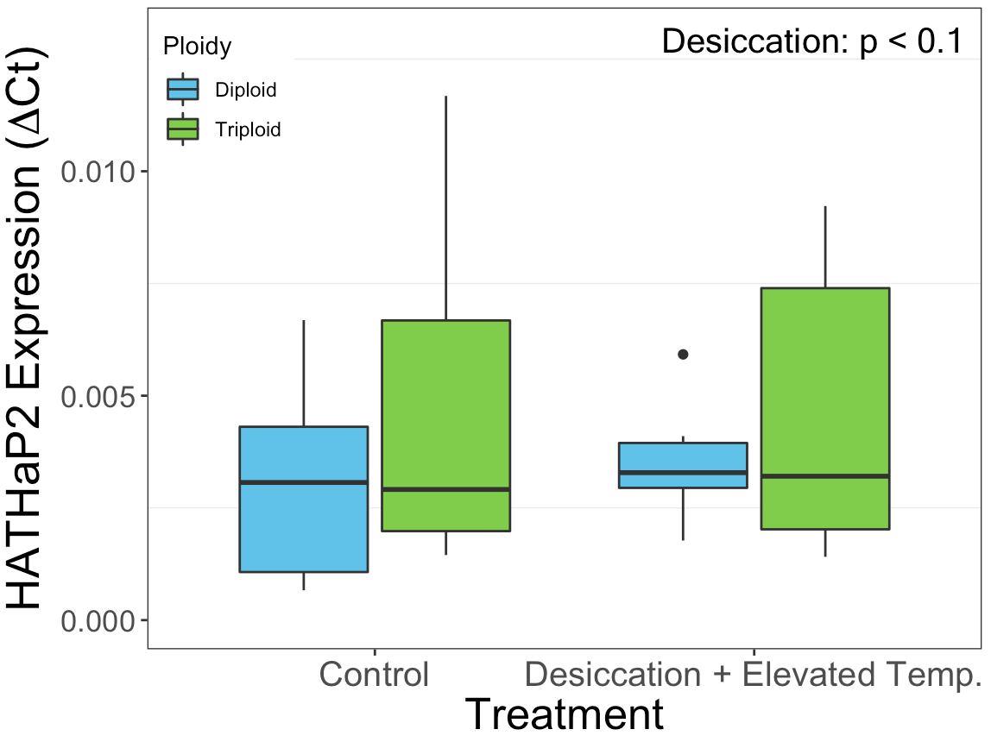
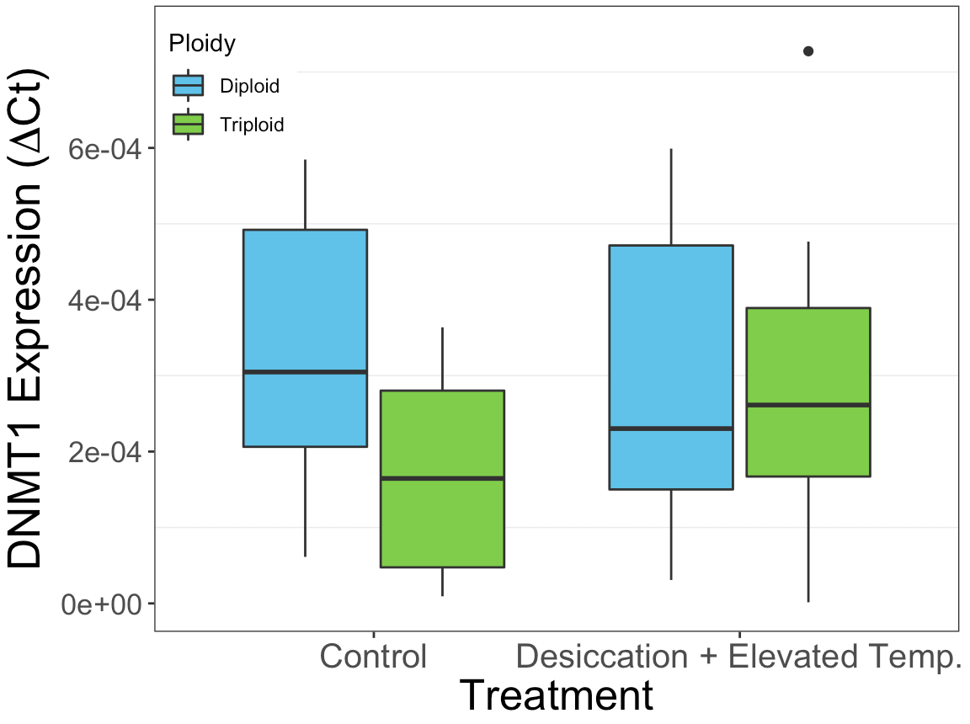
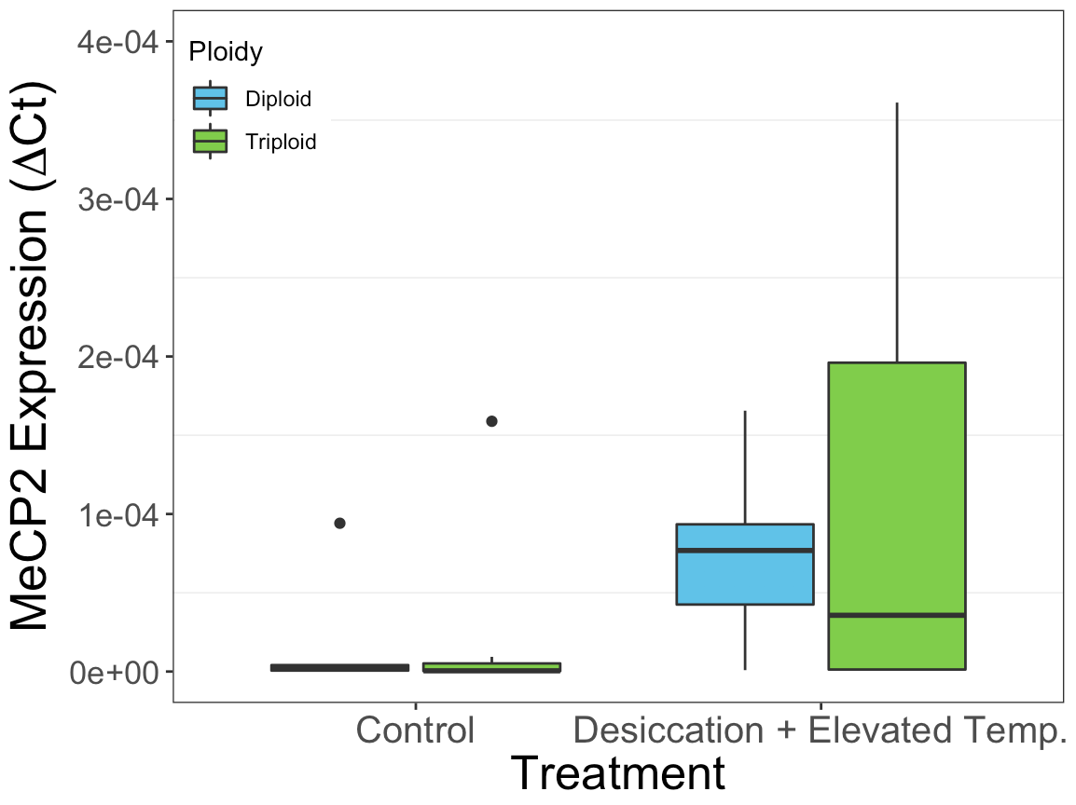
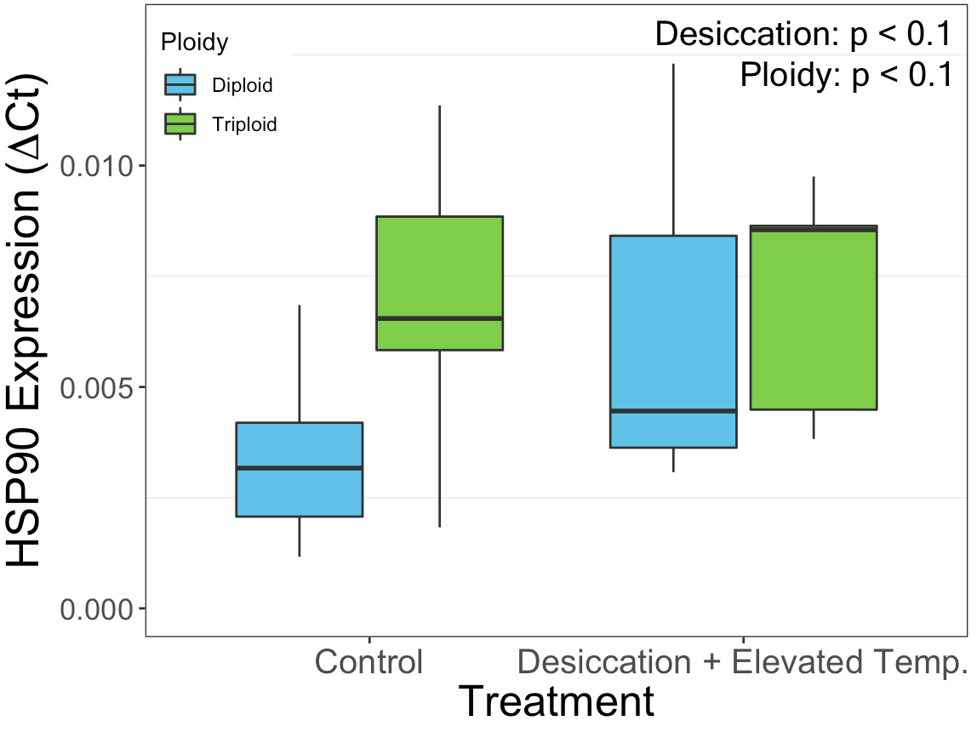
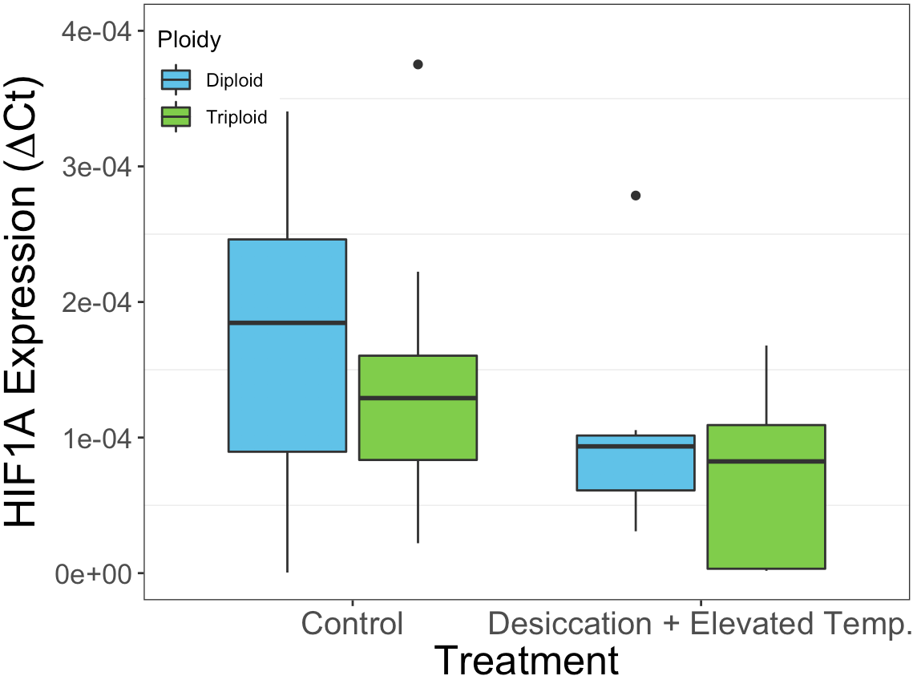
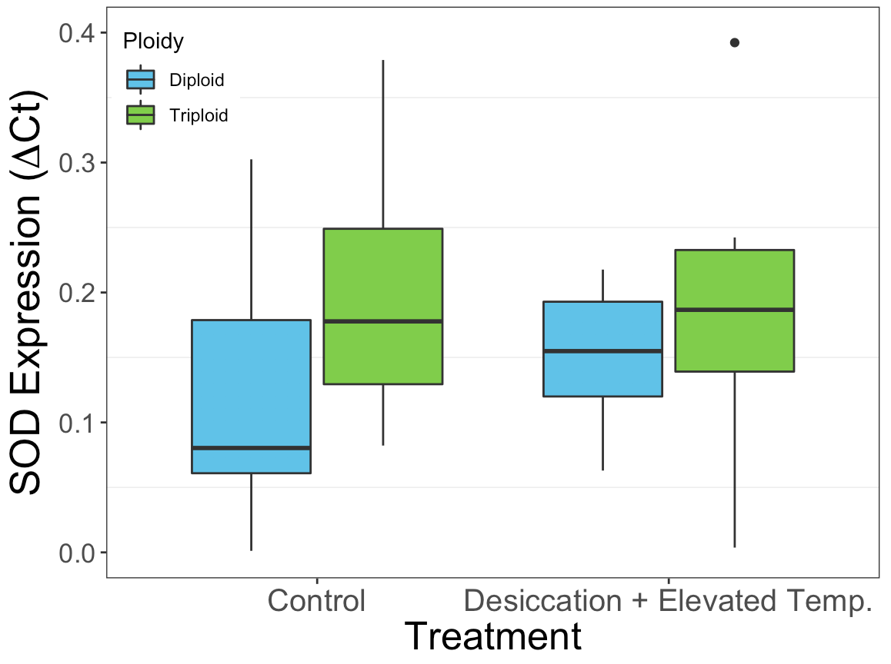
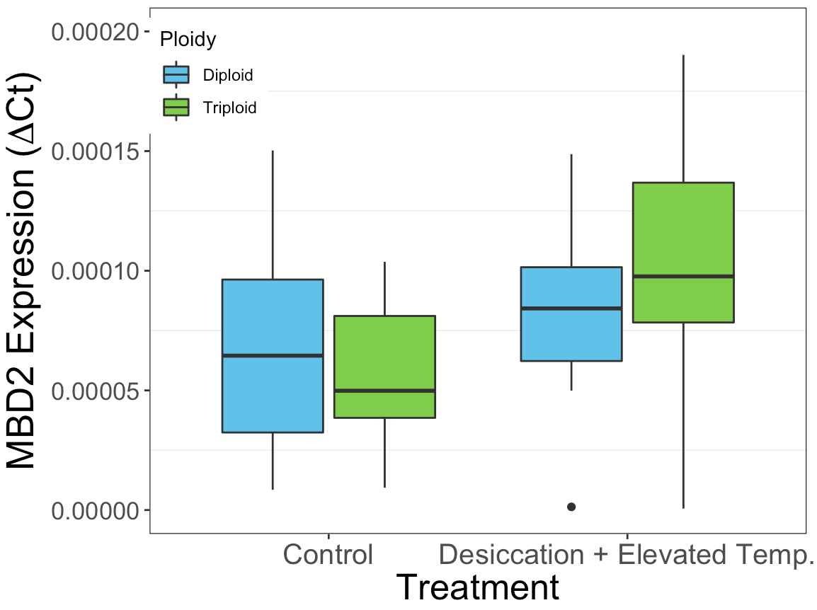
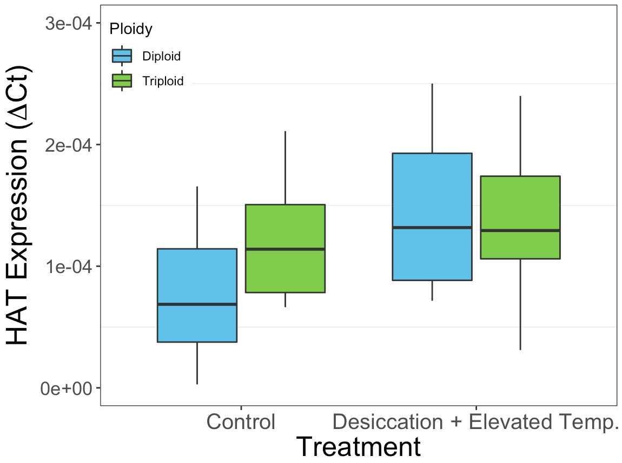
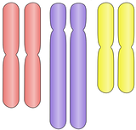



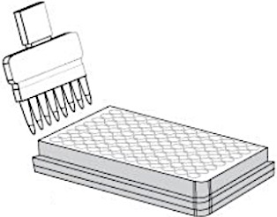
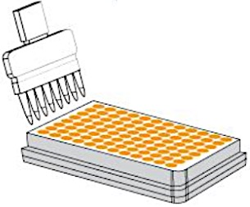
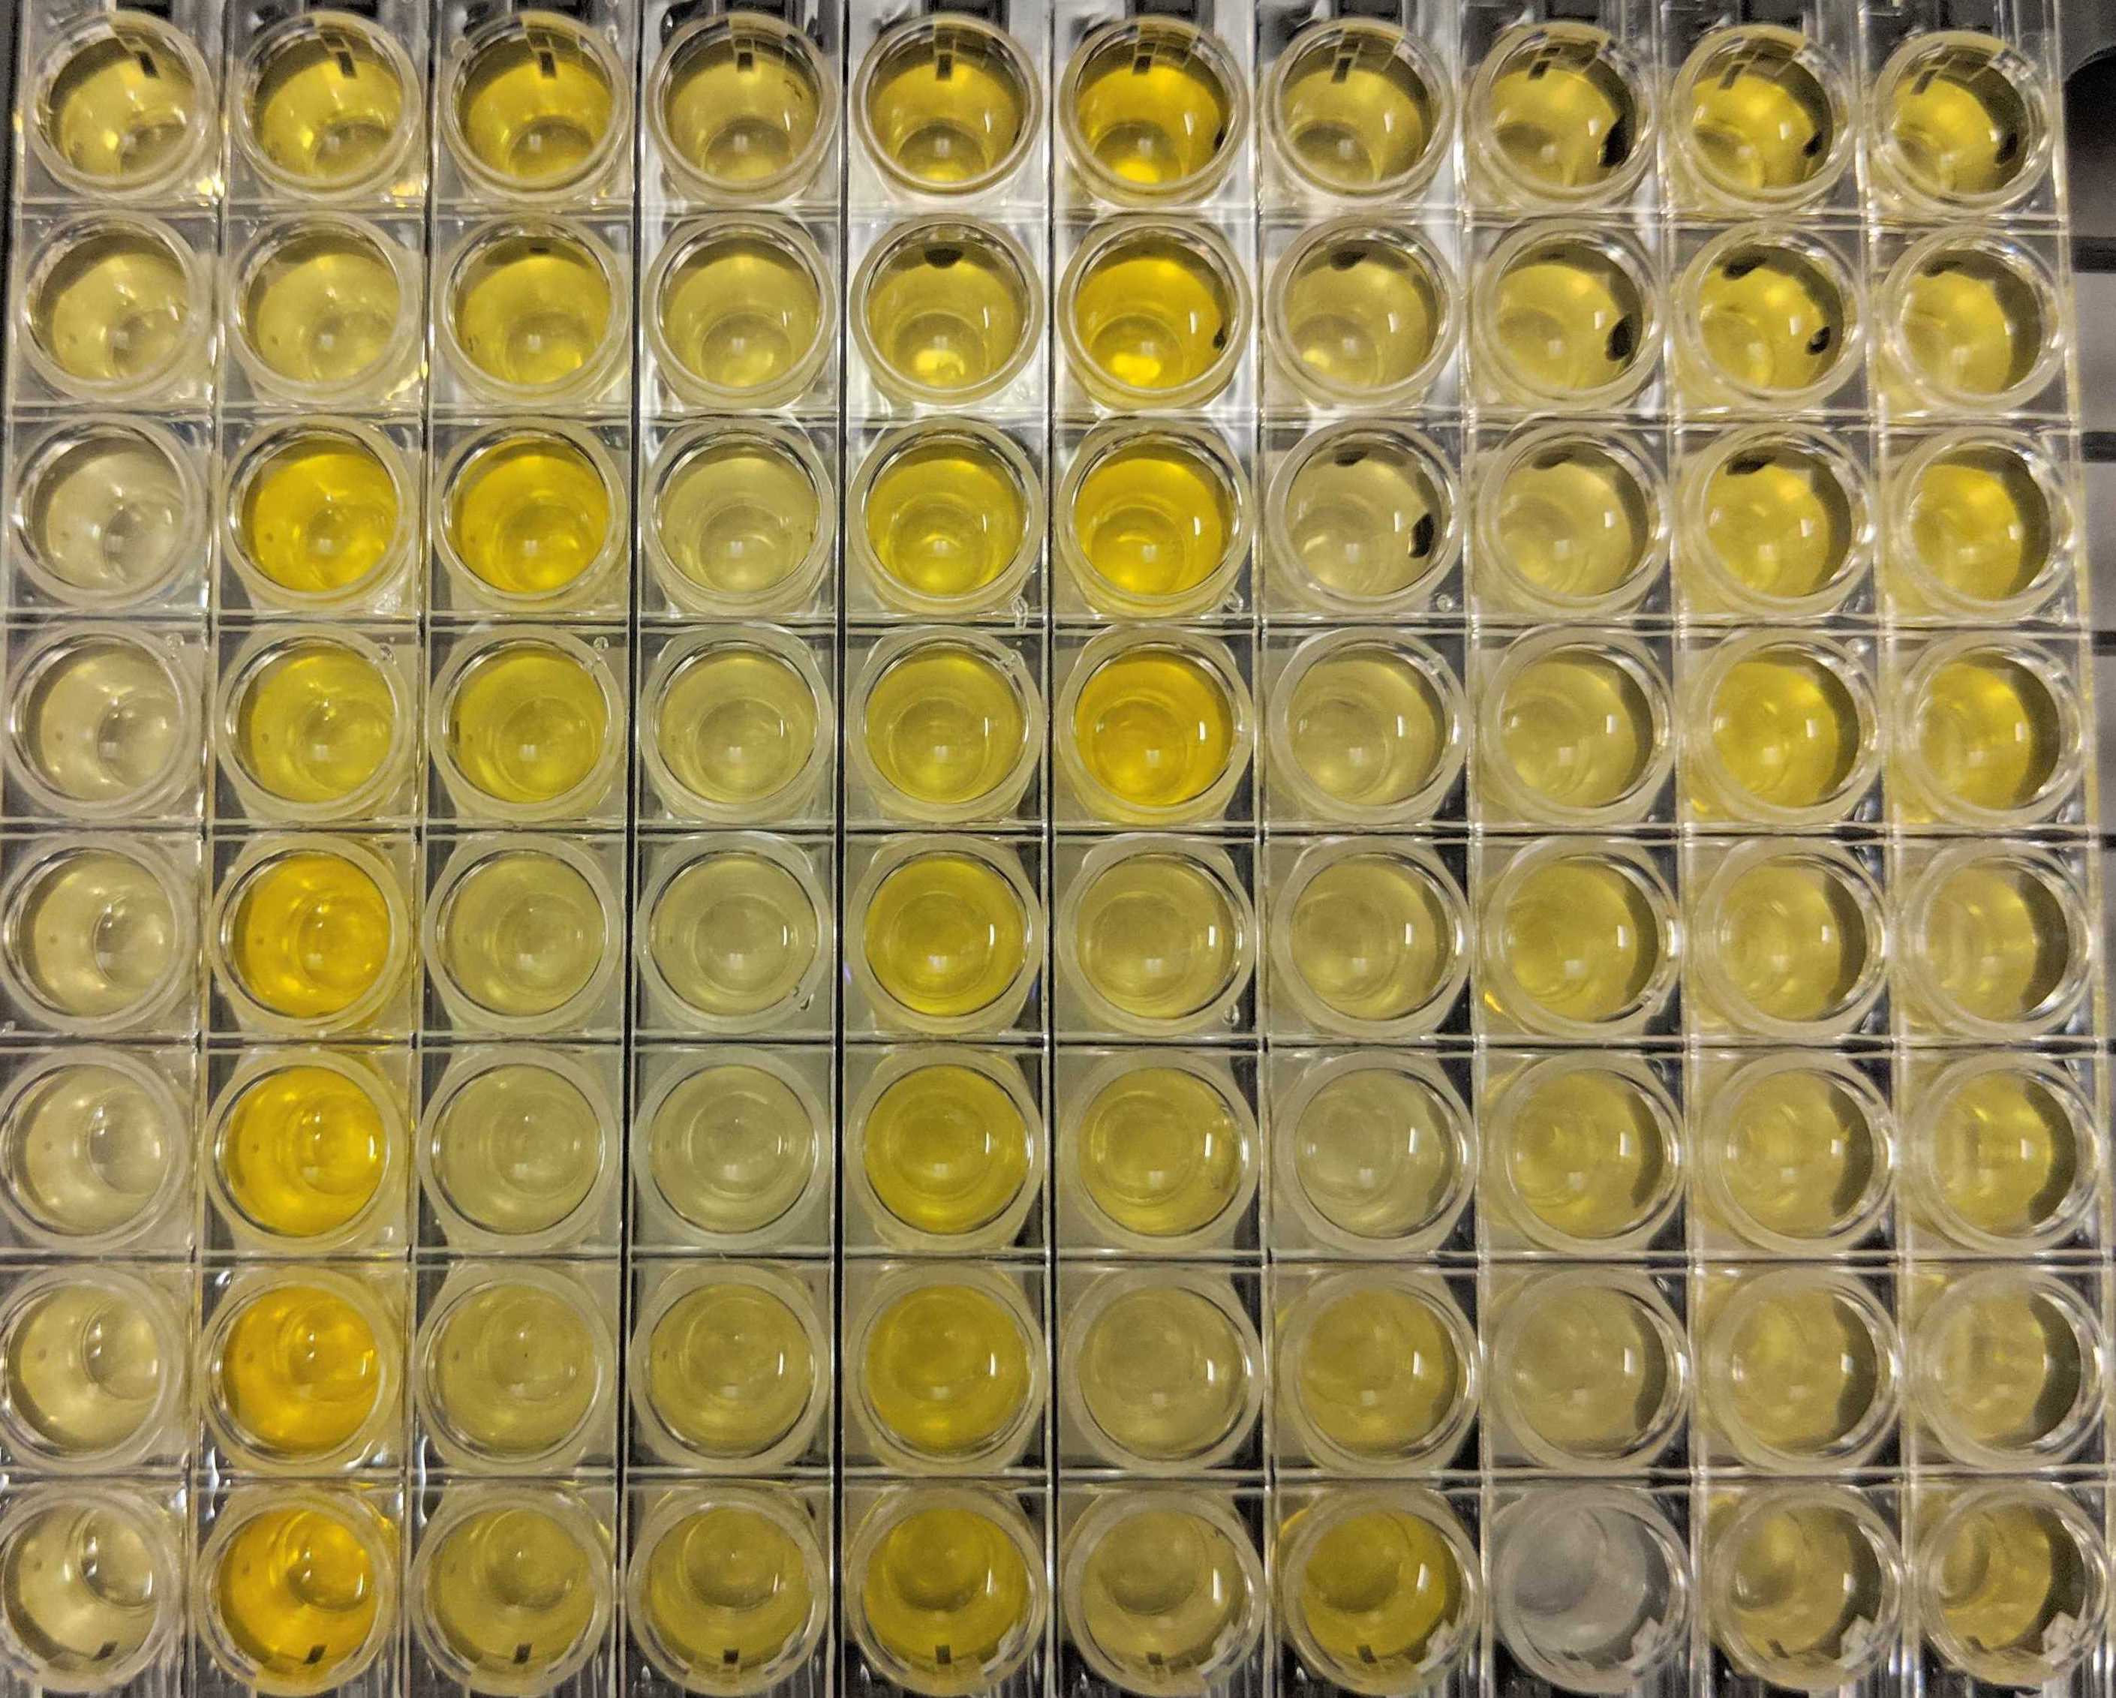
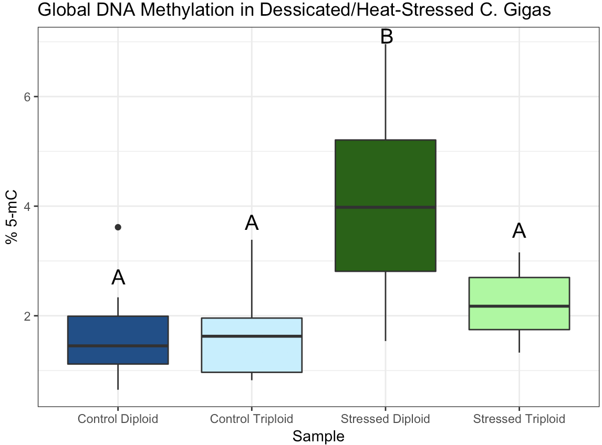
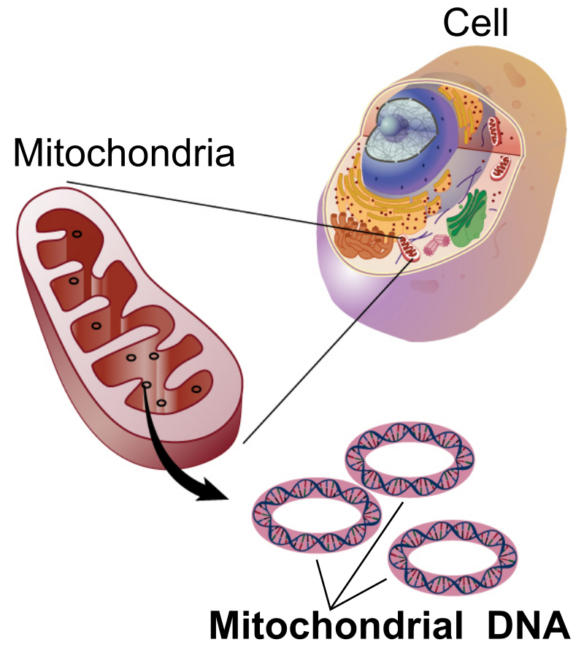
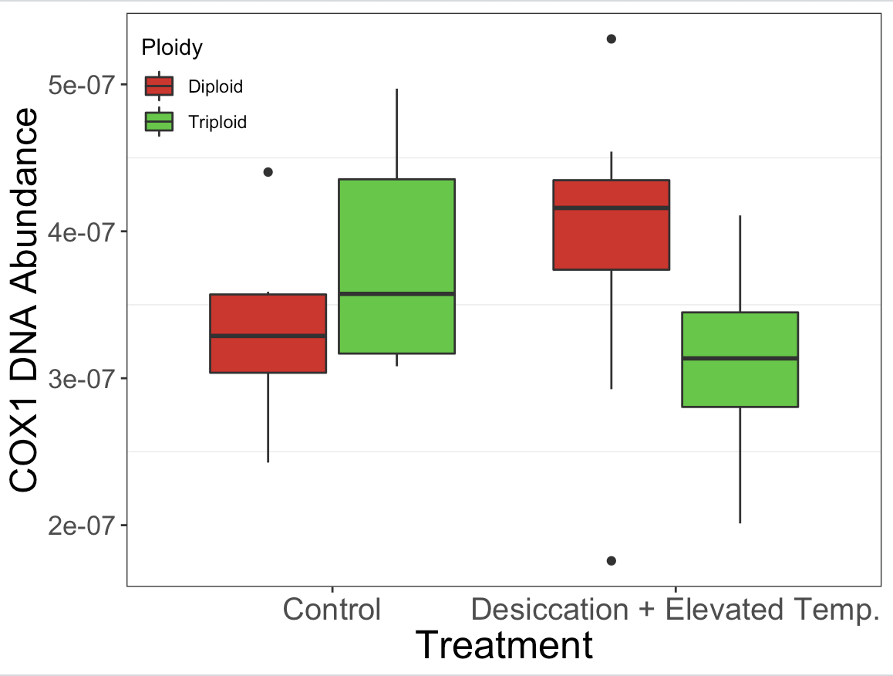

Characterization of Epigenetic and Subcellular Responses to Desiccation/Heat-Stress Exposure in Diploid and Triploid Pacific Oysters
Background
Gene Expression Analysis Using RT-qPCR
Conclusions/Discussion
Recent anthropogenic global climate change has resulted in increasing temperatures worldwide, altering marine ecosystems crucial for food production and thereby raising concerns about possible adverse effects on aquatic organisms. Pacific oysters (C. gigas) are a keystone species that live in intertidal zones and are therefore frequently desiccated. In particular, triploid oysters (with three copies of each chromosome) are crucial to the aquaculture industry, where their sterility and high rates of growth make them ideal for high-volume commercial production. As a result of climate change processes, both diploid and triploid oysters are being exposed to multiple stressors, including elevated temperature and desiccation. Despite the growing ubiquity of this multi-stressor global warming exposure, the mechanisms of stress response in organisms are poorly understood, especially on a molecular level., Moreover, due to recent high mortality rates among triploids in commercial production, there is increasing concern that triploids may be underperforming in stress environments.
Previous research concerning stress response to global warming has focused primarily on single-stressor response—however, this is not environmentally relevant, as many organisms are often exposed to a complex combination of stressors. Additionally, there is currently little research that specifically examines differential diploid and triploid oyster stress responses to understand potential susceptibility to environmental change. Moreover, the effects of global warming stressors on an epigenetic/subcellular level are poorly understood and pose as a next generation area of study.
Target Gene | Function
Heat-shock cognate 70 (HSC70) | Chaperone protein for preservation in heat response
Heat-shock protein 90 (HSP90) | Chaperone protein for preservation in heat response
Superoxide dismutase (SOD) | Catalyzes the breakdown of the superoxide radical (O₂⁻)
Hypoxia-induced factor 1A (HIF1A) | Cellular response to low oxygen levels
ATP synthetase | Enzyme complex that catalyzes the phosphorylation of ADP, resulting in ATP
Target Gene | Function
DNA methyltransferase (DNMT1) | Transfers methyl groups to DNA
Histone acetyltransferase (HAT) | Transfers acetyl groups to histones
Histone acetyltransferase HaP2 (HATHaP2) | Transfers acetyl groups to histones
Methyl-CpG binding domain (MBD2) | Domain that binds to methylated CpGs
Methyl-CpG-binding protein 2 (MeCP2) | Protein that mediates the binding of MBDs to CpGs
qPCR results indicate that multi-stressor global warming exposure (desiccation/elevated temp.) induces alterations in gene regulatory activity, immune response, and metabolic regulatory activity.
Upregulation of HATHaP2 in both diploids and triploids suggests a possible histone acetylation response to stress, which increases the ability of transcription factors to bind to DNA and thereby facilitates transcription.
Downregulation of ATP synthetase suggests shifts in energy demand sensed by the cell and reallocation of energy resources to other cellular processes, possibly homeostasis-linked.
Upregulation of HSP90 in both diploids and triploids indicates a heightened immune response to stress.
Triploids expressed HSP90 at high levels even in control conditions, suggesting non-optimal allocation of energy towards maintaining a high immune response when not needed.
Immune/Stress-Related Genes
Epigenetics-Related Genes
Increase in global 5-mC DNA methylation in diploids following stress exposure suggests an overall increase in gene regulatory activity in diploids.
However, lack of change in global 5-mC DNA in triploids following stress exposure suggests that triploids are unable to incite specific epigenetic modifications in response to stress.
As relative mitochondrial abundance is increased in diploids following stress exposure, results suggest that diploids induce a mitochondrial biogenesis response to meet the increasing energy needs of the cell.
Conversely, relative mitochondrial abundance is decreased in triploids following stress exposure, suggesting that triploids are unable to launch a mitochondrial biogenesis response and thereby cannot optimally meet the energy demands of the cell under stress conditions.
Overall, diploids are able to launch a quicker stress response (i.e. 5-mC DNA methylation, increased mitochondrial abundance) than triploids.
Armour, Kyle. 2016. Southern ocean warming.
Pearson Education. The Intertidal Zone.
Asterisks denote statistical significance as determined by a one-way ANOVA (p < 0.1) and Tukey’s Honest Significance Difference test.
Asterisks denote statistical significance as determined by a one-way ANOVA (p < 0.1) and Tukey’s Honest Significance Difference test.
Alterations in gene regulatory activity, immune response, and metabolic regulatory activity
HATHaP2: Upregulated
ATP Synthetase: Downregulated
HSP90: Upregulated
HSP90 is upregulated following desiccation/heat-stress exposure in both diploids and triploids.
ATP synthetase is downregulated following desiccation/heat-stress exposure in both diploids and triploids.
However, triploids express HSP90 at higher levels than diploids in both control and stressed conditions.
HATHaP2 is upregulated following desiccation/heat-stress exposure in both diploids and triploids.
Statistically significant changes in gene expression are not observed in any other genes.
Purpose
Diploid
Hypermethylation response:
Increase in gene regulatory activity in response to stress
The overarching objective of this study was to elucidate the molecular implications of multi-stressor global warming exposure in diploid and triploid Pacific oysters. Specifically, the purpose was two-fold: (1) characterize epigenetic/subcellular responses to multi-stressor global warming exposure and (2) identify differences in epigenetic/subcellular stress response between diploid and triploid oysters to understand their relative susceptibility to environmental change.
Thus, the research question was: What are the epigenetic/subcellular implications of multi-stressor global warming exposure and how are these molecular indicators of stress differentially expressed between diploid and triploid Pacific oysters? It was hypothesized that global warming stressors might induce changes in gene expression and DNA methylation, with accompanying differences in relative mitochondrial abundance. Speculation regarding differences between diploid and triploid stress response was limited due to a lack of prior studies.
Diploid
Increase in HSP90 expression suggests heightened immune response (preventing proteins from denaturing under high-heat conditions)
Diploid
Increase in HATHaP2 expression suggests histone acetylation response to stress.
Decrease in ATP synthetase expression could indicate shifts in energy demand sensed by the cell.
Able to launch a mitochondrial biogenesis response to meet increasing energy demands of the cell
Triploid
Increase in HSP90 expression suggests heightened immune response. However, HSP90 expression remains high in control conditions.
Triploid
Increase in HATHaP2 expression suggests histone acetylation response to stress.
Nell, John. 2002. Farming triploid oysters.
Lu, Connie. Pangea Shellfish. 2015. Different Methods of Growing Oysters
Decrease in ATP synthetase expression could indicate shifts in energy demand sensed by the cell.
Alterations in gene regulatory activity, immune response, and metabolic regulatory activity
HATHaP2: upregulated
ATP synthetase: Downregulated
HSP90: Upregulated
Global DNA Methylation Analysis Using ELISA Assay
Heat-Stress + Desiccation Exposure
DNA Binding to Assay Wells
Antibody Binding to Methylated DNA
Colorimetric Developer
Color Absorbance Quantification with Spectrophotometer
Triploid
No methylation response:
Possible inability to incite specific epigenetic modifications in response to stress
Diploid and triploid Pacific oysters (n = 8) were desiccated and exposed to heat stress at 27°C in an incubator for 24 hours (typically, Pacific oysters thrive in temperatures ranging from 8-22°C). Oysters were simultaneously subject to desiccation stress. Immediately following stress treatment, oysters were sampled. Mantle, adductor muscle, and ctenidia tissue were resected and stored at -80°C for further analysis.
Using binding solution (BS), DNA is bound to strip wells with a high DNA affinity.
Detection complex solution added.
Capture and detection antibodies bind to methylated DNA.
Developer solution incites a color-change process by reacting with bound antibodies.
Color intensity is proportional to percent methylation.
Methylated fraction of DNA is quantified colorimetrically by measuring well-plate absorbance with a microplate reader.
Diploid and triploid Pacific oysters exposed to heat-stress at 27°C for 24 hours.
Mantle, adductor muscle, and ctenidia tissue were resected.
Samples stored at -80°C for further analysis.
Oysters simultaneously subject to desiccation stress.
Potential inability to launch a mitochondrial biogenesis response to meet increasing energy demands of the cell
Following desiccation/heat-stress exposure, diploids exhibit a statistically significant increase in percent global 5-mC DNA methylation.
Contrastingly, no statistically significant change in global 5-mC DNA methylation is observed in triploids after desiccation/heat-stress exposure.
Implications
Results indicate that global warming stressors (desiccation/elevated temperatures) can alter the epigenetic/subcellular landscape of aquatic organisms.
qPCR/DNA methylation analysis revealed molecular stress responses in Pacific oysters which cannot be detected by crude mortality assays.
Global DNA methylation analysis showed that epigenetic modifications and gene regulatory activity are affected by global-warming stressors and are differentially expressed in diploids and triploids.
COX1-primer qPCR method allowed for examination of changes in relative mitochondrial abundance in response to stress, providing insight into the subcellular mechanisms of stress response.
Results suggest that triploids are less effective at responding to stress, leading to decreased performance and potential mortality in stressful conditions.
Further interpretation suggest that diploids may exhibit greater phenotypic plasticity than triploids in stressful conditions, as evidenced by the increase in diploids in both mitochondrial abundance and 5-mC methylation to heat-stress/desiccation.
Has far-ranging implications for the aquaculture industry where triploid performance in stressful conditions is economically crucial.
Diploid
Stress
Hypermethylation response
Triploid
DNMTs
Methodology Overview
Stress
No methylation response
RNA Extraction
Medians not sharing a letter are statistically different at P < 0.05 (Tukey-adjusted comparison).
DNMTs
Overarching purpose: Elucidate the molecular implications of multi-stressor global warming exposure
Relative Mitochondrial Abundance Quantification Using COX1 Primer qPCR
RT-qPCR Gene Expression Analysis
cDNA Synthesis
Changes in DNA methylation
Primer Development
Total DNA Extraction
qPCR Reaction
Triploids may be unable to launch effective stress response
Epigenetic
qPCR
COX1, or cytochrome c oxidase subunit 1, is a single-copy gene found in C. gigas mitochondrial DNA (mtDNA).
Ctenidia tissue is homegenized.
Addition of chloroform:isoamyl alcohol and Proteinase K solution to separate out DNA from polysaccharides and proteins (aqueous phase).
qPCR is normalized to DNA content.
Fluorophore attached to DNA.
Thermal cycler equipped with optical detection module measures successive fluorescence signals as DNA is amplified.
Although not statistically significant, diploid oysters show increased relative mitochondrial abundance following desiccation/heat-stress exposure.
Unlike the diploids, triploid oysters exhibit a slight reduction in relative mitochondrial abundance after desiccation/heat-stress exposure.
Global warming exposure
Alterations on the epigenetic/
subcellular level
Epigenetic
Total DNA Extraction
Potential differences in mitochondrial abundance
RT-qPCR with COX1 primer
Global DNA Methylation Analysis
RT-qPCR
DNA Methylation ELISA Assay
Diploid
Increased mitochondrial abundance suggests potential mitochondrial biogenesis stress response in diploids.
Future Research Directions
Stress
Fission
Identifying potential changes in histone modification/chromatin accessibility as a stress response using ATAC-seq.
Using proteomic analyses to characterize differences in protein abundance between stressed and non-stressed oysters.
Exposing oysters to single-stressors and multi-stressors to characterize stress response interactions (additivity, synergism, antagonism) on a molecular level.
Conducting physiological assays (i.e. shell strength, whole-body weight) to determine relative susceptibility of triploid/diploid oysters to environmental change. Correlating physiological stress responses to changes on a molecular level is a next generation area of study.
Total
DNA Extraction
Subcellular
RNA Extraction
Triploid
Stress
Slight decrease in mitochondrial abundance suggests no mitochondrial biogenesis stress response in triploids.
qPCR
Fission

