Slide 1
SALVELINUS NAMAYCUSH · ROBERTS LAB, UW SAFS
From Variation to
Candidate Genes
Methylation, structural variation, and functional annotation of lean vs. siscowet lake trout ecotypes
Rick Goetz · Sam White · Cristian Gallardo-Escarate · Steven Roberts
PacBio HiFi comparative epigenomics · research talk

Slide 2
THE BIOLOGICAL QUESTION
What makes a lean a lean and a siscowet a siscowet?
Lean
Siscowet
Shallow · nearshore
Deep · offshore
— Streamlined, low lipid
— Forages shallow water
— Reference-like body plan
— High lipid / fat stores
— Adapted to depth & pressure
— Robust, distinct morphology
Same species, same reference genome. Which genes carry the difference — and what phenotypes might they shape?
01

Slide 3
THE FRAMEWORK
Three layers, one shortlist of genes
LAYER 1 · PAV
LAYER 2 · 5mC
LAYER 3 · ANNOTATION
The hardware
The software
The interpreter
Presence-absence variation — DNA segments gained or lost.
Changes what genes exist.
DNA methylation — reversible marks that switch genes up or down.
Changes how genes are used.
RefSeq function turns coordinates into gene names, products, GO.
Tells us which genes & why.
Same PacBio HiFi reads resolve PAV and methylation at once; annotation joins them to biology.
02

Slide 4
STUDY DESIGN & DATA
Eight fish, one platform, three readouts
8
4 + 4
1
46,359
PacBio HiFi individuals
lean + siscowet
reference: SaNama_1.0
annotated genes
Why HiFi matters here
— Long, accurate reads call structural variants (PAV) and 5mC methylation from the very same molecules — no separate assays, no batch confound.
Samples — Lean: bc2041/2068/2069/2070 · Siscowet: bc2071/2072/2073/2096 · Supporting layer: liver RNA-seq (202 DETs, separate parasite study)
03

Slide 5
LAYER 1 · PRESENCE-ABSENCE VARIATION
Whole segments of DNA present in one ecotype, absent in the other
Lean
— Detected two ways from HiFi alignments:
— Deletions — coverage drops to zero over a region
— Insertions — novel sequence flagged in read CIGAR strings
— Classified as lean-specific, siscowet-specific, or shared
Siscowet
deletion
same locus → different content
04

Slide 6
LAYER 1 · RESULTS
Siscowet carries more ecotype-specific structure
996,228
lean-specific variants
1,332,705
siscowet-specific variants
878,372
shared between ecotypes
≈ 34% more ecotype-specific variation in siscowet — but read with reference bias in mind
Interpretation focuses on 3,465 stringent siscowet-specific deletions (>100 bp, all-4-vs-none) — the high-confidence set carried into annotation.
05

Slide 7
LAYER 1 · FROM VARIANTS TO PHENOTYPE
How presence-absence becomes ecotype
±
×
~
Add / remove genes
Shift gene dosage
Rewire regulation
A PAV overlapping a coding region adds or deletes a gene outright — a present-vs-absent function.
Copy-number change tunes expression up or down without touching the coding sequence.
Indels in promoters / enhancers reposition regulatory elements, altering control.
Candidate targets for ecotype divergence: lipid metabolism, depth & pressure tolerance, sensory adaptation — annotation (Layer 3) tells us which genes are actually hit.
06

Slide 8
LAYER 2 · DNA METHYLATION
Same sequence, different settings
— 5-methylcytosine (5mC) at CpG sites — read directly off HiFi data
— Methylation typically silences genes and represses transposable elements
— Reversible & potentially heritable — a route to plastic phenotype
— We test each CpG for ecotype differences, then group into regions (DMRs)
m
m
methyl marks tune the same DNA
07

Slide 9
LAYER 2 · RESULTS
From half a million sites to 302 regions
540,040
4,440
302
→
→
CpG sites tested
significant DMCs (p < 0.05)
differentially methylated regions
The asymmetry is the story.
282 of 302 DMRs are hypomethylated in siscowet — a genome-wide tilt toward de-repression.
But 0 single CpGs survive q < 0.1 — we lead with the DMR level, not individual sites.
08

Slide 10
LAYER 2 · INTERPRETING THE TILT
Why a hypomethylated siscowet genome matters
Genes switch on
Mobile elements wake
A heritable dial
Lower methylation near promoters can de-repress genes — potentially the lipid & depth programs that define siscowet.
Genome-wide hypomethylation can re-activate transposable elements, a documented engine of rapid divergence.
Methylation state can persist across generations — divergence without waiting for new mutations.
Two independent signals, same direction: siscowet shows more structural variation and broad hypomethylation.
09

Slide 11
LAYER 3 · FUNCTIONAL ANNOTATION (NEW)
Turning coordinates into candidate genes
46,359
46,231
34,367
genes annotated (RefSeq)
with a product description
with ≥1 Gene Ontology term
The move that makes everything interpretable
— Strand-aware assignment of every DMR / DMC / stringent-PAV to genes (promoter ±2 kb, flank ±5 kb)
— 2,036 candidate genes sit within 5 kb of a differential feature — ranked by convergence, placement & expression
— 149/302 DMRs and 1,543/3,465 deletions land near a gene; 54 deletions overlap an exon (candidate copy/LOF)
10

Slide 12
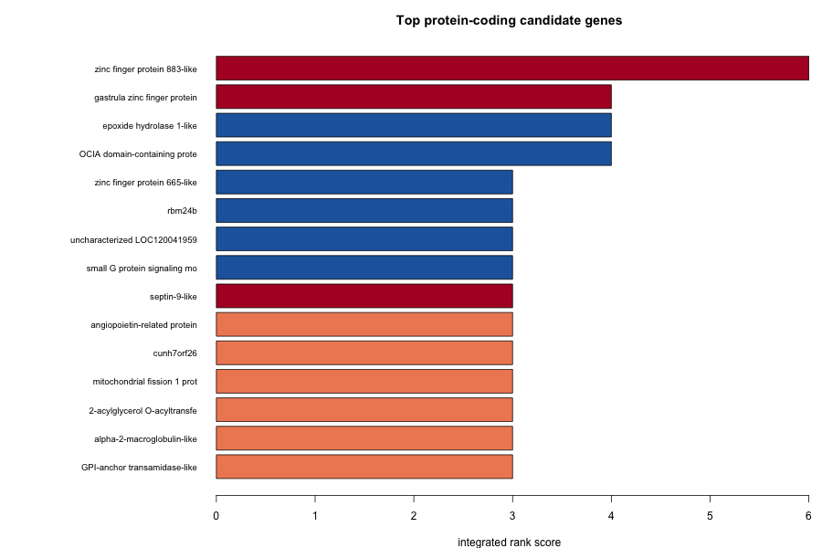
LAYER 3 · WHERE THE LAYERS CONVERGE
Four genes carry both a DMR and a siscowet deletion
4 CONVERGENT LOCI
znf883-like
exon DMR + exonic deletion · TOP
XlCGF57.1-like
intron hypo-DMR + nearby deletion
septin-9-like
intron hyper-DMR + nearby deletion
LOC120039781
uncharacterized · intron hypo-DMR
EXONIC DELETIONS IN LIPID GENES
— angptl5 · mogat2 · epoxide hydrolase 1
— Lipid handling — consistent with the defining high-lipid siscowet phenotype
Top protein-coding candidates by integrated rank score.
11

Slide 13
LAYER 3 · FUNCTION & PHENOTYPE
What the candidate set points toward
HYPOTHESIZED PHENOTYPE AXES
GO enrichment — deletion set
🫧
Lipid & energy storage
term
FOLD
FDR
angptl5, mogat2, ephx1 — high-lipid siscowet / buoyancy
Ca²⁺ transmembrane transport
3.7
5.6e-4
Neuron projection development
2.4
2.6e-3
🐠
Body shape, growth & muscle
rbm24b + growth GO — elongate-lean vs. robust-siscowet
Calcium channel complex
4.6
3.0e-3
Calcium ion transport
3.0
3.0e-3
⚡
Calcium / sensory-neural
Lipid / phospholipid binding
1.5
ns
Ca²⁺ & neuron-projection GO — deep, dark, high-pressure
Calcium transport = most defensible; carries a gene-length caveat. DMR set is a tandem-cluster artifact.
🛡️
Immune & adhesion
a2m, CEACAM, DMBT1 — some real, some reference-divergent
12

Slide 14
READ THIS CAREFULLY
Hypothesis-generating, not causal
Lean-background reference
No single CpG survives correction
SaNama_1.0 is a doubled-haploid lean fish. Siscowet diverges more, inflating its apparent deletions — counts are not magnitude-comparable.
0 DMCs at q < 0.1. Interpretation leads with DMR-level and stringent-PAV sets; single-CpG hits are suggestive only.
Expression support is weak by design
Enrichment confounders
Liver RNA-seq comes from a separate parasite study with different fish — orthogonal support, never confirmation.
PAV GO carries a gene-length bias (long Ca²⁺ channels); the DMR GO signal is a single histone/znf883 tandem cluster.
The deliverable is a ranked, annotated shortlist of candidates — associations on one reference, awaiting functional validation.
13

Slide 15
TAKE-HOME
Three things to remember
Divergence is written at two levels, read at a third
1
Structure (what genes exist) + methylation (how they're used), made interpretable by annotation.
Annotation produced a ranked shortlist
2
2,036 candidates, 4 convergent loci led by znf883-like, lipid-gene deletions, and calcium-transport GO.
Read it as hypotheses, not mechanisms
3
Lean-reference bias, no FDR-significant CpG, and weak expression support keep every link associative.
14

Slide 16
From variation to candidate genes
Methylation and structural variation each track the lean–siscowet split;
functional annotation turns where they converge into the genes that may make an ecotype.
Explore the data — interactive genome browsers (IGV.js + JBrowse 2):
sr320.github.io/project-lake-trout
Goetz · White · Gallardo-Escarate · Roberts · Roberts Lab, UW SAFS

