Slide 1

Influence of Ocean Acidification on the Epigenome of Oyster Reproductive Tissue
Yaamini R. Venkataraman
University of Washington
@YaaminiV
Notes:
Thank you for that introduction, and for coming back after the break.
We care about shellfish, which is why we’re interested in how ocean acidification impacts them.
In my lab, the Steven Roberts lab at UW, and others, we put effort into understanding how parental exposure to low pH or high pCO2 can impact offspring fitness.
After this talk, not only will all of you be experts in epigenetics, but I will also convince you that epigenetics is the key to understanding how parental experience can impact offspring fitness in shellfish species.

Slide 2
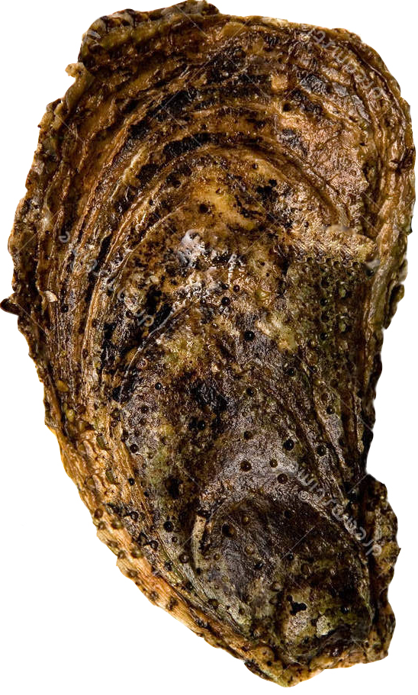
Notes:
Parental exposure can either have no effect on larvae. But if it does, it can be helpful or harmful
Helpful parental exposure to low pH or high pCO2 can lead to positive carryover effects. When adult Sydney rock oysters were exposed to high pCO2 conditions, resulting larvae were faster growing in the same pCO2 conditions than larvae from parents without that prior exposure (Parker et al. 2012, 2015, 2017).
Harmful parental exposure leads to negative carryover effects. Larvae from adult Atlantic hard clams (Mercenaria mercenaria) and bay scallops (Argopecten irradians) developed slower when parents were reproductively conditioned in low pH conditions (pH_{T} = 7.4) (Griffith and Gobler 2017).
Understanding how and why these carryover effects occur is crucial. Growers need to know how broodstock experience can affect next year’s larvae, and resource managers can apply this understanding to natural populations.
Several studies point to epigenetics as a potential mechanisms to explain their findings.

Slide 3
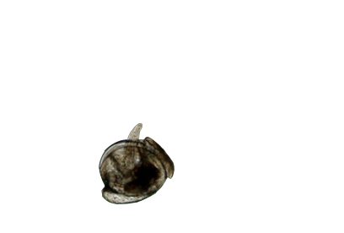
Higher survival
Bigger larvae
Fast-growing
+
Notes:
Parental exposure can be helpful or harmful
Helpful parental exposure to low pH or high pCO2 can lead to positive carryover effects. When adult Sydney rock oysters were exposed to high pCO2 conditions, resulting larvae were faster growing in the same pCO2 conditions than larvae from parents without that prior exposure (Parker et al. 2012, 2015, 2017).
Harmful parental exposure leads to negative carryover effects. Larvae from adult Atlantic hard clams (Mercenaria mercenaria) and bay scallops (Argopecten irradians) developed slower when parents were reproductively conditioned in low pH conditions (pH_{T} = 7.4) (Griffith and Gobler 2017).
Understanding how and why these carryover effects occur is crucial. Growers need to know how broodstock experience can affect next year’s larvae, and resource managers can apply this understanding to natural populations.
Several studies point to epigenetics as a potential mechanisms to explain their findings.

Slide 4
Higher survival
Bigger larvae
Fast-growing
Lower survival
Smaller larvae
Slow-growing
+
-
Notes:
Parental exposure can be helpful or harmful
Helpful parental exposure to low pH or high pCO2 can lead to positive carryover effects. When adult Sydney rock oysters were exposed to high pCO2 conditions, resulting larvae were faster growing in the same pCO2 conditions than larvae from parents without that prior exposure (Parker et al. 2012, 2015, 2017).
Harmful parental exposure leads to negative carryover effects. Larvae from adult Atlantic hard clams (Mercenaria mercenaria) and bay scallops (Argopecten irradians) developed slower when parents were reproductively conditioned in low pH conditions (pH_{T} = 7.4) (Griffith and Gobler 2017).
Understanding how and why these carryover effects occur is crucial. Growers need to know how broodstock experience can affect next year’s larvae, and resource managers can apply this understanding to natural populations.
No effect can also happen….it varies.

Slide 5
Environment
Epigenome
High pCO₂, low salinity, pesticide exposure
Change gene regulation without altering DNA sequence
Notes:
Recent studies have demonstrated that changes in the environment can affect the epigenome, or change gene regulation without altering the DNA sequence itself. One way that happens is through DNA methylation, or the addition of a methyl group onto the cytosine base of DNA. For example, coral species exposed to high pCO2 conditions exhibited differences in DNA methylation, which could then be related to changes in their physiology.
We also know that these DNA methylation patterns are heritable, which means epigenetics is the connection between parental experience and larval fitness. After one generation of daphnia was exposed to low salinity conditions, three subsequent generations exhibited the same DNA methylation patterns. Larvae from Pacific oysters exposed to the pesticide diuron also had differing methylation patterns and altered gene expression patterns

Slide 6
Corals exhibit differential DNA methylation (Putnam et al. 2016)
Environment
Epigenome
High pCO₂, low salinity, pesticide exposure
Change gene regulation without altering DNA sequence
Notes:
Recent studies have demonstrated that changes in the environment can affect the epigenome, or change gene regulation without altering the DNA sequence itself. One way that happens is through DNA methylation, or the addition of a methyl group onto the cytosine base of DNA. For example, coral species exposed to high pCO2 conditions exhibited differences in DNA methylation, which could then be related to changes in their physiology.
We also know that these DNA methylation patterns are heritable, which means epigenetics is the connection between parental experience and larval fitness. After one generation of daphnia was exposed to low salinity conditions, three subsequent generations exhibited the same DNA methylation patterns. Larvae from Pacific oysters exposed to the pesticide diuron also had differing methylation patterns and altered gene expression patterns

Slide 7
Corals exhibit differential DNA methylation (Putnam et al. 2016)
Environment
Epigenome
High pCO₂, low salinity, pesticide exposure
Change gene regulation without altering DNA sequence
Multiple generations of daphnia inherited methylation patterns (Jeremias et al. 2018)
Notes:
Recent studies have demonstrated that changes in the environment can affect the epigenome, or change gene regulation without altering the DNA sequence itself. One way that happens is through DNA methylation, or the addition of a methyl group onto the cytosine base of DNA. For example, coral species exposed to high pCO2 conditions exhibited differences in DNA methylation, which could then be related to changes in their physiology.
We also know that these DNA methylation patterns are heritable, which means epigenetics is the connection between parental experience and larval fitness. After one generation of daphnia was exposed to low salinity conditions, three subsequent generations exhibited the same DNA methylation patterns. Larvae from Pacific oysters exposed to the pesticide diuron also had differing methylation patterns and altered gene expression patterns

Slide 8
Corals exhibit differential DNA methylation (Putnam et al. 2016)
Environment
Epigenome
High pCO₂, low salinity, pesticide exposure
Change gene regulation without altering DNA sequence
Multiple generations of daphnia inherited methylation patterns (Jeremias et al. 2018)
Diuron altered gene expression in adult and larval Pacific oysters (Rondon et al. 2017)
Notes:
Recent studies have demonstrated that changes in the environment can affect the epigenome, or change gene regulation without altering the DNA sequence itself. One way that happens is through DNA methylation, or the addition of a methyl group onto the cytosine base of DNA. For example, coral species exposed to high pCO2 conditions exhibited differences in DNA methylation, which could then be related to changes in their physiology.
We also know that these DNA methylation patterns are heritable, which means epigenetics is the connection between parental experience and larval fitness. After one generation of daphnia was exposed to low salinity conditions, three subsequent generations exhibited the same DNA methylation patterns. Larvae from Pacific oysters exposed to the pesticide diuron also had differing methylation patterns and altered gene expression patterns
To recap: we want to know how parental exposure to high pCO2 can affect larval fitness. We know DNA methylation can shed light on this process.
But before we can jump to understanding how DNA methylation patterns are inherited by larvae and how it affects their performance, we need to ensure that these patterns can in fact be inherited by larvae in this context.

Slide 9
How does high pCO₂ affect methylation in reproductive tissue?
Notes:
If high pCO2 affections methylation patterns in gonad tissue, then it’s possible for those patterns to be inherited by larvae.

Slide 10
4 Week pH Exposure
Elevated pCO₂
(2800 µatm)
Control pCO₂
(400 µatm)
Notes:
Working with the Lotterhos Lab at Northeastern University, we exposed Eastern oysters to either control or elevated pCO2 for four weeks. Although Eastern oysters aren’t native to the west coast, they are grown here. Additionally, they can serve as a model organism for other shellfish species. Most importantly, they have a shiny new genome we can use for our analyses, which as a geneticist is really the coolest thing.
We then extracted DNA from 10 oysters: 5 from the control, 5 from the treatment. We sent them over for bisulfite sequencing.
Once we got our sequencing results, we were able to identify differentially methylated loci, or DMLs, between our samples. We identified loci that were at least 50% different between treatments, with a false discovery rate of 0.01.

Slide 11
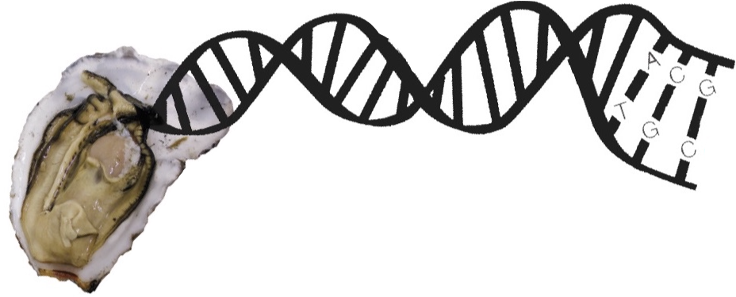
4 Week pH Exposure
Elevated pCO₂
(2800 µatm)
Control pCO₂
(400 µatm)
DNA Extraction and Bisulfite Sequencing
-CH₃
Notes:
Working with the Lotterhos Lab at Northeastern University, we exposed Eastern oysters to either control or elevated pCO2 for four weeks. Eastern oysters can serve as a model organism for other shellfish species, including ones native to the west coast. Most importantly, they have a shiny new genome we can use for our analyses, which as a geneticist is really the coolest thing.
We then extracted DNA from 10 oysters: 5 from the control, 5 from the treatment. We sent them over for bisulfite sequencing.
Once we got our sequencing results, we were able to identify differentially methylated loci, or DMLs, between our samples. We identified loci that were at least 50% different between treatments, with a false discovery rate of 0.01.

Slide 12
4 Week pH Exposure
Elevated pCO₂
(2800 µatm)
Control pCO₂
(400 µatm)
DNA Extraction and Bisulfite Sequencing
-CH₃
Identify Differentially Methylated Loci (DMLs)
Notes:
Working with the Lotterhos Lab at Northeastern University, we exposed Eastern oysters to either control or elevated pCO2 for four weeks. Although Eastern oysters aren’t native to the west coast, they are grown here. Additionally, they can serve as a model organism for other shellfish species. Most importantly, they have a shiny new genome we can use for our analyses, which as a geneticist is really the coolest thing.
We then extracted DNA from 10 oysters: 5 from the control, 5 from the treatment. We sent them over for bisulfite sequencing.
Once we got our sequencing results, we were able to identify differentially methylated loci, or DMLs, between our samples. We identified loci that were at least 50% different between treatments, with a false discovery rate of 0.01.

Slide 13
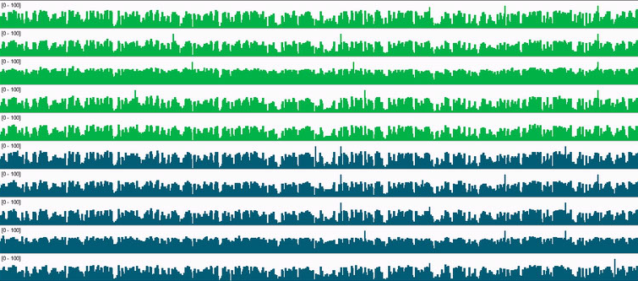
Notes:
We can use a genome viewer, like the one pictured here, to look at our differentially methylated loci.
Each horizontal band depicts the level of methylation in one oyster sample. Methylation at a single loci can go from 0% to 100%. The light green bars are samples that were exposed to high pCO2 conditions, and the dark green are those from our control.
If we zoom in…
Label the things. 0-100% methylation

Slide 14
Notes:
We can use a genome viewer, like the one pictured here, to look at our differentially methylated loci.
Each horizontal band depicts the level of methylation in one oyster sample. Methylation at a single loci can go from 0% to 100%. The light green bars are samples that were exposed to high pCO2 conditions, and the dark green are those from our control.
If we zoom in…
Label the things. 0-100% methylation

Slide 15
Control (400 µatm)
Treatment (2800 µatm)
Notes:
We can use a genome viewer, like the one pictured here, to look at our differentially methylated loci.
Each horizontal band depicts the level of methylation in one oyster sample. Methylation at a single loci can go from 0% to 100%. The light green bars are samples that were exposed to high pCO2 conditions, and the dark green are those from our control.
If we zoom in…
Label the things. 0-100% methylation

Slide 16

Notes:
Differentially methylated loci can either be hypermethylated or hypomethylated.
Hypermethylation means that exposure to high pco2 leads to higher levels of methylation in those oysters. Genes with higher levels of methylation are less likely to be expressed.
On the other hand, exposure to a stressor like high pco2 could lead to reduced levels of methylation in genes, leading to higher levels of gene expression.

Slide 17
Hypermethylation
Higher levels of methylation in treatment
Genes less likely to be expressed
Notes:
Differentially methylated loci can either be hypermethylated or hypomethylated.
Hypermethylation means that exposure to high pco2 leads to higher levels of methylation in those oysters. Genes with higher levels of methylation are less likely to be expressed.
On the other hand, exposure to a stressor like high pco2 could lead to reduced levels of methylation in genes, leading to higher levels of gene expression.

Slide 18

Hypermethylation
Higher levels of methylation in treatment
Genes less likely to be expressed
Notes:
Differentially methylated loci can either be hypermethylated or hypomethylated.
Hypermethylation means that exposure to high pco2 leads to higher levels of methylation in those oysters. Genes with higher levels of methylation are less likely to be expressed.
On the other hand, exposure to a stressor like high pco2 could lead to reduced levels of methylation in genes, leading to higher levels of gene expression.

Slide 19
Hypermethylation
Hypomethylation
Higher levels of methylation in treatment
Genes less likely to be expressed
Lower levels of methylation in treatment
Genes more likely to be expressed
Notes:
Differentially methylated loci can either be hypermethylated or hypomethylated.
Hypermethylation means that exposure to high pco2 leads to higher levels of methylation in those oysters. Genes with higher levels of methylation are less likely to be expressed.
On the other hand, exposure to a stressor like high pco2 could lead to reduced levels of methylation in genes, leading to higher levels of gene expression.

Slide 20
Genomic Feature | Result
Total Genes | 60,201
Total Genes with DMLs | 3,129
Notes:
We found differentially methylated regions in gonad tissue between oysters exposed to high pCO2 conditions and those in ambient conditions.
CGs methylated: Percentage of CGs methylated out of all that exist in the genome
Overlaps between DMLs and exons
Overlaps between DMLs and introns
Overlaps between DMLs and mRNA
Big takeaway is that OA induces DMLs. Our next question was…

Slide 21
Genomic Feature | Result
Total Genes | 60,201
Total Genes with DMLs | 3,129
Total DMLs | 1,470 (694+/776-)
Notes:
We found differentially methylated regions in gonad tissue between oysters exposed to high pCO2 conditions and those in ambient conditions.
CGs methylated: Percentage of CGs methylated out of all that exist in the genome
Overlaps between DMLs and exons
Overlaps between DMLs and introns
Overlaps between DMLs and mRNA
Big takeaway is that OA induces DMLs. Our next question was…

Slide 22
Genomic Feature | Result
Total Genes | 60,201
Total Genes with DMLs | 3,129
Total DMLs | 1,470 (694+/776-)
DMLs in mRNA Coding Regions | 1,353
DMLs in Exons | 971
DMLs in Introns | 409
Notes:
We found differentially methylated regions in gonad tissue between oysters exposed to high pCO2 conditions and those in ambient conditions.
CGs methylated: Percentage of CGs methylated out of all that exist in the genome
Overlaps between DMLs and exons
Overlaps between DMLs and introns
Overlaps between DMLs and mRNA
Big takeaway is that OA induces DMLs. Our next question was…

Slide 23
What biological processes are affected by high pCO₂?
Notes:
We performed a gene enrichment to identify processes that were overrepresented in our DML-mRNA overlaps.

Slide 24
Metabolic processes
p = 1.21e-10
Notes:
Metabolic processes genes can either be hypomethylated or hypermethylated.
If genes for metabolic processes are hypermethylated in oysters exposed to high pCO2, then they are not being expressed as much. Larvae with these methylation patterns may not be able to regulate metabolism, or neutralize harmful cellular waste products, induced by stress from ocean acidification.
If genes for metabolic processes are hypomethylated, then these genes are more likely to be expressed. Larvae with hypomethylation in these genes may have an easier time adjusting to high pCO2 conditions.

Slide 25
Metabolic processes
p = 1.21e-10
Similar to previous work
Elevated pCO₂ induced higher metabolic rates in Eastern oysters (Beniash et al. 2010)
Notes:
Metabolic processes genes can either be hypomethylated or hypermethylated.
If genes for metabolic processes are hypermethylated in oysters exposed to high pCO2, then they are not being expressed as much. Larvae with these methylation patterns may not be able to regulate metabolism, or neutralize harmful cellular waste products, induced by stress from ocean acidification.
If genes for metabolic processes are hypomethylated, then these genes are more likely to be expressed. Larvae with hypomethylation in these genes may have an easier time adjusting to high pCO2 conditions.

Slide 26
Metabolic processes
p = 1.21e-10
Similar to previous work
Elevated pCO₂ induced higher metabolic rates in Eastern oysters (Beniash et al. 2010)
Hypermethylation
Genes for metabolic regulation less likely to be transcribed
Larvae may benefit from stable housekeeping genes
Notes:
Metabolic processes genes can either be hypomethylated or hypermethylated.
If genes for metabolic processes are hypermethylated in oysters exposed to high pCO2, then they are not being expressed as much. Larvae with these methylation patterns may not be able to regulate metabolism, or neutralize harmful cellular waste products, induced by stress from ocean acidification.
If genes for metabolic processes are hypomethylated, then these genes are more likely to be expressed. Larvae with hypomethylation in these genes may have an easier time adjusting to high pCO2 conditions.

Slide 27
Metabolic processes
p = 1.21e-10
Similar to previous work
Elevated pCO₂ induced higher metabolic rates in Eastern oysters (Beniash et al. 2010)
Hypermethylation
Genes for metabolic regulation less likely to be transcribed
Larvae may benefit from stable housekeeping genes
Hypomethylation
Genes more likely to be transcribed
Could increase phenotypic plasticity in larvae
Notes:
Metabolic processes genes can either be hypomethylated or hypermethylated.
If genes for metabolic processes are hypermethylated in oysters exposed to high pCO2, then they are not being expressed as much. Larvae with these methylation patterns may not be able to regulate metabolism, or neutralize harmful cellular waste products, induced by stress from ocean acidification.
If genes for metabolic processes are hypomethylated, then these genes are more likely to be expressed. Larvae with hypomethylation in these genes may have an easier time adjusting to high pCO2 conditions.

Slide 28
Notes:
Our study, which is one of the first to examine changes in DNA methylation in molluscan reproductive tissue due to high pco2, identified over a thousand differentially methylated loci in mRNA coding regions alone.
Some of the processes that were overrepresented in these differentially methylated loci include metabolic processes and organismal development. If metabolic process or organismal development genes are hypomethylated, it’s possible that larvae will have the ability to acclimatize to high pco2 conditions. If hypermethylated, larvae exposed to the same high pco2 conditions may be small and slow-growing.
Understanding how parental environment will affect larval fitness is crucial. Breeding programs have put in a lot of effort into genetic selection for families resistant to various stressors, but there has been little work done on the consequences of unintended epigenetic selection in these scenarios. This research also provides a foundation for exploring avenues for organisms to acclimatize, and eventually adapt, to changing conditions.
Our next steps will be to examine epigenetic inheritance in larvae and determine how methylation plays a role in larval fitness. We conducted a similar experiment with Pacific oysters, and will look at DNA methylation in Pacific oyster gonad tissue and larvae as well for cross-species comparisons.

Slide 29
Environment
Adults Eastern oysters in high pCO₂
Notes:
Our study, which is one of the first to examine changes in DNA methylation in molluscan reproductive tissue due to high pco2, identified over a thousand differentially methylated loci in mRNA coding regions alone.
Some of the processes that were overrepresented in these differentially methylated loci include metabolic processes and organismal development. If metabolic process or organismal development genes are hypomethylated, it’s possible that larvae will have the ability to acclimatize to high pco2 conditions. If hypermethylated, larvae exposed to the same high pco2 conditions may be small and slow-growing.
Understanding how parental environment will affect larval fitness is crucial. Breeding programs have put in a lot of effort into genetic selection for families resistant to various stressors, but there has been little work done on the consequences of unintended epigenetic selection in these scenarios. This research also provides a foundation for exploring avenues for organisms to acclimatize, and eventually adapt, to changing conditions.
Our next steps will be to examine epigenetic inheritance in larvae and determine how methylation plays a role in larval fitness. We conducted a similar experiment with Pacific oysters, and will look at DNA methylation in Pacific oyster gonad tissue and larvae as well for cross-species comparisons.

Slide 30
Environment
Epigenome
Adults Eastern oysters in high pCO₂
>1300 DMLs in mRNA
Notes:
Our study, which is one of the first to examine changes in DNA methylation in molluscan reproductive tissue due to high pco2, identified over a thousand differentially methylated loci in mRNA coding regions alone.
Some of the processes that were overrepresented in these differentially methylated loci include metabolic processes and organismal development. If metabolic process or organismal development genes are hypomethylated, it’s possible that larvae will have the ability to acclimatize to high pco2 conditions. If hypermethylated, larvae exposed to the same high pco2 conditions may be small and slow-growing.
Understanding how parental environment will affect larval fitness is crucial. Breeding programs have put in a lot of effort into genetic selection for families resistant to various stressors, but there has been little work done on the consequences of unintended epigenetic selection in these scenarios. This research also provides a foundation for exploring avenues for organisms to acclimatize, and eventually adapt, to changing conditions.
Our next steps will be to examine epigenetic inheritance in larvae and determine how methylation plays a role in larval fitness. We conducted a similar experiment with Pacific oysters, and will look at DNA methylation in Pacific oyster gonad tissue and larvae as well for cross-species comparisons.

Slide 31
Environment
Epigenome
Adults Eastern oysters in high pCO₂
>1300 DMLs in mRNA
Next steps
Complete gene enrichment analysis
Larval epigenetic inheritance
Compare results to similar study in Pacific oyster
Notes:
Our study, which is one of the first to examine changes in DNA methylation in molluscan reproductive tissue due to high pco2, identified over a thousand differentially methylated loci in mRNA coding regions alone.
Some of the processes that were overrepresented in these differentially methylated loci include metabolic processes and organismal development. If metabolic process or organismal development genes are hypomethylated, it’s possible that larvae will have the ability to acclimatize to high pco2 conditions. If hypermethylated, larvae exposed to the same high pco2 conditions may be small and slow-growing.
Understanding how parental environment will affect larval fitness is crucial. Breeding programs have put in a lot of effort into genetic selection for families resistant to various stressors, but there has been little work done on the consequences of unintended epigenetic selection in these scenarios. This research also provides a foundation for exploring avenues for organisms to acclimatize, and eventually adapt, to changing conditions.
Our next steps will be to examine epigenetic inheritance in larvae and determine how methylation plays a role in larval fitness. We conducted a similar experiment with Pacific oysters, and will look at DNA methylation in Pacific oyster gonad tissue and larvae as well for cross-species comparisons.

Slide 32


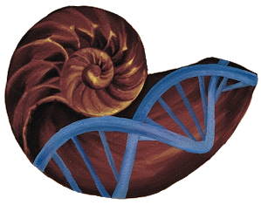
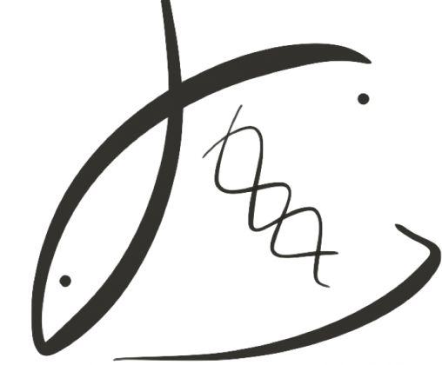
Acknowledgements
Biological Oceanography 001423631
Hall Conservation Genetics Research Award
Dr. Kathleen Lotterhos
Alan Downey-Wall
Dr. Steven Roberts
Sam White
Kaitlyn Mitchell

Slide 33
Questions?
yaaminiv@uw.edu
http://bit.ly/project-virginica-oa

Slide 34
Genomic Feature | Result
Total Genes | 60,201
Total Genes with DMLs | 3,129
Total DMLs | 1,470 (694+/776-)
DMLs in mRNA Coding Regions | 1,353
DMLs in Exons | 971
DMLs in Introns | 409
Notes:
We found differentially methylated regions in gonad tissue between oysters exposed to high pCO2 conditions and those in ambient conditions.
CGs methylated: Percentage of CGs methylated out of all that exist in the genome
Overlaps between DMLs and exons
Overlaps between DMLs and introns
Overlaps between DMLs and mRNA
Big takeaway is that OA induces DMLs. Our next question was…

Slide 35
Environment
Epigenome
Adults Eastern oysters in high pCO₂
>1300 DMLs in mRNA
Next steps
Complete gene enrichment analysis
Larval epigenetic inheritance
Compare results to similar study in Pacific oyster
Notes:
Our study, which is one of the first to examine changes in DNA methylation in molluscan reproductive tissue due to high pco2, identified over a thousand differentially methylated loci in mRNA coding regions alone.
Some of the processes that were overrepresented in these differentially methylated loci include metabolic processes and organismal development. If metabolic process or organismal development genes are hypomethylated, it’s possible that larvae will have the ability to acclimatize to high pco2 conditions. If hypermethylated, larvae exposed to the same high pco2 conditions may be small and slow-growing.
Understanding how parental environment will affect larval fitness is crucial. Breeding programs have put in a lot of effort into genetic selection for families resistant to various stressors, but there has been little work done on the consequences of unintended epigenetic selection in these scenarios. This research also provides a foundation for exploring avenues for organisms to acclimatize, and eventually adapt, to changing conditions.
Our next steps will be to examine epigenetic inheritance in larvae and determine how methylation plays a role in larval fitness. We conducted a similar experiment with Pacific oysters, and will look at DNA methylation in Pacific oyster gonad tissue and larvae as well for cross-species comparisons.

Slide 36
Metabolic processes
p = 1.21e-10
Similar to previous work
Elevated pCO₂ induced higher metabolic rates in Eastern oysters (Beniash et al. 2010)
Hypermethylation
Genes for metabolic regulation less likely to be transcribed
Larvae may benefit from stable housekeeping genes
Hypomethylation
Genes more likely to be transcribed
Could increase phenotypic plasticity in larvae
Notes:
Metabolic processes genes can either be hypomethylated or hypermethylated.
If genes for metabolic processes are hypermethylated in oysters exposed to high pCO2, then they are not being expressed as much. Larvae with these methylation patterns may not be able to regulate metabolism, or neutralize harmful cellular waste products, induced by stress from ocean acidification.
If genes for metabolic processes are hypomethylated, then these genes are more likely to be expressed. Larvae with hypomethylation in these genes may have an easier time adjusting to high pCO2 conditions.

Slide 37
4 Week pH Exposure
Elevated pCO₂
(2800 µatm)
Control pCO₂
(400 µatm)
DNA Extraction and Bisulfite Sequencing
-CH₃
Identify Differentially Methylated Loci (DMLs)
Notes:
Working with the Lotterhos Lab at Northeastern University, we exposed Eastern oysters to either control or elevated pCO2 for four weeks. Although Eastern oysters aren’t native to the west coast, they are grown here. Additionally, they can serve as a model organism for other shellfish species. Most importantly, they have a shiny new genome we can use for our analyses, which as a geneticist is really the coolest thing.
We then extracted DNA from 10 oysters: 5 from the control, 5 from the treatment. We sent them over for bisulfite sequencing.
Once we got our sequencing results, we were able to identify differentially methylated loci, or DMLs, between our samples. We identified loci that were at least 50% different between treatments, with a false discovery rate of 0.01.

Slide 38
Hypermethylation
Hypomethylation
Higher levels of methylation in treatment
Genes less likely to be expressed
Lower levels of methylation in treatment
Genes more likely to be expressed
Notes:
Differentially methylated loci can either be hypermethylated or hypomethylated.
Hypermethylation means that exposure to high pco2 leads to higher levels of methylation in those oysters. Genes with higher levels of methylation are less likely to be expressed.
On the other hand, exposure to a stressor like high pco2 could lead to reduced levels of methylation in genes, leading to higher levels of gene expression.

