Slide 1
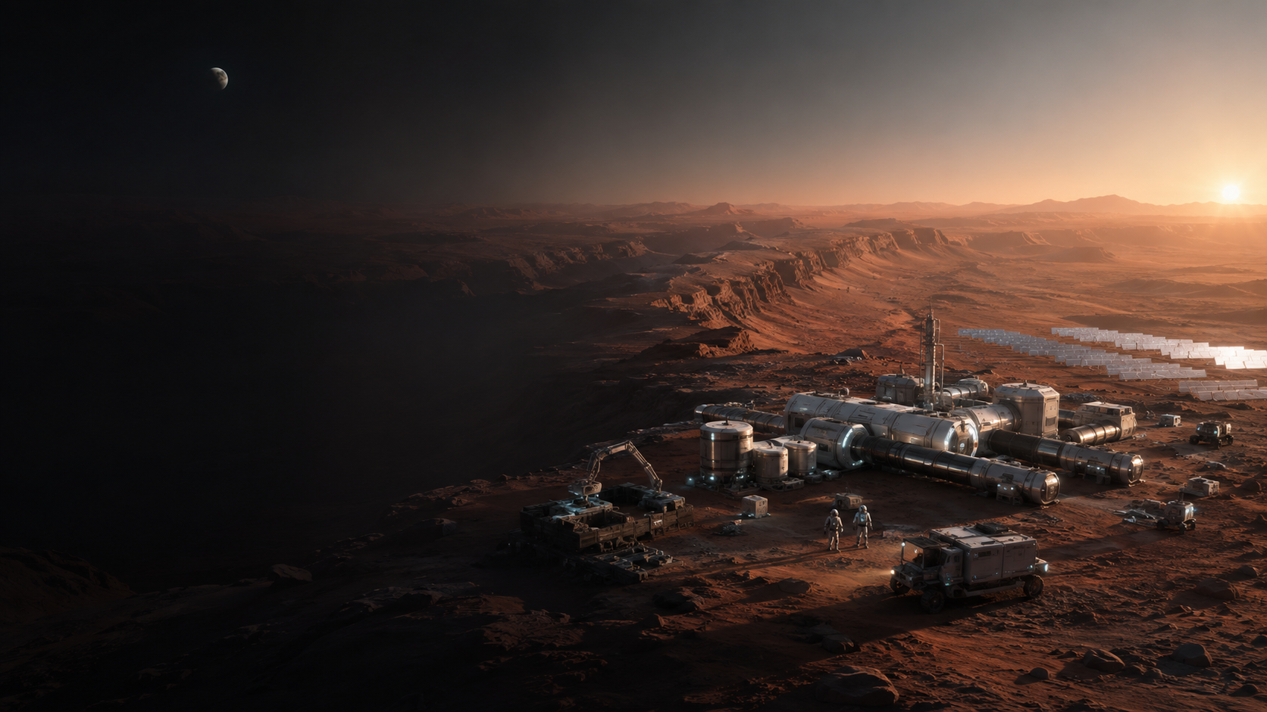
29TH INTERNATIONAL MARS SOCIETY CONVENTION
THE INTELLIGENCE
LAYER FOR MARS
Harnessed agentic AI for science, engineering and settlement
SCIENCE
ENGINEERING
OPERATIONS
OCTOBER 22–24, 2026 • USC, LOS ANGELES
BOB J MILLS
Notes:
[Timing: 1:00]
Mars is not waiting for one discipline at a time. Every meaningful surface system couples science, physical engineering, operations and human survival. The thesis tonight is simple: the next leap is not a larger chatbot. It is an intelligence layer—a governed way for people, AI models, solvers, instruments and robots to work through evidence, design, verification and learning as one system.
The harness is the durable part. Models will change rapidly. Mars missions cannot rebuild their operating method every time the model underneath improves. We need persistent memory, explicit work products, traceable handoffs and gates that stronger future intelligence can inherit. The goal is faster learning without counterfeit certainty.
[Sources]
- https://www.marssociety.org/news/2026/03/23/save-the-dates-29th-annual-international-mars-society-convention-at-usc/
- https://convention.marssociety.org/
- Bob J Mills, Detailed Initial Chat Summary and Restored Concepts, Mars project record.
- Visual: original AI-generated Mars settlement image created for this deck.

Slide 2

02 / MISSION CONSTRAINT
Mars is a learning-rate problem
The scarce resource is elapsed time from uncertain observation to a verified decision.
OBSERVE
GROUND
DECIDE
VERIFY
21–23 min
13–21 days
maximum one-way communication delay in NASA crewed-Mars profiles
blackout examples in two representative NASA mission profiles
A harness attacks coordination latency while preserving the evidence needed to close the decision.
MARS SOCIETY 2026 • HARNESSED AGENTIC SCIENCE + ENGINEERING
BOB J MILLS 02
Notes:
[Timing: 1:15]
Frame the problem as learning latency, not merely compute. Mars teams must turn uncertain observations into defensible action while mass, power, schedule and crew margins keep closing. That requires literature search, data grounding, hypothesis testing, multidisciplinary analysis, review, documentation and physical verification to move as a connected loop.
Communications delay makes the problem visible. NASA’s Moon-to-Mars analysis finds one-way delays can reach roughly twenty-one to twenty-three minutes, with representative blackout periods lasting about thirteen to twenty-one days. Earth cannot remain the synchronous brain for every decision. The same constraint appears before launch: science and engineering teams lose time at handoffs, review preparation and rediscovery of prior reasoning.
Agentic harnesses do not make physics instantaneous. They compress avoidable waiting by running controlled work in parallel, carrying evidence forward and surfacing broken links early.
[Sources]
- https://www.nasa.gov/wp-content/uploads/2024/01/mars-communications-disruption-and-delay.pdf
- https://science.nasa.gov/mars/facts/
- Bob J Mills, Version 4 transcript and restored presentation design record.
- Visual: original AI-generated Mars mission-control image created for this deck.

Slide 3
03 / DESIGN RULE
Seven functions turn a model into a mission harness
The model supplies reasoning. Seven surrounding functions make its work executable, reviewable and durable.
ROLE + PURPOSE + ACCOUNTABILITY
2026
DURABLE
GENERAL LLM
1 LOOP • 2 INSTRUCTIONS • 3 TOOL ACCESS • 4 CONTEXT
NEXT
5 MEMORY + STATE • 6 SUBAGENTS • 7 GUARDRAILS + APPROVALS
SPECIALIST MODEL
GROUND TRUTH • WORK-PRODUCT CONTRACTS • DURABLE STATE
FUTURE
REPLACEABLE
MODELS + AGENTS — SWAPPABLE
AGI / AUTONOMOUS LAB
Stable contracts and approval authority let every stronger model inherit a mission-ready way to work.
MARS SOCIETY 2026 • HARNESSED AGENTIC SCIENCE + ENGINEERING
BOB J MILLS 03
Notes:
[Timing: 1:15]
This is the architectural definition. A model is the engine; the harness is the infrastructure surrounding it. That infrastructure is the difference between describing a task and completing it with evidence and accountable control.
Walk the seven functions: first, the orchestration loop that plans, executes, inspects and repairs. Second, system instructions that define role and purpose. Third, tool access. Fourth, context management. Fifth, memory and state. Sixth, bounded subagents. Seventh, guardrails and approval controls.
The model can change without breaking the process because work-product contracts, ground-truth checks, durable state and authority remain stable. This is why harness design can matter more than the model itself.
[Sources]
- User-supplied agent-harness definition and seven-function brief.

Slide 4
04 / CAPABILITY MAP
Skills are durable; agents are assignments
Define the capability, evidence and work product first. Then assign the best executor available.
HUMAN
AI MODEL
SKILL
CONTRACT
intent • creativity • risk
search • synthesis • critique
SOLVER / DB
ROBOT / LAB
equations • data • simulation
measure • manipulate • test
DISCOVERY
MODELING
ENGINEERING
VERIFICATION
GOVERNANCE
MARS SOCIETY 2026 • HARNESSED AGENTIC SCIENCE + ENGINEERING
BOB J MILLS 04
Notes:
[Timing: 1:15]
Named agents are useful for implementation, but they are a fragile architecture. The durable map is the set of capabilities and the evidence each capability must produce. Scientific reasoning, literature grounding, simulation, systems engineering, CAD, FMEA, test planning and governance are skills. A person, model, database, solver, robot or future AGI can perform a skill if it satisfies the contract.
This matters on Mars because the executor changes with context. During communications delay, a local model may act. For a nonlinear trade, a deterministic solver should act. For a physical claim, an instrument or chamber test must act. For risk acceptance, authorized mission leadership must act.
Skills over agents prevents tool worship. It also makes the handoff auditable: the next stage receives an approved work product, not merely the opinion of a named digital persona.
[Sources]
- Bob J Mills, Detailed Initial Chat Summary and Restored Concepts, section 5.
- https://github.com/Robertstar2000/Hypatia-Pro
- https://github.com/Robertstar2000/Intelligent-Engineer

Slide 5
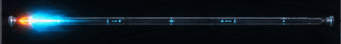
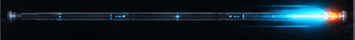
05 / SYSTEM ARCHITECTURE
Two harnesses. One digital thread.
Research and engineering stay specialized, but evidence and unresolved questions move through one governed baseline.
APPROVED EVIDENCE →
HYPATIA PRO
SCIENCE
HARNESS
ENGINEERING
EVIDENCE
PACKAGE
INTELLIGENT
ENGINEER
PRO
VERIFY • MANUFACTURE • OPERATE
← RESEARCH REQUEST PACKAGE
Field and test evidence can reopen the science—or the design.
MARS SOCIETY 2026 • HARNESSED AGENTIC SCIENCE + ENGINEERING
BOB J MILLS 05
Notes:
[Timing: 1:15]
The architecture uses two connected harnesses because science and engineering have different jobs. Hypatia Pro asks what is supported, uncertain or unresolved. Intelligent Engineer Pro asks how to build within that evidence, how to control risk and how to prove the result.
The forward handoff is an Engineering Evidence Package: equations, distributions, operating envelopes, provenance, assumptions, failure thresholds and minimum additional tests. The return handoff is a Research Request Package: a blocked decision, competing hypotheses, variables, Mars boundary conditions, method and acceptance threshold.
That return path is essential. It turns “we need more research” into a bounded job that can be executed and reinserted into the same baseline. Verification, manufacturing and operations then generate new evidence. The digital thread keeps the loop continuous across tools, people and future model generations.
[Sources]
- Bob J Mills, Detailed Initial Chat Summary and Restored Concepts, sections 6–8.
- https://github.com/Robertstar2000/Hypatia-Pro
- https://github.com/Robertstar2000/Intelligent-Engineer
- Animated telemetry assets: original AI-generated sprite sheet assembled into GIFs for this deck.

Slide 6
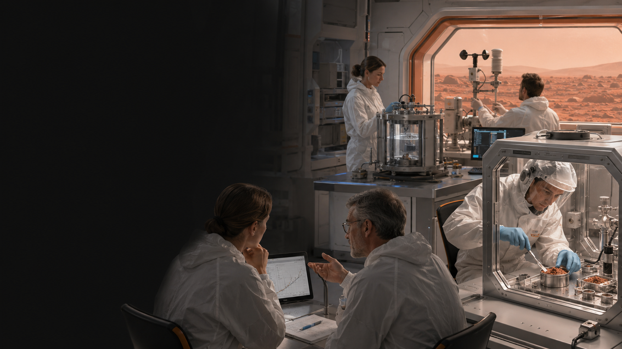
06 / SCIENCE HARNESS
Hypatia turns curiosity into defensible science
Falsifiable questions. Explicit variables. Classified evidence. Adversarial attack.
REFINE
research question
GROUND
literature + data
PREDICT
competing hypotheses
MEASURE
experiment / simulation
ATTACK
peer critique + refutation
SYNTHESIZE
approved result
GENERATE → VALIDATE → CRITIQUE
REPAIR → APPROVE → PERSIST
ONLY APPROVED OUTPUTS FLOW FORWARD
MARS SOCIETY 2026 • HARNESSED AGENTIC SCIENCE + ENGINEERING
BOB J MILLS 06
Notes:
[Timing: 1:20]
Hypatia is a scientific-discovery harness, not a fluent literature summarizer. It refines the question, grounds it in prior evidence, generates falsifiable competing hypotheses, defines variables and measurement protocols, obtains evidence, quantifies uncertainty and invites adversarial attack.
The governing loop is generate, validate, critique, repair, approve and persist. A model may draft an artifact, but drafting is not promotion. The artifact must survive checks appropriate to its class. A literature claim needs a traceable source. A simulated result needs a model, assumptions and boundary conditions. An empirical claim needs measurement provenance. A failed hypothesis is preserved because negative evidence is part of mission knowledge.
The loop can move backward whenever grounding, protocol or inference is weak. That willingness to refuse premature certainty is what makes the output safe enough to become an engineering input.
[Sources]
- Bob J Mills, Detailed Initial Chat Summary and Restored Concepts, section 6.
- https://github.com/Robertstar2000/Hypatia-Pro
- Visual: original AI-generated Mars laboratory image created for this deck.

Slide 7
07 / EVIDENCE CONTROL
Every claim carries epistemic status
The harness prevents a plausible sentence—or a clean simulation—from silently becoming a physical fact.
LITERATURE
what has been reported
SOURCE + SCOPE
MODELED
what the equations predict
ASSUMPTIONS + BOUNDS
NO SILENT
PROMOTION
EMPIRICAL
what was physically measured
METHOD + UNCERTAINTY
OPEN
what remains unresolved
QUESTION + DISPOSITION
Literature informs models. Models guide tests. Tests may revise both. Open questions stay open.
CLAIM
WITH STATUS
MARS SOCIETY 2026 • HARNESSED AGENTIC SCIENCE + ENGINEERING
BOB J MILLS 07
Notes:
[Timing: 1:20]
A mission loses integrity when evidence classes blur. Literature can be authoritative within its scope, but it is not automatically valid at a different pressure, temperature, material or scale. A model can be useful and still be wrong outside its assumptions. A physical measurement can be real and still have uncertainty or limited transferability. An unresolved question is not a defect to hide; it is a work item.
The harness attaches status to the claim itself. It also carries source, scope, assumptions, boundary conditions, measurement method, uncertainty and disposition. That allows engineering to use knowledge without pretending it is stronger than it is.
This is especially important in AI-generated work. Fluency can erase the visual cues that used to warn us an answer was tentative. Explicit epistemic status puts those cues back into the engineering record and lets later evidence reopen affected requirements and decisions.
[Sources]
- Bob J Mills, Sources, Claims and Replacement Ledger, Mars Version 4 package.
- https://science.nasa.gov/mars/facts/
- https://github.com/Robertstar2000/Hypatia-Pro

Slide 8
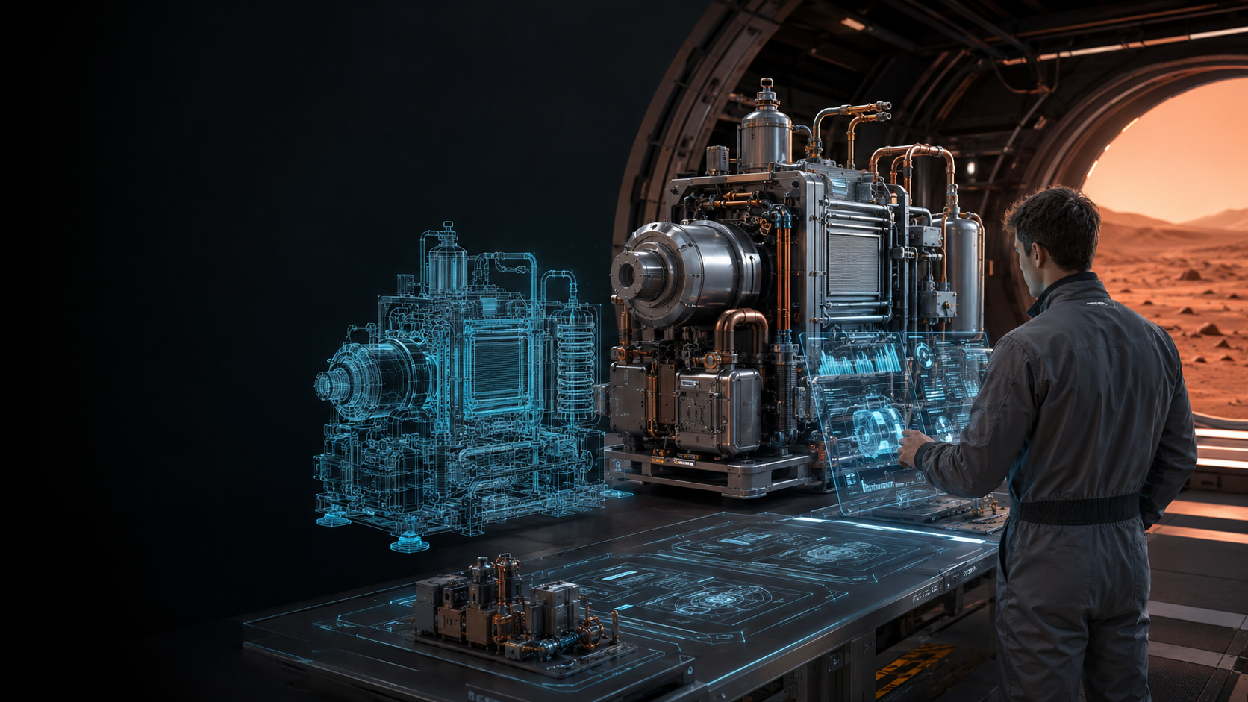
08 / ENGINEERING HARNESS
Intelligent Engineer turns evidence into a controlled baseline
Drafts accelerate work. Phase gates authorize work.
REQUIRE
TRADE
DESIGN
HARDEN
VERIFY
RELEASE
mission + constraints
architecture + margins
PDR / CDR sprints
DFMA • FMEA • faults
methods + acceptance
locked baseline
LOCKED BASELINE
Only reviewed phase outputs become authorized inputs downstream.
MARS SOCIETY 2026 • HARNESSED AGENTIC SCIENCE + ENGINEERING
BOB J MILLS 08
Notes:
[Timing: 1:20]
Intelligent Engineer Pro takes an approved evidence package and converts it into requirements, architecture alternatives, margins, design analyses, risks, verification methods and controlled review artifacts. It is phase-gated because a fast draft must not become an invisible baseline.
The harness supports project definition, requirements and constraints, discipline selection, preliminary and critical design, focused design sprints, multidisciplinary analysis, CAD, FEA, CFD, circuit and process work, DFMA, FMEA, redundancy, manufacturing, maintenance and operations planning. It can generate next-phase seeds, but those seeds remain drafts until reviewed.
The important distinction is authorization. A model can propose a requirement or design. The project records what evidence supports it, what assumptions remain, what test will verify it and what authority locks it. That discipline lets automation accelerate engineering without smuggling unreviewed content into the next phase.
[Sources]
- Bob J Mills, Detailed Initial Chat Summary and Restored Concepts, section 6.
- https://github.com/Robertstar2000/Intelligent-Engineer
- Visual: original AI-generated Mars engineering and digital-twin image created for this deck.

Slide 9
09 / DIGITAL THREAD
The handoff is structured—not conversational
Engineering inherits equations, bounds, provenance and tests together, so changed evidence can reopen the right decisions.
EQUATIONS
REQUIREMENTS
DISTRIBUTIONS
ENGINEERING
EVIDENCE
PACKAGE
TRADE STUDIES
ENVELOPES
ASSUMPTIONS
V&V MATRIX
MACHINE-READABLE LINKS
PROVENANCE
source → claim → parameter → requirement → test → status
OPEN ISSUES
REQUIRED TESTS
A changed parameter triggers focused rework—not a search through old chat.
MARS SOCIETY 2026 • HARNESSED AGENTIC SCIENCE + ENGINEERING
BOB J MILLS 09
Notes:
[Timing: 1:20]
The handoff between science and engineering cannot be a prose answer. Engineering needs a structured evidence package containing equations, parameter distributions, operating envelopes, assumptions, failure thresholds, confidence, provenance and the tests still required.
Each element is linked. A source supports a bounded claim. The claim defines a parameter or constraint. The parameter supports a requirement or trade. The requirement has a verification method and status. When evidence changes, the digital thread identifies exactly which requirement, model, test or decision is affected.
This is where a harness becomes more than workflow automation. It creates machine-readable contracts between disciplines. It allows agents to maintain traceability, detect inconsistencies and reopen focused work before a review. The result is less time reconstructing intent and more time resolving the actual engineering question.
[Sources]
- Bob J Mills, Detailed Initial Chat Summary and Restored Concepts, section 7.
- https://github.com/Robertstar2000/Hypatia-Pro
- https://github.com/Robertstar2000/Intelligent-Engineer

Slide 10
10 / COMPLETION LOOP
The fastest path to completion includes a return to research
Agents accelerate the issue → research request → evidence return → baseline update cycle instead of hiding uncertainty.
APPROVED
EVIDENCE
1
REQUIREMENTS
+ TRADES
NO FAKE CERTAINTY
2
Verification, manufacturing and operations can reopen any earlier node.
BASELINE UPDATE
+ CONTINUE
ENGINEERING
TO COMPLETION
6
DESIGN ISSUE
SURFACED
3
TARGETED
EVIDENCE
5
RESEARCH
REQUEST
4
THE RETURN PATH IS A FEATURE
MARS SOCIETY 2026 • HARNESSED AGENTIC SCIENCE + ENGINEERING
BOB J MILLS 10
Notes:
[Timing: 1:20]
A linear research-to-engineering arrow is incomplete. The real acceleration comes from closing the return path. Research delivers approved evidence. Engineering turns it into requirements and trades. Design or analysis exposes a blocking uncertainty. The harness packages that uncertainty as a precise research request. Targeted evidence returns to the same baseline, the affected decision is updated and engineering continues.
Agents can search, simulate, critique, document and maintain links throughout the loop. The key is that they do not erase the issue. They make it explicit and executable. A good Research Request Package names the blocked decision, hypotheses, variables, Mars boundary conditions, method, minimum detectable effect, evidence quality and acceptance threshold.
Verification, manufacturing and operations remain part of the same learning system. A failed test or field observation can reopen science, requirements or design without losing the chain of reasoning.
[Sources]
- Bob J Mills, Detailed Initial Chat Summary and Restored Concepts, section 8.
- https://github.com/Robertstar2000/Hypatia-Pro
- https://github.com/Robertstar2000/Intelligent-Engineer

Slide 11
11 / AGENTIC ACCELERATION
Parallel work shortens waiting; gates preserve truth
The harness coordinates independent searches, analyses and critiques—then merges only reviewed work.
EVIDENCE SEARCH
sources • conflicts • gaps
VALIDATE
CRITIQUE
APPROVE
MISSION
QUESTION
MODELS + TRADES
simulation • sensitivity
ONE
REVIEWED
PACKAGE
ADVERSARIAL ATTACK
failure • counterexample
ARTIFACT BUILD
trace • report • review pack
SEQUENTIAL
HARNESS
same evidence standard • less avoidable waiting
MARS SOCIETY 2026 • HARNESSED AGENTIC SCIENCE + ENGINEERING
BOB J MILLS 11
Notes:
[Timing: 1:10]
Parallelism is where agentic systems can attack real schedule. One workstream searches evidence and contradictions. Another runs models and sensitivity studies. Another tries to break the preferred conclusion. Another builds traceable artifacts and review material. These tasks can overlap when their interfaces and permissions are defined.
The merge gate matters more than the number of agents. Independent outputs must be reconciled, validated, critiqued and approved before they become one package. Parallel work should not create four incompatible truths or hide duplicated assumptions. The harness records dependencies, evidence classes and unresolved conflicts.
The result is not “AI worked four times faster.” The defensible claim is narrower: controlled concurrency reduces avoidable waiting and review preparation while preserving the evidence standard. That is a practical way to compress the research–engineering–research issue–completion loop.
[Sources]
- Bob J Mills, Version 4 Change Log and restored presentation design record.
- https://github.com/Robertstar2000/Hypatia-Pro
- https://github.com/Robertstar2000/Intelligent-Engineer

Slide 12
12 / VERIFICATION
Verification starts at the first claim
Agents maintain the links, expose breaks and launch focused rework before a review gate.
CLAIM
SOURCE
REQUIREMENT
METHOD
RESULT
STATUS
dust fouling dominates
literature + model
recover performance
Mars dust chamber
measured evidence
open / accepted
BROKEN LINK → REWORK
Every uncertainty gets a disposition
ANALYZE
TEST
CONSTRAIN
ACCEPT RISK
AI can assist verification. It cannot make missing physical evidence real.
MARS SOCIETY 2026 • HARNESSED AGENTIC SCIENCE + ENGINEERING
BOB J MILLS 12
Notes:
[Timing: 1:10]
Verification is not the last phase. It begins with the first claim. Every claim needs provenance. Every requirement needs a method. Every uncertainty needs a disposition: analyze it, test it, constrain the design around it or explicitly accept the risk.
A harness can maintain the trace matrix continuously. It can identify a source that no longer supports its claim, a changed parameter that invalidates a requirement, a requirement without a method or a test result that does not meet its acceptance criterion. That broken link becomes focused rework before the review, not a surprise during it.
AI can help generate tests, check consistency, update FMEA and organize evidence. It cannot claim that a simulation physically validated hardware. Verification is the discipline that separates an impressive demonstration from engineering that can be trusted on Mars.
[Sources]
- Bob J Mills, Detailed Initial Chat Summary and Restored Concepts, section 9.
- https://ntrs.nasa.gov/citations/20100036405
- https://github.com/Robertstar2000/Intelligent-Engineer

Slide 13
13 / MISSION MEMORY
Mission memory is the compounding asset
A governed knowledge graph preserves what the mission knows, assumes, decides, tests and learns across model generations.
ASSUMPTIONS
PARAMETERS
EVIDENCE
REQUIREMENTS
GOVERNED
MISSION GRAPH
RISKS
DECISIONS
FIELD DATA
TESTS
PEOPLE • MODELS • SOLVERS • CAD/PLM • LABS • ROBOTS
MARS SOCIETY 2026 • HARNESSED AGENTIC SCIENCE + ENGINEERING
BOB J MILLS 13
Notes:
[Timing: 1:10]
The shared digital brain is not a personified super-AI. It is governed mission context: evidence, assumptions, parameters, requirements, decisions, risks, tests, field data and open questions connected in a reusable graph.
That memory survives staff changes, model upgrades and tool replacements. It prevents context from disappearing into isolated chats or static reports. It also makes future models more useful because they inherit structured knowledge instead of reconstructing the mission from fragments.
Every harness reads and writes through controlled interfaces. Hypatia adds approved evidence and uncertainty. Intelligent Engineer adds requirements, trades and verification. CAD, PLM, simulators, labs and operations add models and results. The digital thread links them. This is how learning compounds across projects: a negative test, failed hypothesis or field observation remains available to prevent repetition and sharpen the next decision.
[Sources]
- Bob J Mills, Detailed Initial Chat Summary and Restored Concepts, section 11.
- https://github.com/Robertstar2000/Hypatia-Pro
- https://github.com/Robertstar2000/Intelligent-Engineer

Slide 14
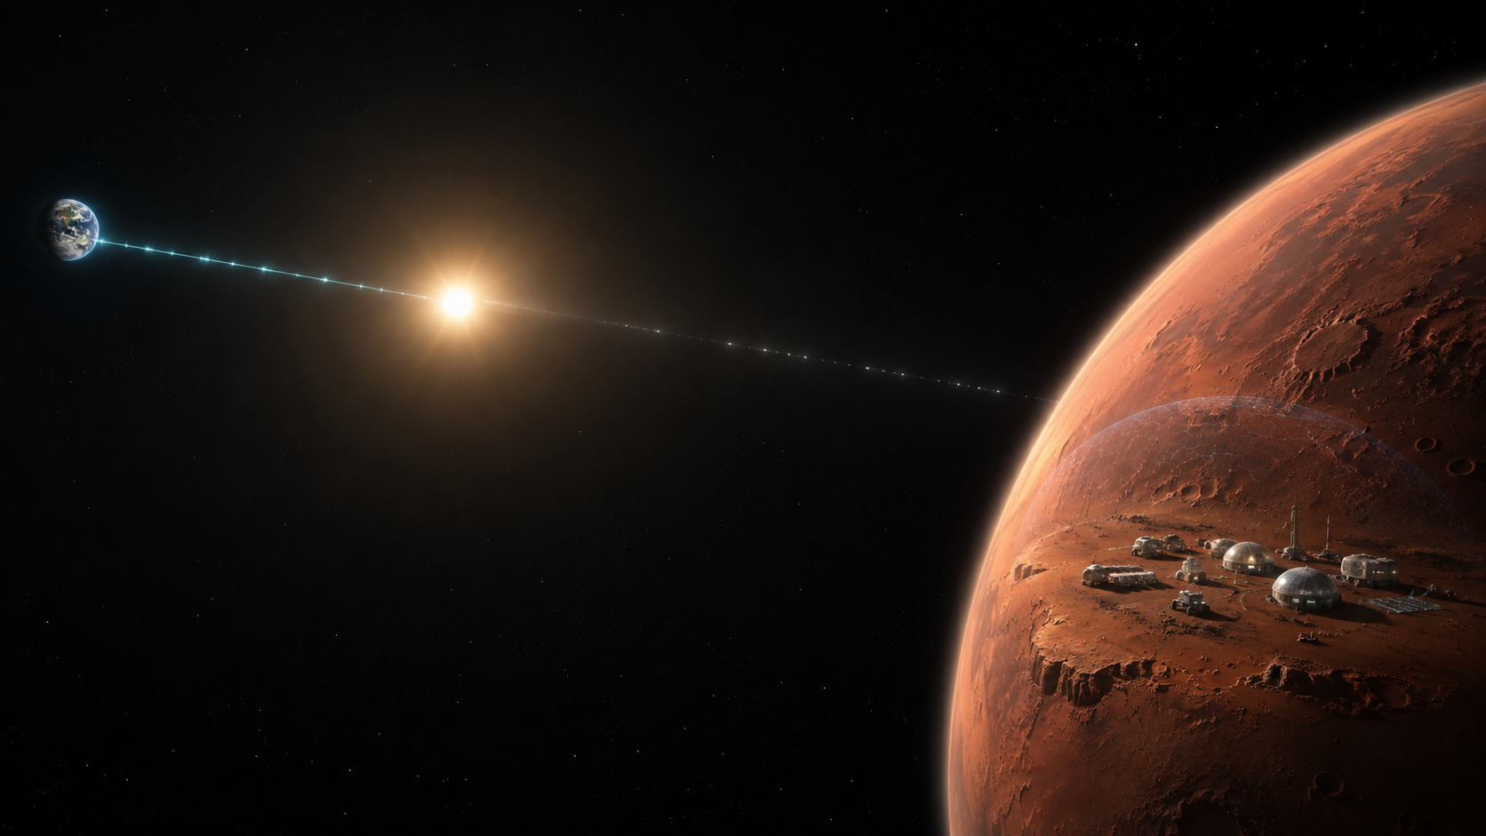
14 / MARS AUTONOMY
Mars cannot wait for Earth to think
Delay and blackout make local intelligence mission infrastructure—not a convenience.
21–23 min
WEEKS
maximum one-way delay in NASA crewed-Mars profiles
communications blackouts are unavoidable in representative profiles
LOCAL
SYNC
SAFE
operate through delay
reconcile with Earth
degrade predictably
Cached evidence • controlled tools • asynchronous synchronization • explicit authority
MARS SOCIETY 2026 • HARNESSED AGENTIC SCIENCE + ENGINEERING
BOB J MILLS 14
Notes:
[Timing: 1:10]
NASA’s communication analysis makes the autonomy requirement unavoidable. One-way delay can exceed twenty minutes, and solar conjunction can produce blackouts lasting roughly two or three weeks in representative mission profiles. Relays may mitigate some disruption, but they cannot eliminate the speed-of-light delay.
A Mars intelligence layer therefore needs three operating modes. Local mode uses cached evidence, local models and controlled tools to keep work moving. Sync mode reconciles new evidence, decisions and software with Earth when the link is available. Safe mode degrades predictably when capabilities, data or authority are insufficient.
The harness makes those boundaries explicit. It knows which decisions can be made locally, which require later reconciliation and which must stop. This is more robust than treating autonomy as a single “agent” and more realistic than assuming mission control remains continuously synchronous.
[Sources]
- https://www.nasa.gov/wp-content/uploads/2024/01/mars-communications-disruption-and-delay.pdf
- https://science.nasa.gov/mars/facts/
- Visual: original AI-generated Earth–Mars communications image created for this deck.

Slide 15
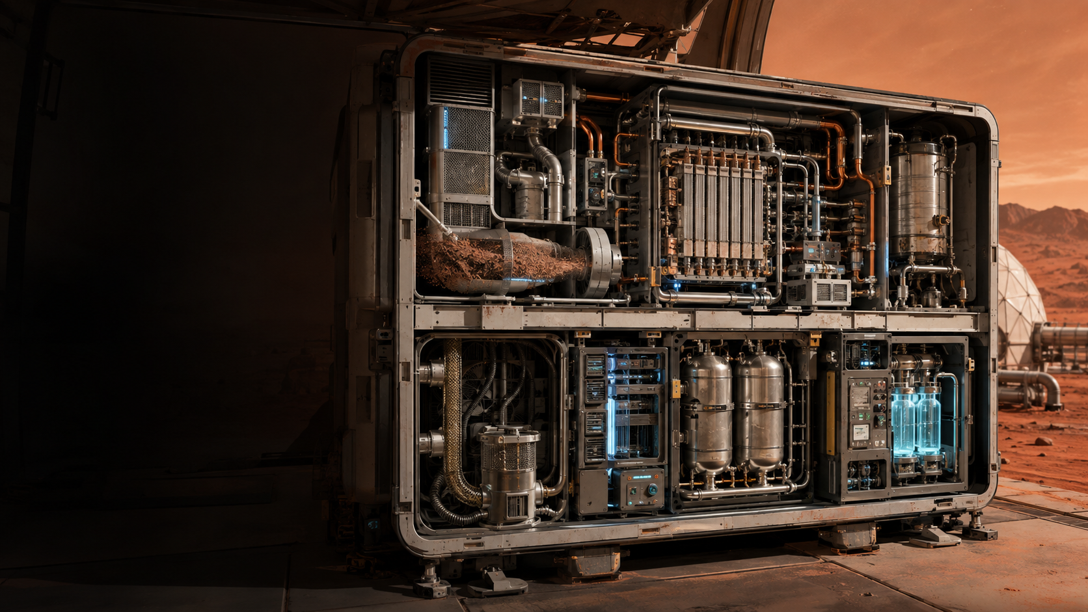
15 / CASE STUDY — SCIENCE OUTPUT
MOXIE proved the chemistry. Settlement scale is a systems problem.
EMPIRICAL — NASA MOXIE
16
122 g
≥98%
oxygen production
runs
total oxygen produced
peak oxygen purity
Peak O₂ production rate
OPEN FOR SETTLEMENT SCALE
dust • inlet variability • thermal cycling • aging • liquefaction • storage • maintenance
MARS SOCIETY 2026 • HARNESSED AGENTIC SCIENCE + ENGINEERING
BOB J MILLS 15
Notes:
[Timing: 2:30]
Now apply the architecture to a compact Mars oxygen plant. NASA’s MOXIE experiment gives us a real empirical anchor. Across sixteen runs it produced a total of 122 grams of oxygen. At peak it reached 12 grams per hour—twice its original goal—at 98 percent purity or better. That is powerful evidence that solid-oxide electrolysis can extract oxygen from the Martian carbon-dioxide atmosphere.
But a settlement plant is not simply “make MOXIE bigger.” NASA’s own next-step framing includes the generator plus oxygen liquefaction and storage. Engineering must also resolve atmospheric variability, dust filtration and electrostatics, thermal cycling, material and seal degradation, process aging, contamination, maintenance access, redundancy and interfaces to power and storage.
A Hypatia evidence package would separate the empirical MOXIE results from literature, modeled expectations and open questions. It would carry equations, parameter ranges, boundary conditions, uncertainty, failed hypotheses and the minimum additional experiments required. The visible open list is intentionally not presented as solved. This is the integrity point: proof of principle is evidence, but it is not yet a settlement-qualified baseline.
[Sources]
- https://www.nasa.gov/missions/mars-2020-perseverance/perseverance-rover/nasas-oxygen-generating-experiment-moxie-completes-mars-mission/
- https://science.nasa.gov/mars/facts/
- https://ntrs.nasa.gov/citations/20100036405
- Bob J Mills, Hypatia / Intelligent Engineer Demo Package, Mars Version 4.
- Visual: original AI-generated Mars ISRU cutaway created for this deck.

Slide 16
16 / CASE STUDY — ENGINEERING OUTPUT
Evidence becomes a requirement—or remains an assumption
Illustrative translation of the ISRU evidence package. This is not a qualified design baseline.
ILLUSTRATIVE • REPLACE WITH REVIEWED HARNESS OUTPUT
EVIDENCE
REQUIREMENT
VERIFICATION
MOXIE proof
of principle
REQ-PROD-01
Meet mission-defined oxygen demand with qualified margin.
Integrated endurance
demonstration
Thin CO₂ atmosphere
+ inlet variability
REQ-ENV-02
Operate across the qualified inlet pressure and composition envelope.
Mars-atmosphere
chamber profile
Dust hazard
remains open
REQ-DUST-03
Recover required performance after the specified dust exposure.
Dust loading +
recovery test
NASA next step:
liquefy + store
REQ-STOR-04
Provide a controlled interface to oxygen liquefaction and storage.
Integrated interface
acceptance test
Every row keeps the source, obligation and proof method connected.
MARS SOCIETY 2026 • HARNESSED AGENTIC SCIENCE + ENGINEERING
BOB J MILLS 16
Notes:
[Timing: 2:30]
This slide demonstrates how Intelligent Engineer should translate evidence into a controlled baseline. It is explicitly illustrative; the final conference version should replace these rows with reviewed harness output.
The first track begins with MOXIE’s empirical proof of principle. It does not invent a settlement production number. It creates a requirement to meet mission-defined oxygen demand with qualified margin, verified by an integrated endurance demonstration. The second track uses the thin carbon-dioxide atmosphere and the need for an inlet envelope. The requirement must reference the qualified pressure and composition profile, then be verified in a representative chamber.
The third track refuses to pretend the dust issue is solved. It creates a recoverability requirement tied to a specified exposure, with a dust loading and recovery test. The fourth track follows NASA’s stated future direction: a full system needs oxygen generation plus liquefaction and storage, so engineering defines and verifies that interface.
Notice the pattern. Evidence may support a requirement. Open uncertainty may create a bounded assumption, margin or research request. A mission decision may deliberately set a value. Every path remains visible. Every requirement has a proof method from the moment it enters the baseline.
[Sources]
- https://www.nasa.gov/missions/mars-2020-perseverance/perseverance-rover/nasas-oxygen-generating-experiment-moxie-completes-mars-mission/
- https://science.nasa.gov/mars/facts/
- https://ntrs.nasa.gov/citations/20100036405
- Bob J Mills, Hypatia / Intelligent Engineer Demo Package, Mars Version 4.
- https://github.com/Robertstar2000/Intelligent-Engineer

Slide 17
17 / CASE STUDY — RETURN PATH
Engineering returns one bounded scientific question
A design-blocking uncertainty becomes an executable Research Request Package—not a vague demand for more study.
ILLUSTRATIVE RESEARCH REQUEST • NOT AN EMPIRICAL RESULT
BLOCKED DECISION
FILTER CLEANING INTERVAL
RESEARCH REQUEST PACKAGE
REVIEWED EVIDENCE
RETURNS TO BASELINE
HYPOTHESES
H1 limited thermal-cycling effect
H2 adhesion drives persistent fouling
VARIABLES
pressure drop • dust loading • adhesion • cycles • temperature
BOUNDARY
Mars pressure/composition • qualified dust simulant • thermal profile
METHOD
factorial dust-chamber test + uncertainty analysis
ACCEPTANCE
requirement-derived pressure-drop and recovery limits
ENGINEERING
CONTINUES
UPDATE
FILTER SIZE
MAINTENANCE
V&V
MARS SOCIETY 2026 • HARNESSED AGENTIC SCIENCE + ENGINEERING
BOB J MILLS 17
Notes:
[Timing: 2:30]
Here the engineering analysis has reached a real decision: how often must the inlet filter be cleaned or replaced? That decision affects filter area, compressor margin, maintenance time, spares and operating availability. But dust adhesion after repeated thermal cycling under Mars pressure is not sufficiently bounded.
Instead of burying a convenient assumption, Intelligent Engineer creates a Research Request Package. It states competing hypotheses. One says thermal cycling has limited effect within the qualified range. Another says electrostatic adhesion drives persistent fouling. It defines the dependent measures—pressure drop, recovery and adhesion—and the independent variables—dust loading, temperature cycles and exposure. It specifies Mars-relevant pressure and composition, a qualified simulant, the proposed factorial chamber test and uncertainty analysis. The acceptance criterion is not invented by the scientist; it is derived from the engineering margin and requirement.
Hypatia executes or coordinates the targeted work, classifies the evidence, attacks the inference and returns only reviewed findings. The baseline then updates the filter sizing, compressor margin, cleaning interval and verification plan. Engineering continues from the same traceable state. This is the completion loop the presentation is advocating.
[Sources]
- https://ntrs.nasa.gov/citations/20100036405
- https://www.nasa.gov/science-research/kennedy-scientists-developing-technology-to-remove-martian-dust/
- https://science.nasa.gov/mars/facts/
- Bob J Mills, Hypatia / Intelligent Engineer Demo Package and restored completion-loop requirement.
- https://github.com/Robertstar2000/Hypatia-Pro
- https://github.com/Robertstar2000/Intelligent-Engineer

Slide 18
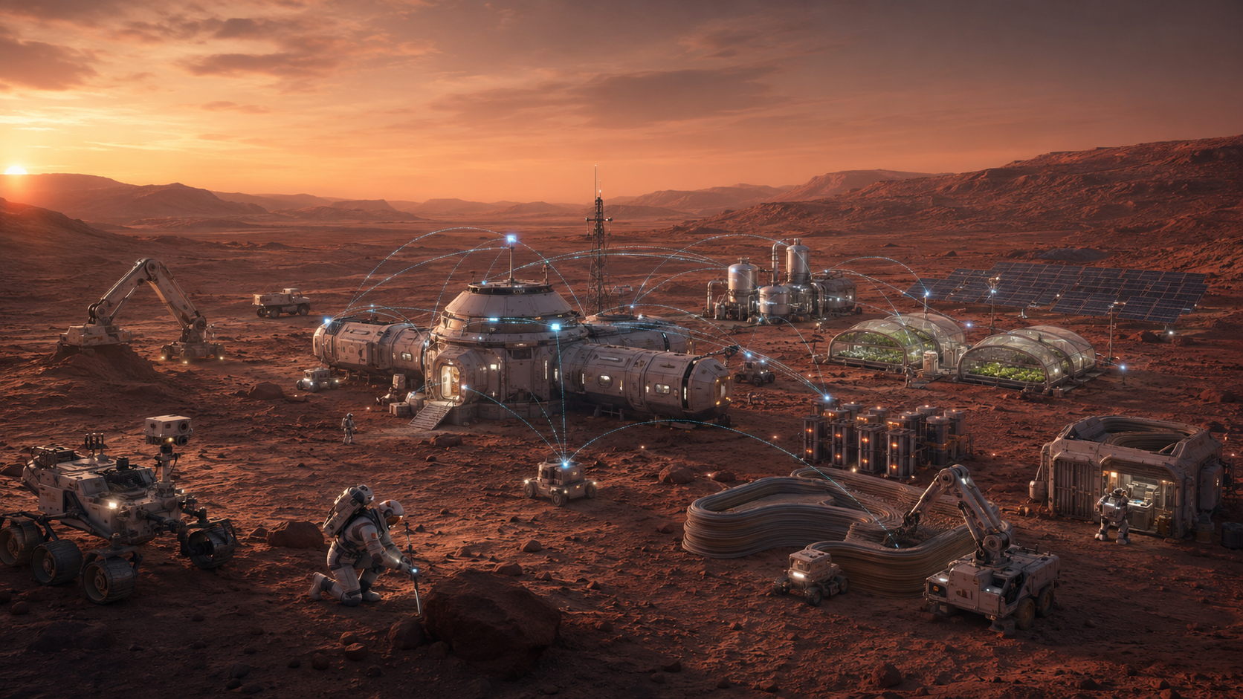
18 / HARNESS ECOSYSTEM
SaaS workflows become portable mission skills
Codex, Claude Cowork, Hermes and Grok can load the same core skill contracts; available tools determine execution.
ISRU + POWER
HABITAT
FIELD SCIENCE
FOOD
CONSTRUCTION
MAINTENANCE
HYPATIA
INTELLIGENT ENGINEER
HYPERIA
VIBE ENGINEERING
PM ACCELERATOR
science
physical systems
research + synthesis
collaborative design
execution + controls
RUNTIMES: CODEX • CLAUDE COWORK • HERMES • GROK
MARS SOCIETY 2026 • HARNESSED AGENTIC SCIENCE + ENGINEERING
BOB J MILLS 18
Notes:
[Timing: 1:50]
The five application patterns become portable skills. Hypatia structures scientific work. Hyperia performs broad research and synthesis. Intelligent Engineer controls the physical-engineering baseline. Vibe Engineering supports collaborative design. PM Accelerator controls execution and review readiness.
Each pack defines a role, decision loop, tool contract, work product, ground-truth checks, memory rules and approval boundaries. Three shared controls—orchestration, validation and mission memory—compose them safely.
The core instructions can travel across Codex, Claude Cowork, Hermes and Grok. Placement and invocation differ, and the runtime can execute only the tools and permissions it actually has.
This is functional workflow emulation, not a copy of a proprietary interface or a claim of feature parity.
[Sources]
- https://docs.x.ai/build/features/skills-plugins-marketplaces
- https://github.com/NousResearch/hermes-agent/blob/main/website/docs/user-guide/features/skills.md
- https://support.claude.com/en/articles/12512198-how-to-create-custom-skills
- User-supplied SaaS application concepts.

Slide 19
19 / ADOPTION
Start with one consequential loop
Prove traceability and expert equivalence on a recurring decision before attempting an enterprise-wide ecosystem.
FIRST WIN
5
SCALE
One high-value learning loop
with evidence that survives review.
only after the loop
survives pressure
4
VALIDATE
expert baseline +
failed cases
2
DEFINE
work products +
evidence classes
3
CONNECT
SELECT
controlled tools +
mission memory
1
one recurring
decision
CHATBOT → AGENT → HARNESS → ECOSYSTEM → LEARNING ORG
MARS SOCIETY 2026 • HARNESSED AGENTIC SCIENCE + ENGINEERING
BOB J MILLS 19
Notes:
[Timing: 1:40]
The practical starting point is not an enterprise transformation. Choose one recurring decision where delay, rework or lost evidence matters. Define the required work products, evidence classes, tools, permissions, validation steps and release authority. Connect only the data and tools needed for that loop.
Then compare the harness output against expert work and known failure cases. Can it preserve provenance? Does it distinguish modeled from empirical evidence? Does it expose uncertainty? Can a reviewer reconstruct the decision? Does it fail safely when the evidence is inadequate?
Only after that loop survives real pressure should the organization scale to adjacent skills and domains. Most organizations are still moving from chatbot to task agent. The practical next stage is the harness: workflow, memory, tools and gates. Mars-scale learning eventually requires an ecosystem, but reliability is earned one consequential loop at a time.
[Sources]
- Bob J Mills, Version 4 Run of Show and restored adoption model.
- https://github.com/Robertstar2000/Hypatia-Pro
- https://github.com/Robertstar2000/Intelligent-Engineer

Slide 20

20 / CALL TO ACTION
MAKE ENGINEERING
A LEARNING SYSTEM
Mars will reward teams that learn faster without losing discipline.
SCIENCE
ENGINEERING
VERIFICATION
OPERATIONS
Build the intelligence layer now—so every stronger model inherits a mission-ready way to work.
MARS SOCIETY 2026 • HARNESSED AGENTIC SCIENCE + ENGINEERING
BOB J MILLS 20
Notes:
[Timing: 1:40]
Return to the opening promise. Mars is a learning-rate problem, but speed without discipline is not progress. The architecture presented here turns AI into structured engineering capacity: specialized harnesses, durable skills, explicit evidence classes, phase gates, continuous verification, persistent mission memory and a complete return path from engineering uncertainty to targeted science.
The model is replaceable. The way the mission defines work, remembers evidence, accepts risk and proves a result must endure. Stronger AI will move more execution into automation. That makes the harness more important, not less, because purpose, authority, provenance and acceptance must remain visible as capability changes.
Start with one consequential loop. Make the evidence survive review. Preserve negative results. Let science refuse false certainty. Let engineering return precise questions. Then connect the loops until science, engineering, verification and operations become one learning system.
Mars will not be built by a chatbot. It will be built by people and increasingly capable intelligence working through a mission-ready way to learn.
[Sources]
- Bob J Mills, Detailed Initial Chat Summary and Restored Concepts, durable principles and closing frame.
- https://www.nasa.gov/wp-content/uploads/2024/01/mars-communications-disruption-and-delay.pdf
- https://www.nasa.gov/missions/mars-2020-perseverance/perseverance-rover/nasas-oxygen-generating-experiment-moxie-completes-mars-mission/
- https://github.com/Robertstar2000/Hypatia-Pro
- https://github.com/Robertstar2000/Intelligent-Engineer
- Visual: original AI-generated closing Mars settlement image created for this deck.

