Slide 1


MARS HARNESS LAB / VERSION 5
FROM RESEARCH IDEATION
TO VERIFIED ACTION - FASTER
A practical intelligence layer for science,
engineering, and mission delivery.
(A lot) More mission learning per hour of expert attention.
15 MIN TALK / 5 MIN DISCUSSION
Notes:
[Timing: 0:45]
Open with the practical promise on the slide: this is an intelligence layer for science, engineering, and mission delivery. The objective is not another chat interface. It is more mission learning per hour of expert attention.
Set expectations for the talk: about fifteen minutes of presentation followed by discussion. The central idea is to use governed AI harnesses to carry evidence and work products forward while people retain authority over consequential decisions.

Slide 2
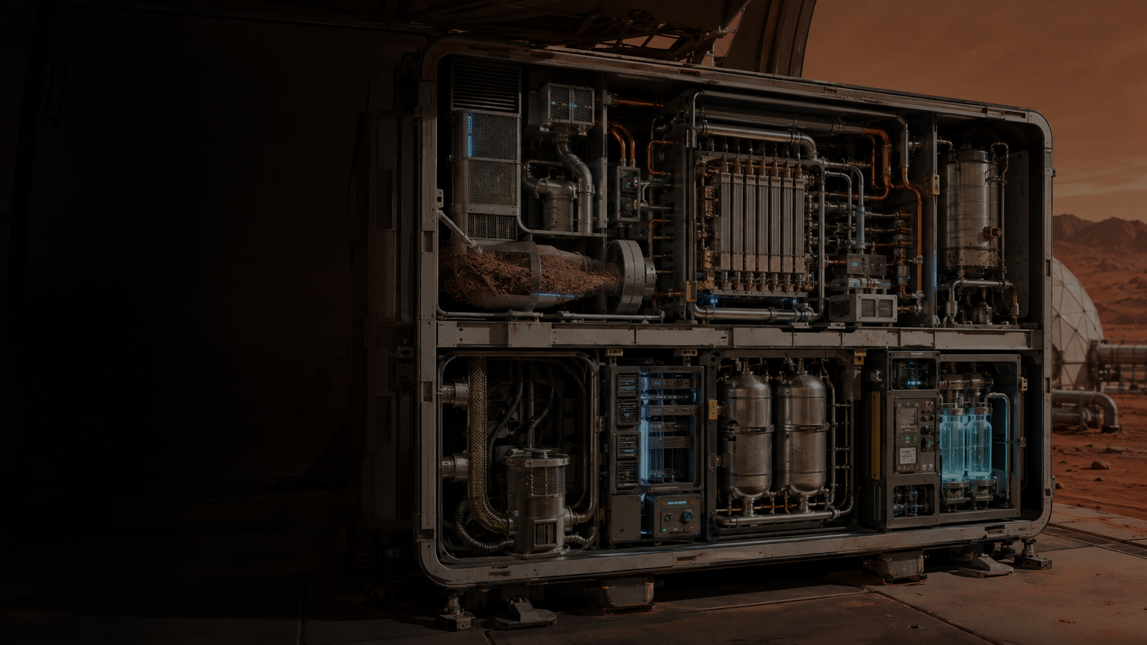
A MARS AI HARNESS CASE STUDY EXAMPLE
MOXIE shows than we can produce O² on Mars.
As a demonstration we asked the Ai advanced harnesses – Can we scale this to industrial levels to refuel a start ship in 2 years.
OBSERVED
WHAT WAS MODELED
THE RESULT
12 g/h
SCALED to 34kg/h
600 tons – 3+ orders of magnitude
TO DEMONSTRATE
The Ai harnesses answered this via a scientific paper with analysis, a engineering design for a prototype and a operations plan for Plant-level reliability, maintenance, and mission performance. And yes the AI says it is possible
At its most efficient, the flight unit produced oxygen on Mars.
Massive volume of O2 is a requirement to make habitats and the ability to return people to Mars possible. This is one path to do that.
Reported by NASA • a measured demonstration result
Design analysis • assumptions, simulation and models, and designs are needed
Tests and are still required
The result is a clearer path from evidence to the next test scaling the process. This will save thousands of hours of work, not all human work, but much of the documentation, providing the researchers and engineers with rapid ideation and a complete framework to build on.
MARS HARNESS LAB • MIFECO
Notes:
[Timing: 1:30]
Use MOXIE as the concrete example. Start with the observed result shown on the slide: 12 grams of oxygen per hour at the demonstrated high point. Then separate that evidence from the modeled scale-up target of about 34 kilograms per hour and roughly 600 tons over two years.
The point of the example is the work process. The harnesses generated a scientific analysis, an engineering prototype concept, and an operations plan. That is a much richer starting package than a single AI answer. Keep the evidence boundary explicit: the scale-up is modeled and still requires testing and qualification.

Slide 3

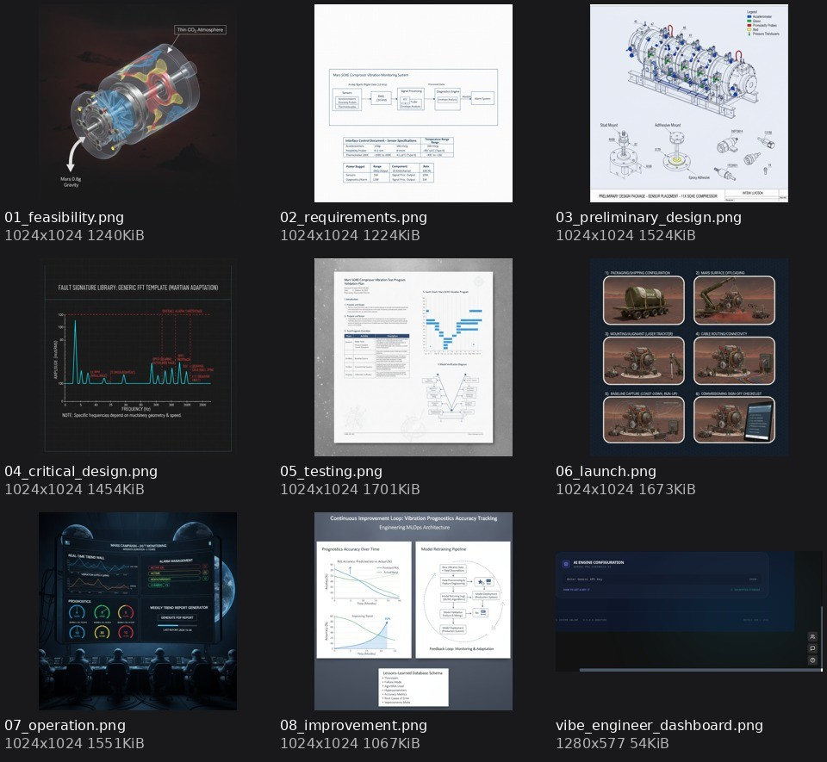
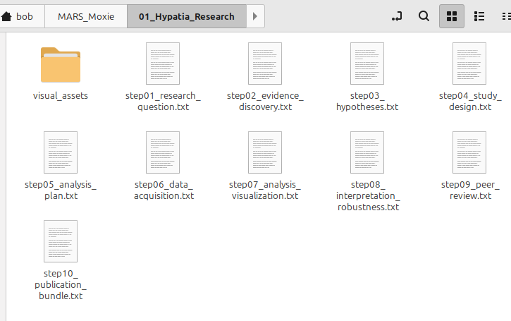
DESIGN CONTROL
The case study result – 145 artifacts - and yes, it is possible
Doing the research… It is possible to scale MOXIE?
# Step 10: Publication Bundle - Project ARES-SOE
**Title:** Industrial-Scale Solid Oxide $CO_2$ Electrolysis (SOXE) for Human Mars Missions: A 33.8 kg/hr Modular Architecture for Habitat Life Support and Starship Propellant Refueling
**Author List:** Hypatia AI (Lead Systems Architect), Mars In
### 1. Abstract As human Mars exploration transitions from exploration to habitation, In-Situ Resource Utilization (ISRU) must scale by three orders of magnitude. This paper presents the design and validation framework for Project ARES-SOE (Advanced Regenerative Electrolysis System for Sustained
Oxygen Production), a scaled-up solid-oxide $CO_2$ electrolysis system. Building on the heritage of the NASA MOXIE instrument, the system is designed to produce 592.4 t of $O_2$ over 2 Earth years (17,520 hours)—sufficient to sustain a 12-person habitat and provide 50% of the…
MARS HARNESS LAB • MIFECO
Notes:
[Timing: 1:20]
This slide shows the output of the case study rather than another chat response. The research and engineering folders, publication bundle, diagrams, reports, and other generated work products add up to 145 artifacts in the example.
Emphasize the idea of design control and continuity. The artifacts are indexed to the same problem and can be reviewed, challenged, revised, and passed downstream. The harness can rapidly build a structured feasibility package, but the resulting design is still a proposal until the physical assumptions and tests are validated.

Slide 4
KNOWLEDGE AND WORKFLOW UPDATE
First principles reveals better design options
1 ASSUMPTIONS
2 FUNDAMENTALS
3 COST GAP
Law, measured fact, estimate, habit or opinion
Dated sources, units, bounds and uncertainty
Current baseline versus a feasible lower bound
4 REBUILD
5 STRESS TEST
6 DECISION
Bold redesign and conservative alternative
First failure, skeptical challenge and test
Best supported option and first reversible step
Deliver assumptions, source ledger, cost-gap table and a 30-day plan.
MARS HARNESS LAB / 29 OCTOBER 2026
4
Notes:
Explain why first principles precedes optimization. Inventory laws, measured facts, estimates, habits and opinions. Decompose materials, energy, time, people and money. Every lower bound needs a dated source, units, uncertainty and boundary conditions. A physical minimum differs from a manufacturable estimate and lifecycle cost. Compare a bold and conservative design, then attack each with a falsification test. Keep unknown bounds unknown and never divide by a zero or unknown bound. Deliver assumptions.md, SOURCES.md, cost-gap.csv and a gated 30-day plan. Apply this to oxygen demand, operating hours, energy and degradation in the existing MOXIE scenario. Critical numerical checks retain independent review.
Sources: Mars Harness Lab knowledge-workflows.html and conformance.html, release dated 29 October 2026. Concepts synthesized from five user-supplied reference images. Vendor-specific claims and live host capabilities have not been independently verified. No new MOXIE results are claimed.

Slide 5
KNOWLEDGE AND WORKFLOW UPDATE
Every action returns a checkable receipt
CONTRACT
ACTION
RECEIPT
VERIFY
Goal, inputs and acceptance
One bounded tool step
Result, paths and error
Evidence against criterion
PASS
FAIL
BLOCKED
UNVERIFIED
Evidence satisfies the check
Evidence contradicts it
A dependency prevents it
Evidence is insufficient
Repair within limits. Save a checkpoint. Deliver artifacts with evidence.
MARS HARNESS LAB / 29 OCTOBER 2026
5
Notes:
The task contract specifies measurable acceptance, input files, scope and limits. Choose one checkable step and record its expected result. File tools return paths, exit status and output streams. Browser tools return observed page state. Connectors return scoped results or errors. ToolReceipt/v1 binds input references, call ID, policy decision, output paths, observations, errors and usage to acceptance checks and RunTrace. PASS requires evidence. FAIL means the criterion is contradicted. BLOCKED names a missing dependency. UNVERIFIED means evidence is insufficient. Repair the affected part within the original time, turn, token and cost caps. Reconcile uncertain external writes before retry. Save progress and continue independent authorized work if another step is blocked. Host isolation, credential proxying and provider connections require their own capability evidence.
Sources: Mars Harness Lab knowledge-workflows.html and conformance.html, release dated 29 October 2026. Concepts synthesized from five user-supplied reference images. Vendor-specific claims and live host capabilities have not been independently verified. No new MOXIE results are claimed.

Slide 6
SPECIALIZED HARNESSES AND SHARED ARTIFACTS
Specialized harnesses share a common artifact graph
SCIENCE
ENGINEERING
PROJECT EXECUTION
Source ledger, equations
Evidence and uncertainty
Requirements and design
Models, parts and tests
Resources, schedule
Field records and issues
COMMON WIKI / GRAPH / ARTIFACT STORE
Wiki explanations + typed dependencies + immutable artifact files
Pinned inputs, checks, approvals and correction history
Approved outputs flow forward. Targeted correction requests can return upstream.
MARS HARNESS LAB / 29 OCTOBER 2026
6
Notes:
Each specialized harness is a bounded system of role instructions, tools, a working loop, memory access and acceptance tests. Research synthesis and science publish source ledgers, hypotheses, equations, datasets, uncertainties and required tests. Engineering consumes exact approved revisions to produce requirements, trade studies, CAD/geometry, schematics and parts lists, analysis and a verification plan. Project execution consumes the controlled design to produce resources, cost estimates, dependencies, schedules, authorized execution records and field issues. These are selectable stages rather than mandatory extra agents. All stages use the same stable artifact IDs and versioned dependencies. The wiki explains the work, the graph records relationships and the artifact store retains actual bytes. Read and publish through typed manifests. Promote only independently checked outputs within human authority. A stage may use only its approved, relevant context and may not infer extra permissions from store access.
Source: Mars Harness Lab, method 15, Shared Artifact Chain and Correction, 29 October 2026. This is a proposed operating architecture and an illustrative case, not a new MOXIE experiment or a running authenticated cross-application bus. Host tool, storage, permissions, isolation and review enforcement require demonstrated integration.

Slide 7
SPECIALIZED HARNESSES AND SHARED ARTIFACTS
Downstream blockers trigger controlled regeneration
DETECT
REQUEST
REGENERATE
REVALIDATE
Failed check or
execution blocker
Pinned revisions
and bounded question
Upstream owner
creates a revision
Rebuild dependents
and check release
B1 stays in history. Correction branch C1 holds revised work.
B2 becomes current only after approved upstream evidence, downstream checks and required authority agree.
Stale inputs block promotion. Unrelated work needs a recorded independence check.
MARS HARNESS LAB / 29 OCTOBER 2026
7
Notes:
A downstream issue creates CorrectionRequest/v1 with detector and run, affected artifact revisions, symptom, reproduction, expected result, failing criterion, evidence, severity, root-cause hypothesis, requested upstream deliverable, acceptance check, owner, budget and permission scope. The Director and Memory Steward triage the issue and identify the earliest justified owner. Do not assume every problem requires new science. Preserve the old approved baseline, open a correction branch and mark dependent outputs stale or review-required. Upstream work creates a new immutable revision. Independent review must pass before the minimal affected downstream closure regenerates in dependency order. Recheck interfaces, configurations, tests, plans and approval gates. A workflow revisits stages but each pinned revision graph remains acyclic. Unknown, blocked or failed checks stop dependent promotion. Bounded retries and time/cost caps prevent indefinite repair. Physical work, purchases and external commitments require their own compensation and authorization, not a pretend file rollback. Unrelated branches may continue only with reviewed independence.
Source: Mars Harness Lab, method 15, Shared Artifact Chain and Correction, 29 October 2026. This is a proposed operating architecture and an illustrative case, not a new MOXIE experiment or a running authenticated cross-application bus. Host tool, storage, permissions, isolation and review enforcement require demonstrated integration.

Slide 8

GOVERNANCE
Automation works inside explicit authority.
Make the safe path the easy path—and make the stop conditions visible.
THE HARNESS CAN
A PERSON MUST
✓ Retrieve and compare sources
• Set the objective and operating limits
✓ Draft claims, requirements, and test plans
• Approve consequential assumptions
✓ Run approved tools and record outputs
• Accept evidence and risk
✓ Flag conflicts, missing evidence, and stale links
• Authorize release or field action
STOP WHEN
Source is missing • evidence conflicts • tool is out of scope • authority is unclear
MARS HARNESS LAB • MIFECO
Notes:
[Timing: 1:15]
Governance is what makes automation usable for consequential work. The harness can retrieve and compare sources, draft claims and plans, run approved tools, record outputs, and flag missing or conflicting evidence.
A person must still set the objective and operating limits, approve consequential assumptions, accept evidence and risk, and authorize release or field action. The stop conditions at the bottom are deliberate: stop when a source is missing, evidence conflicts, a tool is out of scope, or authority is unclear.
Update: require explicit policy, redacted tool receipts, capped usage, timeout cancellation and an OS isolation boundary for generated code. Prompt instructions alone do not prove enforcement. Sources: Mars Harness Lab knowledge-workflows.html and conformance.html, release dated 29 October 2026. Concepts synthesized from five user-supplied reference images. Vendor-specific claims and live host capabilities have not been independently verified. No new MOXIE results are claimed.

Slide 9
KNOWLEDGE AND WORKFLOW UPDATE
Reviewed lessons improve the next working loop
tasks/todo.md
tasks/lessons.md
Goal and bounded plan
Observable acceptance checks
Progress and final review
Mistake and root cause
Scoped prevention rule
Early detection signal
Resume from checked work. Re-plan after evidence changes. Keep workers bounded.
97 requirements mapped. Local checks support the methods. Live host enforcement still needs evidence.
MARS HARNESS LAB / 29 OCTOBER 2026
9
Notes:
At session start read the active task, checkpoint and relevant approved lessons. Use a plan for complex work, including verification steps and a final review. After a correction record scope, root cause, prevention rule and early detection signal. Review skill changes before promotion and preserve supersession. Delegate one bounded assignment per worker only when supported, permitted and justified, using the existing depth, concurrency and parent-budget limits. Before delivery ask what evidence proves completion, what remains uncertain, whether a simpler maintainable solution exists and what fails first. The conformance package maps all 97 assessment requirements and supplies tested local reference utilities. It does not certify runtime enforcement, OS isolation or connected SaaS behavior. ACP and A2A remain deferred. Human authority and nonwaivable safety constraints remain in force.
Sources: Mars Harness Lab knowledge-workflows.html and conformance.html, release dated 29 October 2026. Concepts synthesized from five user-supplied reference images. Vendor-specific claims and live host capabilities have not been independently verified. No new MOXIE results are claimed.

Slide 10
GET STARTED
Get started in three ways.
Free lab downloads, paid preconfigured applications, and open-source references.
FREE LAB MATERIALS
PRECONFIGURED ACCESS
OPEN SOURCE
Apache License 2.0
MIFECO applications
Robertstar2000 on GitHub
Instructions, skills, templates, and example workflows. These can run on most agentic harnesses’, Grok Bot, Hermes, Open Claw, Claude Code, Codex, etc.
Hosted versions for science, engineering, and project execution.
These are paid version to cover the Ai token expenses as these use frontier models extensively
Review source repositories behind the specialist workflows.
OPEN DOWNLOADS ↗
EXPLORE GITHUB ↗
VIEW MIFECO CATALOG ↗
Hypatia-Pro repo ↗
This contains free downloads for agents, skills, code, memory managment, etc.
Project Hypatia Pro ↗
Intelligent-Engineer-Pro repo ↗
Vibe Engineer ↗
project-management-accelerator ↗
PM Accelerator ↗
MARS HARNESS LAB • MIFECO
Notes:
[Timing: 1:10]
There are three ways to start. The first is the free Mars Harness Lab material under Apache 2.0: instructions, skills, templates, memory material, and example workflows that can be used with several agentic runtimes.
The second is preconfigured hosted access through the MIFECO applications for science, engineering, and project execution. The third is the open-source path through the listed GitHub repositories. This lets an audience member choose between learning from the materials, using a hosted implementation, or inspecting the source.

Slide 11
DISCUSSION
Questions &
conversation
What would you want to put through one complete loop?
5 MINUTES
MARS HARNESS LAB • MIFECO
Notes:
[Timing: 5:00 discussion]
End by turning the concept back to the audience. Ask what real science, engineering, or mission problem they would want to put through one complete loop.
Good discussion topics are evidence quality, where human approval should sit, what an acceptable pilot would look like, and which handoff currently consumes the most expert time.

