Slide 1
BarBuddy
By: Ibrahim Binmahfood and Robert Wilcox

Slide 2
BarBuddy is a Real-time Exercise Coaching and Range of Motion Tracking using RTOS

Slide 3
Overview
The target project is to have an interactive Real-time coach and Range of Motion tracker
Adafruit BNO055 AHRS sensor
ESP32 for BLE communication
Real Digital Boolean Board for interpreting data and user interaction

Slide 4
Range of motion and training
While range of motion analysis is often used in a scientific setting, there aren’t really any commercially available options. With the ever growing state of the wearables market, we thought this niche needed filling.

Slide 5
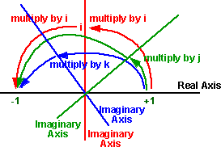
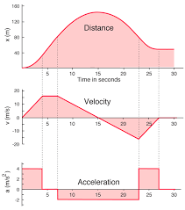
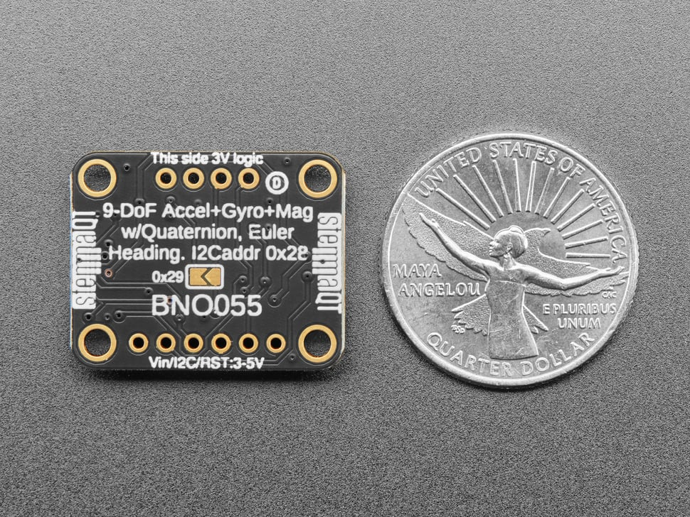
Attitude and heading reference system

Slide 6
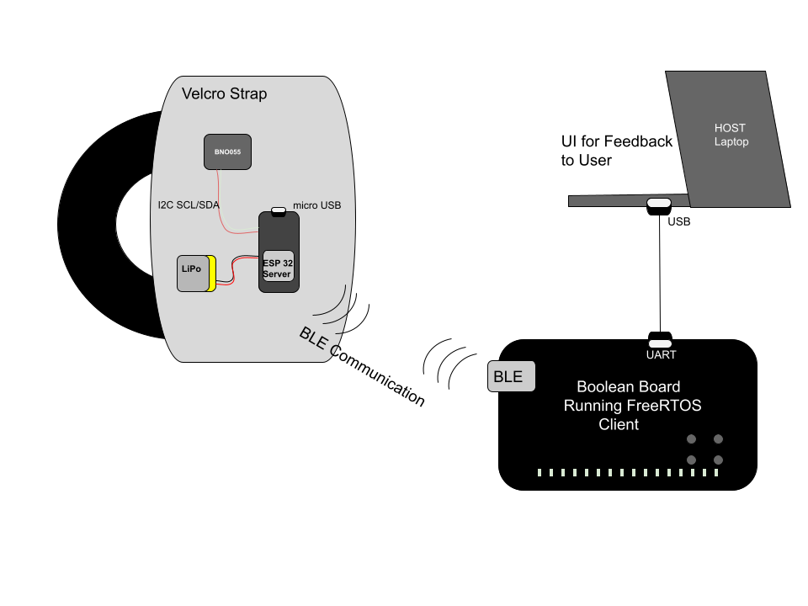
System design

Slide 7
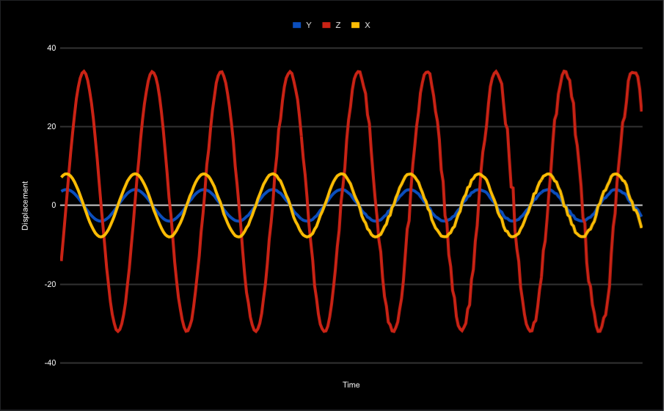
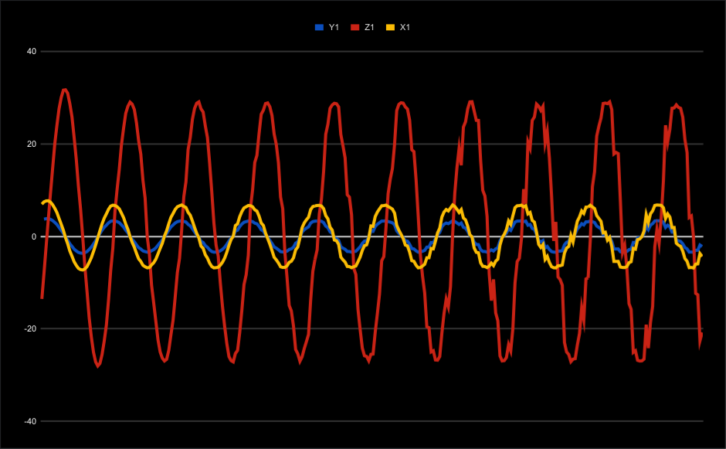
User interaction
Warm up:
Record warm up range of motion and save for later comparison
Working set:
Read data points and coach user

Slide 8
Difficulties
Boolean Board BLE Module Insufficient Documentation (switched to using two ESP32s)
Printing out floats in FreeRTOS requires buffering and helper functions to figure out decimal point in numbers
BNO055 linear acceleration data very noisy
ESP32 Transmission of data was lossy, which required to apply checksums for verification
FreeRTOS tasks interfering with data reads
Very limited stack space on Boolean Board

