Slide 1
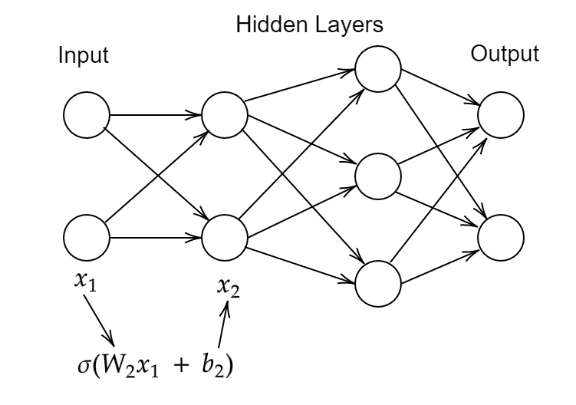
Physics Informed Neural Networks for Numerical Analysis
Robin Pfeiffer
Supervised by Niall Madden
June 2022

Slide 2
Overview of Presentation
Introduction
Activation Function
Setup of Neural Network
Stochastic Gradient Descent
Classification Problem
Interpolation Problems
Physics Informed Problems
What I have Learned and What I would do next​

Slide 3
Introduction
In its simplest form, a neural network is just a function with some parameters that can be chosen.​
Given some 'training data', i.e., some inputs and their desired output, we want to choose these parameters so that this function fits the training data.​
Evaluating the function at new points then gives predicted output.​
The networks we use follow the most standard format:​
The network has a number of layers, which have different possible numbers of inputs and outputs.​
Each layer has number of "neurons" per layer; each "neuron" is an activation function, which evaluates as zero or one for most inputs, with a rapid transition between values.​ That is, “fires” for some inputs, and not for others.
Each layer can be encoded by a weight matrix and bias vector: "training" the network means choosing values for the entries in these matrices and vectors.

Slide 4
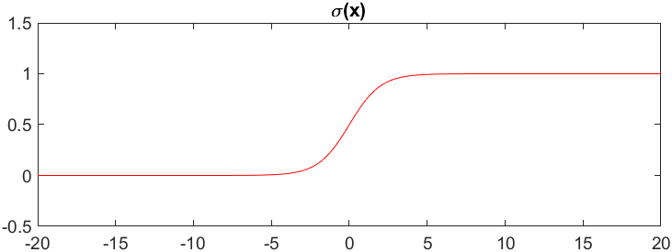
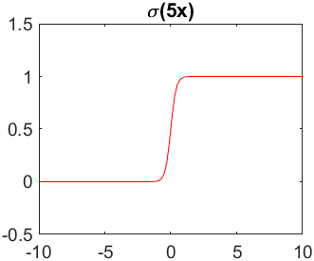
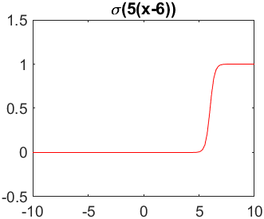
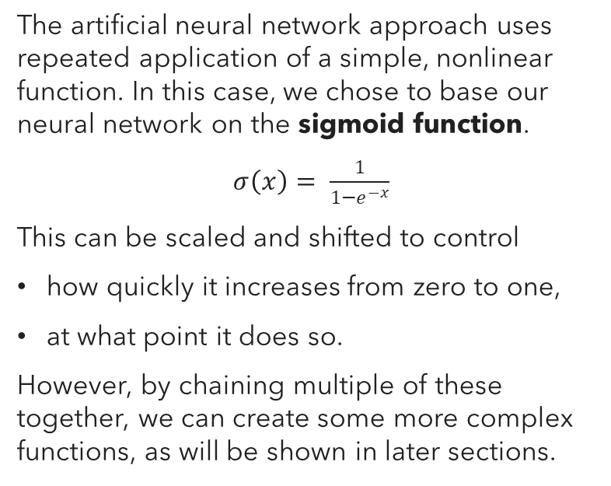
Activation Function
The artificial neural network approach uses repeated application of a simple, nonlinear function. In this case, we chose to base our neural network on the sigmoid function.
$σ\left(x\right)= \frac{1}{1−e^{−x}}$
This can be scaled and shifted to control
how quickly it increases from zero to one, ​
at what point it does so. ​
However, by chaining multiple of these together, we can create some more complex functions, as will be shown in later sections.

Slide 5
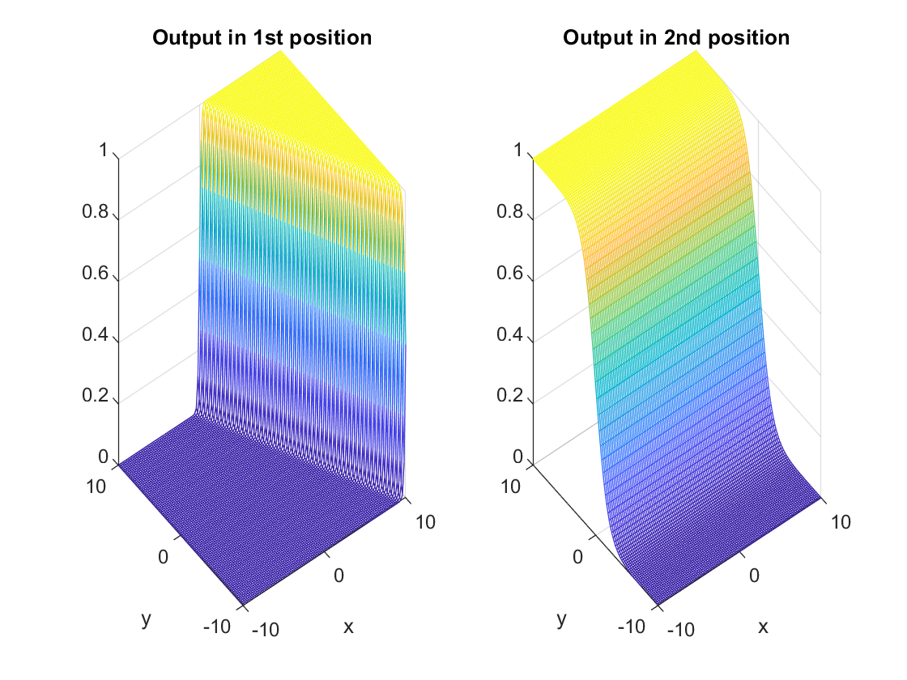
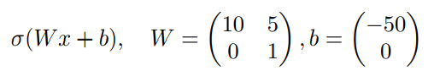

Activation Function
It is also possible to have a vector based sigmoid function. To map from m inputs to n outputs, the activation function is​
$$σ=σ(Wx+b)$$
where W is an m x n matrix, and b is a n-vector.
In the following example, I am mapping 2 inputs to 2 outputs.

Slide 6

Setup of Neural Network
A neural network is built on multiple layers, with multiple nodes in each layer. In order to go from one layer to another, we first multiply it by a matrix of weights W and add some bias b, and then run it through our activation function.
We now have a function that symbolises our neural network. We let X be the input of our training data, and Y the required output. We can now create a measure for how close our network is to the required solution. We let the cost function be
$$Cost=\frac{1}{N}\sum_{i=1}^{N}{\frac{1}{2}{\left|\left|y\left(x^{i}\right)−f\left(x^{i}\right)\right|\right|}^{2}}$$
We now need to minimise this cost function, by changing the weights and biases in our network.

Slide 7
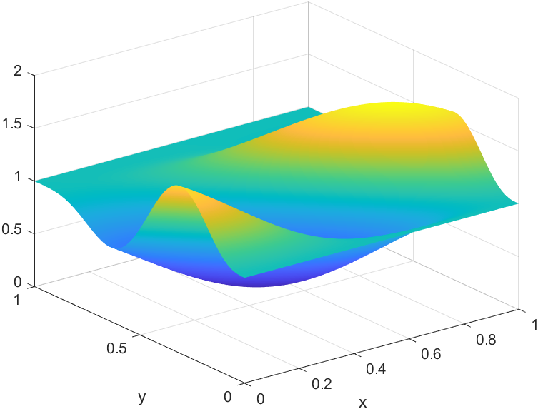
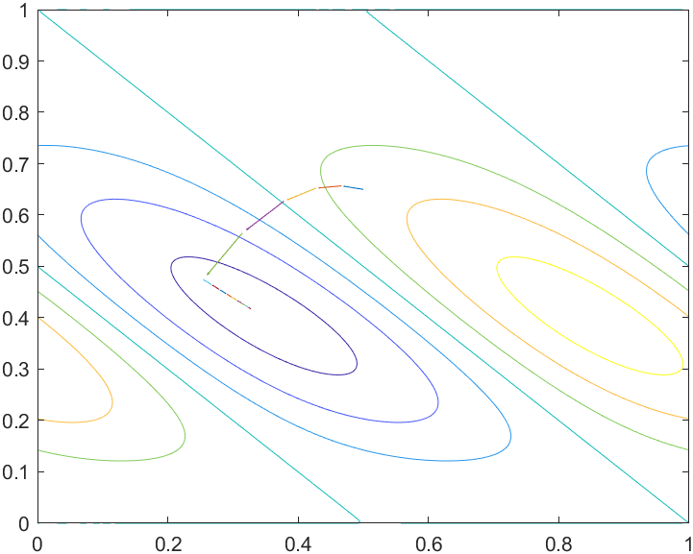

Stochastic Gradient Descent
We use gradient descent to minimise our cost function. The basic idea of gradient descent is, if $x_{(i−1)}$ is an estimate for $x_{min}$, then $x_{(i)}= x_{(i−1)}−η ∇f$ should be a better one.
We can see this in action in the following example.

Slide 8
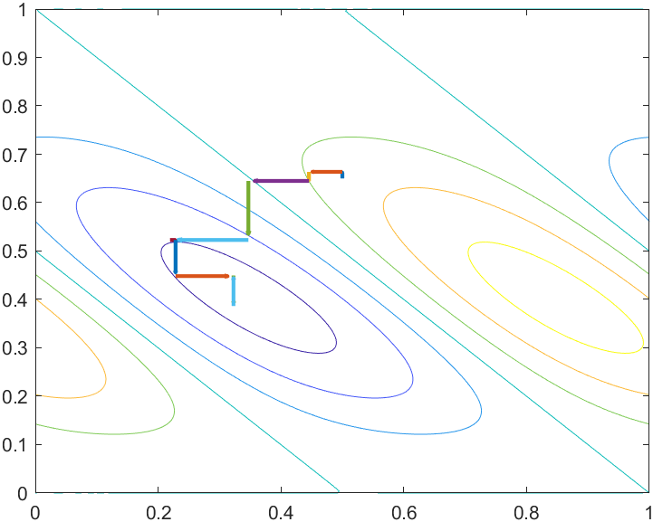
Stochastic Gradient Descent
Calculating the total derivative can be quite expensive, so in stochastic gradient descent we only look at one variable at a time.

Slide 9
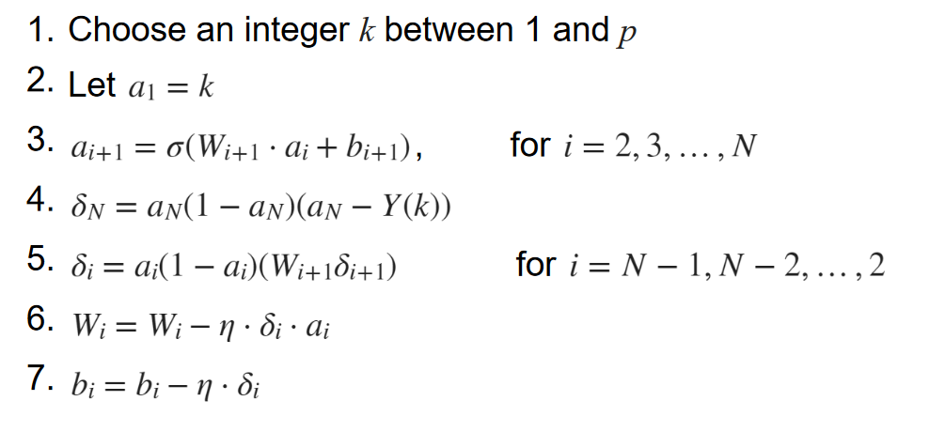
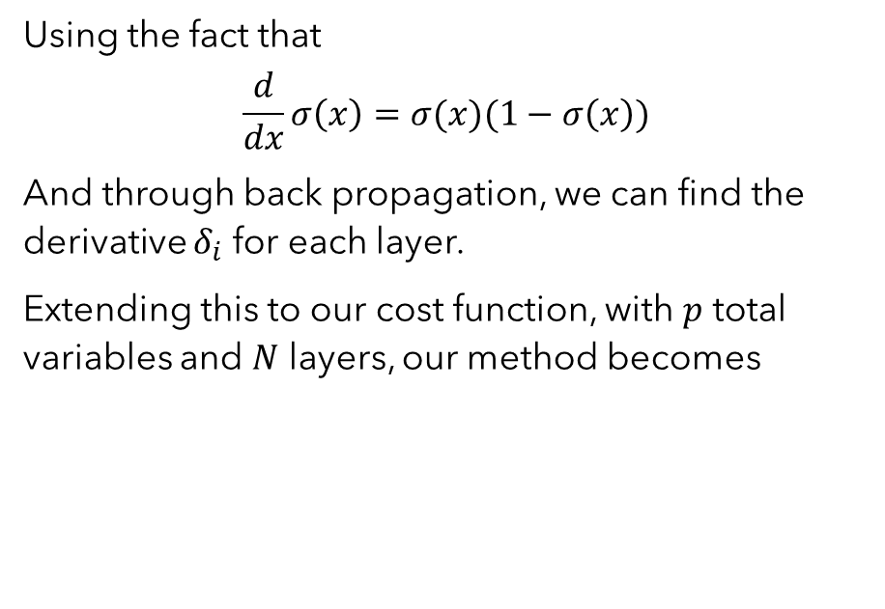
Stochastic Gradient Descent
Using the fact that
$$\frac{d}{dx}σ\left(x\right)=σ(x)(1−σ\left(x\right))$$
And through back propagation, we can find the derivative $δ_{i}$ for each layer.
Extending this to our cost function, with $p$ total variables and $N$ layers, our method becomes

Slide 10
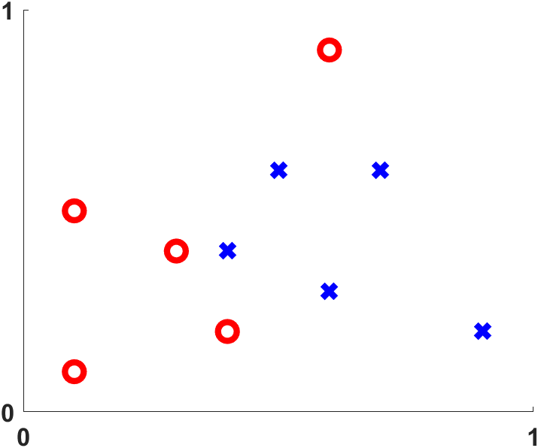
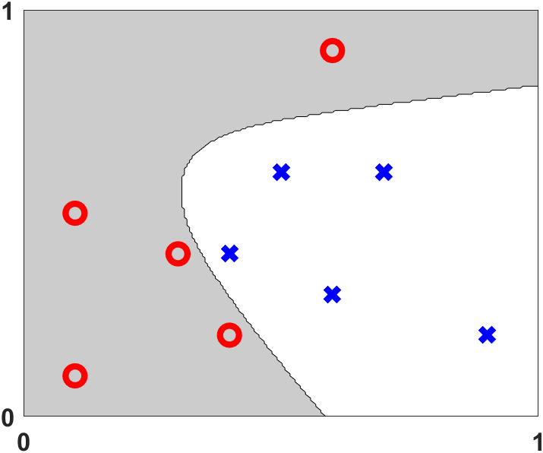
Classification Problem

Slide 11
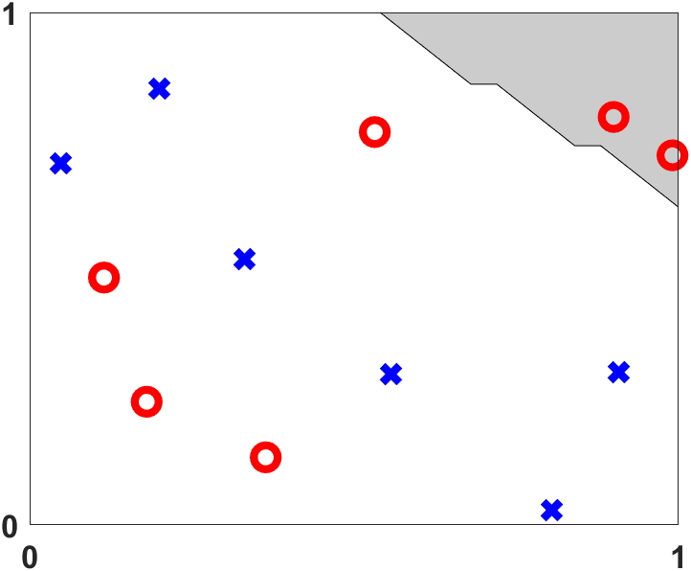
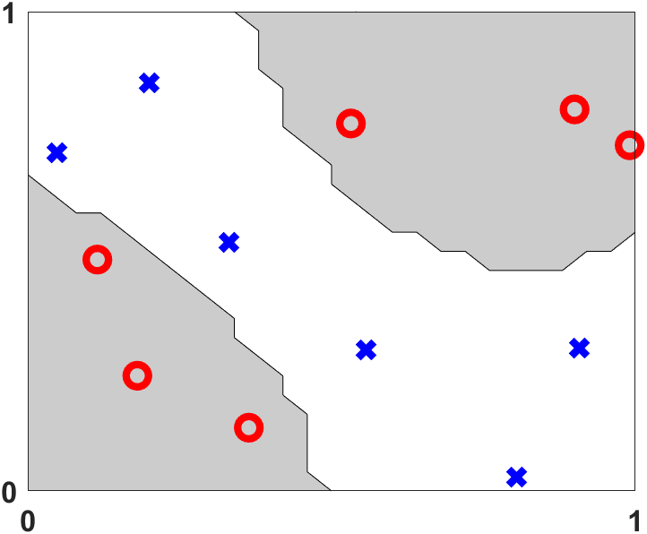
Classification Problem

Slide 12
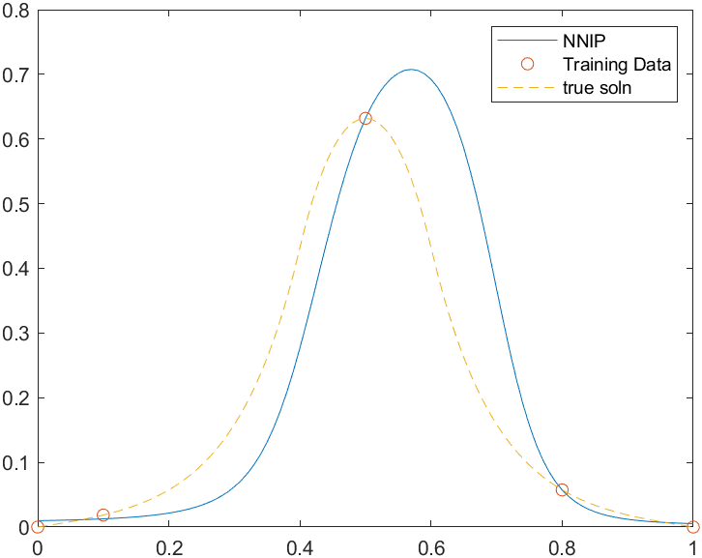
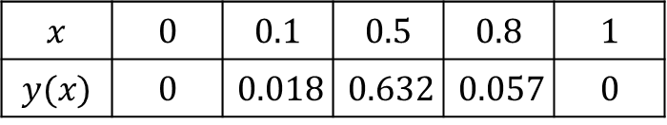
Interpolation Problems
In numerical analysis, the process of interpolation means to find a function that agrees with a data set. We can use the same setup of a neural network to interpolate a data set.
$$x$$ | $$0$$ | $$0.1$$ | $$0.5$$ | $$0.8$$ | $$1$$
$$y(x)$$ | $$0$$ | $$0.018$$ | $$0.632$$ | $$0.057$$ | $$0$$

Slide 13
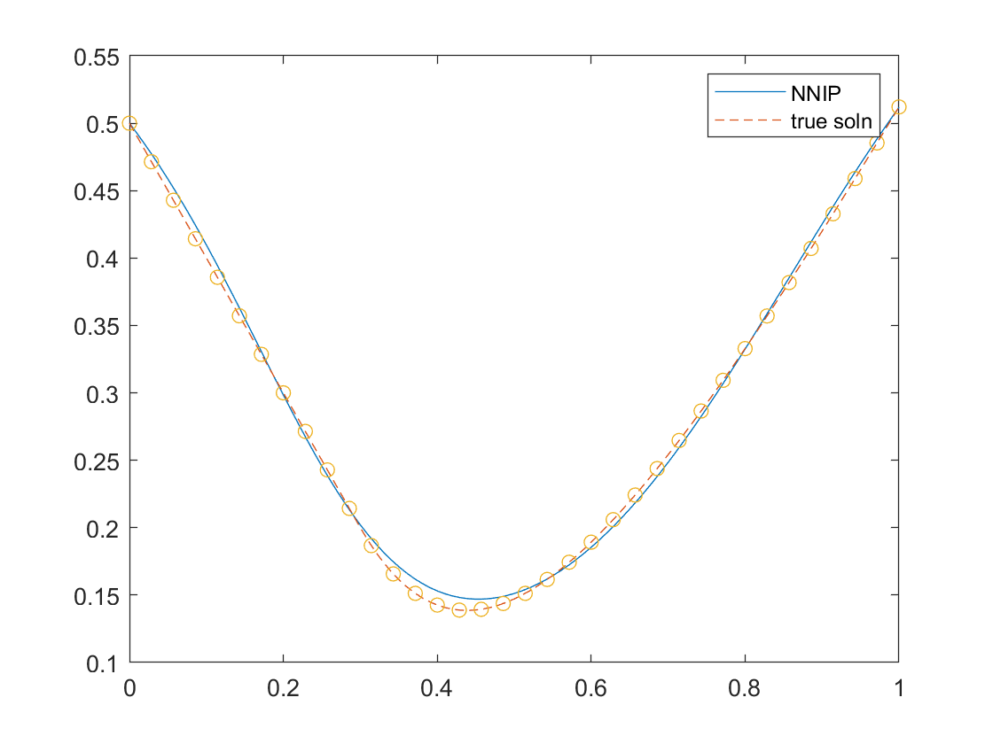
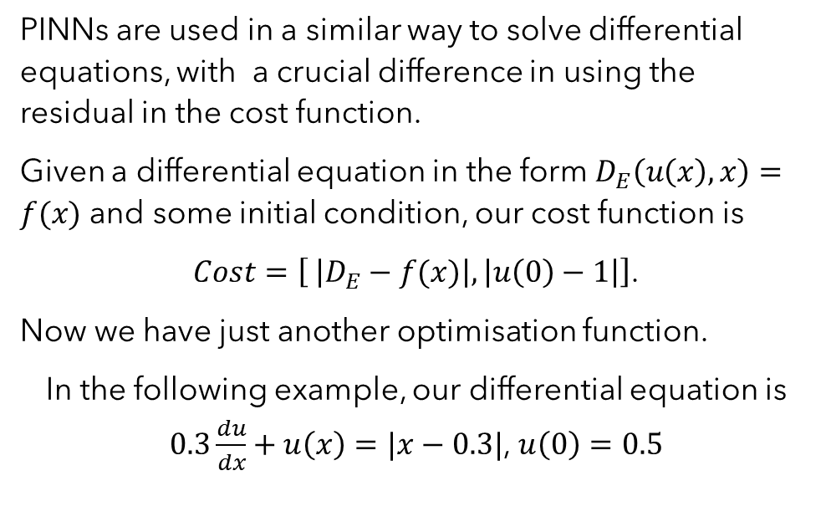
Physics Informed Neural Network
PINNs are used in a similar way to solve differential equations, with a crucial difference in using the residual in the cost function.
Given a differential equation in the form $D_{E}\left(u\left(x\right), x\right)=f(x)$ and some initial condition, our cost function is
$Cost=\left[ \left|D_{E}−f(x)\right|, \left|u\left(0\right)−1\right|\right]$.
Now we have just another optimisation function.
In the following example, our differential equation is $0.3\frac{du}{dx}+u\left(x\right)=|x−0.3|$, $u\left(0\right)=0.5$

Slide 14
What I have Learned and What I would do next​
Much of what I've learned has been based on Higham + Higham (2018), PINNs were covered in Raissi (2019)
All code is in MATLAB, and uses the chebfun toolbox​
If I had more time:​
More general ODEs (boundary value problems; coupled systems; non-linear problems; noisy data);​
Develop code in Python (for example) so it can be shared more easily.​
The ODE example uses a built-in non-linear solver; work on Gradient Descent method.​
Need to experiment with the number of layers and neurons.

Slide 15
References
Higham, C. F. and Higham, D. J. (2019) Deep learning: an introduction for applied mathematicians. SIAM Review, 61(4), pp. 860-891. (doi: 10.1137/18M1165748)
Raissi, P. Perdikaris, G.E. Karniadakis, (2019). Physics-informed neural networks: A deep learning framework for solving forward and inverse problems involving nonlinear partial differential equations. J. Comp Phys 37, pp686-707. (doi: 10.1016/j.jcp.2018.10.045).

