Slide 1

Cyanobacteria
Protein Design
AI for Life Sciences
S M A L L P R O T E I N S
B I G P O S S I B I L I T I E S
蓝藻 GvpA 蛋白序列生成研究
Cyanobacterial GvpA Protein
Sequence Generation
机器学习综合实践 · GV02-01 · 阶段性汇报
Machine Learning Practice · GV02-01 · Progress Report
结合生物信息学与生成模型，探索蓝藻气囊蛋白 GvpA 的序列设计
Combining bioinformatics and generative models for cyanobacterial GvpA sequence design.

Slide 2












研究背景与动机 / Biological Motivation
蓝藻气囊蛋白 GvpA 及其应用前景
Cyanobacterial GvpA and Its Potential Applications
三大目标 / Three Objectives
01
气囊（Gas Vesicles, GVs）
Gas Vesicles in Cyanobacteria
✓
蓝藻特有的纳米级气体囊泡结构
约束满足
Nano-sized gas-filled organelles in cyanobacteria
Validity
✓
调节浮力，适应光照与环境
满足生物学与
结构约束
Regulate buoyancy for optimal light and environment
02
GvpA：主要的气囊壳蛋白
Satisfy biological
and structural
constraints
GvpA: Major Gas Vesicle Shell Protein
✓
构成气囊壳体的主要结构蛋白
Major structural protein of GV shell
GvpA
Sequence
Generation
✓
小而稳定，具有重复序列特征
新颖性
多样性
Small, stable, and rich in repeating motifs
Novelty
Diversity
03
生物工程与超声成像应用
生成新颖且
非冗余的序列
覆盖更广的
序列空间
Applications in Bioengineering & Ultrasound Imaging
Generate novel
and non-redundant
sequences
Cover a broader
sequence space
✓
可用于合成生物学与生物材料设计
Useful for synthetic biology and biomaterials design
✓
作为超声成像对比剂的潜在平台
Potential platform for ultrasound imaging contrast agents
核心挑战：在保持生物学约束的同时生成新颖且多样的序列
Core challenge: generate novel and diverse sequences while preserving biological constraints.
2 / 12

Slide 3







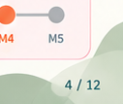
Cyanobacteria
Protein Design
AI for Life Sciences
题目要求与当前进度 / Requirement Mapping
将题目要求分解为可执行的里程碑，并跟踪当前完成情况
Map the project requirements to actionable milestones and track our progress.
M1
M2
M3
M4
M5
问题定义与数据构建
探索性数据分析
基线与简单生成模型
完整实验与权衡分析
最终报告与展示
Problem & Data
Definition
Exploratory Analysis
Baseline + Simple
Generative Models
Full Experiments &
Trade-off Analysis
Final Report
✓
明确研究问题
✓
序列统计分析
✓
基线方法实现
多模型实验比较
完整实验结果
Define research scope
Sequence analysis
Baseline generation
Compare multiple models
Complete results
✓
构建 GvpA 数据集
✓
可视化与模式发现
✓
简单生成模型
新颖性-多样性权衡
撰写论文/报告
Build GvpA dataset
Visualization &
pattern discovery
Simple generative models
(e.g., RNN, VAE)
Novelty-diversity trade-off
Write report
✓
数据预处理与划分
生物学特征分析
初步结果分析
深入结果分析
准备答辩与展示
Data preprocessing
& split
✓
✓
Biological feature analysis
Preliminary results
In-depth analysis
Prepare presentation
✓
已完成
Done
✓
基本完成
Mostly done
✓
基本完成
Basically done
进行中
In progress
待开始
Upcoming
题目具体要求（GV02-01） / Key Requirements（GV02-01）
当前位置于 M3 – M4 之间
1. 基线生成方法
2. 至少两种深度生成模型
3. 多指标评估
4. 嵌入空间分析
Current Position:
between M3 and M4
Baseline generation
At least two deep generative models
Multi-metric evaluation
Embedding-space analysis
实现并评价基线生成方法
实现至少两种深度生成模型
使用多个评价指标
在嵌入空间中分析生成结果
Implement and evaluate
baseline generation methods
Implement at least two
deep generative models
(e.g., validity, novelty, diversity)
Analyze generated sequences
in embedding space
M1
M2
M3
M4
M5
Research Group | 2024
Sequence · Structure · Function · Design
4 / 12

Slide 4







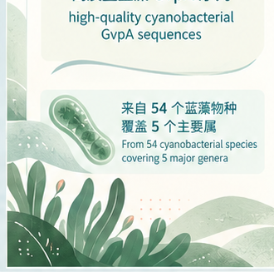









数据构建与划分 / Dataset Construction
构建高质量的蓝藻 GvpA 蛋白序列数据集，用于生成与评估研究
Build a high-quality cyanobacterial GvpA protein dataset for generation and evaluation
最终冻结数据集
数据划分 / Dataset Split
数据质量控制 /
Final Frozen Dataset
Quality Control
165
多源核验
139
13
13
multi-source verification
训练集
验证集
测试集
整合公共数据库，交叉验证序列注释
高质量蓝藻 GvpA 序列
Integrate public databases and
cross-validate annotations
high-quality cyanobacterial
GvpA sequences
Train
(84%)
Validation
(8%)
Test
(8%)
用于模型训练
用于模型选择
用于最终评估
去冗余
Model training
Model selection
Final evaluation
de-duplication
去除高度相似序列，保留代表性序列
来自 54 个蓝藻物种
覆盖 5 个主要属
数据来源 / Data Sources
Remove redundant sequences and
keep representative ones
From 54 cyanobacterial species
covering 5 major genera
防泄漏划分
leakage-aware split
基于物种/属的家族感知划分
Family-aware split by species/genus
to prevent information leakage
5 / 12

Slide 5



















生成与评估流程 / Generation & Evaluation Pipeline
从高质量的真实序列出发，生成新序列并进行多维度评估
From curated real sequences to novel generation and comprehensive evaluation
1
数据准备
2
序列表示
3
生成模型
4
生成序列
5
统一评估
Curated Sequences
Tokenization
Generative Models
Generated FASTA
Unified Evaluator
AA-frequency
有效性 / 生物学约束
165
Validity (biological constraints)
基于氨基酸频率
高质量真实序列
新颖性
high-quality
real sequences
M T A Q ···
k-mer model
Novelty
基于 k-mer 特征
>generated_001
MTAQDTVKQATL...
>generated_002
NTSVDTVRQAVDI...
>generated_003
MGAGDTVKQVDA...
. . .
>Nostoc_sp._GvpA
MTAQDTVKQATLA...
NTSVDTVKQAVDI...
MGAGDTVKQAVDA...
. . .
✓
氨基酸级别编码
多样性
AA-level tokenization
Diversity
LSTM
✓
k-mer 特征
循环神经网络
长度分布
k-mer representations
Length distribution
✓
序列长度处理
VAE
嵌入分布
Sequence padding
& truncation
变分自编码器
Distribution (embedding space)
Generate
Evaluate
Compare
Improve
生成新序列
多维度评估
方法对比
迭代优化
6 / 12

Slide 6





模型方法 / LSTM 与 VAE
两种生成模型的结构设计与特点
Model architectures and characteristics for sequence generation
LSTM（自回归模型）
VAE（变分自编码器）
LSTM Autoregressive Generation
Variational Autoencoder
N(0, I)
<BOS>
hₜ
hₜ₊₁
hₜ₊₂
⋯
Encoder
q(z|x)
Decoder
p(x|z)
z
M
T
A
Q
M
T
A
Q
M
T
A
Q
✓
Autoregressive decoding
✓
Latent-space modeling
Generate one token at a time from left to right
Map sequences to a continuous latent space
✓
Captures local dependencies
✓
Diversity-friendly generation
Models conditional probability p(xₜ | x₍<ₜ₎)
Sample in latent space to generate diverse sequences
✓
Simple baseline deep model
✓
Continuous representation
Strong and widely-used sequence model
Learn compact and smooth sequence representations
Shared tokenizer, dataloader, checkpointing and FASTA generation interface.
8 / 12

Slide 7







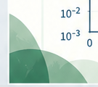
GPU 烟雾测试结果 / GPU Smoke-test Results
在小规模数据集上验证训练与生成流程的可行性
Verify the training and generation pipeline on a small subset of data
新颖性 ↑
唯一性比例 ↑
长度通过率 ↑
Novelty ↑
Unique ratio ↑
Length pass rate ↑
0.89
0.91
0.93
0.94
1.0
1.0
1.0
0.8
0.8
0.8
0.6
0.6
0.6
0.4
0.4
0.4
0.17
0.18
0.2
0.2
0.2
0.0
0.0
0.0
LSTM
VAE
LSTM
VAE
LSTM
VAE
训练损失曲线（示例）/ Training Loss Curve (Example)
实验设置 / Setup
10⁰
GPU 训练 / 生成流程已验证；
当前结果为烟雾测试，尚非最终实验结果。
LSTM
小规模数据集 (~5K 序列)
10⁻¹
VAE
Small subset (~5K sequences)
10⁻²
GPU training / generation pipeline verified;
current results are smoke tests rather than
final experiments.
相同的预处理与评估指标
10⁻³
Same preprocessing & evaluation metrics
0
500
1,000
1,500
2,000
主要用于验证流程可行性
Training steps
Focused on pipeline verification
9 / 12

Slide 8








瓶颈与误差分析 / Failure Analysis
分析生成结果中的常见问题，定位影响生成质量的关键因素
Analyze common issues in generated sequences and identify key factors affecting generation quality
1
过早结束（Early <EOS>）
⚙
可能原因 / Possible Causes
示例输出 / Example Outputs
✓
生成序列在开头即输出 <EOS>
Input: M T A Q ...
Output: <EOS>
训练数据长度分布不均
Model generates <EOS> too early
Training data length skew
Input: G V P A ...
Output: M <EOS>
训练集中短序列占比过高
✓
导致空序列或极短序列
Input: A L K T ...
Output: <EOS>
Short sequences dominate the training set
Results in empty or very short sequences
<EOS> 预测过于自信
EOS overconfidence
2
偏短序列（Length Bias）
序列长度分布 / Sequence Length Distribution
模型过早预测生成结束
Model becomes overconfident in predicting <EOS>
0.20
Real (test set)
✓
生成序列普遍短于真实序列
0.15
Generated (VAE)
训练步数不足
Generated sequences are
consistently shorter than real ones
Limited training steps
Density
0.10
模型尚未充分学习长程依赖
0.05
Model not fully trained to capture long-range dependencies
✓
缺乏足够的结构和功能片段
0.00
Missing important structural
and functional patterns
0
50
100
150
200
长度控制能力较弱
Sequence length (aa)
Weak length control
缺乏显式的长度约束或训练目标
No explicit length constraints or training objectives
当前瓶颈不在工程跑通，而在生成质量控制。
The bottleneck has shifted from pipeline execution to generation quality control.
10 / 12

Slide 9
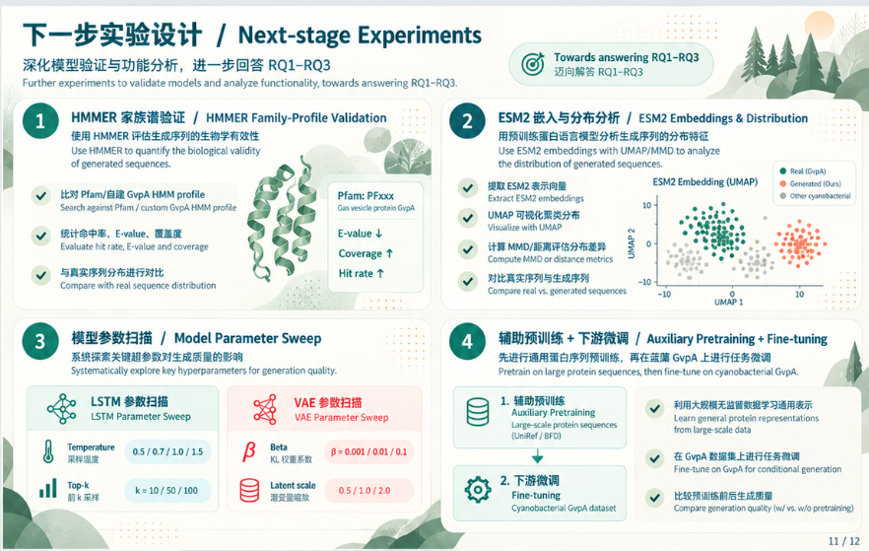
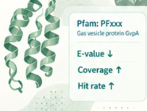
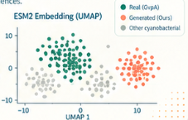




下一步实验设计 / Next-stage Experiments
深化模型验证与功能分析，进一步回答 RQ1–RQ3
◎
Towards answering RQ1–RQ3
Further experiments to validate models and analyze functionality, towards answering RQ1–RQ3.
迈向回答 RQ1–RQ3
1
HMMER 家族谱验证 / HMMER Family-Profile Validation
2
ESM2 嵌入与分布分析 / ESM2 Embeddings & Distribution
使用 HMMER 评估生成序列的生物学有效性
用预训练蛋白语言模型分析生成序列的分布特征
Use HMMER to quantify the biological validity
of generated sequences.
Use ESM2 embeddings with UMAP/MMD to analyze
the distribution of generated sequences.
✓
比对 Pfam/自建 GvpA HMM profile
✓
提取 ESM2 表示向量
Search against Pfam / custom GvpA HMM profile
Extract ESM2 embeddings
✓
UMAP 可视化聚类分布
✓
统计命中率、E-value、覆盖度
Visualize with UMAP
Evaluate hit rate, E-value and coverage
✓
计算 MMD/距离评估分布差异
✓
与真实序列分布进行对比
Compute MMD or distance metrics
Compare with real sequence distribution
✓
对比真实序列与生成序列
Compare real vs. generated sequences
3
模型参数扫描 / Model Parameter Sweep
4
辅助预训练 + 下游微调 / Auxiliary Pretraining + Fine-tuning
系统探索关键超参数对生成质量的影响
先进行通用蛋白序列预训练，再在蓝藻 GvpA 上进行任务微调
Systematically explore key hyperparameters for generation quality.
Pretrain on large protein sequences, then fine-tune on cyanobacterial GvpA.
LSTM 参数扫描
VAE 参数扫描
1. 辅助预训练
✓
利用大规模无监督数据学习通用表示
LSTM Parameter Sweep
VAE Parameter Sweep
Auxiliary Pretraining
Learn general protein representations
from large-scale data
Large-scale protein sequences
(UniRef / BFD)
Temperature
0.5 / 0.7 / 1.0 / 1.5
Beta
β = 0.001 / 0.01 / 0.1
采样温度
KL 权重系数
✓
在 GvpA 数据集上进行任务微调
Top-k
Latent scale
2. 下游微调
Fine-tune on GvpA for conditional generation
前 k 采样
k = 10 / 50 / 100
潜变量缩放
0.5 / 1.0 / 2.0
Fine-tuning
Cyanobacterial GvpA dataset
✓
比较预训练前后生成质量
Compare generation quality (w/ vs. w/o pretraining)
11 / 12

Slide 10
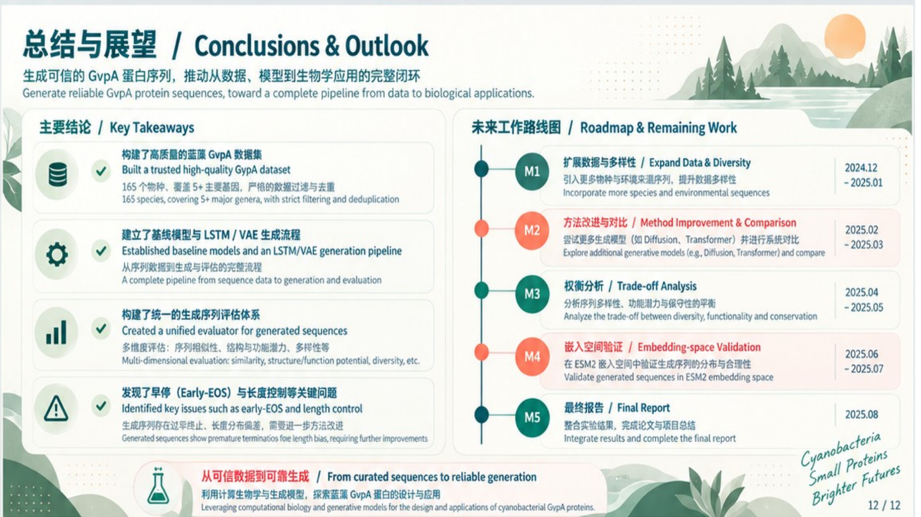




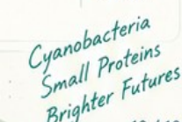

总结与展望 / Conclusions & Outlook
生成可信的 GvpA 蛋白序列，推动从数据、模型到生物学应用的完整闭环
Generate reliable GvpA protein sequences, toward a complete pipeline from data to biological applications.
主要结论 / Key Takeaways
未来工作路线图 / Roadmap & Remaining Work
✓
构建了高质量的蓝藻 GvpA 数据集
扩展数据与多样性 / Expand Data & Diversity
Built a trusted high-quality GvpA dataset
M1
引入更多物种与环境来源序列，提升数据多样性
2024.12
– 2025.01
165 个物种、覆盖 5+ 主要菌属，严格的数据过滤与去重
Incorporate more species and environmental sequences
165 species, covering 5+ major genera, with strict filtering and deduplication
建立了基线模型与 LSTM / VAE 生成流程
M2
方法改进与对比 / Method Improvement & Comparison
2025.02
– 2025.03
✓
Established baseline models and an LSTM/VAE generation pipeline
尝试更多生成模型（如 Diffusion、Transformer）并进行系统对比
Explore additional generative models (e.g., Diffusion, Transformer) and compare
从序列数据到生成与评估的完整流程
A complete pipeline from sequence data to generation and evaluation
权衡分析 / Trade-off Analysis
M3
分析序列多样性、功能潜力与保守性的平衡
2025.04
– 2025.05
✓
构建了统一的生成序列评估体系
Analyze the trade-off between diversity, functionality and conservation
Created a unified evaluator for generated sequences
多维度评估：序列相似性、结构与功能潜力、多样性等
嵌入空间验证 / Embedding-space Validation
Multi-dimensional evaluation: similarity, structure/function potential, diversity, etc.
M4
在 ESM2 嵌入空间中验证生成序列的分布与合理性
2025.06
– 2025.07
Validate generated sequences in ESM2 embedding space
✓
发现了早停（Early-EOS）与长度控制等关键问题
Identified key issues such as early-EOS and length control
最终报告 / Final Report
生成序列存在过早终止、长度分布偏差，需要进一步方法改进
M5
整合实验结果，完成论文与项目总结
2025.08
Generated sequences show premature terminations and length bias, requiring further improvements
Integrate results and complete the final report
从可信数据到可靠生成 / From curated sequences to reliable generation
利用计算生物学与生成模型，探索蓝藻 GvpA 蛋白的设计与应用
Leveraging computational biology and generative models for the design and applications of cyanobacterial GvpA proteins.
12 / 12

