Slide 1
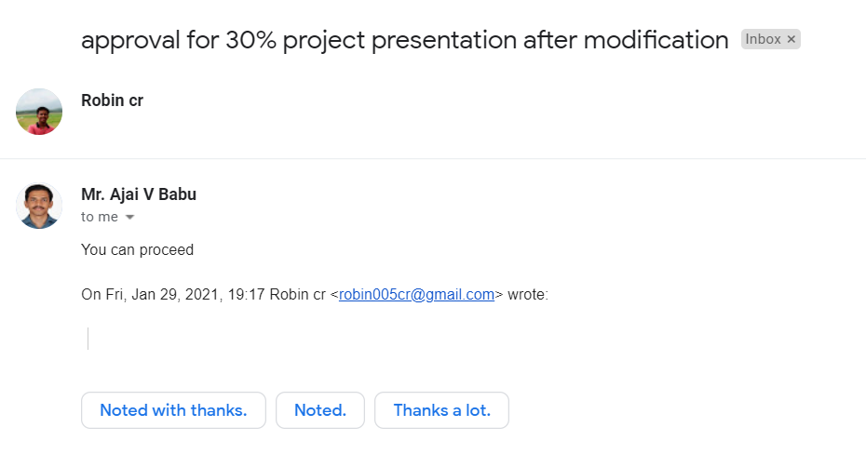

Slide 2
TRAFFIC SIGN BOARD DETECTION
Team Members
Guide
Mr. Ajai V Babu
Assistant Professor
Department of ECE
RSET
ROBIN CR - RET17EC126
SANJAY MS - RET17EC136
VIDHU KRISHNAN - RET17EC178
VS ACHUTHAN - RET17EC186

Slide 3
CONTENTS
TOPIC | PAGE NO
OBJECTIVE MILESTONES COMPLETED Dataset Preparation Traffic Signs CNN - code Voice Message - code Interfacing hardware FUTURE WORK TIME SPAN WORK DIVISION REFERENCE | 1 2 3 4 6 8 9 10 12 13 14

Slide 4
OBJECTIVE
To detect the traffic sign boards and to provide a voice message according to the sign.
To create a Traffic sign inventory, which detects the missing sign boards in a city.
1

Slide 5
MILESTONES COMPLETED
Dataset Preparation :- Created a dataset for 12 traffic signs.
Training :- The model for traffic sign detecion is implemented with the help of Convolutional Neural Network (CNN).
Voice messages :- After identifying the traffic sign, the model need to give a voice message which is implemented in python.
Interfacing hardware components:- Configures Raspberry Pi with GPS Sensor.
2

Slide 6
DATASET PREPARATION
After thorough research we have selected 12 signs, that if the driver didn't notice any of these sign boards the chances of getting to accident is very high.
The signs are selected based on the collision accident rates in India.
3

Slide 7






Traffic Signs
SPEED LIMIT
80 KM\HR
PEDESTRIAN CROSSING
SLIPPERY ROAD
SCHOOL AHEAD
GIVE WAY
HUMP AHEAD
4

Slide 8






Traffic Signs
COMPULSORY AHEAD
COMPULSORY TURN RIGHT
COMPULSORY TURN AHEAD OR RIGHT
COMPULSORY TURN LEFT
COMPULSORY TURN AHEAD OR LEFT
STOP
5

Slide 9
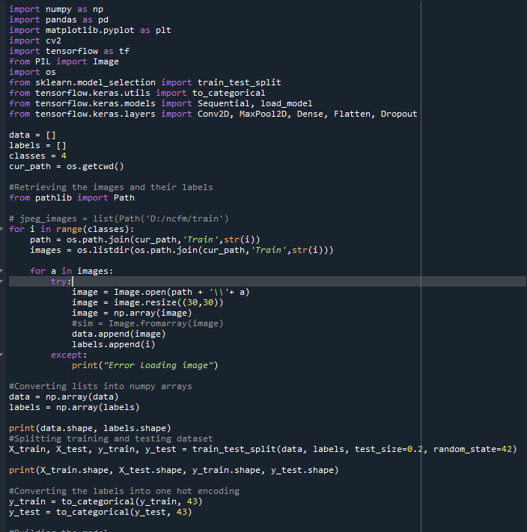
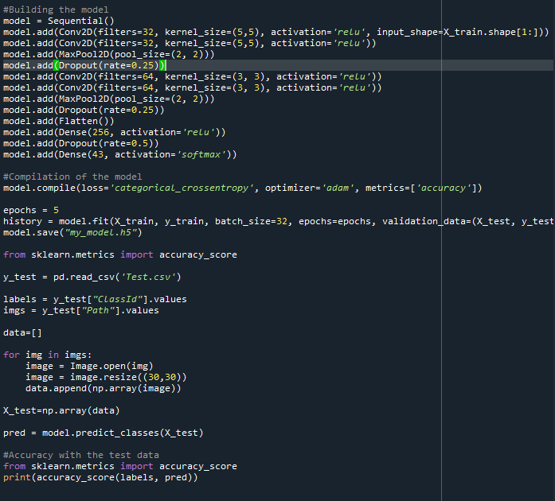
CNN is implemented in python - CODE
6

Slide 10
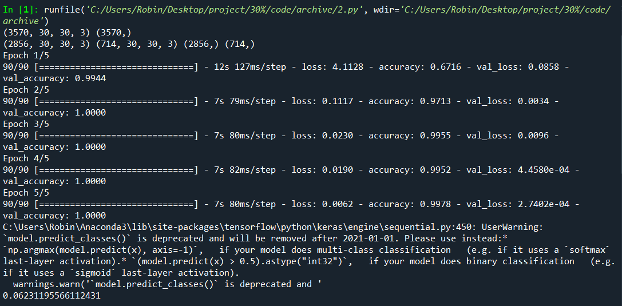
Output
7

Slide 11
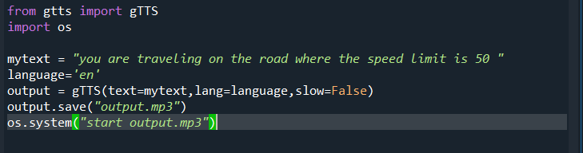
Voice messages
School Ahead, Please control the speed
School Ahead, Please control the speed
8

Slide 12
INTERFACING HARDWARE
Raspberry Pi is configured and interfaced with GPS Sensor to collect the locations. Some trial runs were done to collect the locations.
CHALLENGE - Recorded location cannot be matched with live location.
9

Slide 13
Future Work - Traffic Sign Inventory
Database Creation :-A database with name of traffic sign and GPS location will be created.
Hardware Implementation :- Raspberry Pi will be interfaced with GPS Sensor and camera module. The program will be loaded and will be using for trial and test run.
10

Slide 14
Future Work - Traffic Sign detection
Real time detection :-The trained image recognition model will be tested real time, with the help of a webcam. A new set of images will be used for testing.
Testing with other algorithms :- The current model is implemented in Convolutional Neural Network (CNN). The model will be tested with other algorithms such as Artifical Neural Network (ANN), Recurrent Neural Network (RNN) etc... in order to compare the performance.
11

Slide 15
TIME SPAN
30 – 60%
60 – 80%
80 – 100%
Real time sign detection
Testing algorithms
Creating database for traffic sign
Hardware implementation
Creating a User Inter Face
Testing
MAR
APR
MAY
12

Slide 16
WORK DIVISION
Real time sign detection - Robin CR
Testing algorithms - VS Achuthan
Creating database for traffic sign - Sanjay MS
Hardware Implementation - Vidhu Krishnan
13

Slide 17
REFERENCE
[1] Dimitrios Konstantinidis, Tania Stathaki, Vasileios Argyriou, and Nikolaos Grammalidis,
“Building Detection Using Enhanced HOG–LBP Features and Region Refinement Processes”,
IEEE Journal OF Selected Topics In Applied Earth Observations And Remote Sensing,
Aug.2016.
[2] VLADIMIR TADIC, AKOS ODRY, ATTILA TOTH2, ZOLTAN VIZVARI, AND PETER ODRY,
“Fuzzified Circular Gabor Filter for Circular and Near-Circular Object Detection”,
May. 2020.
[3] Chenggang Yan, Hongtao Xie, Shun Liu, Jian Yin, Yongdong Zhang,and Qionghai Dai,
“Effective Uyghur Language Text Detection in Complex Background Images for Traffic
Prompt Identification”, IEEE Trans. Intell. Transp. Syst. , Jun. 2017.
[4] Changbin You, Chenglu Wen, Cheng Wang ,Jonathan Li, and AymanHabib,
“Joint 2-D–3-D Traffic Sign Landmark DataSet for Geo-Localization Using Mobile Laser
Scanning Data”, IEEE Trans. Intell. Transp. Syst. ,Aug. 2018.
14

Slide 18
THANKYOU

