Slide 1
ABC CALL VOLUME TRENDS ANALYSIS
Vivek Panchal

Slide 2
Description
For you final project we are providing you with a dataset of a Customer Experience (CX) Inbound calling team for 23 days. Data includes Agent_Name, Agent_ID, Queue_Time [duration for which customer have to wait before they get connected to an agent], Time [time at which call was made by customer in a day], Time_Bucket [for easiness we have also provided you with the time bucket], Duration [duration for which a customer and executives are on call, Call_Seconds [for simplicity we have also converted those time into seconds], call status (Abandon, answered, transferred).

Slide 3
A customer experience (CX) team consists of professionals who analyze customer feedback and data, and share insights with the rest of the organization. Typically, these teams fulfil various roles and responsibilities such as: Customer experience programs (CX programs), Digital customer experience, Design and processes, Internal communications, Voice of the customer (VoC), User experiences, Customer experience management, Journey mapping, Nurturing customer interactions, Customer success, Customer support, Handling customer data, Learning about the customer journey.

Slide 4
Approach
The data given below contains the information about the user experience.
Understanding data columns and data
Checking for missing data and outliers(If any)
Handle them
Use excel functionalities to find insights
Visulization of findings.

Slide 5
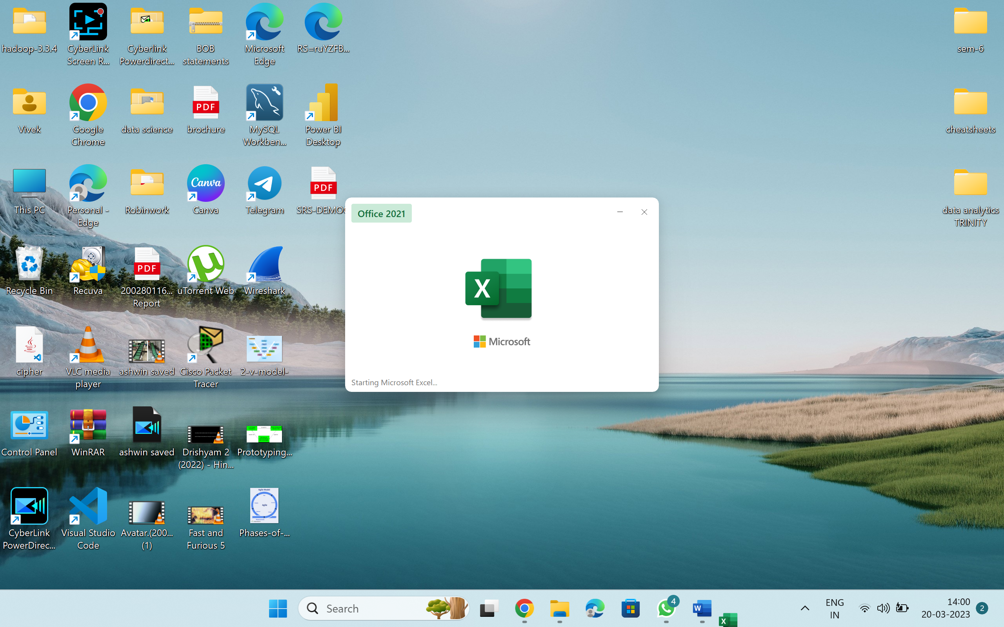
Tech Stack Used:
Microsoft Excel is used.

Slide 6
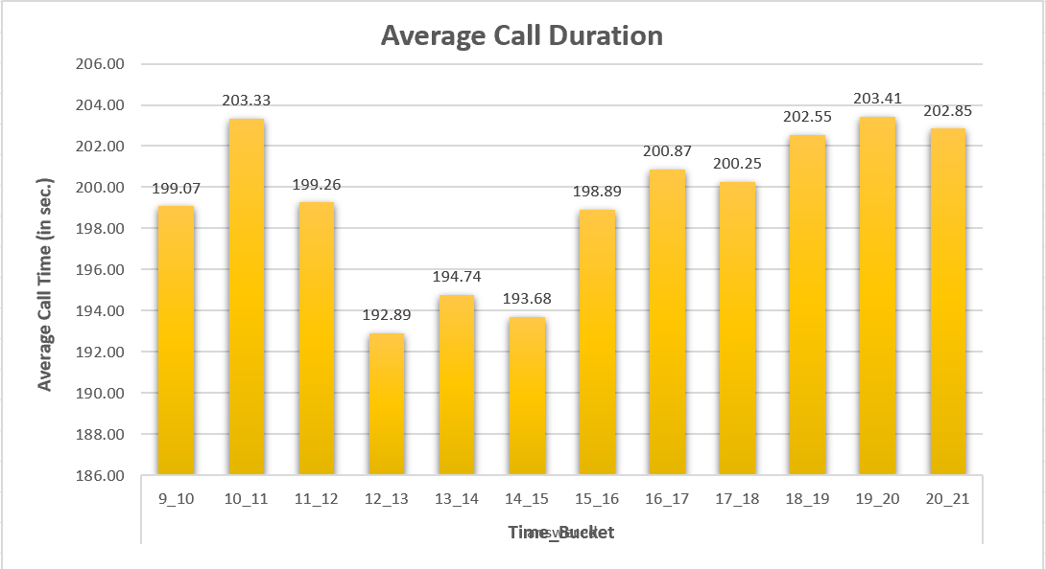
Insights and Results:
Calculate the average call time duration for all incoming calls received by agents (in each Time_Bucket).
Time_Bucket | Average of Call_Seconds (s)
answered | 198.62
9_10 | 199.07
10_11 | 203.33
11_12 | 199.26
12_13 | 192.89
13_14 | 194.74
14_15 | 193.68
15_16 | 198.89
16_17 | 200.87
17_18 | 200.25
18_19 | 202.55
19_20 | 203.41
20_21 | 202.85
Average | 198.62

Slide 7
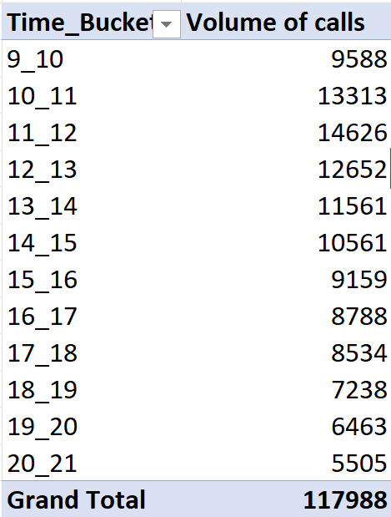
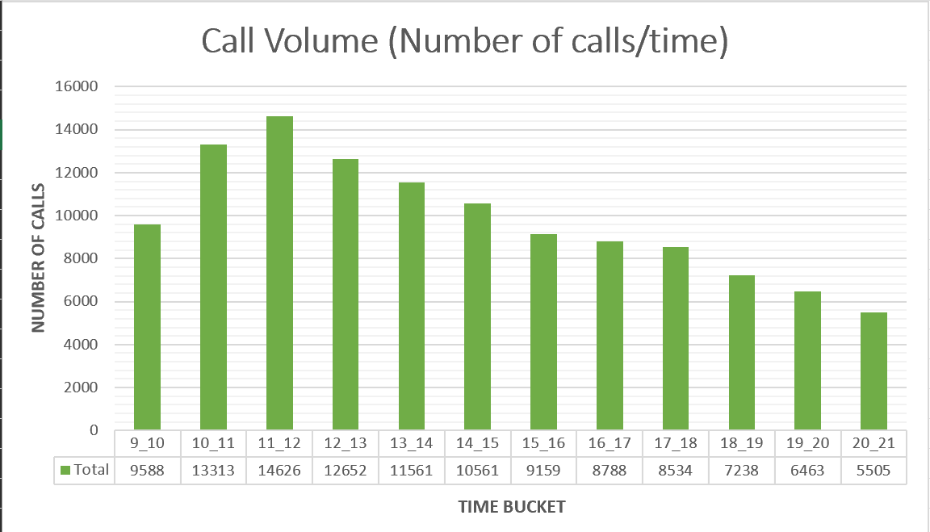
(2) volume/ number of calls coming in via charts/ graphs [Number of calls v/s Time]. You Show the total can select time in a bucket form (i.e. 1-2, 2-3, …..)

Slide 8
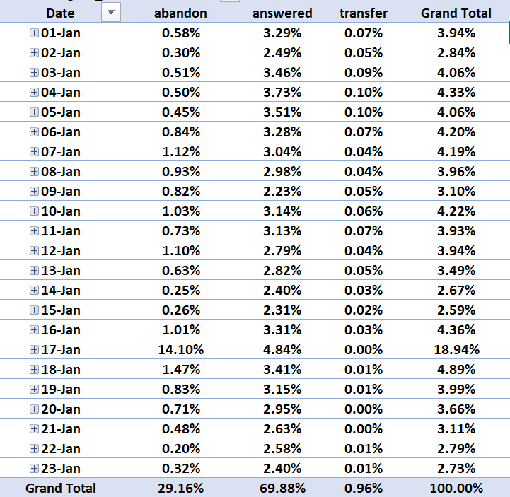
(3) As you can see current abandon rate is approximately 30%. Propose a manpower plan required during each time bucket [between 9am to 9pm] to reduce the abandon rate to 10%. (i.e. You have to calculate minimum number of agents required in each time bucket so that at least 90 calls should be answered out of 100.)
As we know,
Daily Average call volume is : 5130
Average call duration (in seconds) is : 198
Total daily hours : 5130*198/3600 = 282.15
Atleast 90% calls must answered : 282.15*0.9 = 253.7
Each agent is working 60% of their 7 hours = 4.5 hours
So,
Total agents needed : 253.7/4.5 = ~57

Slide 9
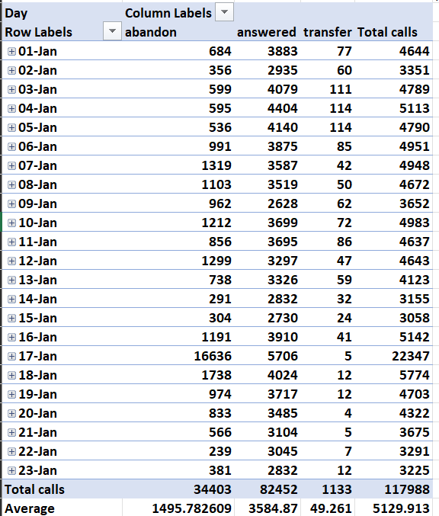

Slide 10
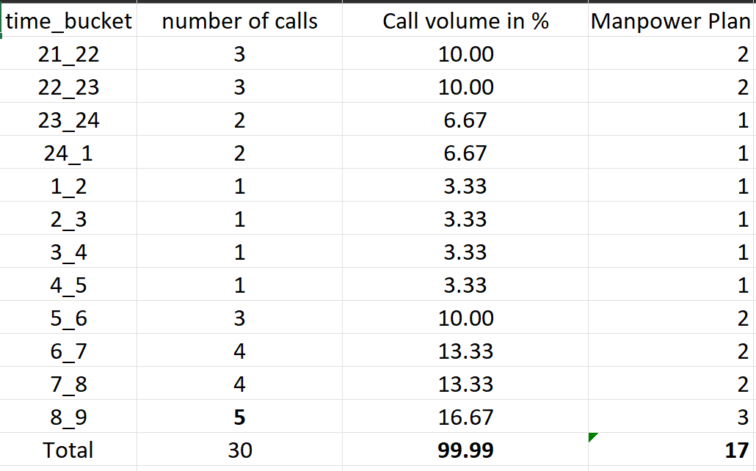
(4) Let’s say customers also call this ABC insurance company in night but didn’t get answer as there are no agents to answer, this creates a bad customer experience for this Insurance company. Suppose every 100 calls that customer made during 9 Am to 9 Pm, customer also made 30 calls in night between interval [9 Pm to 9 Am] and distribution of those 30 calls are as follows:
Now propose a manpower plan required during each time bucket in a day. Maximum Abandon rate assumption would be same 10%.
number of calls (30% of 9am – 9pm) | 1539
average call duration | 198
total sec | 304722
total hour | 76.1805
total agents (9am – 9pm) | ~17
Total Agents | 74

Slide 11
Thank You….

