Slide 1



TEXTOPIA – an adaptive learning platform for dyslexic children
SAIRAM SDG SOLVEATHON 4.0

Slide 2


JUSTIFICATION FOR SUSTAINABLE DEVELOPMENT GOAL
TITLE | PRIMARY | SECONDARY | TERITARY
GOAL | SDG 4 | SDG 3 | SDG 9
TARGET | 4.5 | 3.4 | 9.C

Slide 3



Who we are
Name of your Venture:…Textopia…
Why ?
Explain why do you want to pursue this Business Idea.
This business idea comes from a desire to help children from dyslexia, a condition affecting about 10 percentage of population
What ?
Provide a brief on what does your venture do.
Utilizes real-time feedback and adaptive content to deliver personalized challenges that foster spelling, reading, and cognitive development
How ?
Explain how your venture solves the problem and make its revenue.
Provides a fun, interactive environment with activities like puzzles and word games, adapting to each child’s learning pace to maintain motivation and engagement.

Slide 4
Problem/Opportunity
CONTEXT When does the problem occur? | PROBLEM What is the root cause of the problem? | ALTERNATIVES What do customers do now to ﬁx the problem?
CUSTOMERS Who has the problem most often? | EMOTIONAL IMPACT How does the customer feel? | QUANTIFIABLE IMPACT What is the measurable impact ? I
 | .I
Dyslexia often becomes noticeable between ages 4 and 8, when children start learning to read and write.
Dyslexia results from differences in brain structure and function, primarily affecting phonological processing.
Private Tutoring
Specialized Programs
General Education Apps
frustrated,
anxious,
sometimes embarrassed due to their difficulties with reading and language.
Improved reading fluency,
indicated by increased words per minute accuracy
enhanced literacy skills
Children with dyslexia, especially in early school years (ages 4–8), who need tailored literacy support.

Slide 5

Problem Interviews And Surveys Results
How many customers did you interview? - 100
What was the interview mode? - Both online and offline
How many of them agree this is a problem and wants a solution? - 90
How many of them said they don't need a new solution? - 10

Slide 6
Market Size Estimation
How to calculate market size?
1. Total Addressable Market (TAM):
Global Estimate: With 100-200 million children worldwide with dyslexia: TAM (Global)=100 million children×₹500=₹50,000crore
India Estimate: With 10-12 million children in India with dyslexia: TAM (India)=10 million children×₹500=₹5,000crore
2. Serviceable Available Market (SAM):
Assuming a serviceable population of 2 million children in India (urban and semi-urban regions):
SAM (India)=2 million children×₹500=₹1,000crore
For the U.S., assuming 2.5-5 million children represent SAM:
SAM (U.S.)=2.5 million children×₹500=₹1,250crore
3. Market Penetration Rate:
Assuming 2% penetration:
Global Market Size: Market Size (Global)=₹50,000 crore×0.02=₹1,000crore
India Market Size: Market Size (India)=₹1,000 crore×0.02=₹20crore
TAM
SAM
SOM
.
Sources: ……

Slide 7

Customer Persona
Personality trait
Personality trait
Personality trait
Motivations
Goals
Improve reading fluency, spelling accuracy, and comprehension skills
Build confidence and reduce frustration with literacy tasks
Develop a love for reading and learning
Emma
Frustrations
Struggles with Phonics and Word Decoding: Difficulty sounding out words leads to slower reading progress, making her feel left behind.
Anxiety about Making Mistakes: Fear of judgment while reading in front of others causes her to feel self-conscious and hesitant.
Age: 7
Occupation: Urban area, attending primary school
Location: Chennai
Emma, 7 Years Old, Primary School Student with Dyslexia
Emma is a bright and curious seven-year-old who recently started primary school. She was diagnosed with dyslexia, which has made reading and spelling more challenging for her compared to her peers. Emma often struggles with phonics and word decoding, leading to slower reading progress and feelings of frustration. She feels anxious about making mistakes, especially when asked to read aloud, fearing judgment or embarrassment.
Personality

Slide 8
Value Proposition Canvas
What do you offer that makes the customers happy?
Our App makes learning enjoyable by incorporating interactive games that engage children through fun and dynamic exercise .We create a motivating environment that encourages continuous participation and progress
.
I would LOVE it if:
Learning was fun and engaging, keeping children motivated and excited
Profgress was visible and measurable showing clear improvement in literacy skill
Positive reinforcement learning was prioritized, building confidence without frustation
.
I would WANT:
To find the tools that enhance child’s literacy skills
To research and compare educational solutions tailored for dyslexia
To implement and experiment with different teaching strategies
GAIN CREATORS
FIT
GAINS
What is the product or service that you are offering?
We offer a game based learning app designed to support children with dyslexia
PRODUCT/
SERVICE
JOBS
PAIN KILLERS
PAINS
I would HATE it if:
Inefficient tools that fail to improve literacy skills
Lack of engagement leading to low motivation
High costs andl imited access to quality solution
Difficult in using educational resources
Which features of your offering relieve the customer's pains?
Our Adaptive learning that personalizes exercise to each child’s need and real time feedback to guide improvement

Slide 9
Solution
We offer a comprehensive game-based learning experience
Powered by our Reinforcement Adaptive Learning Framework (RALF), our platform includes a wide range of engaging, interactive games designed to support children’s learning through fun and adaptive methods:
🎧 Word Weaver – An audio-based pronunciation game that sharpens listening and articulation skills.
🧠 Memory Match – A challenge that boosts memory recall and visual recognition through fun pairing exercises.
🔠 Letter Land – A colorful environment where children practice letter and word sequencing using drag-and-drop techniques.
🗣️ Say It, Match It – An interactive game that enhances vocabulary and phonological awareness.
🐾 Guess the Animal – A visual guessing game where children view an image and identify the animal using voice or text input, with rewards reinforcing correct answers.
🧩 Puzzle Play – Engaging drag-and-drop puzzles that develop spatial reasoning and problem-solving skills.
🔡 Alphabet Learning – A foundational game helping children recognize, sequence, and pronounce letters interactively.
List the Benefits of Your solutions
1.Personalized Learning
RALF adapts the difficulty and content of each game to match the individual needs of each child, providing a customized learning experience.
2. Enhanced Language Skills
Games like 'Word Weaver' and 'Say It, Match It!' improve pronunciation, vocabulary, and phonological awareness, crucial for reading and language development
3. Improved Memory and Sequencing
'Memory Match' and 'Letterland' strengthen memory, recall, and letter/word sequencing skills, which are essential for spelling and sentence construction.
4. Engaging and Motivating
The game-based format makes learning fun and interactive, increasing motivation and engagement, which leads to better retention and a positive attitude towards learning.

Slide 10
Competition Analysis
Benefits | Competitor 1 Lexercise | Competitor 2 Nessy | Competitor 3 Dyslexia Quest | Your Venture TEXTOPIA
Product | Therapy & games | Educational game | Cognitive games | Learning games
Price | Paid or Free | Subscription | One time purchase | Free with Limited content
Branding channels | Website, educational institutions | Website, School partnership | App stores, educational forums | App stores, educational forums , websites
Packaging | Online platform | Digital platform | Mobile app | Mobile app
Market reviews | Strong therapist guide | Positive for engagement | Well received for fun | Fun interactive and feedback based

Slide 11
Lean Canvas
Specialized Tutoring
Programs Assistive
Technology Educational Apps
Audio books and E-Learning Tools
SOLUTION
A RALF that adjusts difficulty levels based on real-time performance.
UNIQUE VALUE PROPOSITION
Personalized Learning
Game-Based Learning
Real-Time Progress Tracking
HIGH-LEVEL CONCEPT
Game Mechanics
Adaptive Learning
Progress Tracking
Parental & Teacher Dashboards
UNFAIR ADVANTAGE
Personalized Support
Engagement & Motivation
Proactive Customer Support
CUSTOMER SEGMENTS
Primary: Parents of children aged 4–8 with dyslexia.
Secondary: Schools and educators , specialized for dyslexia children
EARLY ADOPTERS
Parents of Dyslexic Children
Special Education Teachers
Therapists and Learning Specialists
Educational Institutions
Nonprofit Organizations
PROBLEM
Children with dyslexia struggle
reading,
writing,
memory,
communication
KEY METRICS
User Engagement
Learning Progress
Retention and Satisfaction
Revenue and Business
Market Penetration
CHANNELS
Personalized Support
Ongoing Engagement & Motivation
Proactive Customer Support
EXISTING ALTERNATIVES
COST STRUCTURE
Development and maintenance of the app.
Marketing and customer acquisition.
Customer support and content updates.
REVENUE STREAMS
Freemium model
Partnerships with schools and educational institutions for bulk licensing.

Slide 12
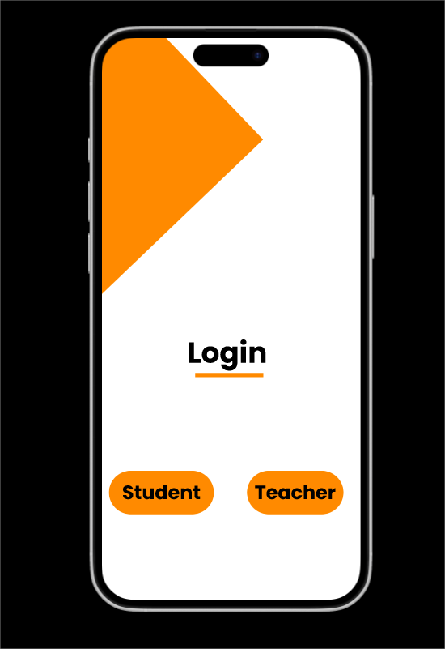
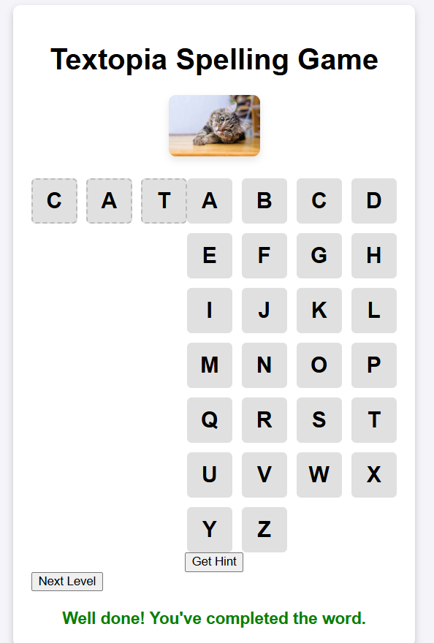
MVP
Product: An AI-driven app designed to improve reading, writing, memory, and communication skills for children with dyslexia through interactive, game-based activities. The content adapts based on individual progress for a personalized learning experience.
Service: Ongoing support with real-time progress tracking for parents and teachers, providing insights into skill development and areas for improvement. Regular updates and refinements based on user feedback ensure continuous enhancement of the learning experience.
Link
https://www.figma.com/proto/XyuseIL7G6GFIRifkNa4wk/sample?node-id=16-2&node-type=canvas&t=VBJ77rnSwVWjmKkA-1&scaling=scale-down&content-scaling=fixed&page-id=5%3A73
https://robin7339.github.io/RL-drag-game/

Slide 13
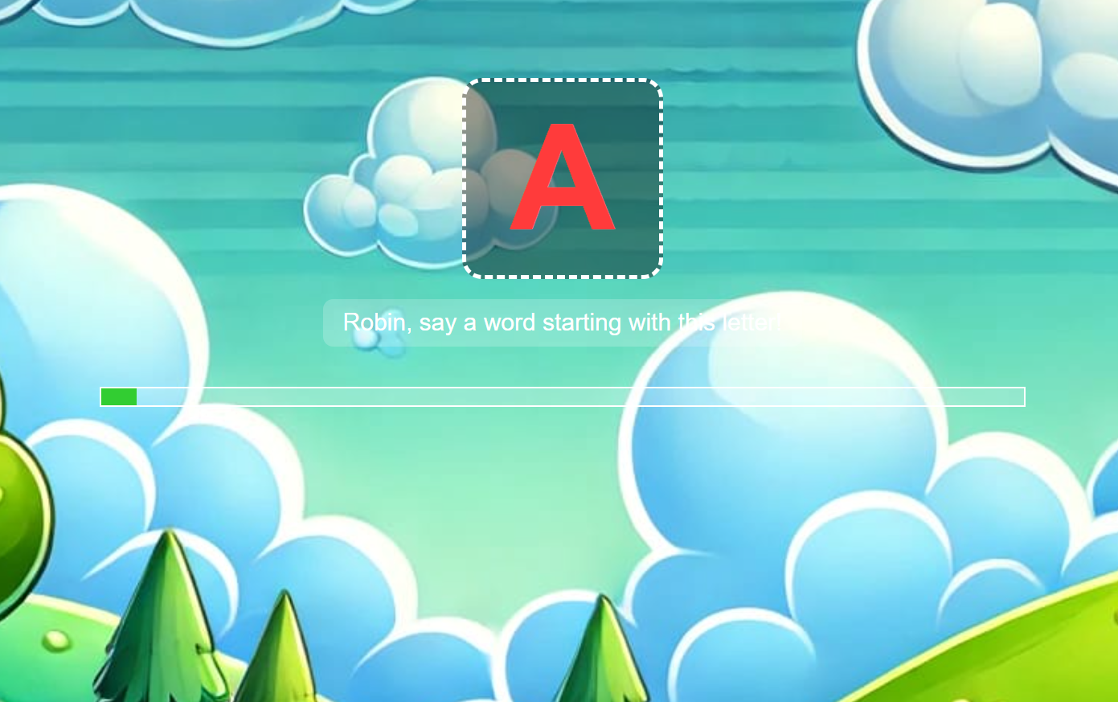
Games
🎮 Game 1: Alphabetical Learning Game
🧩 Description: A voice-based interactive game where the user is shown an alphabet and must say a word that starts with the given letter. Speech recognition and real-time feedback are provided.
🚀 Key Features:
Speech recognition with real-time voice feedback
Adaptive learning using rewards for each alphabet
Progress bar indicating user's learning journey
Uses positive reinforcement and retry mechanism
🧠 Technology Stack:
Speech API: Web Speech API (SpeechRecognition, SpeechSynthesis)
Adaptive Logic: JavaScript-based reward system
🤖 Reinforcement Learning Logic:
Reward-Based Adaptation: Each alphabet has a reward score.
Correct answers decrease difficulty (reward--), making it less frequent.
Incorrect answers increase exposure (reward++), focusing learning on weak areas
RL Mechanism Used: Inspired by Multi-Armed Bandit Problem
Exploration vs. Exploitation trade-off: frequently missed letters are shown more.
Adaptive content delivery simulates Policy Improvement.
🎯 Learning Outcome: Promotes letter recognition, pronunciation, and vocabulary building with adaptive difficulty to support personalized learning.

Slide 14
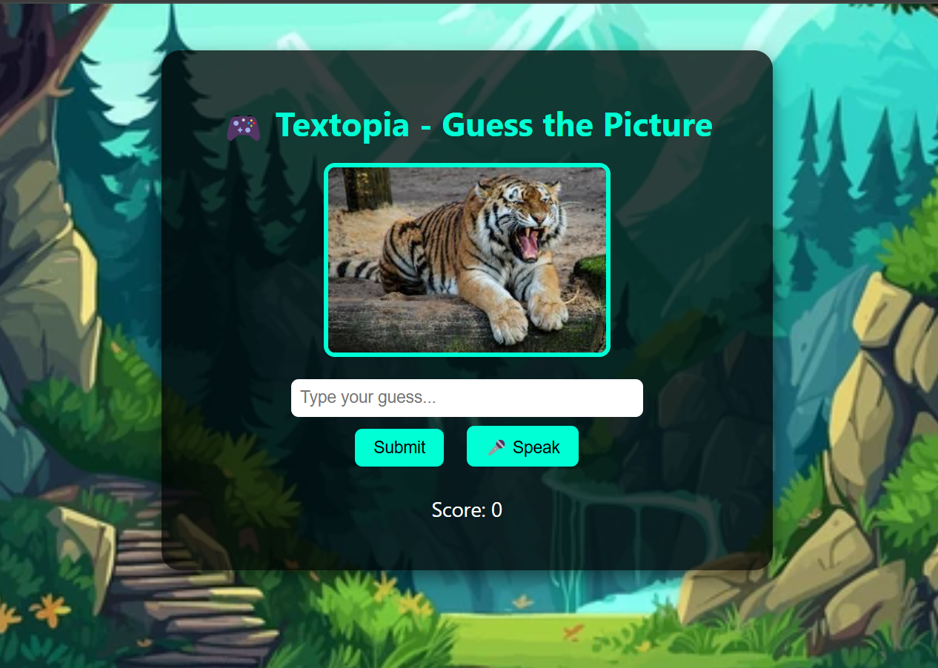
🎮 Game 2: Guess the Picture
Description: In this interactive game, children view an image (e.g., of a dog or cat) and guess the correct label by typing or using voice input. Positive feedback is given for correct answers, and voice synthesis enhances engagement.
🤖 Reinforcement Learning Elements:
Concept | Implementation
Agent | The child/student playing the game.
Environment | The Flask web application that presents images and takes guesses.
State | The current image shown and guess input from the child.
Action | The child's text/voice-based guess for the image label.
Reward | +1 for a correct guess, 0 for an incorrect guess. Stored in a reward list.
Feedback Loop | Immediate audio/visual feedback improves learning through reinforcement.

Slide 15
MVP Validation
What is your MVP
Conclusion:
Test Details:
Positive User Engagement
UI/UX Improvements
Expanded Testing and Features
How long will we test this MVP?
We conducted testing for 3 weeks with daily game interactions
Who is our target audience for the test? How many of them?
children aged 4-8 with dyslexia, with an initial test group of 7 children.
How will we get to that audience?
We partnered with local dyslexia support groups, parents, and educators from specialized schools for children with learning disabilities.
Results of Test:
Realizations / Insights:
Positive User Feedback
High Engagement
Effectiveness of Personalization
Interest in Paid Version
UI/UX Feedback
Feature Expansion
Did enough customers buy? Why or why not? Not applicable at this stage, as it was a pre-launch prototype, but all test users expressed interest in continuing the app.
Did customers pay the price we expected? Why or why not? The MVP was free for testing, but parents expressed interest in subscribing to a paid version if it continued delivering positive learning outcomes.
Did customers come back to our product or show interest in doing so? Why or why not? Participants returned regularly, reporting high engagement and interest in continuing the games.
Next Steps:
Finalize Concept and Features
Prototype Design
Refine Learning Algorithms
Set Up Backend Infrastructure
Create MVP (Minimum Viable Product)
Did customers recommend our product to others or evangelize about it? Why or why not? Yes, customers recommended the app due to positive outcomes and high engagement.

Slide 16
Sales Plan
Customer Sales Funnel
Customer Acquisition Plan
TARGET MARKET:
Children with dyslexia in India, with an estimated 10-20 million potential users.
OPPORTUNITIES/PROSPECTS:
Schools and parents actively seeking tech-driven solutions for dyslexia support
CUSTOMER:
Teachers, students, and parents
LEADS:
Schools, parents, and therapists
1 | 2 | 3 | 4 | 5
Target Customer Segment (Type) | Target Customer Segment (Number) | Channels to be used to attract the target customer segment | Estimated number of leads | Estimated cost to convert these leads to actual customers
Parents of dyslexic children | 100,000 | Local social media ads, community WhatsApp groups, partnerships with dyslexia orgs | 3,000 | ₹50,000
Schools & educational institutions | 500 schools | Direct outreach, local partnerships, webinars | 1,500 | ₹30,000
Special education and dyslexia centers | 200 centers | Email campaigns, low-cost educational events, community workshops | 500 | ₹20,000

Slide 17
Go-to-Market Strategy
Category | Details
1. Social Media Presence | Platforms: Facebook, LinkedIn, Instagram, Twitter, YouTube, WhatsApp. Focus: Educational posts, videos, reels, infographics, and community engagement.
2. Branding Video | Duration: 2-3 minutes. Content: Highlights challenges of dyslexia, explains Textopia’s value, target audience, and unique features through animations or real-life scenarios.
3. Positioning Statement | "Textopia is an adaptive learning app for children with dyslexia, enhancing reading, spelling, and cognitive skills through gamified exercises. It offers a fun experience for students and insights for educators."
4. Action Plan | Target: 50,000 users in Year 1. Strategies: 1. Marketing campaigns on social media and Google. 2. Partnerships with schools and NGOs. 3. Content marketing and awareness events.
5. Sales Channels | 1. Direct-to-Consumer (D2C): Parents and teachers via app stores or website. 2. Institutional Sales: Partnerships with schools and NGOs. 3. Referral Program: Rewards for new sign-ups.
6. Distribution Channels | 1. Digital: App stores (Google Play, Apple App Store), website. 2. Offline: Schools, bookstores, and child development centers

Slide 18
FINANCIAL PLAN
Start-up Costs
Starting Costs
Startup Cost | ₹2,17,000
Business Registration | ₹13,000
Licenses | ₹9,000
Equipment and Utesils | ₹45,000
Interirors and Furnitures | ₹50,000
Website development | ₹1,00,000
Capital Work in Progress ( Fixed Asset ) | ₹80,000
Laptop/ POS | ₹80,000
Starting Operations ( Budgeted ) | ₹1,03,000
Promotion | ₹50,000
Hosting and Domain Space | ₹20,000
Misceleneous | ₹20,000
Start-up capital | ₹4,00,000
Share Captial | ₹2,00,000
Funds | ₹2,00,000
Explanation:
Business registration and licenses (₹22,000) for legal compliance.
Equipment, utensils, and furnishings (₹95,000) to set up the workspace.
Website development (₹1,00,000) for establishing an online presence.
Capital assets (₹80,000) for long-term investments like machinery and property.
Tech equipment (₹80,000) including laptops and POS systems.
Starting operations (₹1,03,000) for initial resources and stock.
Marketing (₹50,000) to promote the business.
Miscellaneous costs (₹20,000) for unforeseen expenses.
Start-up capital (₹4,00,000) and share capital (₹2,00,000) for initial funding

Slide 19
Forecast P&L
Profit & Loss Account ( Income Statement)
 | Jan | Feb | Mar | Apr | May | Jun | Jul | Aug | Sep | Oct | Nov | Dec | Totals
Sales | Gross Profit = Sales - COGS |  | Net Profit=Sales - COGS - Fixed Expenses
Cash Sales | ₹ 40,000 | ₹ 44,000 | ₹ 48,400 | ₹ 53,200 | ₹ 58,400 | ₹ 64,400 | ₹ 70,800 | ₹ 77,600 | ₹ 85,200 | ₹ 93,600 | ₹ 1,02,800 | ₹ 1,13,200 | ₹ 8,51,600
No. of Customers | 100 | 110 | 121 | 133 | 146 | 161 | 177 | 194 | 213 | 234 | 257 | 283 | 2129
Price Per Unit | 400 | ₹ 400 | ₹ 400 | ₹ 400 | ₹ 400 | ₹ 400 | ₹ 400 | ₹ 400 | ₹ 400 | ₹ 400 | ₹ 400 | ₹ 400 | ₹ 400
Other Cash Receipts
Total Sales | ₹ 40,000 | ₹ 44,000 | ₹ 48,400 | ₹ 53,200 | ₹ 58,400 | ₹ 64,400 | ₹ 70,800 | ₹ 77,600 | ₹ 85,200 | ₹ 93,600 | ₹ 1,02,800 | ₹ 1,13,200 | ₹ 8,51,600
COGS
Cost of Services | ₹ 10,000 | ₹ 8,800 | ₹ 9,680 | ₹ 10,640 | ₹ 11,680 | ₹ 12,880 | ₹ 14,160 | ₹ 15,520 | ₹ 17,040 | ₹ 18,720 | ₹ 20,560 | ₹ 22,640 | ₹ 1,72,320
Cost Per Unit | ₹ 100 | ₹ 80 | ₹ 80 | ₹ 80 | ₹ 80 | ₹ 80 | ₹ 80 | ₹ 80 | ₹ 80 | ₹ 80 | ₹ 80 | ₹ 80 | ₹ 81
Gross profit | ₹ 30,000 | ₹ 35,200 | ₹ 38,720 | ₹ 42,560 | ₹ 46,720 | ₹ 51,520 | ₹ 56,640 | ₹ 62,080 | ₹ 68,160 | ₹ 74,880 | ₹ 82,240 | ₹ 90,560 | ₹ 6,79,280
Fixed Expenses
Salaries | ₹ 39,000 | ₹ 39,000 | ₹ 39,000 | ₹ 39,000 | ₹ 39,000 | ₹ 39,000 | ₹ 39,000 | ₹ 39,000 | ₹ 39,000 | ₹ 39,000 | ₹ 39,000 | ₹ 39,000 | ₹ 4,68,000
Marketing and Promotion | ₹ - | ₹ - | ₹ 1,000 | ₹ 1,000 | ₹ 2,000 | ₹ 5,000 | ₹ 5,000 | ₹ 5,000 | ₹ 5,000 | ₹ 5,000 | ₹ 5,000 | ₹ 5,000 | ₹ 39,000
Digital Marketing | ₹ 2,000 | ₹ 2,000 | ₹ 1,000 | ₹ 1,000 | ₹ 2,000 | ₹ 2,000 | ₹ 5,000 | ₹ 5,000 | ₹ 5,000 | ₹ 5,000 | ₹ 5,000 | ₹ 5,000 | ₹ 40,000
Utilities (Electricity etc.) | ₹ 500 | ₹ 1,000 | ₹ 1,000 | ₹ 1,000 | ₹ 1,000 | ₹ 1,000 | ₹ 1,000 | ₹ 1,000 | ₹ 1,000 | ₹ 1,000 | ₹ 1,000 | ₹ 1,000 | ₹ 11,500
Customer Service | ₹ 1,000 | ₹ 1,000 | ₹ 1,000 | ₹ 1,000 | ₹ 1,000 | ₹ 1,000 | ₹ 1,000 | ₹ 1,000 | ₹ 1,000 | ₹ 1,000 | ₹ 1,000 | ₹ 1,000 | ₹ 12,000
Rent | ₹ - | ₹ - | ₹ - | ₹ - | ₹ - | ₹ - | ₹ - | ₹ - | ₹ - | ₹ - | ₹ - | ₹ - | ₹ -
Total Expenses | ₹ 42,500 | ₹ 43,000 | ₹ 43,000 | ₹ 43,000 | ₹ 45,000 | ₹ 48,000 | ₹ 51,000 | ₹ 51,000 | ₹ 51,000 | ₹ 51,000 | ₹ 51,000 | ₹ 51,000 | ₹ 5,70,500
Result
Net Profit/Loss | ₹ -12,500 | ₹ -7,800 | ₹ -4,280 | ₹ -440 | ₹ 1,720 | ₹ 3,520 | ₹ 5,640 | ₹ 11,080 | ₹ 17,160 | ₹ 23,880 | ₹ 31,240 | ₹ 39,560 | ₹ 1,08,780
Gross Profit Margin | 75% | 80% | 80% | 80% | 80% | 80% | 80% | 80% | 80% | 80% | 80% | 80% | 80%
Net Profit Margin | -31% | -18% | -9% | -1% | 3% | 5% | 8% | 14% | 20% | 26% | 30% | 35% | 13%

Slide 20
Financial Projections
 | Year 1 | Year 2 | Year 3 | Year 4 | Year 5
Number of sales | 2129 | 2561 | 3073 | 3692 | 4390
Value of each sale (Contribution) | ₹ 350 | ₹ 350 | ₹ 423 | ₹ 423 | ₹ 463
Average Price per unit | ₹ 400 | ₹ 400 | ₹ 480 | ₹ 480 | ₹ 520
Average Cost per unit | ₹ 50 | ₹ 50 | ₹ 57 | ₹ 57 | ₹ 57
Total revenue | ₹ 8,51,600 | ₹ 10,24,320 | ₹ 14,75,021 | ₹ 17,71,945 | ₹ 22,82,658
Gross Profit | ₹ 7,45,150 | ₹ 8,96,280 | ₹ 12,99,417 | ₹ 15,60,991 | ₹ 20,31,800
Capital costs
Land and building | N.A. | N.A. | N.A. | N.A. | N.A.
Equipment
Product development costs
Others
Total
Expenses (Annual)
Salaries | ₹ 4,68,000 | ₹ 5,14,800 | ₹ 5,66,280 | ₹ 6,22,908 | ₹ 6,85,199
Marketing and Promotion | ₹ 39,000 | ₹ 42,900 | ₹ 47,190 | ₹ 51,909 | ₹ 57,100
Digital Marketing & Customer Services | ₹ 40,000 | ₹ 44,000 | ₹ 48,400 | ₹ 53,240 | ₹ 58,564
Utilities (electricity etc.) | ₹ 11,500 | ₹ 12,650 | ₹ 13,915 | ₹ 15,307 | ₹ 16,837
Office Supplies | ₹ 12,000 | ₹ 13,200 | ₹ 14,520 | ₹ 15,972 | ₹ 17,569
Rent | ₹ - | ₹ - | ₹ - | ₹ - | ₹ -
Total | ₹ 5,70,500 | ₹ 6,27,550 | ₹ 6,90,305 | ₹ 7,59,336 | ₹ 8,35,269
Earnings (EBITDA) | ₹ 1,74,650 | ₹ 2,68,730 | ₹ 6,09,112 | ₹ 8,01,656 | ₹ 11,96,530

Slide 21
Unit Economics
P & L/ unit | Value
Revenue | ₹ 400
COGS | ₹ 50
Gross Profit | ₹ 350
Gross Profit Margin | 88%
Operating Costs | ₹ 318
Operating Profit | ₹ 82.03
Unit Economics | Value
CAC | ₹ 37
CLV | ₹ 596
ARPU | ₹ 3,406

Slide 22
Thank You!

