Slide 4
Safe Control for High-Speed Driving using Decomposition-Based Reachability Analysis
Robin Abrahamse

Slide 5
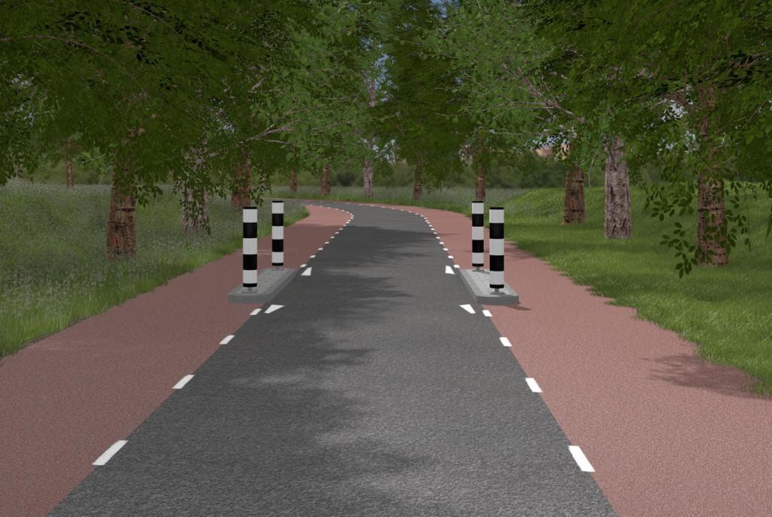
A Scenario

Slide 6
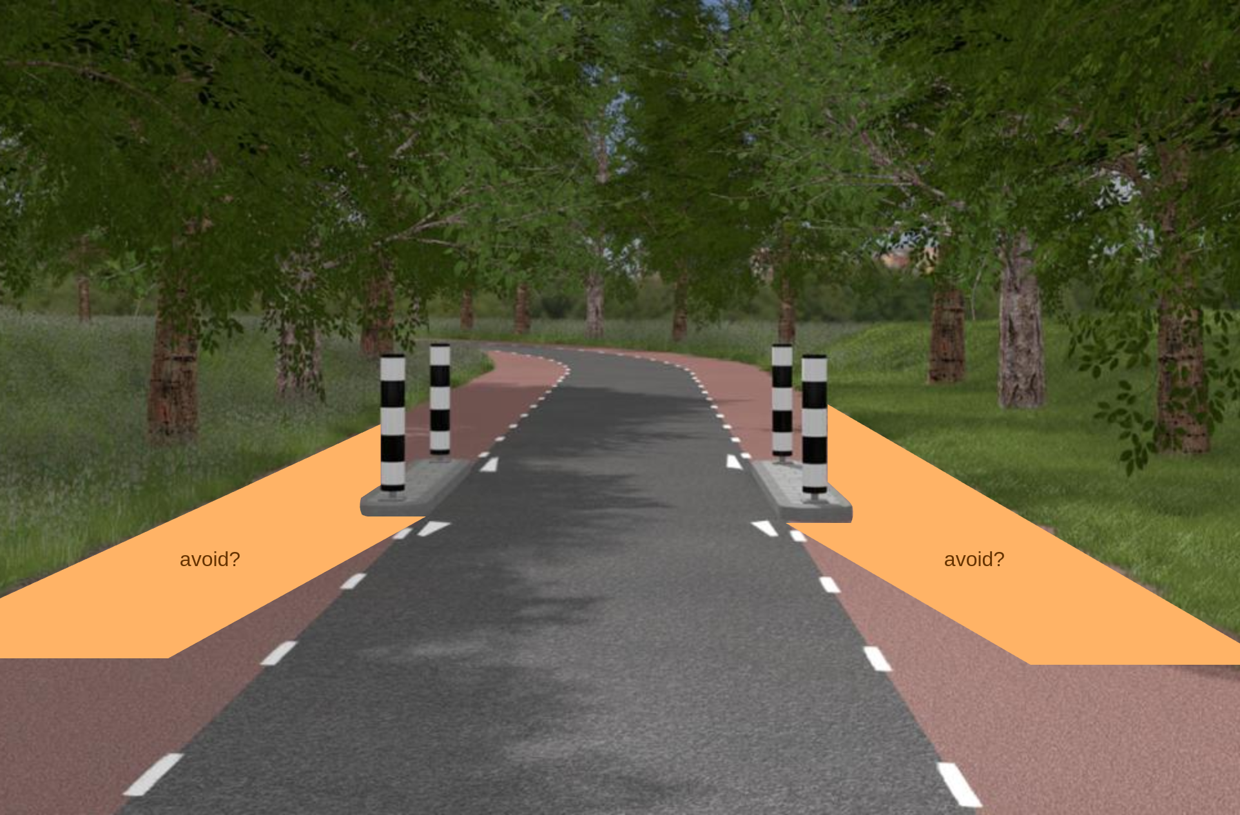
A Scenario (cont.)

Slide 7
A Scenario (cont.)
Area to avoid?
Unsafe velocities?
Safe driver inputs?

Slide 8
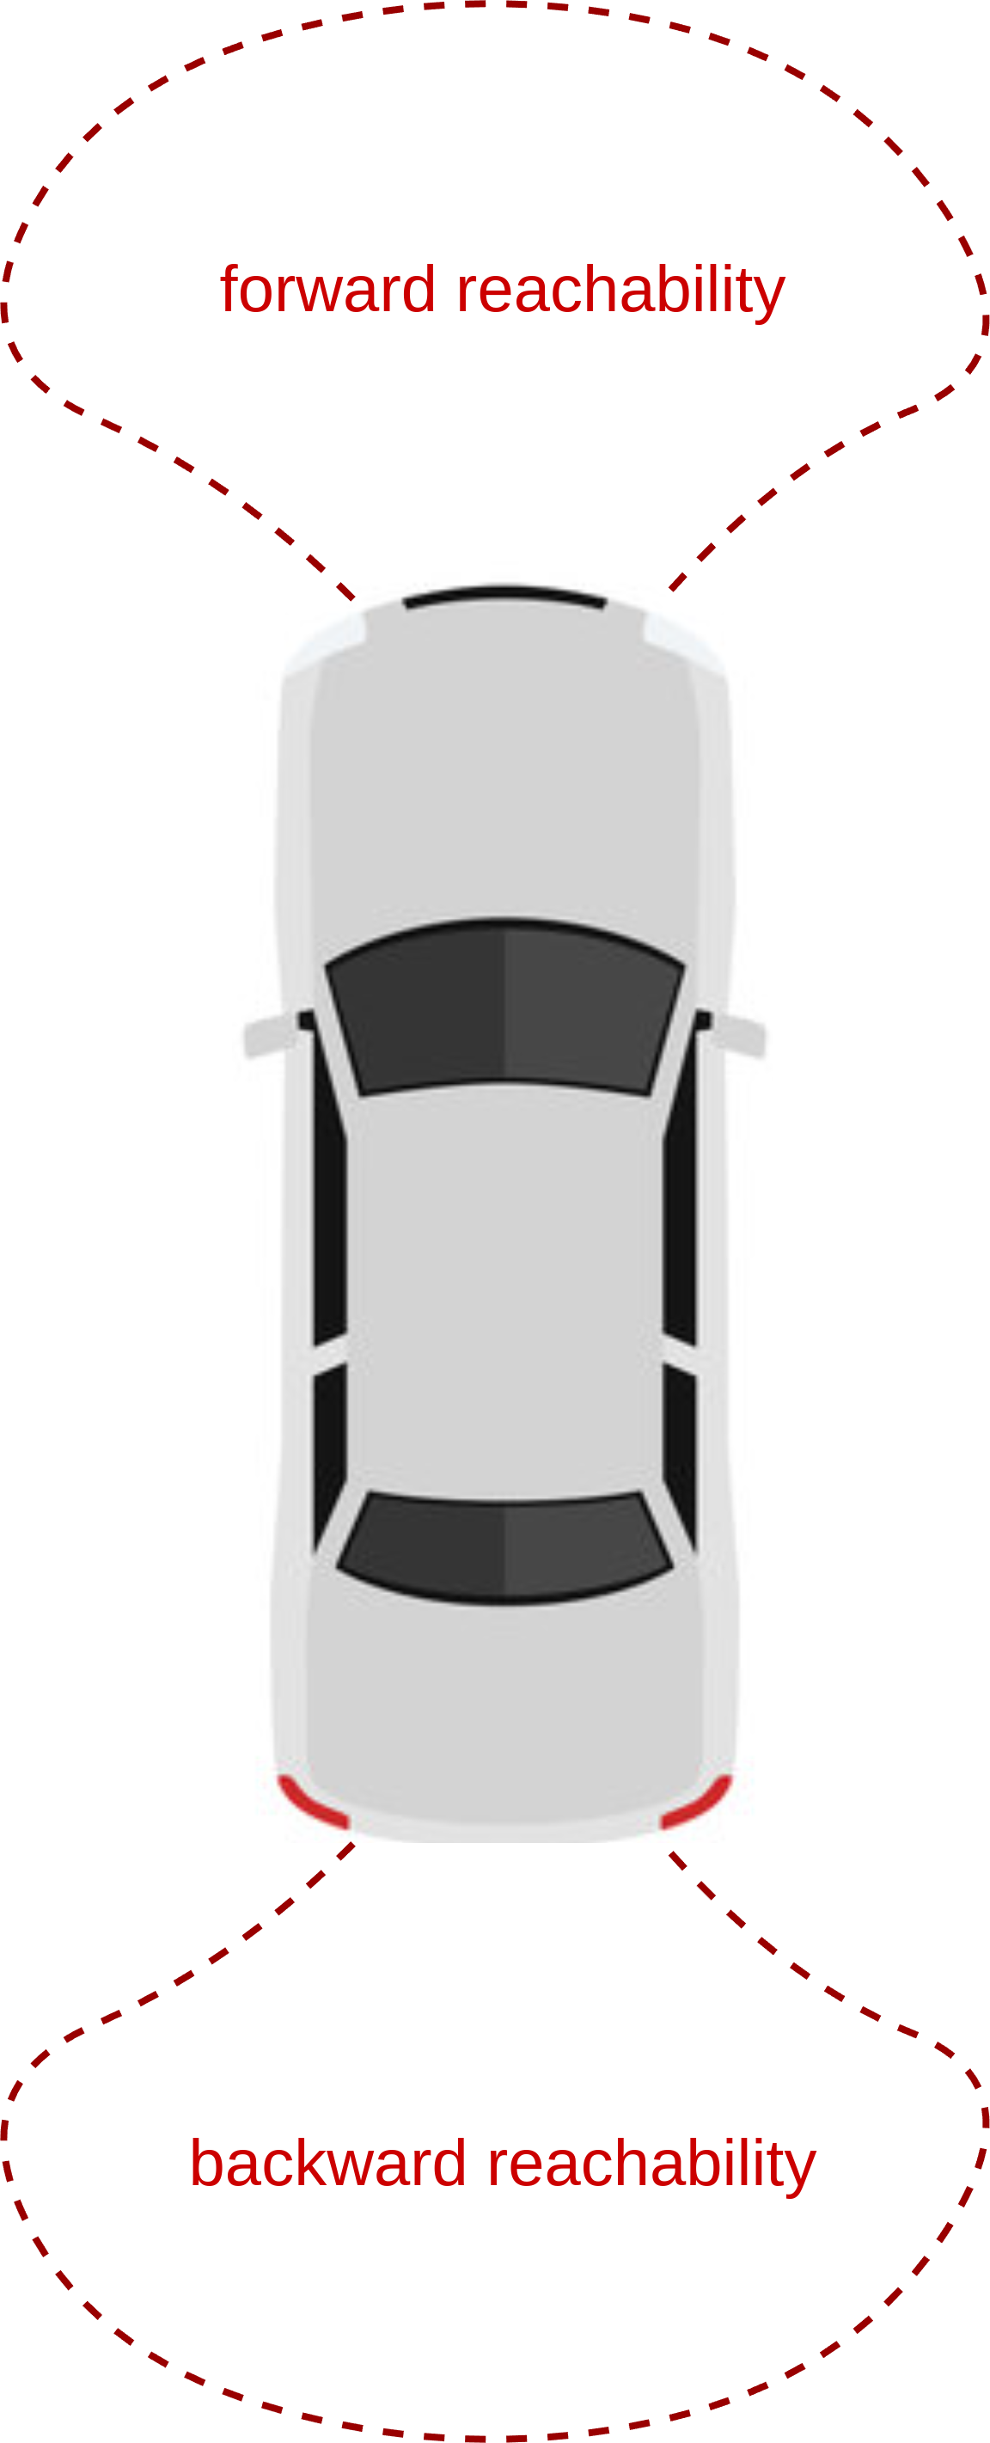
Reachability
Forward: reachable states within time t
Backward: states from which specific area is reachable within time t
Hamilton-Jacobi reachability
Model-based

Slide 9
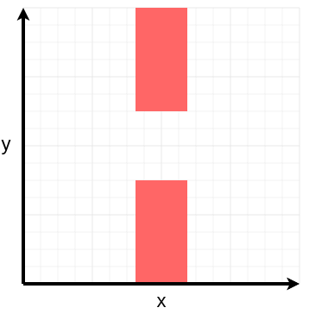
Reachability Application
Describe obstacles
Backward reachability from obstacles
Avoid computed region

Slide 10
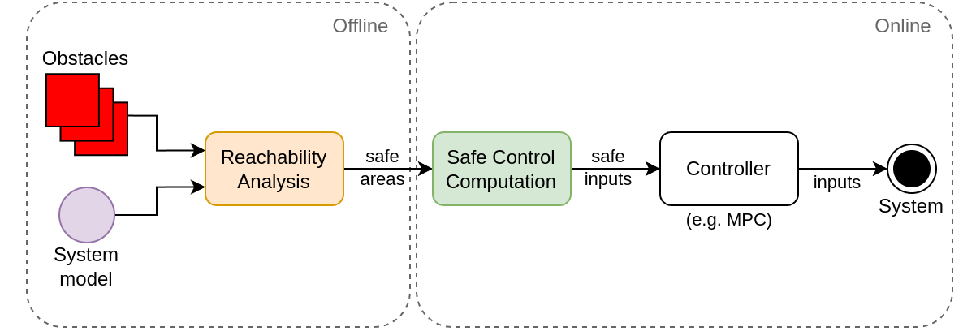
System Diagram

Slide 11

Reachability Challenges
Scales exponentially with model order
Results dependent on model accuracy
Dubins car

Slide 12
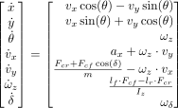
Model Accuracy
High-speed driving
↓
High-order dynamics
↓
Increased model demands
↓
Reachability analysis intractable

Slide 13


System Decomposition
Decompose into subsystems
Reachability on subsystems
Combine results
Subsystem 1
Subsystem 2

Slide 14


System Decomposition (cont.)
Decompose into subsystems
Reachability on subsystems
Combine results
Subsystem 1
Subsystem 2

Slide 15
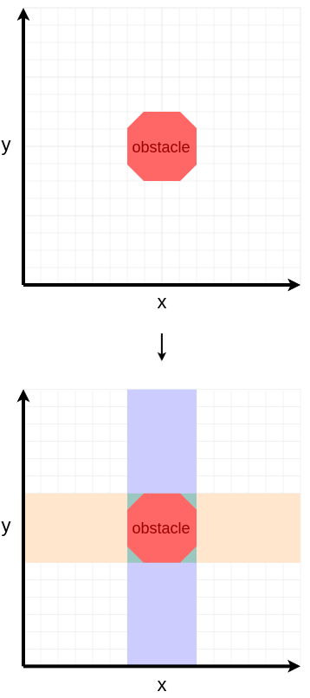
Obstacle Decomposition
Identify obstacle
Reduce dimensionality

Slide 16
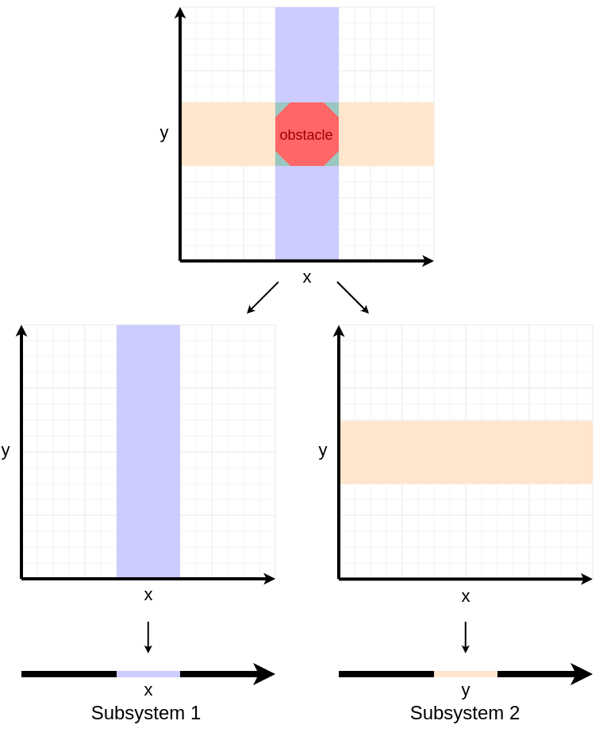
Obstacle Decomposition (cont.)
Identify obstacle
Reduce dimensionality
Project onto subsystems

Slide 17
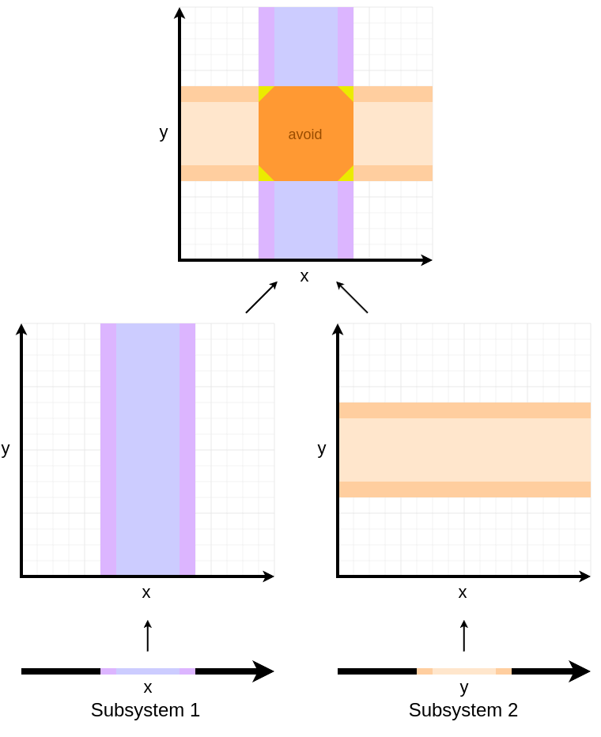
Calculation & Reconstruction
Subsystem reachability
Back-project
Intersect

Slide 18
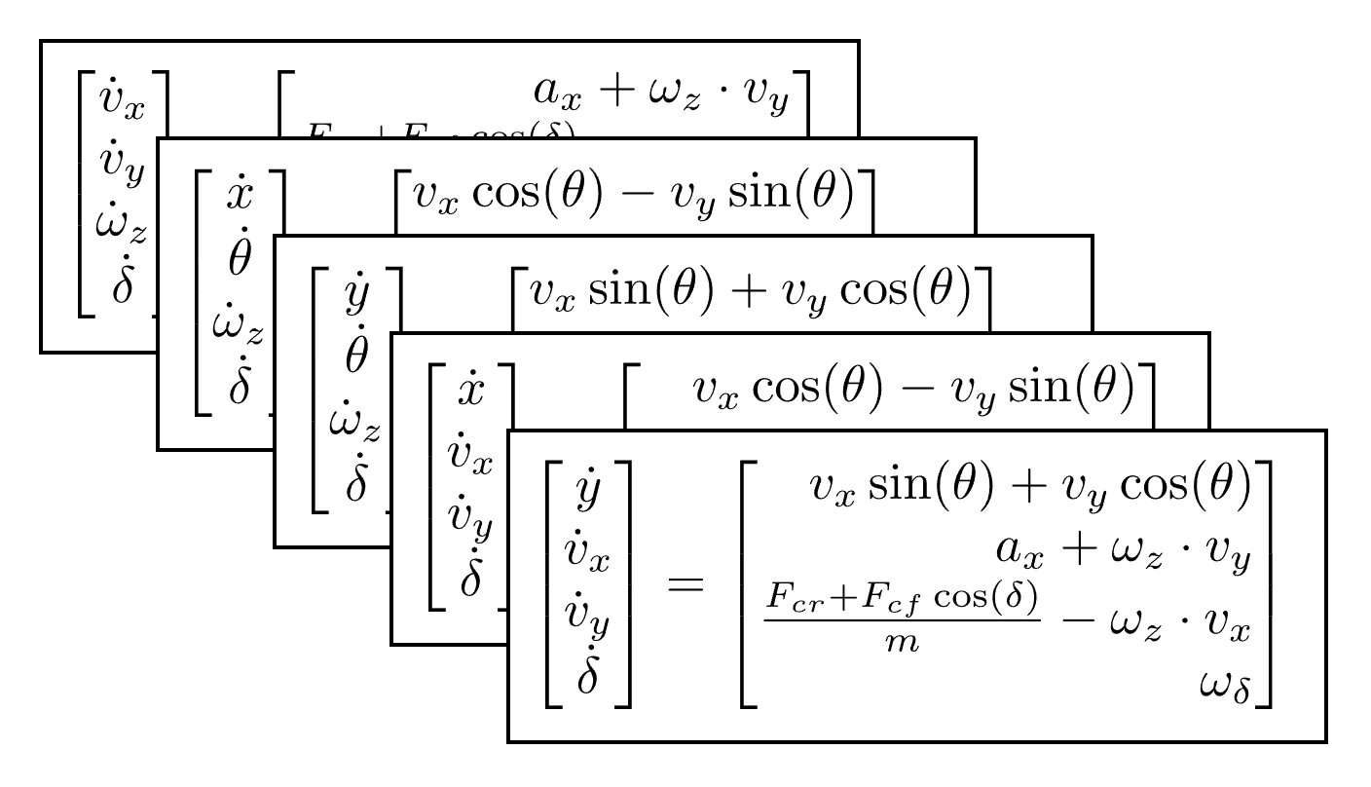

Model Decomposition
Subsystems

Slide 19
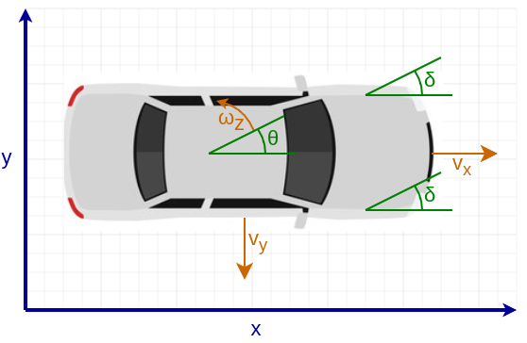
Model Features
7 dimensions
Single-track dynamics model
Identified from SVEA

Slide 20
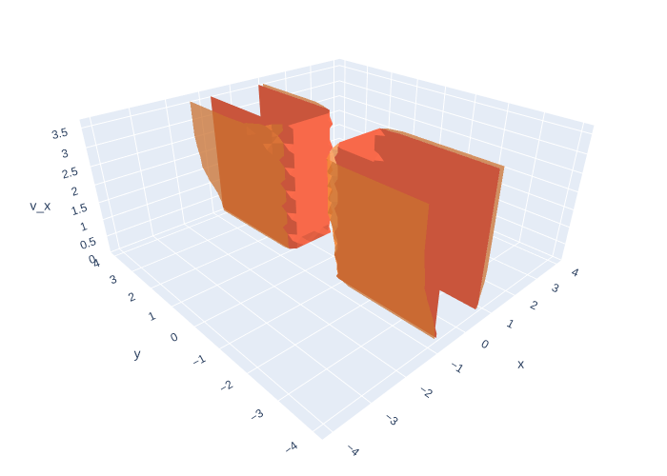
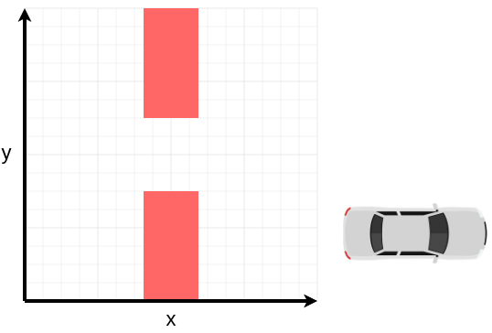
Results (1/4)

Slide 21
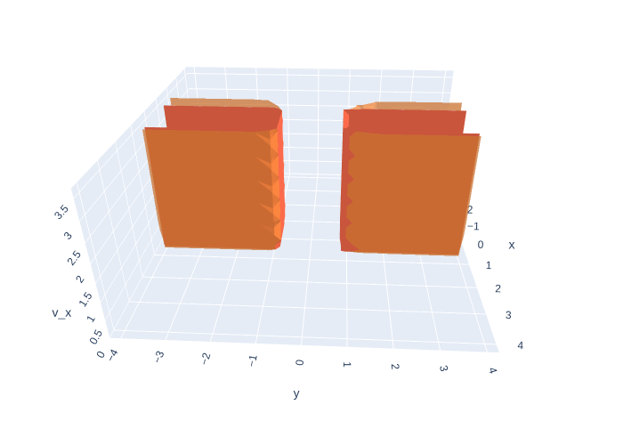
Results (1/4)

Slide 22
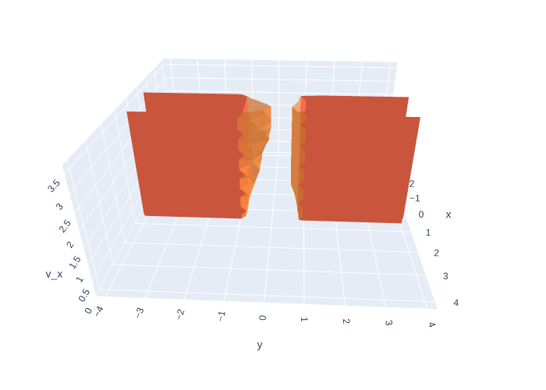
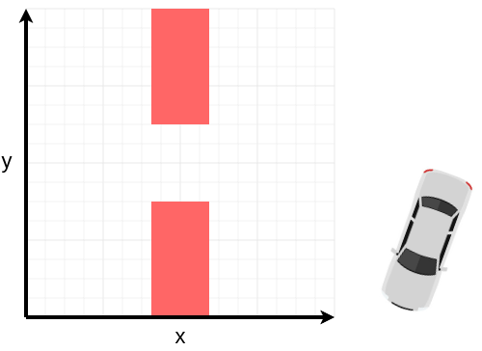
Results (2/4)

Slide 23
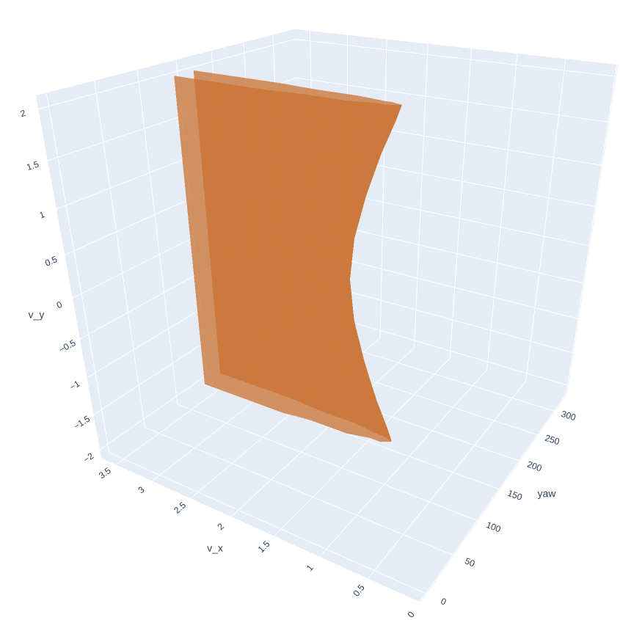
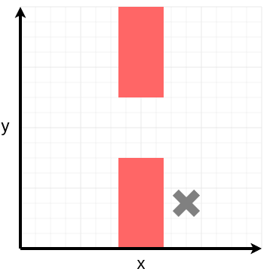
Results (3/4)

Slide 24
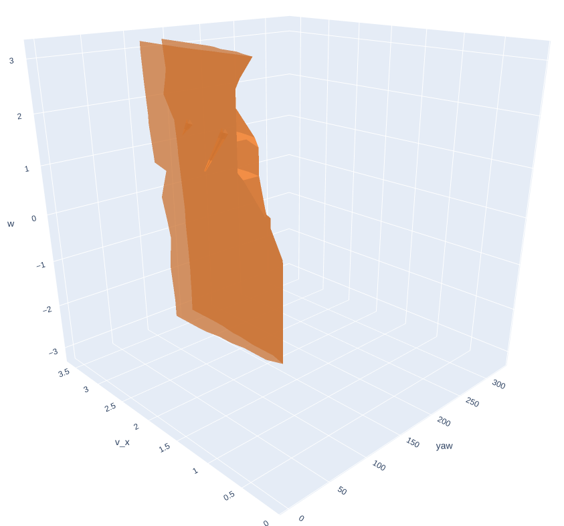
Results (4/4)

Slide 25
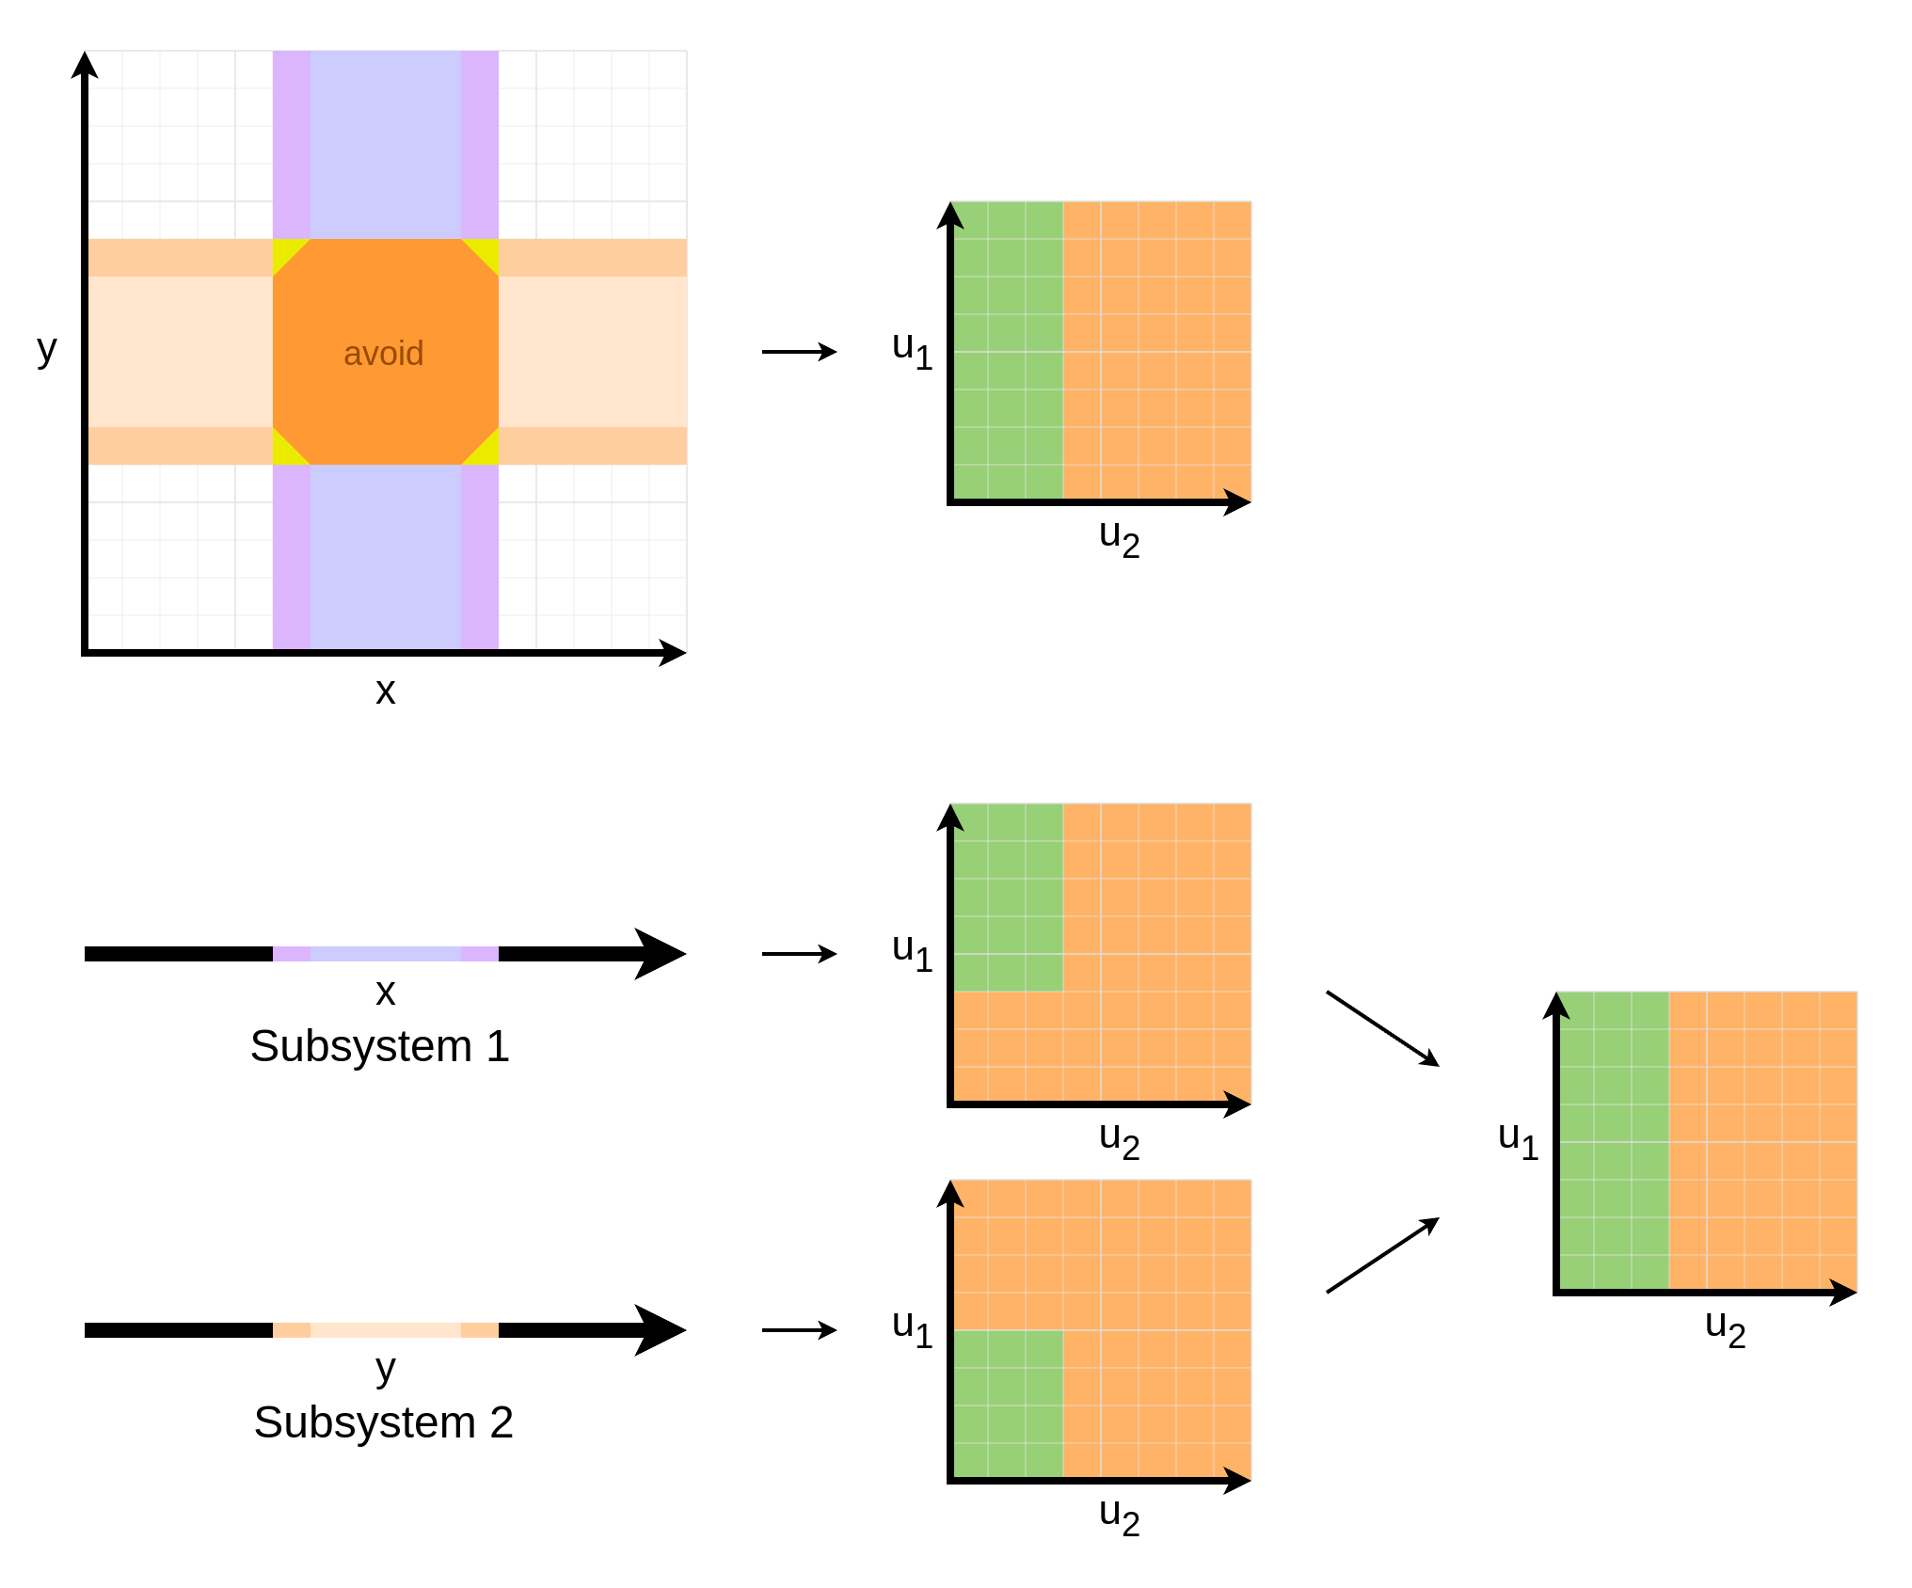
Safe Control Inputs
Compute inputs that avoid reconstructed unsafe areas
Scalability still problematic
Instead, compute from
subsystems directly

Slide 26
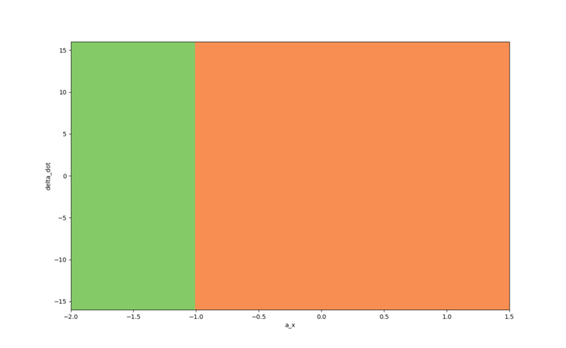
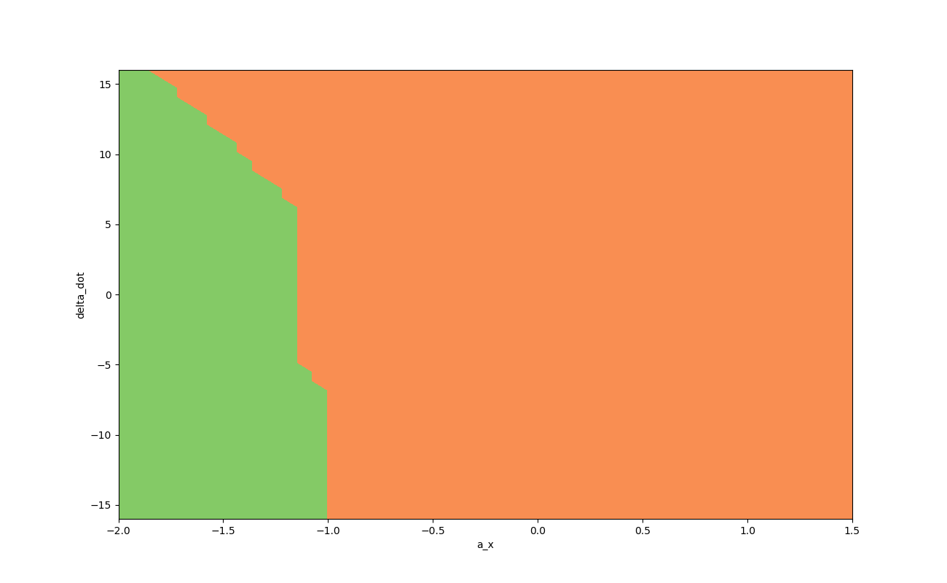
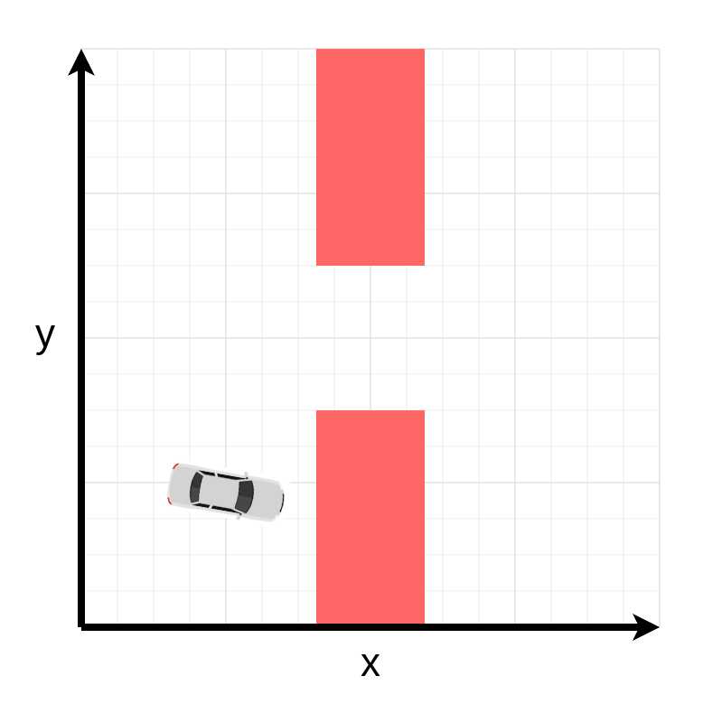
Safe Control Inputs
Compute inputs that avoid reconstructed unsafe areas
Scalability still problematic
Instead, compute from
subsystems directly

Slide 27
Safe Control Inputs (cont.)
640x reduction

Slide 28
Summary
High-speed driving requires complex models
Full-scale reachability analysis is intractable
Decomposition-based analysis can provide rich safety insights
Novel method guarantees safe control

Slide 29
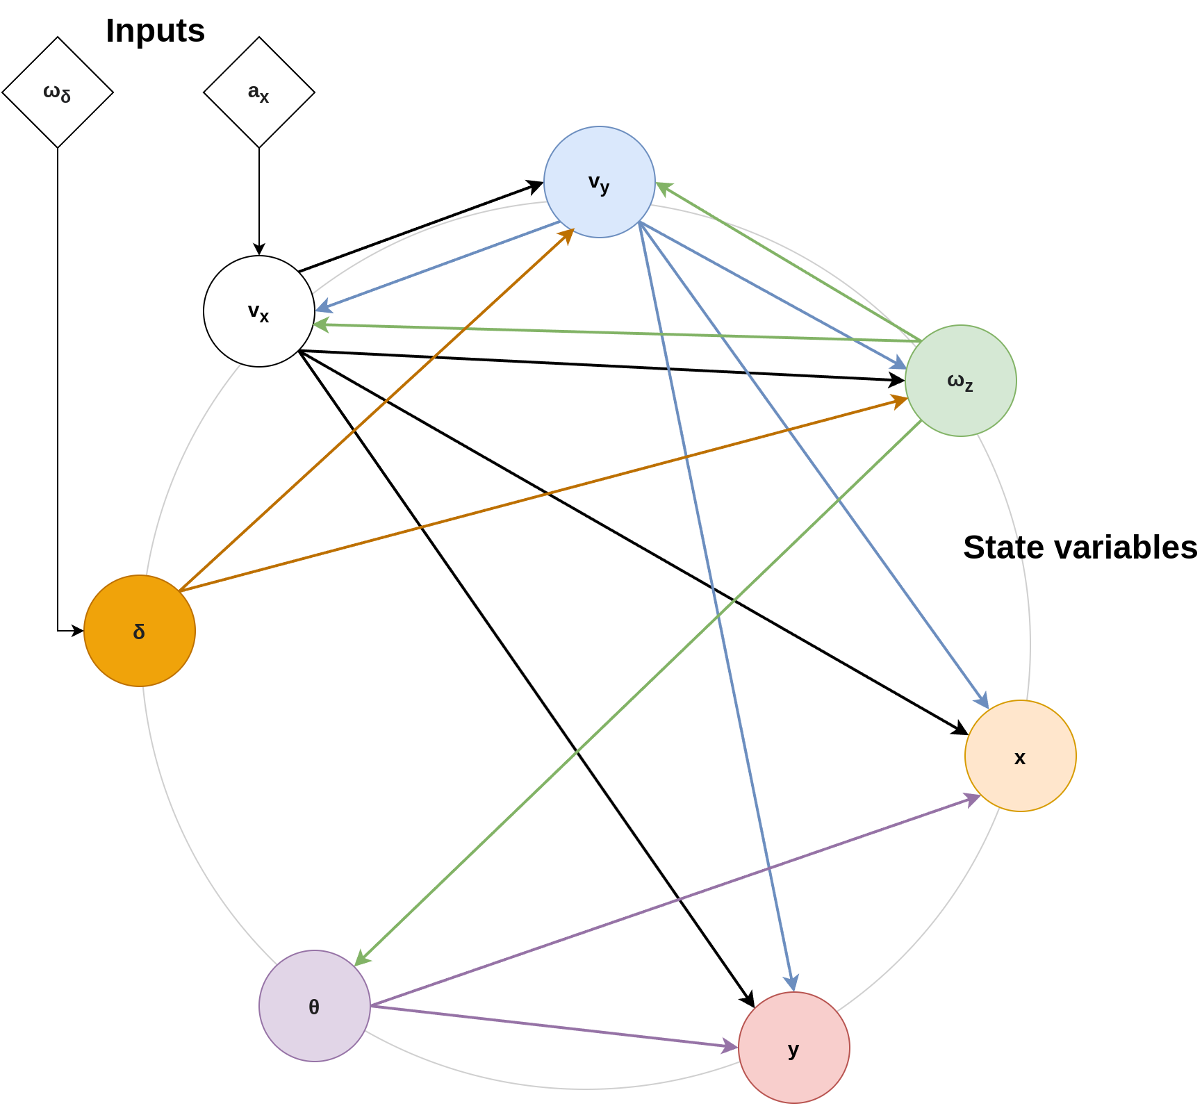
Model Dependency Graph

Slide 30
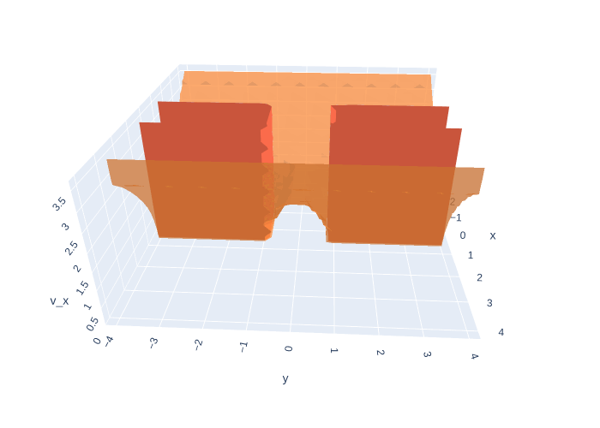
Conservativity

