Slide 1
Data Literacy
Nico Rinck, Robin Allgeier, Adriano Polzer, Jonas Mahr, Jannik Rombach

Slide 2
Our data
~2.3 million
Records
Public Library Tübingen
Borrowing data with item, loan, and return details.
2019 – Nov. 2025
Time Period
Notes:
Simple introduction to what kind of data set we have.
-> What, where from, how much, from when to when…

Slide 3
issue_id | 2668875
Loan date/time | 2024-01-02 11:14:41
Return date/time | 2024-02-02 12:07:58
Loan period | 31
Overdue | Yes
Days overdue | 2
Collection code (CCODE) | kisl1
Media type | Children‘s book
Barcode | 16153567
Titel | Leo Lausemaus will sich nicht die Zähne putzen
Author | -
Interest group | To grow up
User category | KIND
Loans
Notes:
Core table of the data, the loan dataset
Short description of the columns in the load dataset using a simple example….

Slide 4

Library Tübingen
issue_id
Loan date/time
Return date/time
Loan period
Overdue
Days overdue
Collection code (CCODE)
Media type
Barcode
Titel
Author
Interest group
User category
Loans
ISBN
Publish date
Page count
Subject people
Subject places
Subject times
…
Books
Barcode
ISBN
Notes:
Use Barcode (used just internally in the libary) in the Loan Table to identify the Book ISBN.
The ISBN can be used to access further information about a book from other freely available data sets such as the open Library.
For example, the number of pages or the content.
Subject_people -> People the book is about,…

Slide 5
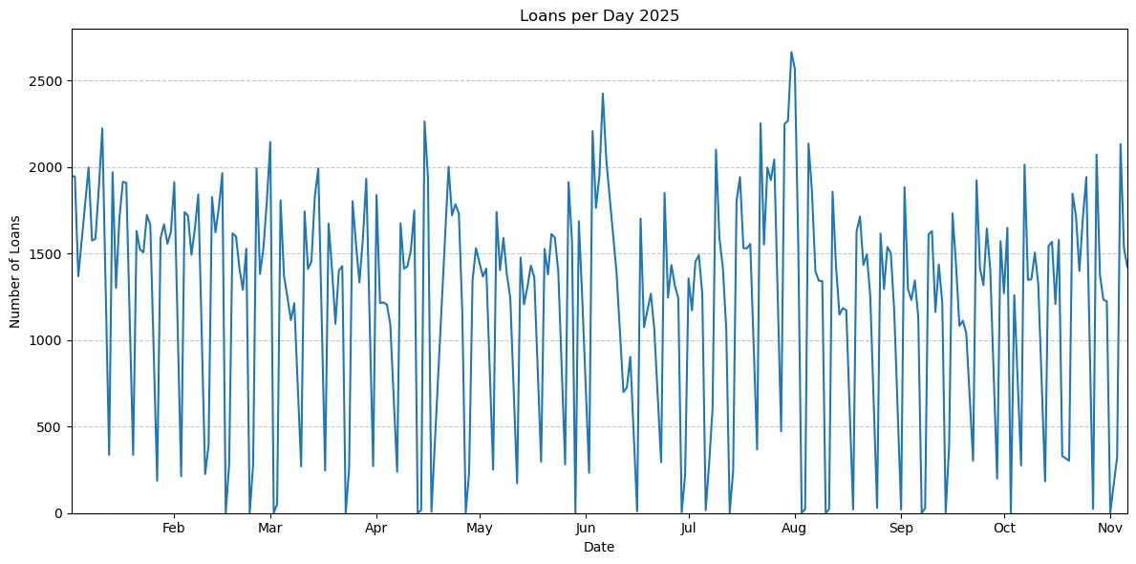
Notes:
Hauptsitz öffnungszeiten:
Di bis Fr 10.30 bis 19 Uhr
Sa 10.30 bis 14 Uhr
Mo geschlossen
Branch office hat andere Öffnungszeiten teilweise Montags offen.

Slide 6
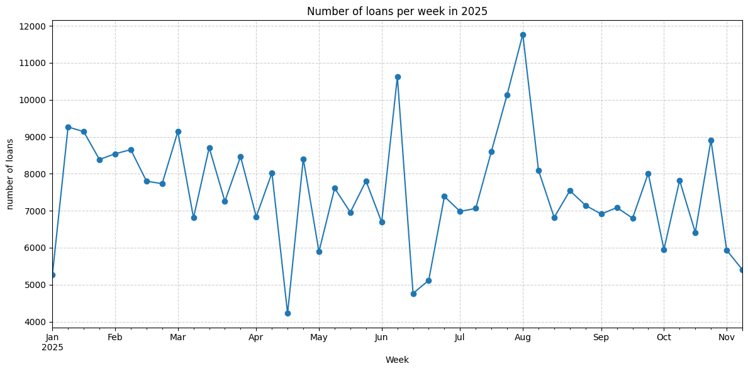

Slide 7
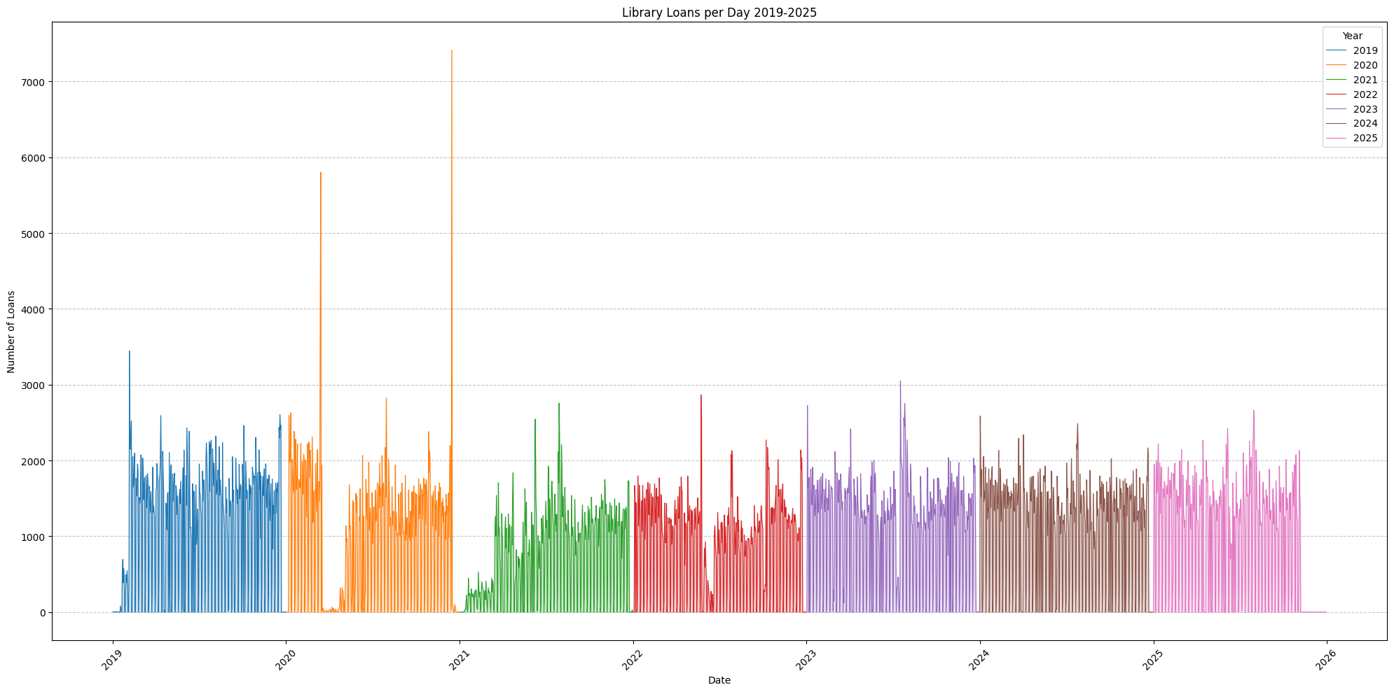

Slide 8
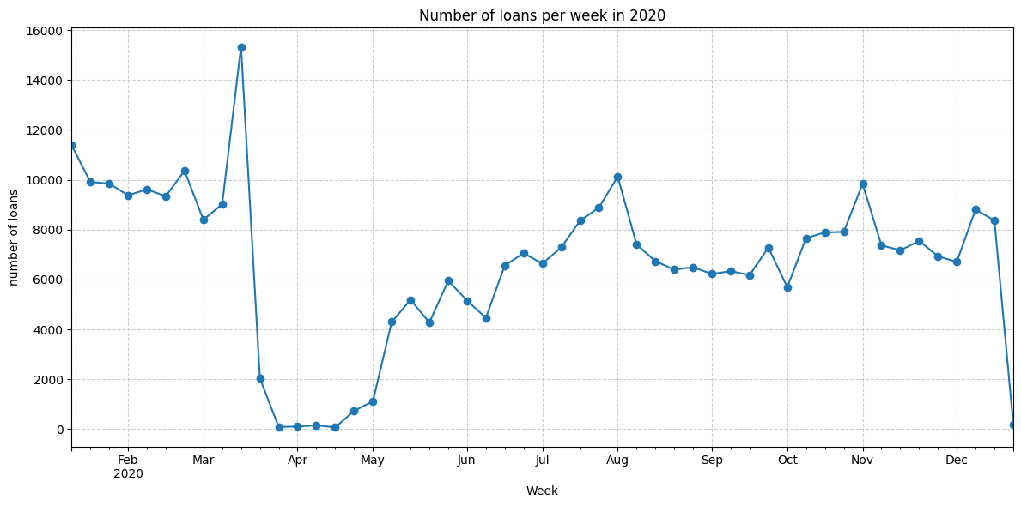
Notes:
Bücherei hat am 6.Mai wieder aufgamacht.
Vorher reservierung abholung und Lieferung nach hause möglich aber eingeschränkt

Slide 9
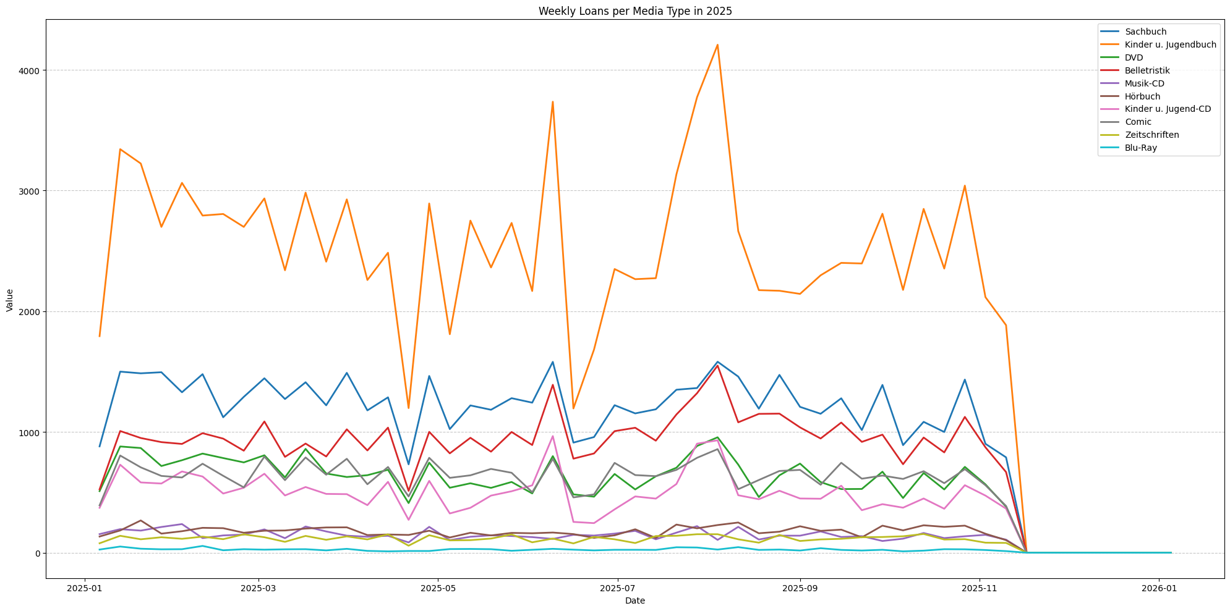
Notes:
Sachbuch → Non-fiction
Kinder u. Jugendbuch → Children’s and young adult book
DVD → DVD
Belletristik → Fiction
Musik-CD → Music CD
Hörbuch → Audiobook
Kinder u. Jugend-CD → Children’s and young adult CD
Comic → Comic
Zeitschriften → Magazines
Blu-Ray → Blu-ray

Slide 10
Timeline – Project Roadmap
30.01
Deadline
08.01
Start Report
Structure the results and write the report
Hypothesis Testing
Analysis of the relationship between book size and borrowing behavior
08.12
24.11
Exploratory Data Analysis
Explore Distributions, trends, correlations
Data Understanding, Cleaning & Enrichment
Clarify open questions, handle missing data correctly and enrich the data for later analysis
13.11

Slide 11
Data Understanding, Cleaning & Enrichment
Clarify open questions:
          Why was the data collected?
            Why only since 2019?
      Why are data points missing?
      Have any transformations been made to the data set?
Make an appointment with the library or send an email to clarify these points
Data quality and missing data
            Deleted titles
            Missing return date
          Enrichment
            add data from Open Library

Slide 12
Exploratory Data Analysis
Descriptive statistics
  Key variables
  Distributions
  Outliers and anomalies
Temporal analysis
  Trends in borrowing over time (e.g. effect of COVID)
Data relationships
  Correlations between features
Goal:
  Gain more insights into the dataset
  Explore potential relationships
  Build foundation for hypothesis testing
Notes:
We have, of course, already performed an initial exploratory data analysis in order to select the data set for our project.

Slide 13
Hypothesis Testing
Borrowing Behaviour
Relationship between book size and borrowing duration
Loan Duration and Punctuality
Borrowing activity is higher during winter months or school terms.
Larger books are borrowed for longer periods.
Is there a correlation between genre an overdue returns.
...

