Slide 1
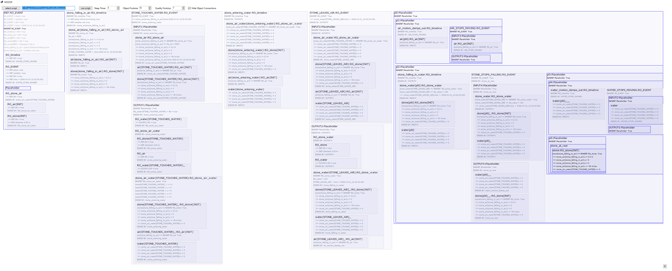
WOOOF output: PoolAndStone.txt
Run the script.
Hide object connections to simplify the presentation.
Air comes to rest.
Water comes to rest.
An Event
with INPUT
with OUTPUT
Stone at bottom of the pool.

Slide 2
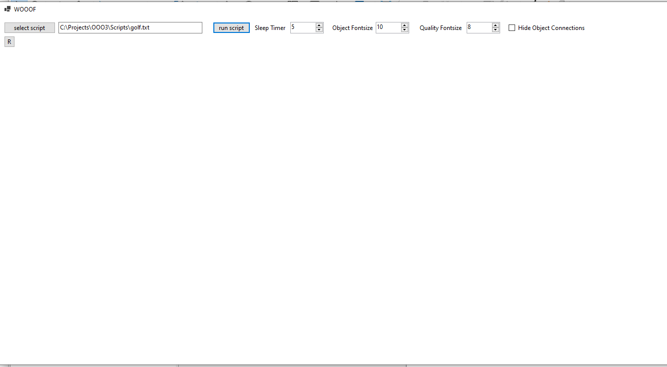
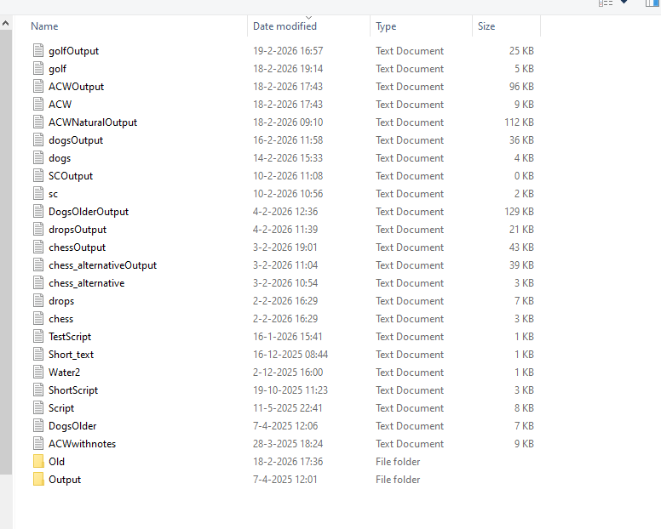
WOOOF interface instructions.
Hide object connections to simplify the presentation.
Select a script.
Selected script.
Adjust the speed of the processing in msecs.
Run the script.
Adjust Object text size.
Adjust Property/Quality text size.

Slide 3
drops.txt
golf.txt

Slide 4
PoolAndStone.txt

