Slide 1
Trying to depolarize by penalizing The most active users of a network

Slide 2
The Model
Multidimensional assimilative opinion model by Fabian Baumann et. Al.
What makes it special?
The network is activity driven
In each iteration step, each agent has an individual probability to get active and form connections with others
This leads to different dynamics of agents with high activity vs low activity agents

Slide 3
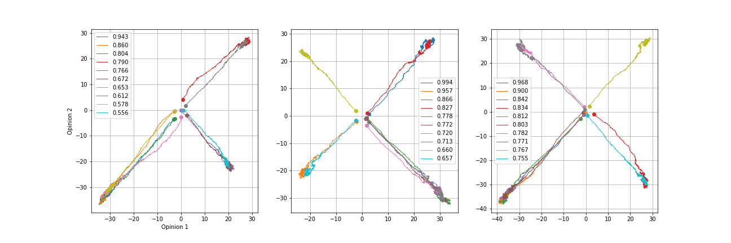
The Flow of Highly Active Agents
Most active agents form extreme opinions very quickly
Dots show the starting point of the nodes opinion
Usual peaks of opinions around –2 and 2
Hypothesis: Most active nodes "pull" others towards extremes

Slide 4
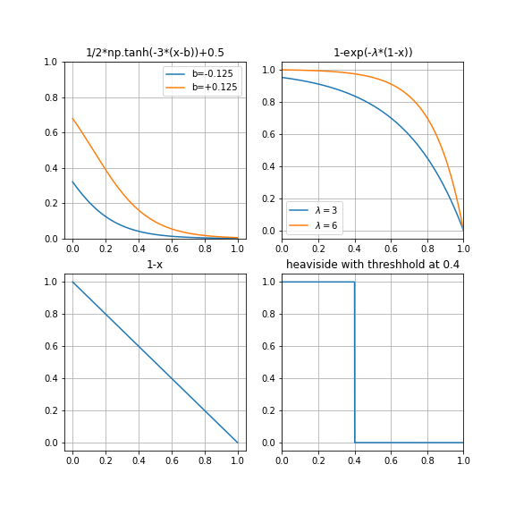
Penalizing most active nodes
Multiplying penalty functions onto their influence, that depend on the activity of a node

Slide 5
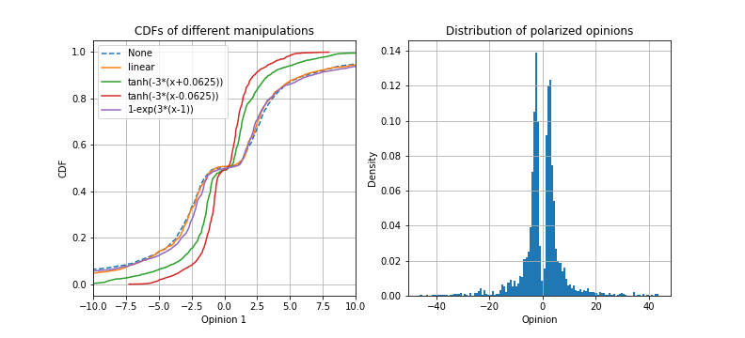
Does penalizing work?
Looking into the CDFs of different penalized simulations
A saddle in the CDF means polarization -> all distributions are polarized.
-> Penalizing does not work

Slide 6
New idea for depolarization?
Take a certain fraction of the top-active nodes and set them constantly to opinion 0
-> Using the activity of the nodes to "pull" others towards the center
This mimics moderators in a network
-> Can this lead to depolarization? How big does the fraction of moderators need to be?

