Slide 1
Multiclass Native Language Identification and Language Proficiency Identification:
Feature analysis on Toefl-11 Dataset
Presentation by De Paepe Robin
Master Digital Text Analysis
Natural Language Processing
Prof. Dr. Daelemans
Dr. Markov
Dr. Banari

Slide 2
Tasks
1. Native Language Identification (NLI): native language (L1) of a person based on his/her writing in a second language (L2)
2. Proficiency level identification (cf. automated essay scoring): identifying the L2 (English) proficiency of a person based on his/her writing

Slide 3
Overview
Introduction
Theoretical Framework
The Data
Model & Feature Selection
Results
Conclusion

Slide 4
Introduction
NLP machine learning as an alternative for much more human labour-intensive proficiency and identification testing
NLI as a tool for developing grammatical error correction systems
Wide array of usage in different fields (authorship profiling, forensic linguistics,….)

Slide 5
Theoretical Framework
Lot of prior research on NLI: Markov et al (2017) as blueprint work
Tetreault, Joel, Daniel Blanchard, and Aoife Cahill. 2013. A report on the first native language identification shared task. In Proceedings of the eighth workshop on innovative use of NLP for building educational applications, pages 48–57
The importance of n-grams as features:
Koppel, Moshe, Jonathan Schler, and Kfir Zigdon. 2005. Automatically determining ananonymous author’s native language. InInternational Conference on Intelligence and SecurityInformatics, pages 209–217, Springer.
In addition to the introduction of syntactic and spelling errors:
Tsur, Oren and Ari Rappoport. 2007. Using classifier features for studying the effect of nativelanguage on the choice of written second language words. InProceedings of the Workshop onCognitive Aspects of Computational Language Acquisition, pages 9–16.
Error analysis & Contrastive Analysis Hypothesis as the main unifier of Task 1 and 2

Slide 6
Errors and Contrastive Analysis
Errors made in second language learning provide evidence that a learner uses a definite system of language at every point in his development’.
Corder, Stephen Pit. 1967. The significance of learner’s errors.
Errors made by second language users, originate from habit formation created during learning of the native language. The Contrastive Analysis Hypothesis (CAH) formulated by Robert Lado, argues that errors potentially made by learners of a second language are predicted from interference by the native language. Such a phenomenon is usually known as negative transfer.
Lado, Robert. 1957. Sentence structure.College Composition and Communication, 8(1):12–16.
→ Good approach for combining Proficiciency testing with L1 identification?

Slide 7
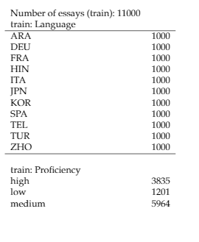
The Data
TOEFL 11 Corpus
Selection of 11 Languages : Arabic, Chinese, French, German, Hindi, Italian, Japanese, Korean, Spanish, Telugu and Turkish
3 proficiency levels: low, medium, high
Training data: 11.000 English written Essays
Test data: 1.000 essays
Distribution
Balanced language distribution
Imbalanced proficiency distribution

Slide 8
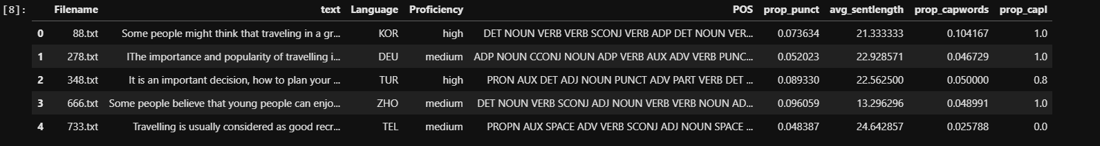
Model Selection & Features
N-grams:
Character
Word
POS-Tags
Proportion of punctuation
Average sentence lenght
Proportion of capitalised words
Proportion of capitalised ‘i’’s
Linear Support Vector Machine (SVM)
Commonly used in a number of prior tasks
Performed best in combination with a TF-IDF vectorizer
Deep Learning?

Slide 9
Feature simplification
L1 identificication performed best without the implementation of proportion of capitalised words
Proficiency identification was optimized by dropping proportion of capitalized words and average sentence lenght

Slide 10
Optimization
Hyperparameter finetuning through gridsearch
Word n-grams: uni-grams and bi-grams
Character n-grams : bi-grams, tri-grams & 4-grams
POS n-grams: unigrams, bi-grams and tri-grams

Slide 11
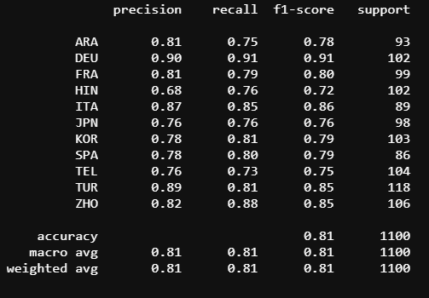
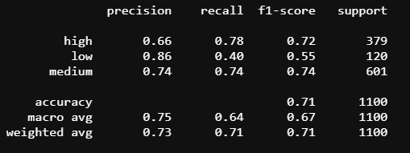
Results
L1 Identification
Proficiency
Use of 10% of train set as dev set

Slide 12
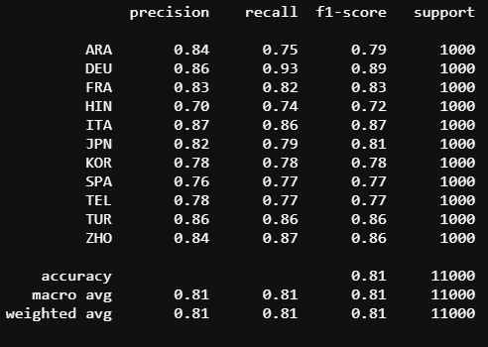
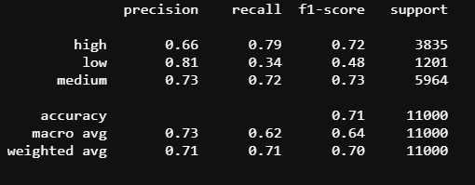
10-fold cross validation
L1 Identification
Proficiency

Slide 13
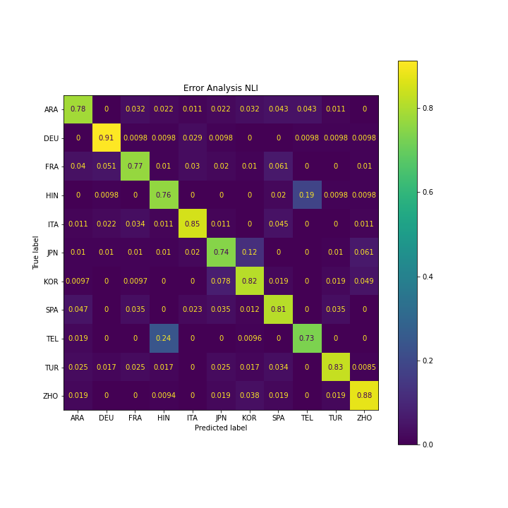
NLI
Strong performance on:
German
Chinese
Italian
Trouble with:
Hindi –Telugu
Japanese : Korean – Chinese
Arabic

Slide 14
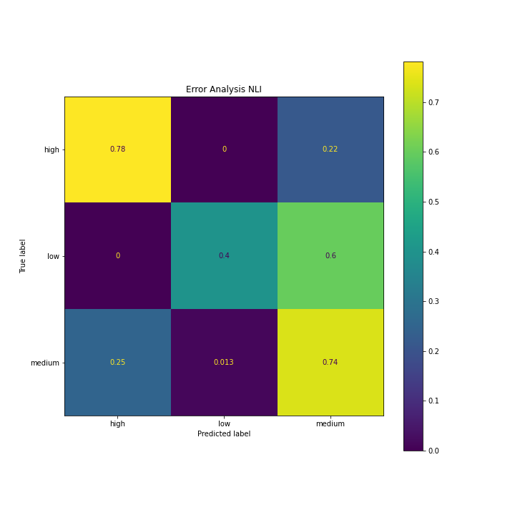
Profiency
Bad model perfomance mainly due to low recall rates of low-proficiency texts

Slide 15
Conclusion
Proficiency identification needs more refined model for low-level text detection
Perfomance on these features on deep learning models?
Deeper Linguistic interpretation needed?

