Slide 1
Feedback Reading to improve service implementation
by De Paepe Robin

Slide 2
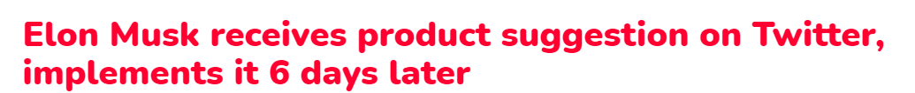
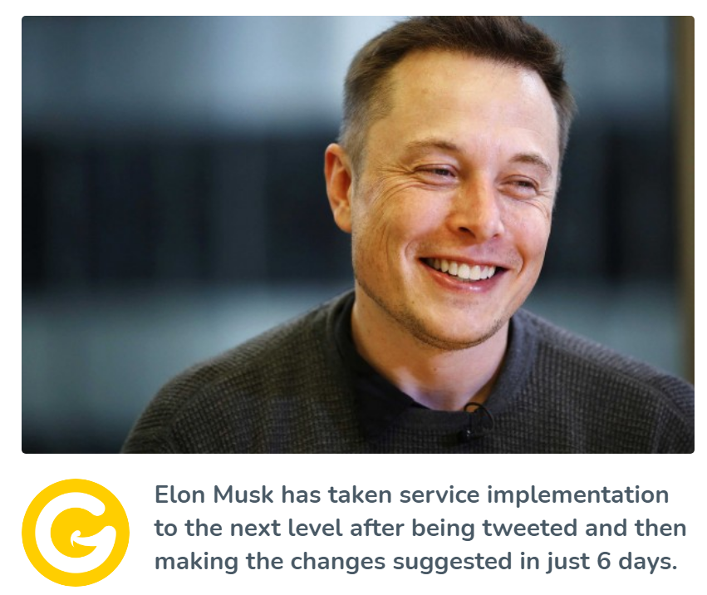
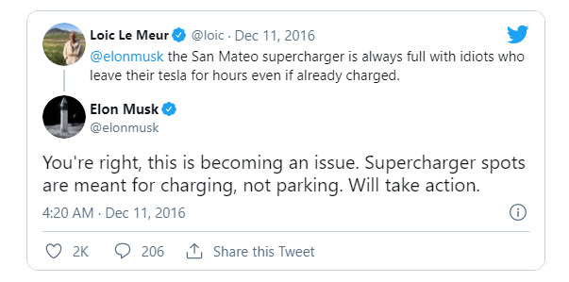

Slide 3
Harvesting data relevant to current and future service landscape
Feedback + input review
Combine user input with market-trends (StockTwits API)
Wide usage among service landscape

