Slide 1


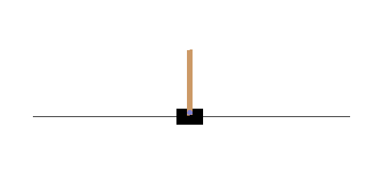
Deep Learning
Deep Reinforcement Learning Beginners Tutorial
Computer Science and Microsystems Technology
Kaiserslautern University of Applied Sciences, Zweibrücken Site
Introduction
Methods and Materials
Deep Reinforcement Learning (also called DRL) is a huge step towards the creation of an universal artificial intelligence. In 2013 a company, owned by Google, called ''Deep Mind'', was able to create an astonishing implementation of RL, which was capable to play retro games of the console ''Atari 2600''. In many cases, the Artificial Intelligence was not only able to play the games successfully, but also exceeded human performances significantly. After these impressive results, it is definitly worth to take a closer look at Reinforcement Learning.
Libraries and Toolsets:
Keras
Numpy
Matplotlib
Pyvirtualdisplay
Gym
JSAnimation
Ipython
Jupyter Notebooks
Literature and Lecture Materials:
Google Deep Mind lecture on RL https://www.youtube.com/watch?v=2pWv7GOvuf0
Massachusetts Institute of Technology (MIT) online course materials http://introtodeeplearning.com
Deep Q Learning Networks lecture by LiveLessons https://www.youtube.com/watch?v=OYhFoMySoVs
The references to all sources in detail can be found in the notebooks
Figure 1: Concept of reinforcement learning
Results
Artifacts | Content
Deep Reinforcement Learning Beginners Tutorial (1) - Theory | Theory behind the concept of Reinforcement Learning Deep Learning Aspect Q-Learning including the formulas required Outlook
Deep Reinforcement Learning Beginners Tutorial (2) - Practice | Implementation of a RL agent Introduction to OpenAi Gym framework Exercises Outlook
Installation-guide | Usage of Google Cloud Deep Learning VM Installing Software required for the Project Usage of Jupyter Notebooks
Figure 2: The cartpole game used in the notebooks
Targets of the Notebooks:
Beginnerfriendly introduction to Reinforcement Learning and associated components
Introduction of Q-learning in the context of RL
Deep Learning in RL
Introduction to the usage of games in RL
Training visualization
Implementation of a RL agent and its configuration and training
Discussing further steps
Requirements:
Basic knowledge about Python
Basic knowledge about Artificial Intelligence
Knowledge regarding neural networks
Knowledge regarding deep learning
Table 1: Artifacts
Contact
B. Sc. Robin Guth
B. Sc. Julian Bernhart
rogu0005@stud.hs-kl.de
jube0010@stud.hs-kl.de
Feel free to contact us for friendly exchange of experience, advice or course materials.
Notes:
Kontakt: Martin.Decker@hs-kl.de

