Slide 1


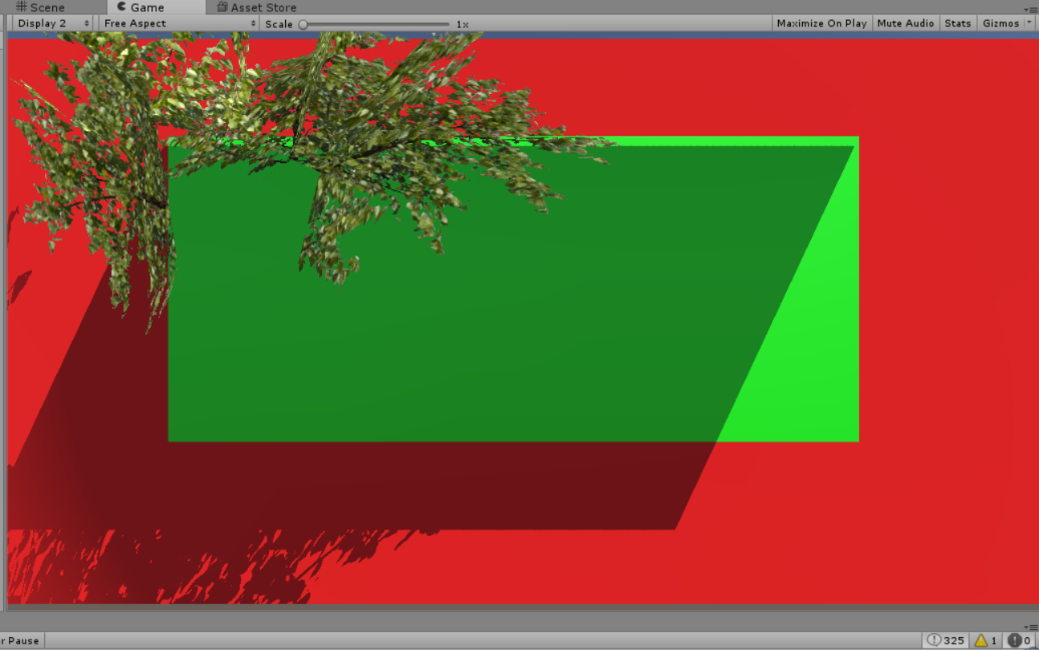
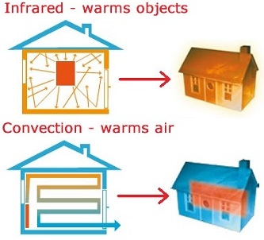
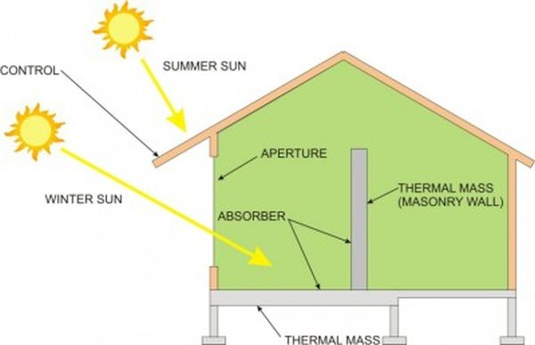
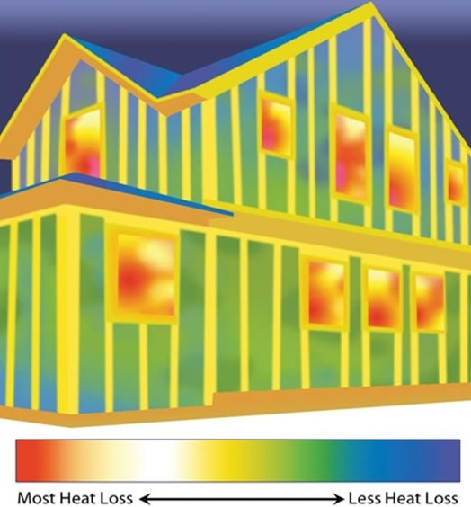
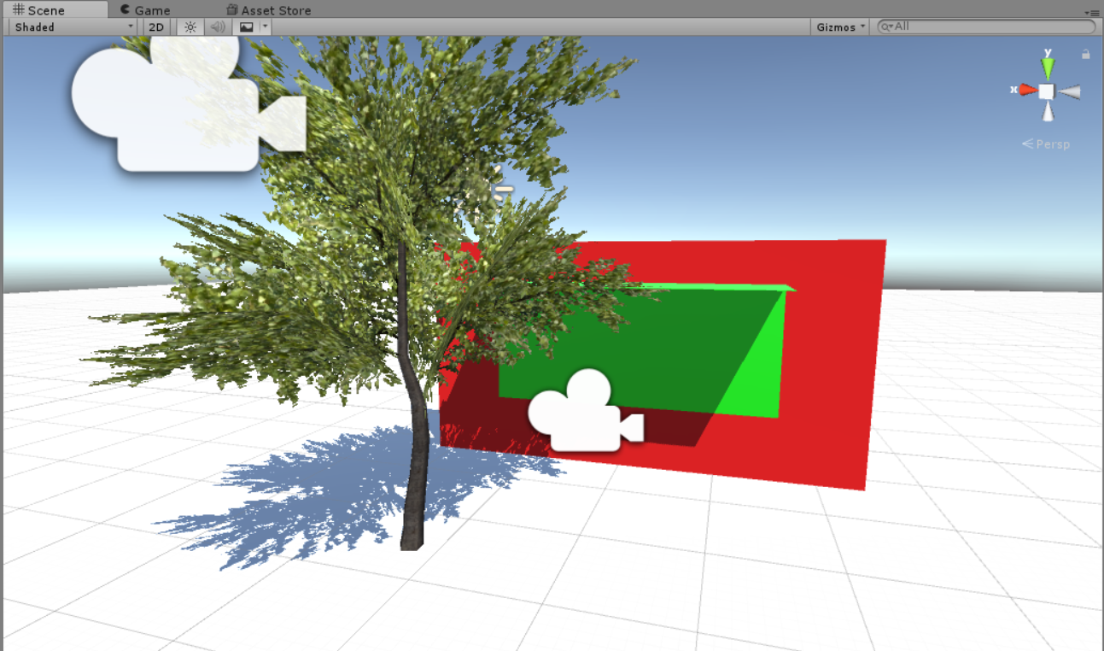
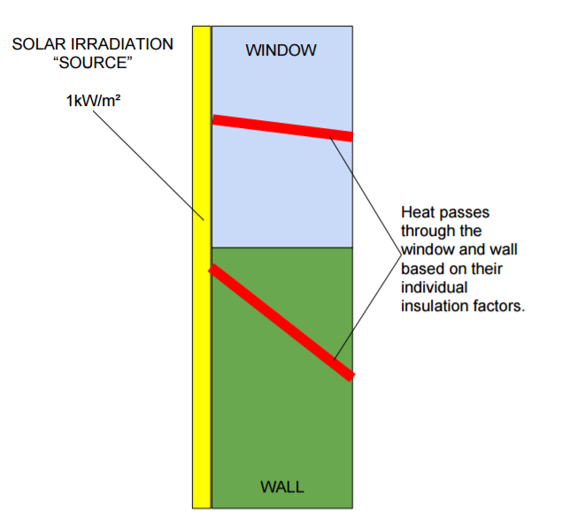
Passive Solar Design by Genetic Algorithm
Silvia Smith, Brady Riddle, Aditya Chauhan
CS 5890 Machine Intelligence in Clean Energy Spring 2017
Abstract
Modeling
Summary
Passive solar heating and cooling is an energy-saving design that requires no effort or thought from the user. Designing a home or building to use less energy to be heated Is becoming more popular through a variety of methods. To help generate optimal energy-saving designs, several of these methods are balanced and evaluated using a genetic algorithm. This project provides a proof of concept program that creates the best configuration for passive solar design, which can then be used in many building and architecture applications.
House configurations are modeled using Unity game development software. The house is drawn up and a solar path is installed as the source of light. The sun’s position is determined for a specific day and time. An evaluator takes an image of the configuration and counts how many pixels are exposed to the light. The area exposed to the sun is calculated and heat passage is calculated for that instance. The heat passage is compared against 1800 W, which is the estimated need to heat a 225 ft² room. The difference in heat
A home or building can be modeled and designed to take great advantage of passive heating and cooling principles. This modeling is performed by a genetic algorithm to arrive at the configuration that minimizes the necessary electricity input for heating and cooling. The process of performing the genetic algorithm also creates patterns of good designs that may be considered for use. The algorithm can be adapted to a number of applications.
passage is added to the total energy use for the year, as energy input is needed to correct for excess or insufficient heat passage. The solar path is then iterated throughout the year for three times of day on the 20th of each month. The total energy use for the year is passed to the genetic algorithm and minimized.
Limitations and Recommendations
Problem Description
This algorithm serves as a proof of concept and therefore has limitations to its applications. The concept serves as a design aid, showing a viable method of balancing and experimenting with the variables involved in passive solar design. As the first of its kind, the model is extremely simplified to only one room and one window. Factors that could be accounted for in future creations include multiple-room layouts, thermal and reflective surfaces within and without the house, and more complete house modeling with multiple surfaces.
Passive solar design reduces the need for heating and cooling in a house or building by using the architecture design to keep the interior cool in the summer and warm in the winter. There are many methods and variables that can be used in passive solar design. The best design depends on factors such as location, climate, and building orientation.
To aid design in balancing the variables involved, a genetic algorithm is used as a proof of concept. The genetic algorithm will adjust the chosen variables and search for an optimal configuration.
Figure 3. Perspective from the evaluator.
Figure 5. The roles of irradiation and thermal masses in passive solar heat transfer.
Results
After 25 generations, the optimal design reached is pictured in Figure 4. Increasing the number of generations will yield a more robust solution. Other configurations that fared well are also good designs that could be used based on other constraints or personal preference. The algorithm can store the information of the best solutions along the generation path, and these solutions can be used as suggestions for homebuyers and contractors.
Coupling the algorithm with thermal modelling software could also evaluate heat transfer through convection in the house, as well as heat exit.
Producing a more continuous sampling rate or more accurate model could even predict energy usage and savings.
Method
Figure 1. Concept of how passive solar design works.
Genetic Algorithm: Passive solar heating and cooling is based on a number of variables. For this application, seven variables were selected for use in the genetic algorithm: window height and width, tree position (x and y), depth of overhang as a function of window height, and insulation factors for the wall and window. The size, thickness, location, and orientation of the wall are held constant.
Heat Transfer: Heat flow was calculated based on heat entry only. In further iterations, heat exit should also be addressed. The unit of solar radiation used is 1 sun = 1000 W/m². The area of the sun-exposed façade
Figure 6. Heat transfer software can create a more accurate model.
Conclusion
Passive solar heating and cooling is a simple design. Creating a user-friendly algorithm to suggest energy-saving designs can help make passive solar architecture more common. Integration is based primarily on the training and decision of contractors. Making design suggestions as straightforward and easy to use as possible allows for more widespread use of passive solar principles.
Engineering Assumptions
Heat Transfer Assumptions: True heat transfer is dependent on the temperature differential between two surfaces. This means that the existing interior temperature drives heat passage significantly. Exterior temperature can also be a factor (especially in heat loss). The heat irradiated on the surface of the façade is seen as the heat source for the system, which reduces some of the error of excluding exterior temperature.
References
Figure 4. An optimal design configuration.
GA code and tutorial: Newcombe, J. (2016, May 29). Implementing Genetic Algorithms in C#. Retrieved May 05, 2017, from https://www.codeproject.com/articles/873559/implementing-genetic-algorithms-in-csharp
Images:
M, R. (n.d.). How To Convert Your Home To Passive Solar. Retrieved May 05, 2017, from http://www.offthegridnews.com/grid-threats/how-to-convert-your-home-to-passive-solar/
The algorithm may easily be adapted for a number of situations, such as different locations and climates. The path of the sun is depended upon latitude and longitude, as well as the time of year. Therefore, to use the algorithm for a different location, the solar path input can be altered, and a new configuration will be optimized for those conditions.
Figure 2. Simple heat transfer diagram.

