Slide 1

NCL Class3 NCL programming & graphics (II)
2023/03/09
Tzu-Yun Liu

Slide 2
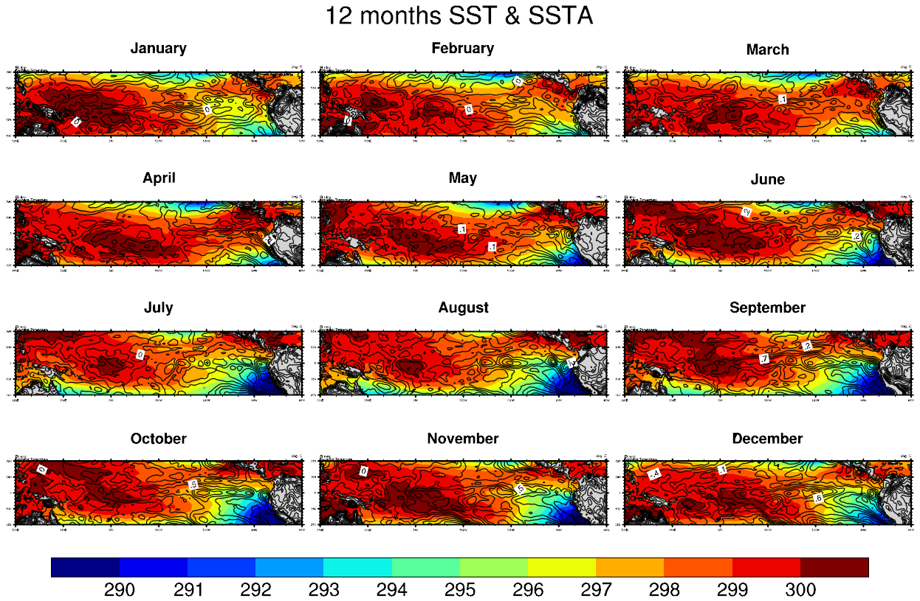
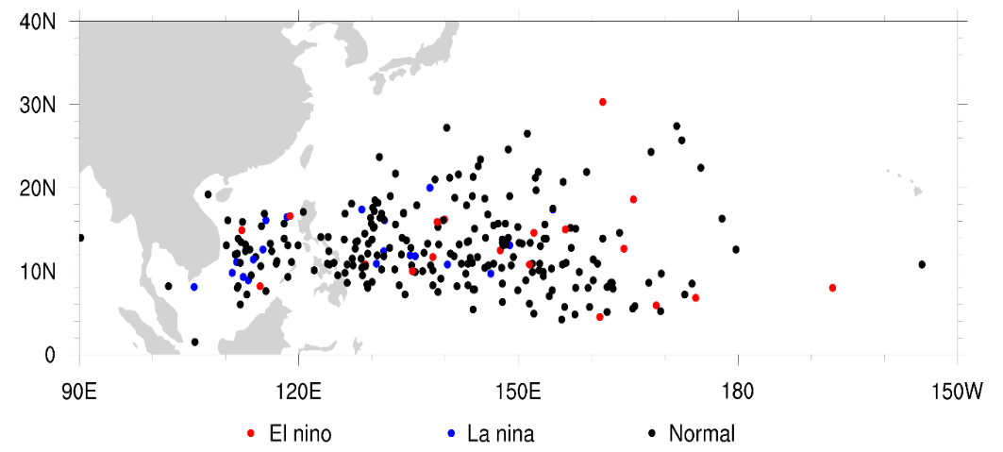
Basic plot type
2D contour map
2D vector map
Vertical profile
Time series
Panel (attach plot)
Scatter plot
Basic plot skill
wks setting
res (resource)
named color & table
add_poly
overlay plots
font adjustment

Slide 3
Ascii (.txt) files
Read
ascii_read(file_path, dims, data_type)
ascii_read(file_path, -1, “string”)
all the values in the file will be read into 1D variable
Write
asciiwrite(file_path, var)
write_table(file_path, option, alist, format)
“w” : overwrite
“a” : append

Slide 4
Ascii (.txt) files
Show columns and rows of the file
numAsciiCol(file_path)
numAsciiRow(file_path)
Split the string
str_split(var, delimiter)
str_split_by_length(var, length_value)

Slide 5
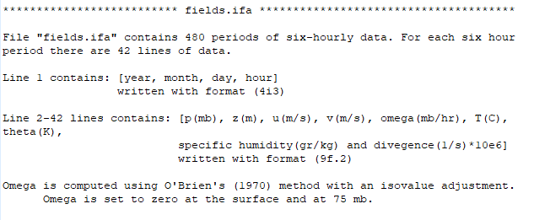
Ascii (.txt) files
/data/course/TOGA-COARE/TOGA_IFA/fields.txt
03-1_ascii_read_file.ncl

Slide 6
Ascii (.txt) files
/data/course/ASCII/2018_IGRA/ IGRA_20NS_stations.txt
03-2_read_ascii_string.ncl

Slide 7

Scatter plot
Attach a polymarker to the given plot
gsn_add_polymarker(wks,plot,x,y,res)
Draw polymarker on the given workstation
gsn_polymarker_ndc(wks,x,y,res)
Draw text strings on the given workstation
gsn_text_ndc(wks,text,x,y,res)

Slide 8

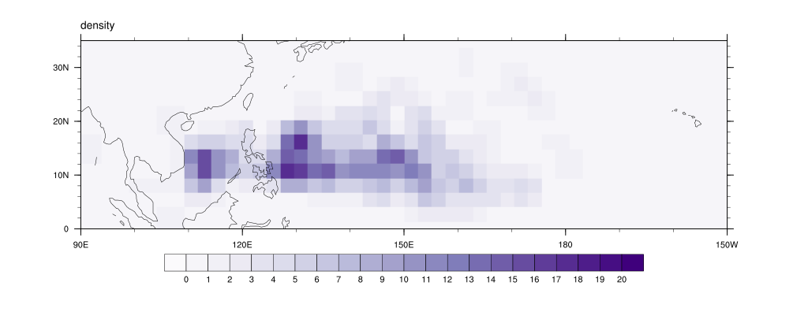
Scatter plot
/data/course/ASCII/2018_TC_JTWC_Lat/
/data/course/ASCII/2018_TC_JTWC_Lon/
03-3_graphic_scatterplot.ncl
03-4_graphic_density.ncl

Slide 9
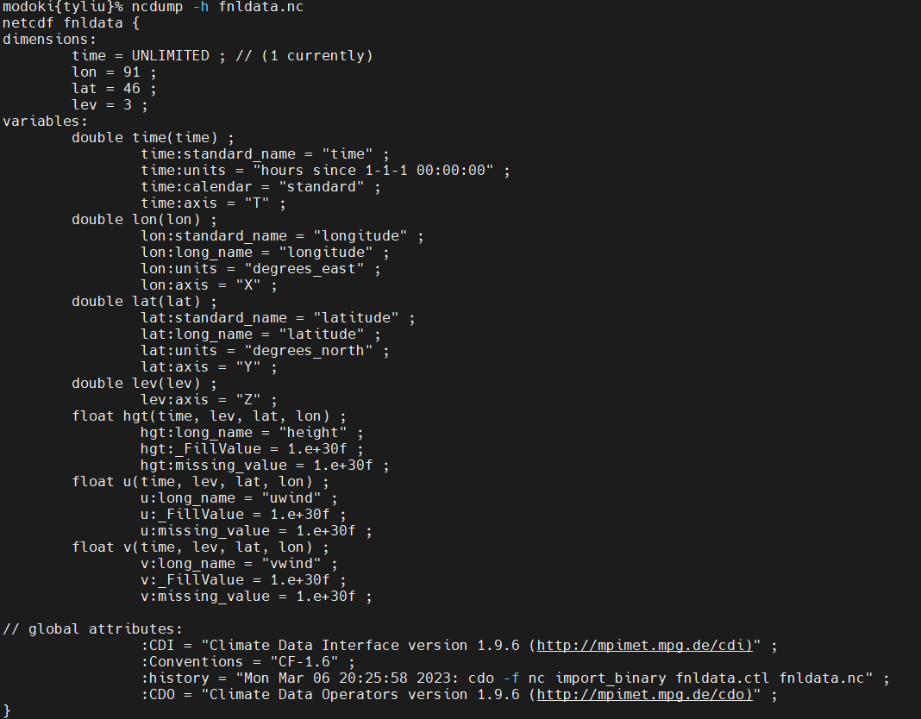
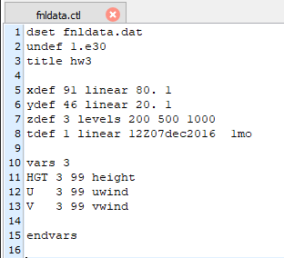
Binary files
Convert it into NetCDF by CDO
cdo –f nc import_binary file.ctl newfile.nc

Slide 10
Binary files
Fortran
Var(lon, lat, level, time)
NCL
Var(time, level, lat, lon)
NCL function
fbindirread(file_path,rec_num,rec_dims,rectype)
03-5_read_binary_file.ncl

Slide 11

HW 3
Climate research
Code
*.png or *.pdf
PPT or Word (data & method, results …)
(You can find the data in /data/course/)
Deadline: 2023/03/16 14:59
Please put your homework under /data/course/2023_NCL_course/student/your_name/hw3/

Slide 12
FB : 劉祉筠
 | Monday | Tuesday | Wednesday | Thursday | Friday
1 | X | X
2 | X | X
3 |  |  |  | X
4 |  |  |  | X
5
6
7 |  |  |  |  | X
8 |  |  |  |  | X

