Slide 1
IS 362 Final Project
How the Stock Market and Oil Reacted to the Late-February 2026 Iran Conflict Period
Robin Marte • Professor Larry Cohen
IS 362 • Final Project

Slide 2
Project question and data
I looked at whether a major geopolitical event showed up in the broad market and in oil prices.
I used the S&P 500 as the market proxy and WTI crude oil as the commodity series.
I pulled both series from FRED so the notebook stays reproducible.
I used a 45-day window before and after the event date so the trend is easier to see.
I compared the before and after periods using daily returns, normalized prices, and a simple t-test.
Main analysis steps
• Load the two daily series
• Clean and merge by date
• Normalize both series
• Calculate daily returns
• Group by before / after event
• Compare volatility and significance
IS 362 • Final Project

Slide 3
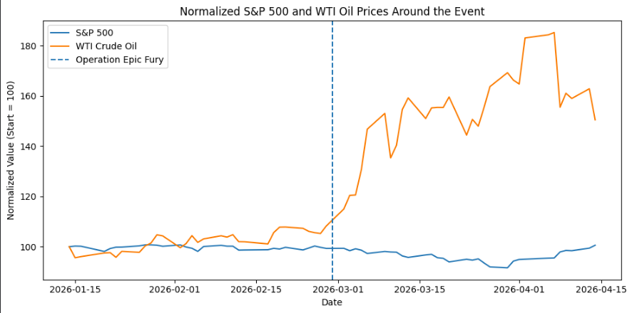
Normalized price chart
What I notice:
The S&P 500 stays fairly close to its starting point, while WTI oil jumps sharply after the event and stays elevated. That makes oil look much more sensitive to the conflict than the overall market.
IS 362 • Final Project

Slide 4
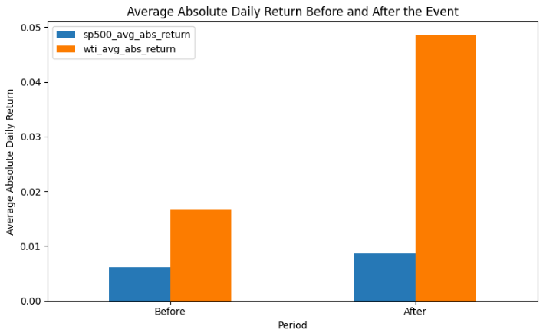
Average daily movement before and after
What I notice:
Both series move more after the event, but oil's increase is much bigger. That matches what the line chart showed and suggests the event had a stronger effect on oil than on the broad market.
IS 362 • Final Project

Slide 5
Summary statistics and statistical test
Metric | Before | After
S&P 500 avg abs return | 0.006109 | 0.008672
WTI avg abs return | 0.016606 | 0.048564
S&P 500 volatility | 0.008238 | 0.011298
WTI volatility | 0.021436 | 0.063079
T-test results
• S&P 500 p-value = 0.1171
• WTI p-value = 0.00023
• The S&P 500 change is not statistically strong.
• The WTI change is statistically significant.
IS 362 • Final Project

Slide 6
Conclusion
Final takeaways
• The broad market stayed relatively stable across the window.
• Oil reacted much more strongly and became more volatile after the event.
• The chart, the grouped summary, and the t-test all point in the same direction.
• The weekend event date was the main challenge, so I used nearby trading days instead.
Sources
FRED
S&P 500 daily series
WTI crude oil daily series
Reuters coverage for timing
IS 362 • Final Project

