Slide 1

Supply Chain Management
By Robin Mitra
(Learnbay)

Slide 2
Content
▪ Objectives
▪ Architecture
▪ Data set
▪ EDA
▪ Data Pre-Processing
▪ Model Building & evaluation
▪ Feature importance
▪ Key Performance Indicators (KPI)
▪ Q & A

Slide 3
Objective
This exercise aims to build a model, using historical data that will determine the optimum weight of the product to be shipped each time to the warehouse Benefits :
Gets idea about how much the company require to minimize percentage for destroying the product.
This can help company in focusing more on the product storage facility.

Slide 4
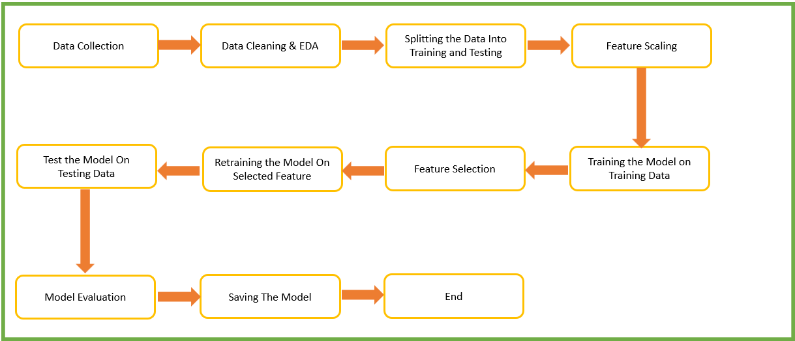
Architecture

Slide 5
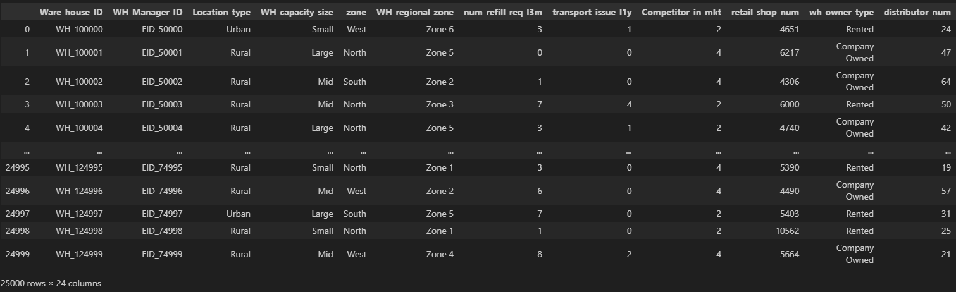
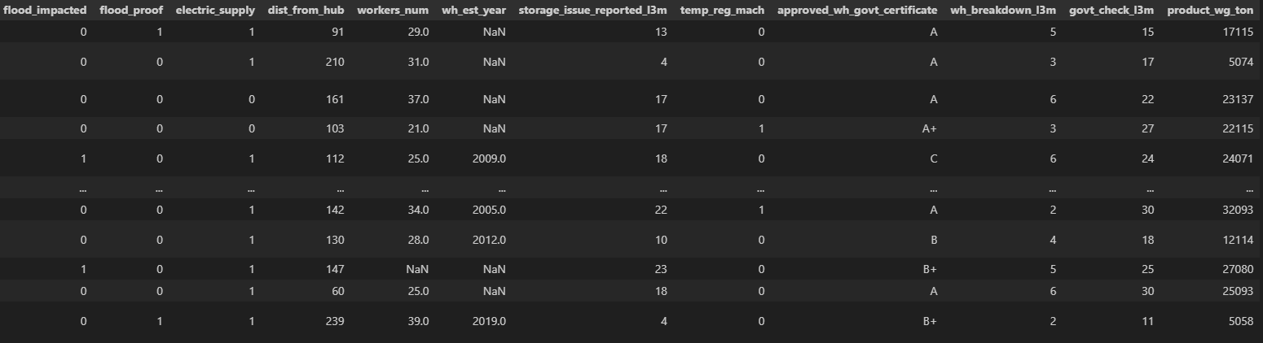
Data Set
For training and testing the model, I used the company data set available in Learnbay,

Slide 6
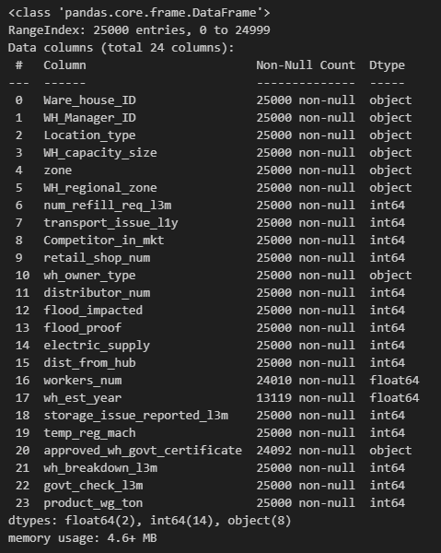
EDA- Data Cleaning
• The given data set has 24 features and each one is quantitative in nature.
• This data set does have some missing values.
• The shape of the data set is 25000 rows × 24 columns.

Slide 7
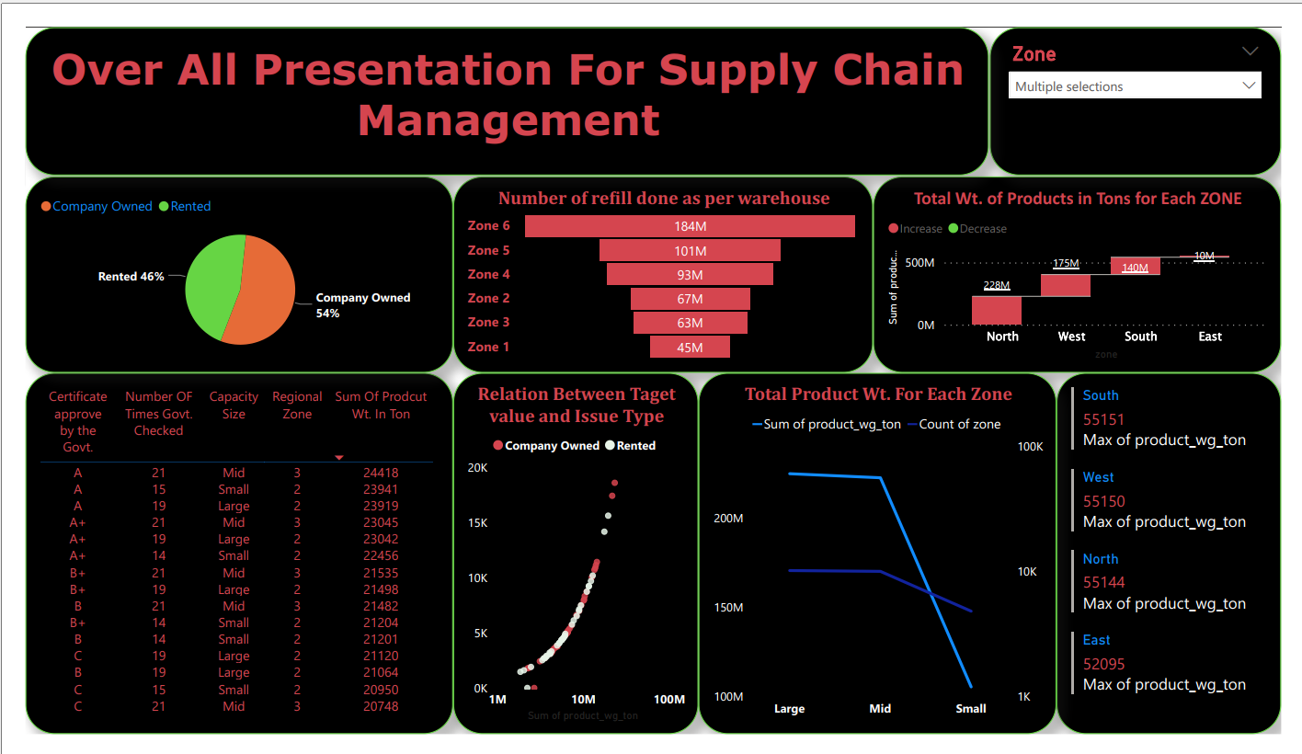
EDA- Data Visualization
Basically For Data Visualization We Use POWER BI

Slide 8
Data Pre-Processing
• Split the data-frame into the training (75% of the data) and testing (25% of the data) data-frames respectively.
• For building linear regression models, used the scaled data obtained by scaling the features using the Standard scaler. Tree models use the original data i.e., without scaling as they aren’t affected by the feature scaling.
• Then both the training and testing data-frames were further split into X_train,X_test, y_train and y_test. Here the data-frames with X indicate independent features while those with y. indicate the dependent or the target feature.

Slide 9
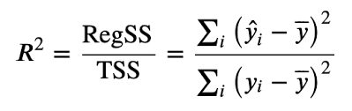
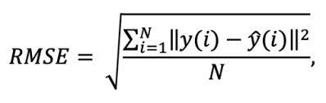
Model Building & Evaluation
• Experimented with linear, Voting models & Tree models such as Decision Tree, Random Forest .
• Decision Tree Regressor is the best model followed by the random forest regressor model.
• Evaluation as per R2-score & RMSE value

Slide 10
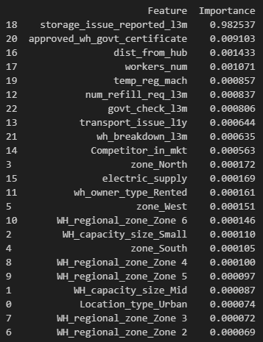
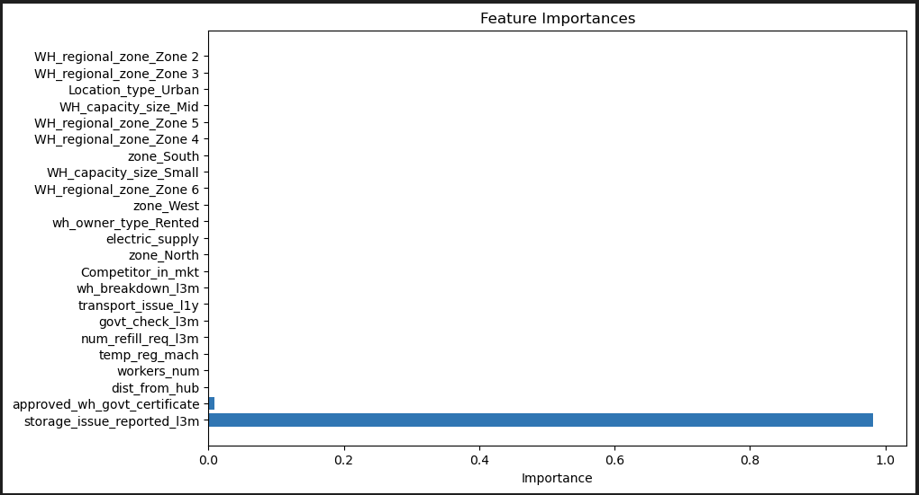
Feature Importance
• DecisionTreeRegressor
Feature importance is calculated as the decrease in node impurity weighted by the probability of reaching that node. The node probability can be calculated by the number of samples that reach the node, divided by the total number of samples. The higher the vales the more important the feature

Slide 11
Key Performance Indicator (KPI)
• Time and workload reduction using the regression models.
• Comparison of the R2 scores of the model on both the training and the testing data.
• Comparison of the RMSE scores of the model on both the training and the testing data.

Slide 12
Q & A
• How are logs managed?
Answer: The entire project is divided into two stages - the development stage and
the deployment stage. The logs recorded during the development stage are stored in the "development_logs.log" file while the logs recorded during the local deployment are stored in the "deployment_logs.log" file.
• Explain importance of virtual environment?
Answer: Virtual environment gives us an independent platform to decouple and
isolate versions of Python and its associated pip packages. This allows end-users to install and manage their own set of packages that are independent of those provided by the system.

Slide 13
Q & A
• Why we use branch in git?
Answer:
- A branch represents an independent line of development. A branch to isolate development
work without affecting other branches in the repository
- The git branch command lets you create, list, rename, and delete branches. It doesn't let you switch between branches or put a forked history back together again. For this reason, git branch is tightly integrated with the git checkout and git merge commands.

